Slide 1
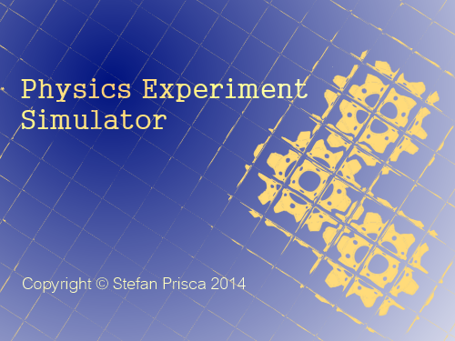
Physics Experiment Simulator
The project provides an easy-to use interface that allows users to edit and run experiments,
to create his/her own experiments and share them with the world, test experiments created by other users, or even famous physics experiments.

Slide 2
Theoretical Fundamentals
Main theoretical fundamentals will be physics. The project should be able to compute any experiment, from any branch of physics. So a basic knowledge of physics and what you want to achive through this program is required. The user can write a description for an experiment, which will provide some therethical background on that experiment and which results should be expected from it. The application also comes with some tutorials on how to write and run experiments.

Slide 3
IT Technology
This program will be developed using xtend/java programming language, and using the eclipse RCP framework to export the application as exe, for designing the UI (together with SWT), and for dependency and OSGi management.

Slide 4
Functionality
View a list of local experiments
Select and view details of experiments from the list
Run a selected experiment
Debug the experiment using a console
Create or modify existing experiments
Get help from the Help section

Slide 5
General Presentation of Actors and Access Rights
Simple application that can be used by anyone. You do not need special access rights to add/edit/remove experiments, as all experiments are local.
In order to share experiments you need to push them on the repository. Here, you will need developer rights or permission.

Slide 6
Use Case

Slide 7
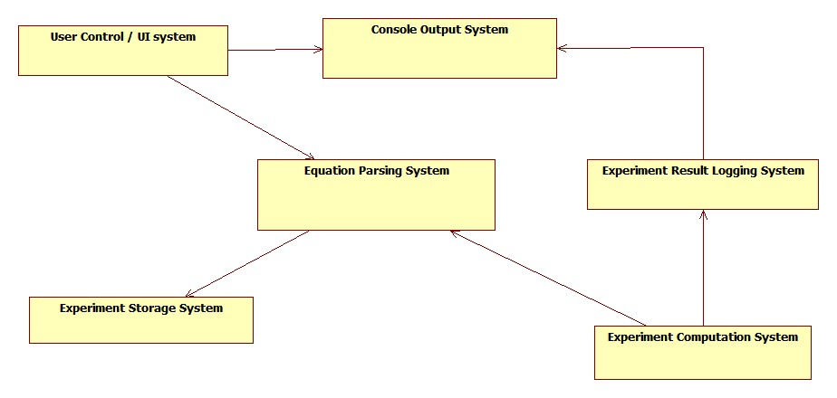
System Architecture

Slide 8
Describing System Architecture
UI System → allows user controll over an experiments and displays the results of computations as well as problems
Console Output System → creates a console in the console view that will display the results from computations
Experiment Result Logging System → uses a costum logger to log each result that is obtained in the computers in the Console Output System.
Enhances experiment debugging as it uses collored texts to differ an experiment from another and to ligh-up errors.
Experiment Computation System → uses the computers to obtain the results of experiments
Equation Parsing System → parses each equation of the experiment, separating variables, mathematical functions and simple numbers into operations of 2 operands.
Experiment Storage System → deals with storing experiments.

Slide 9
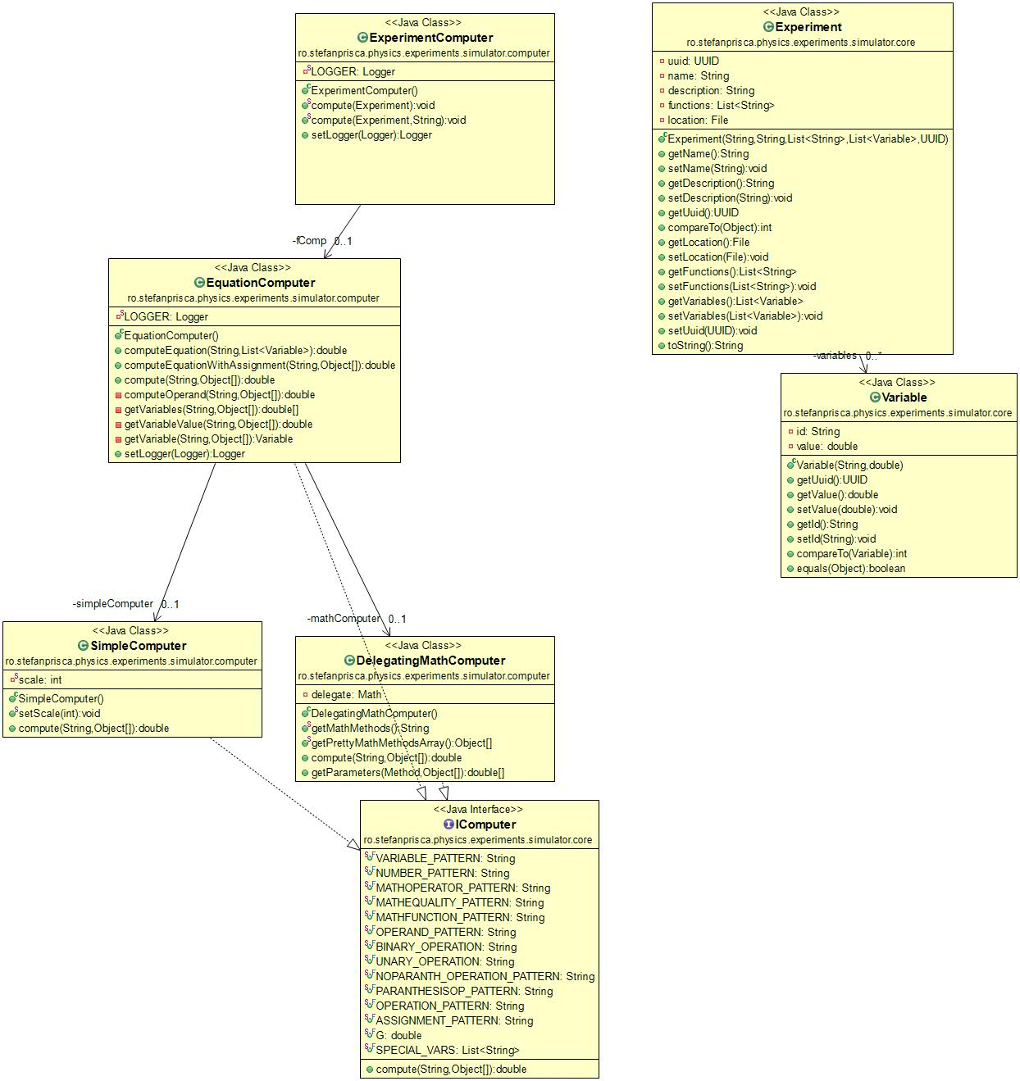
Computers class diagram

Slide 10
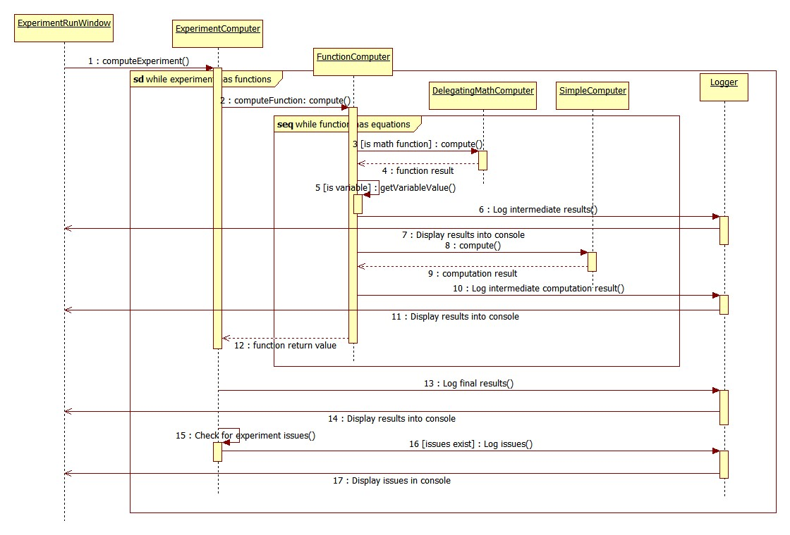
Computers sequence diagram

Slide 11
Operating Mode/ Interactivity Features
After starting the application, the user needs to set the path to the experiment folder.
This is done via File->Preferences->Simulator Preferences
Next, in order to show the local experiments, you need to press the Re-Index button next to the experiment list in the upper left corner. This will bring all experiments in the list.
The user will be able to run this experiments. This means that:
      The experiment will do the computations required and post the results in a console. This will be done as interactively as possible using a logger to display step-by-step what happens in the experiment.
      If a computation went wrong (e.g. division by zero) an message will be displayed in the console suggesting to look for issues in the log.
      The user will be able to analyze intermediate results and debug the experiment if something went wrong.
Editing experiments is done with the experiment editor. This allows the user to edit each field of the experiment.
You can find more about this in the help section of the application and on the welcome page.

Slide 12
Resources
The project is available on my personal GitHub repository
You can follow its updates there.
Also the experiments are stored in this repository.

