Slide 1
Physics Experiment Simulator
The project will provide an easy to use interface for simulating physics experiments. Each experiment will be stored in its specific file, such that it will be easier to add/remove/edit experiments.

Slide 2
Theoretical Fundamentals
Main theoretical fundamentals will be physics. The project should be able to compute any experiment, from any branch of phisics. So a basic knowladge of physics and what you want to achive through this program is required. It will provide some theoretical background on each experiment, but this might not always be enough.

Slide 3
IT Technology
This program will be developed using xtend/java programming language, and using the eclipse RCP framework to export the applicastion as exe, for the sake of portability, and to use all the cool features that come with the eclipse RCP frameworks. (Import/Export bundles would be the best of them)

Slide 4
List of functionalities
View a list of local experiments
Select and view details of experiments from the list
Run a selected experiment
Debug the experiment using a console
Create or modify existing experiments

Slide 5
General Presentation of Actors and Access Rights
Simple application that can be used by anyone. You do not need special access rights to add/edit/remove experiments, as all experiments are local. A public repository containing some basic experiments will be available, where you will need access from the developer to post new experiments.

Slide 6
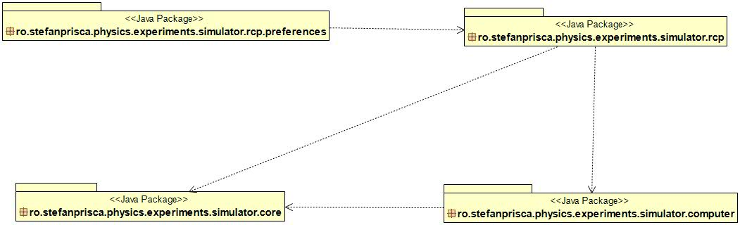
System Architecture
System Architecture
The project will be split in the UI part and the “worker” part. As it is developed using the eclipse RCP framework, the UI part will be made using eclipse extension points (Views, Perspectives, etc).
Therfore there will be 2 main packages :
ro.stefanprisca.physics.experiments.simulator containing the working classes
ro.stefanprisca.physics.experiments.simulator.rcp containing the UI parts
The tests will go in r.s.p.e.s.tests

Slide 7
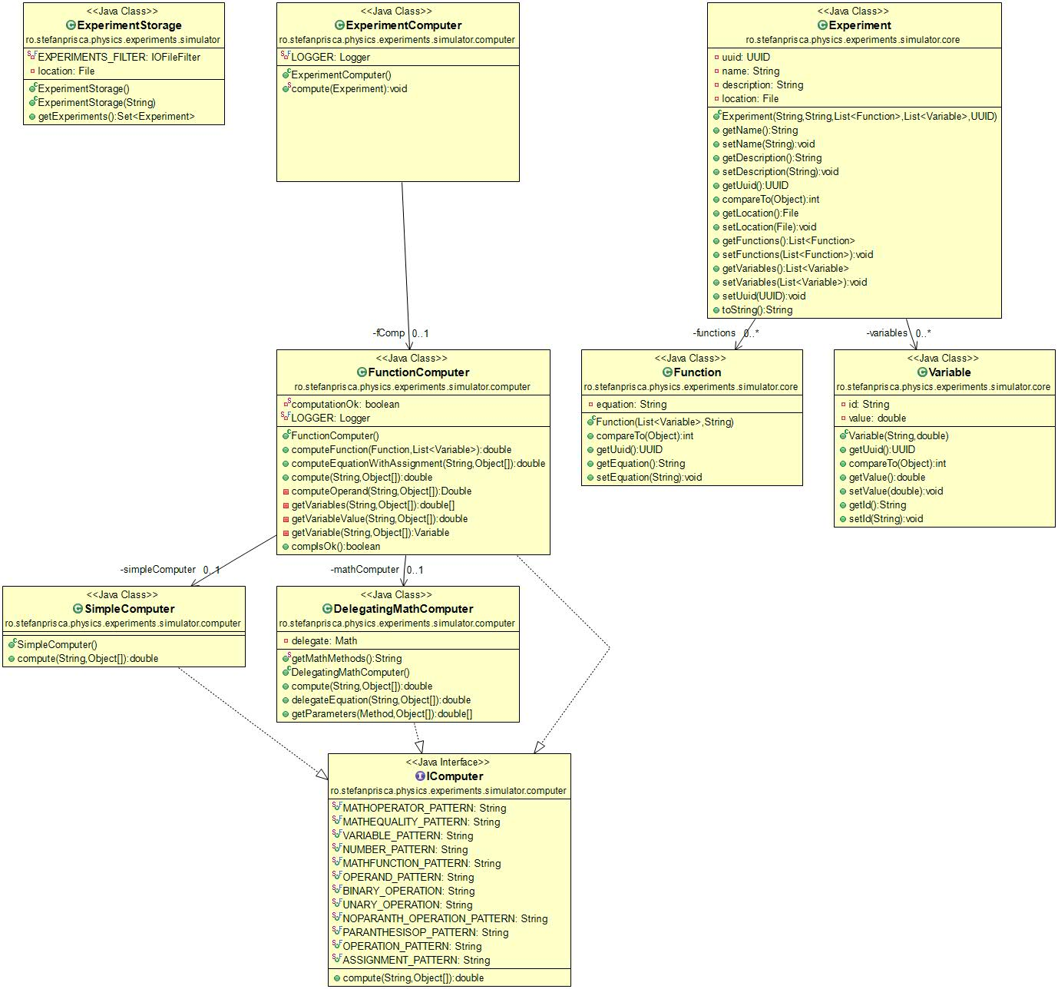
Computers class diagram

Slide 8
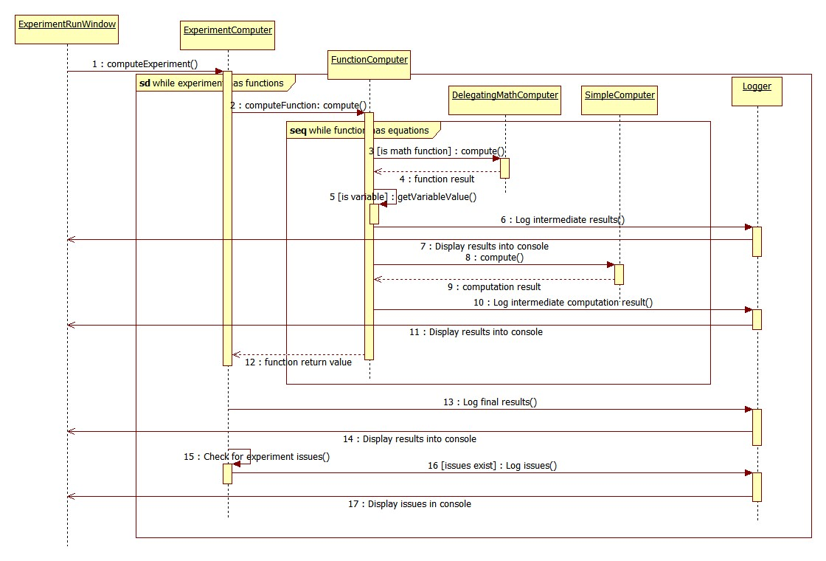
Computers sequence diagram

Slide 9
Operating Mode/ Interactivity Features
First, the user will select an experiment from the list. This brings up the following:
Some details about the experiment will pop up in the main frame
the user will be able to run that experiment. This means that:
  The user will be required to input the necessary parameters for the selected experiment
  The experiment will do the computations required and post the results in a console. This will be done as interactively as possible using a logger to display step-by-step what happens in the experiment.
Besides running experiments, a wizard that will help you create your own will be available. So not only you can test existing experiments, but you can add your own contribution to science! Cool, eh?

Slide 10
Glossary &Bibliography
Eclipse RCP development: http://wiki.eclipse.org/index.php/Rich_Client_Platform
Xtend developing language: http://www.eclipse.org/xtend/

