Slide 1

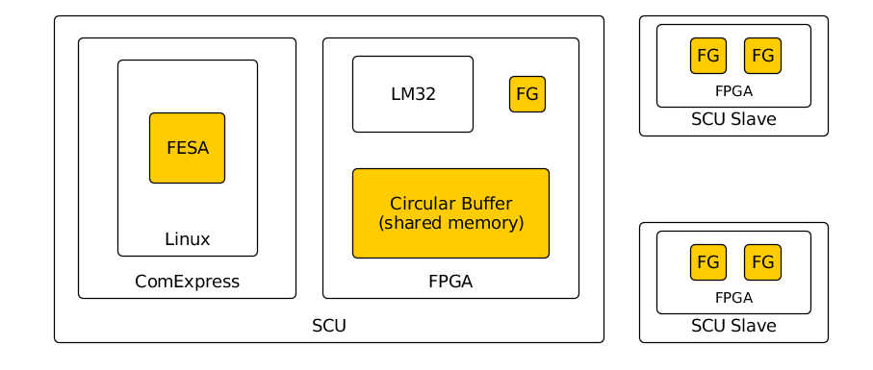
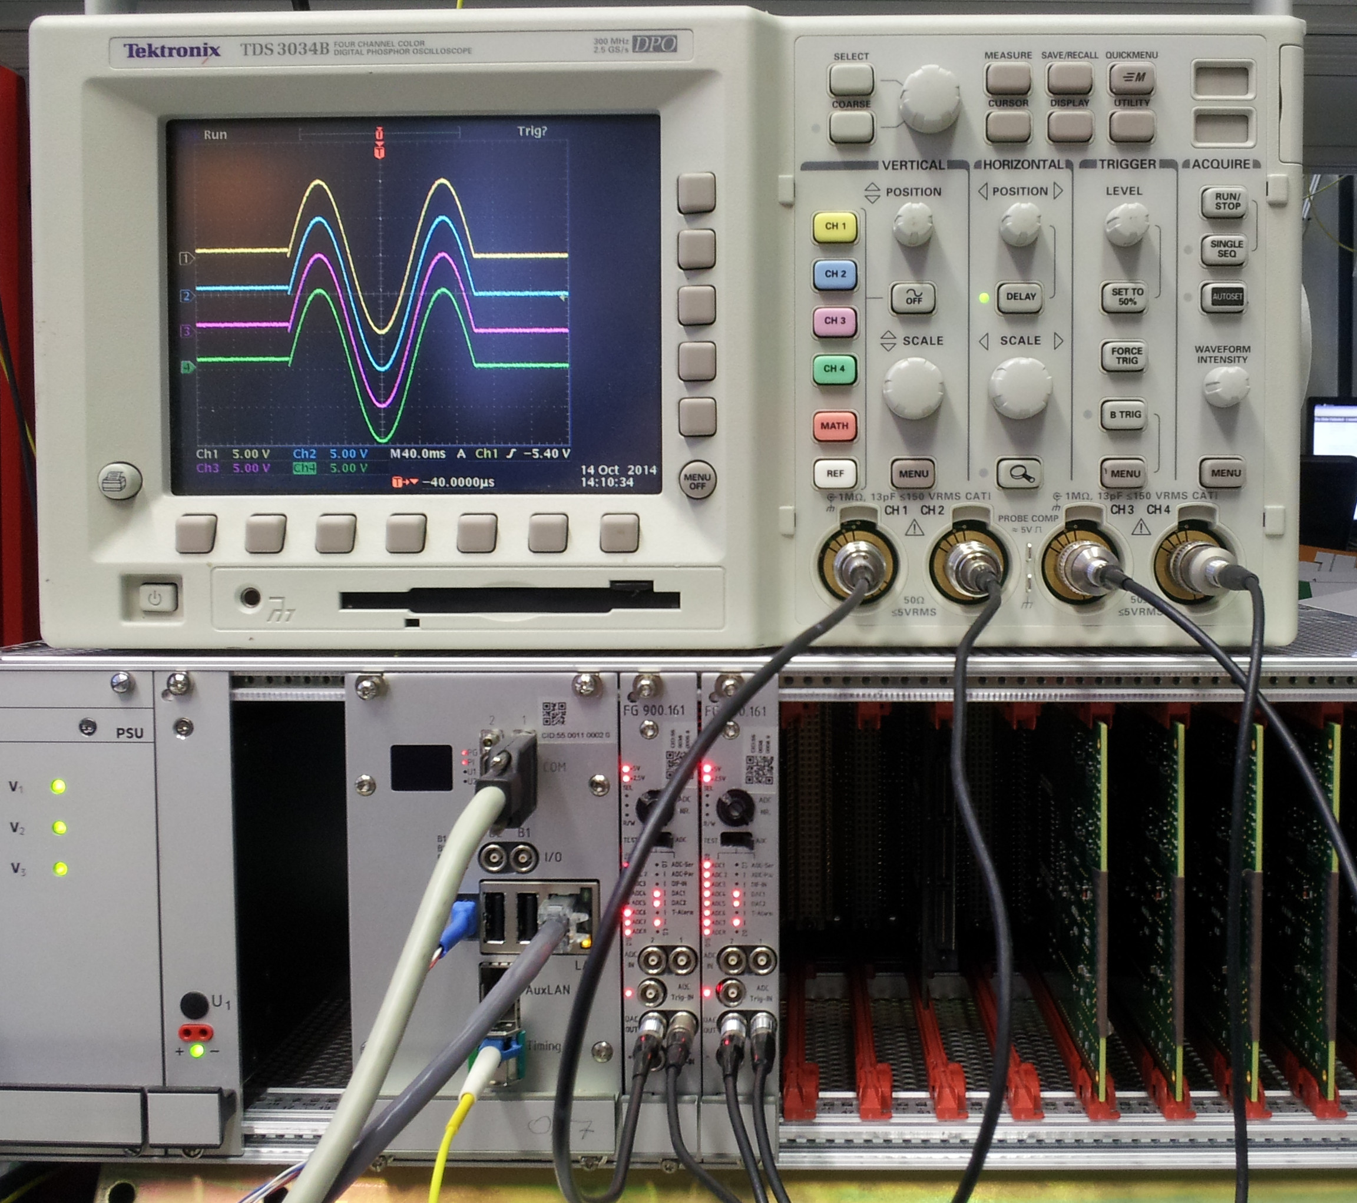

Managing Multiple Function Generators for FAIR
S. Rauch, M. Thieme, R. Bär, GSI Centre for Heavy Ion Research, Darmstadt
Abstract
In the FAIR control system, equipment which needs to be controlled with ramped nominal values (e.g. power converters) is controlled by a standard front-end controller called scalable control unit (SCU). An SCU combines a ComExpressBoard with Intel CPU and an FPGA baseboard and acts as bus-master on the SCU host-bus. Up to 12 function generators can be implemented in slave-board FPGAs and can be controlled from one SCU.
The real-time data supply for the generators demands a special software/hardware approach. Direct control of the generators with a FESA (front-end control software architecture) class, running on an Intel Atom CPU with Linux, does not meet the timing requirements. So an extra layer with an LM32 soft-core CPU is added to the FPGA. Communication between Linux and the LM32 is done via shared memory and a circular buffer data structure. The LM32 supplies the function generators with new parameter sets when it is triggered by interrupts. This two-step approach decouples the Linux CPU from the hard real-time requirements. For synchronous start and coherent clocking of all function generators, special pins on the SCU backplane are being used to avoid bus latencies.
Data Supply with Real Time Boundaries
Interpolation from 250 to 32000 steps
Sample frequency 16 kHz up to 1 Mhz
Worst case 250 steps with 1 Mhz sample rate: 250 µs
Data rate too high for linux, to service 12 channels
Implementation with LM32 and MSI
Add real time layer with LM32
No operating sytem and software written in C
Real time behaviour is easy to predict
Real time processing done in IRQ handler
Circular buffer in shared memory
IRQ round trip 5 µs, SCU bus access 300 ns
With a step width of 250, 13 FGs could be serviced
Software Interrupt scheme from linux with MSI for messages
FG Operation
LM32 software scans for FGs and enumerates them
Up to 12 Fgs supported
Presented as virtual devices to linux
Circular buffer filled with parameters by linux, emptied by IRQ handler
IRQ signalling is done via MSI
Project Status
Hardware is implemented
Test program for the FG system exists
FESA integration ongoing
Future Work
Use interrupts to the PCIe bridge for data transfer
Use the same system for Data Aquisition(DAQ)
SCU
standard frontend controller for FAIR
FPGA board with ComExpress CPU attached
Controls parallel bus called SCU bus
SoC design in the FPGA on basis of Wishbone
LM32 cluster connected via wishbone crossbar
MSI wishbone crossbar with LM32 and PCIe bridge as targets
FG
Function generator macro written in VHDL
Can be used in SCU slaves cards or with wishbone interface
Slave cards: DIOB (1 FG), ADDAC1/2 (2 FGs)
Digital output with 32 Bit on DIOB card
Analog output with 16 Bits on ADDAC card
Is configured with a parameter set and interpolates for n steps
Overview of SCU with slaves
a | Shift a | b | Shift b | c | Steps
-29698 | -31 | 25318 | -13 | 0 | 2
-21975 | -29 | 25201 | -13 | 3084 | 2
... | ... | ... | ... | ... | ...
Example parameter set for a sine wave
Example with 4 channel sine wave generated by the FG.
Shown is an SCU with two ADDAC cards. The DAC outputs are connected to an oscilloscope.

