Slide 1

Ruud Puts & Stefan Renne
Eindhoven, 16 September 2016

Slide 2
Agenda.
History
Syntax in Playground
Casus
Resources

Slide 3
Swift.
Safe, Fast, Expressive
Protocol oriented language
Build on with LLVM compiler
Can be mixed with C, C++ and Objective-C
Ruby-like (irb) command line interface (repl)
For iOS, WatchOS, tvOS, OS X and Linux
Fast addoption rate

Slide 4
History.
July 2010 Development Started
Chris Lattner (Apple)
Influenced by Ruby, Objective-c, Python, Etc
June 2014 Swift 1.0 announced
June 2015 Swift 2.0 announced
December 2015 Open sourced
June 2016 Swift 3.0 announced
Ported to Server Side, Linux, PS4, Windows, Android

Slide 5
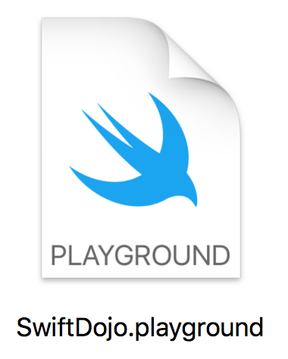

Syntax in Playground.
https://github.com/stefanrenne/swiftBootcamp

Slide 6
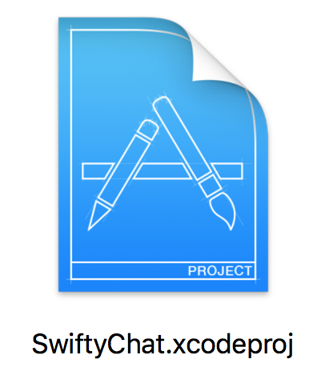
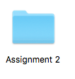
Casus.
https://github.com/stefanrenne/swiftBootcamp

Slide 7
Resources.
http://developer.apple.com/wwdc/
https://github.com/apple/swift-evolution
https://itunes.apple.com/nl/book/swift-programming-language/id881256329
https://swift.org/about/
http://ericasadun.com
https://swiftlang.ng.bluemix.net/#/repl

Slide 8
Thank you!

