Slide 1

Ruud Puts & Stefan Renne
Vianen, 08 September 2016

Slide 2
Agenda.
History
Syntax in Playground
Casus
Resources

Slide 3
History.
July 2010 Development Started
Chris Lattner (Apple)
Influenced by Ruby, Objective-c, Python, Etc
June 2014 Swift 1.0 announced
June 2015 Swift 2.0 announced
December 2015 Open sourced
June 2016 Swift 3.0 announced
Ported to Server Side, Linux, PS4, Windows, Android

Slide 4
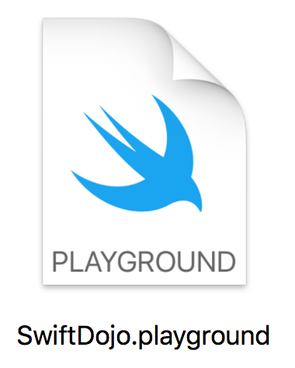
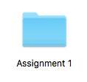
Syntax in Playground.
https://github.com/stefanrenne/swiftBootcamp

Slide 5
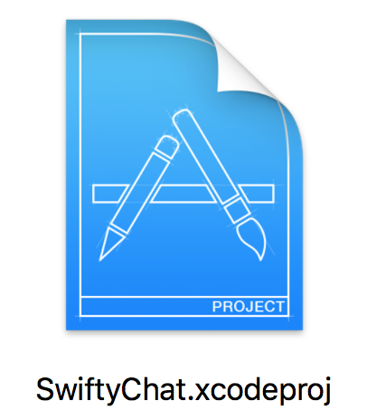
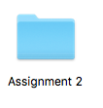
Casus.
https://github.com/stefanrenne/swiftBootcamp

Slide 6
Resources.
http://developer.apple.com/wwdc/
https://github.com/apple/swift-evolution
https://itunes.apple.com/nl/book/swift-programming-language/id881256329
https://swift.org/about/
http://ericasadun.com

Slide 7
Thank you!

