Slide 1
Haze Datathon
Team Boycott

Slide 2
Analysis of causes and effects of haze
Causes of the haze
Economic factors: palm oil demand and supply
Physical factors: forest burning
Effects of the haze
Health
Palm oil industry
Transport
Humidity

Slide 3
Causes:
Research question:
How does economic activity relate to the haze?

Slide 4
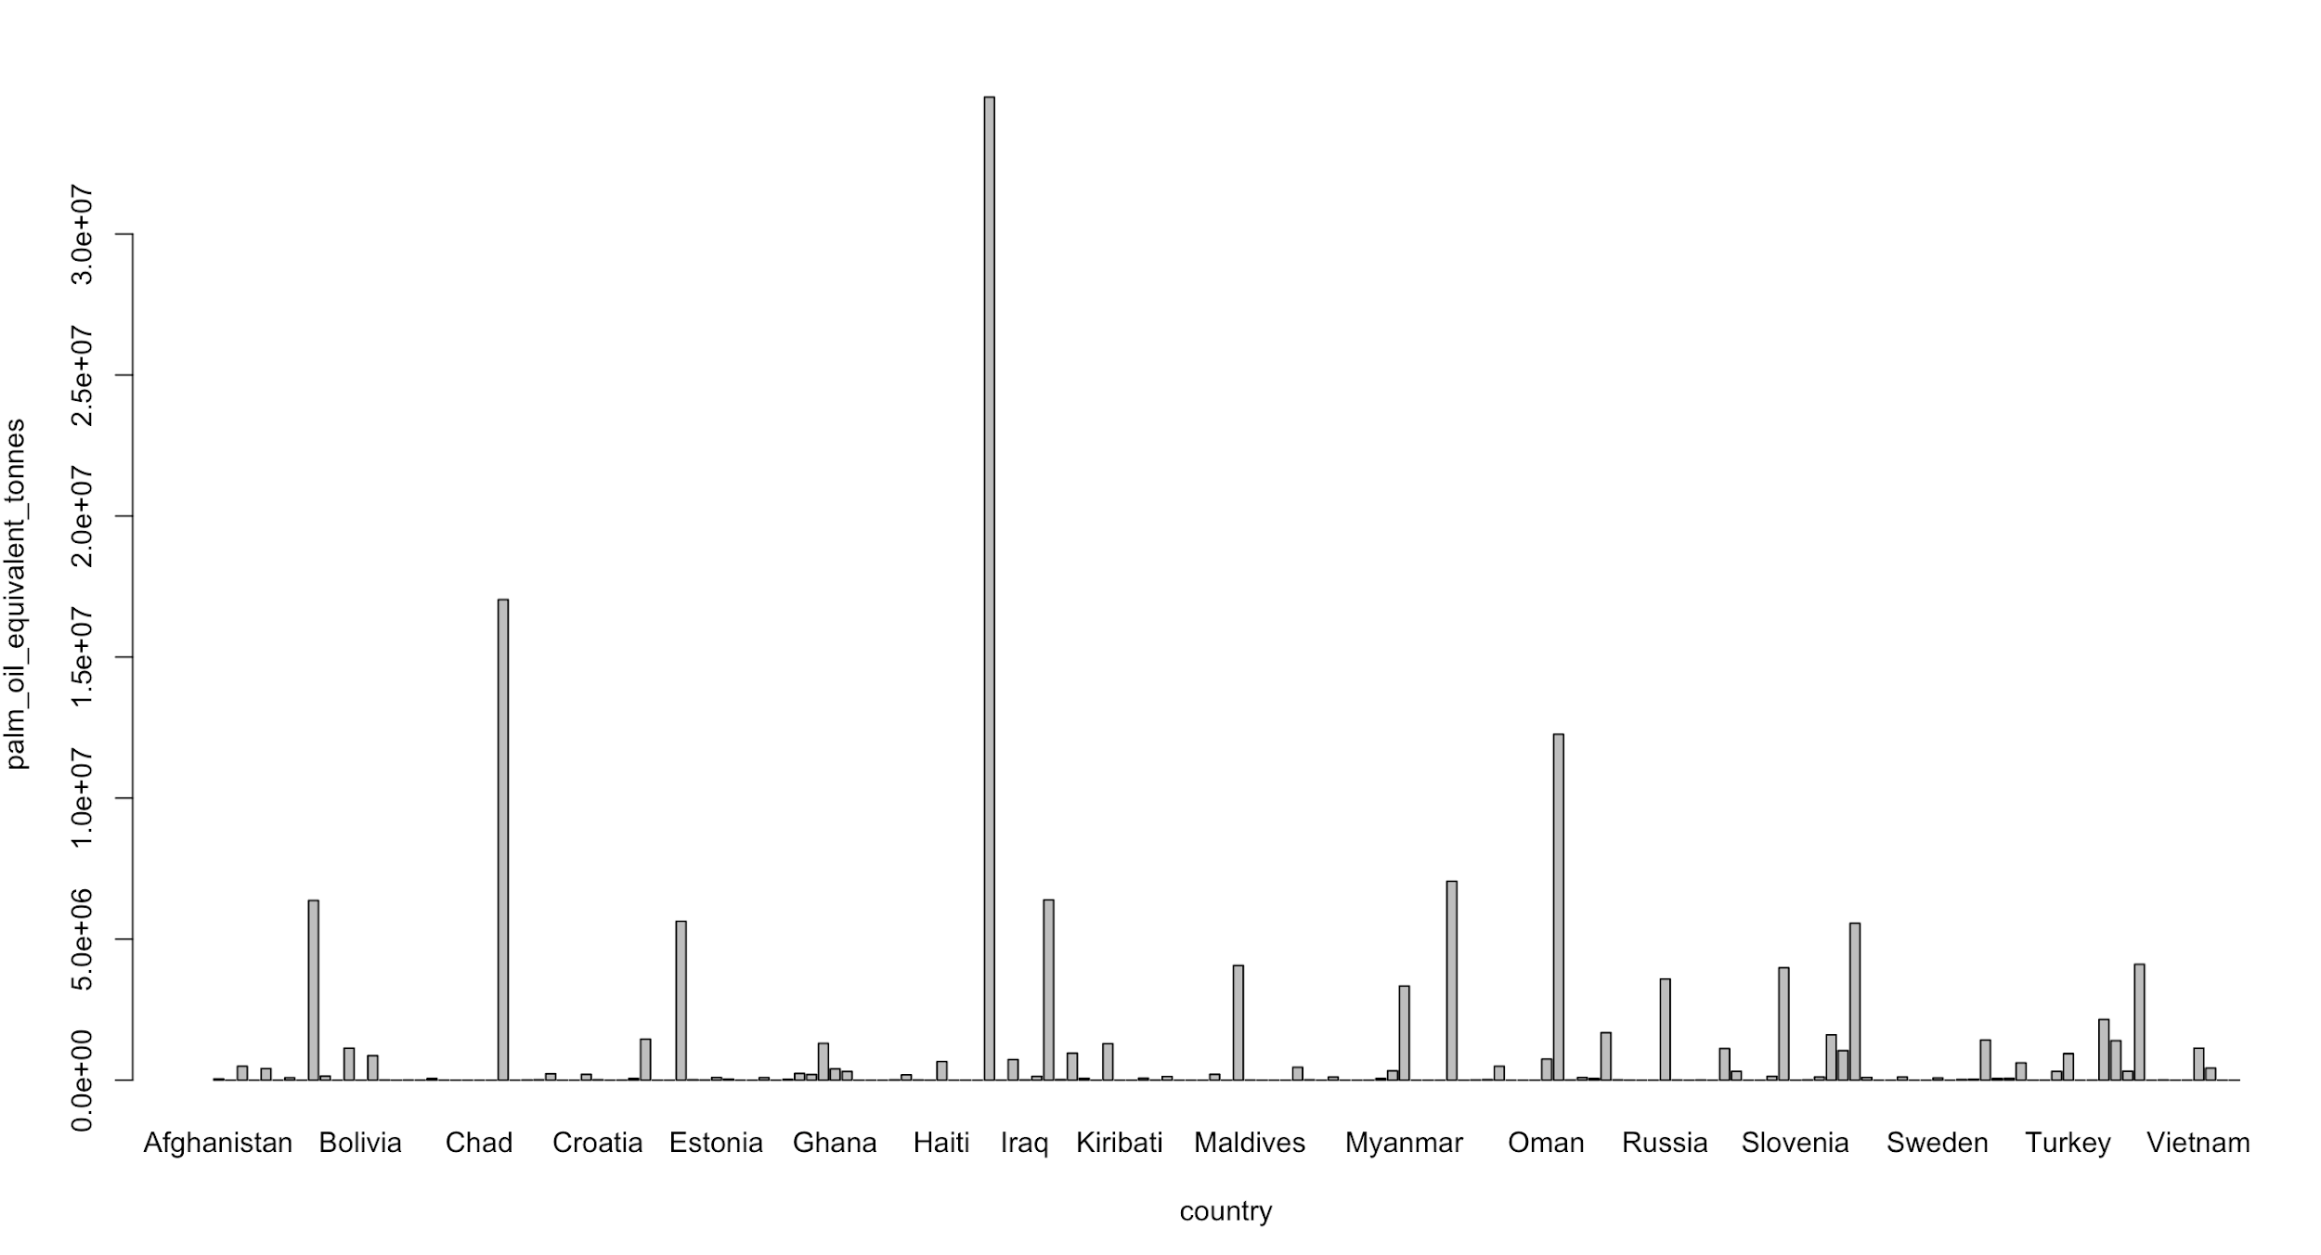
Causes of the Haze
Since the haze is caused by slash-and-burn farming practices, we examined where the demands of palm oil is coming from and what the oil is used for.
Demand from importers and companies from other countries
Country importing the largest amount of palm oil: India
Company importing largest amount of palm oil: Golden Agri International Pte Ltd
Singaporean palm oil company
Imports the largest amount of palm oil from multiple Indonesian ports and multiple exporters
Tonnes of Palm Oil Imported to Country

Slide 5
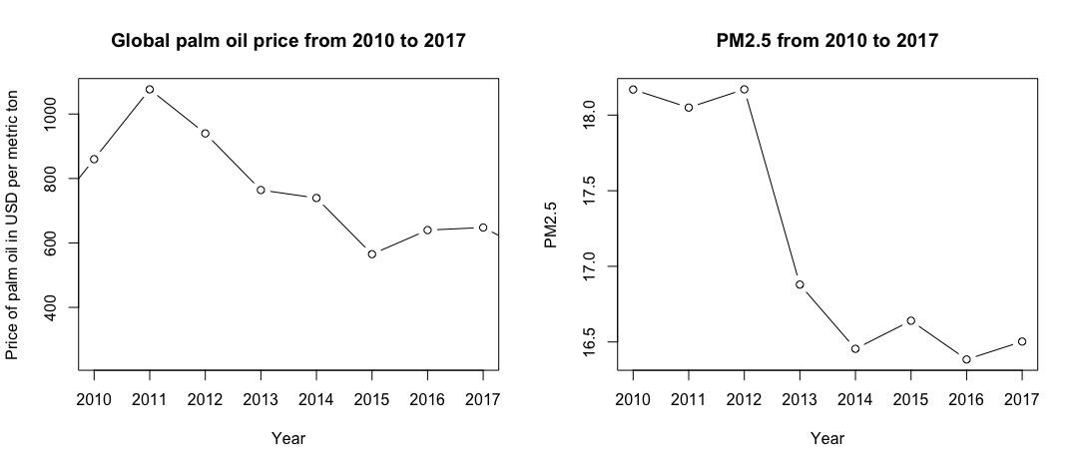
Relationship between the economy and the haze
Notes:
Increase DD → increase SS → decrease price + increase deforestation → increase haze

Slide 6
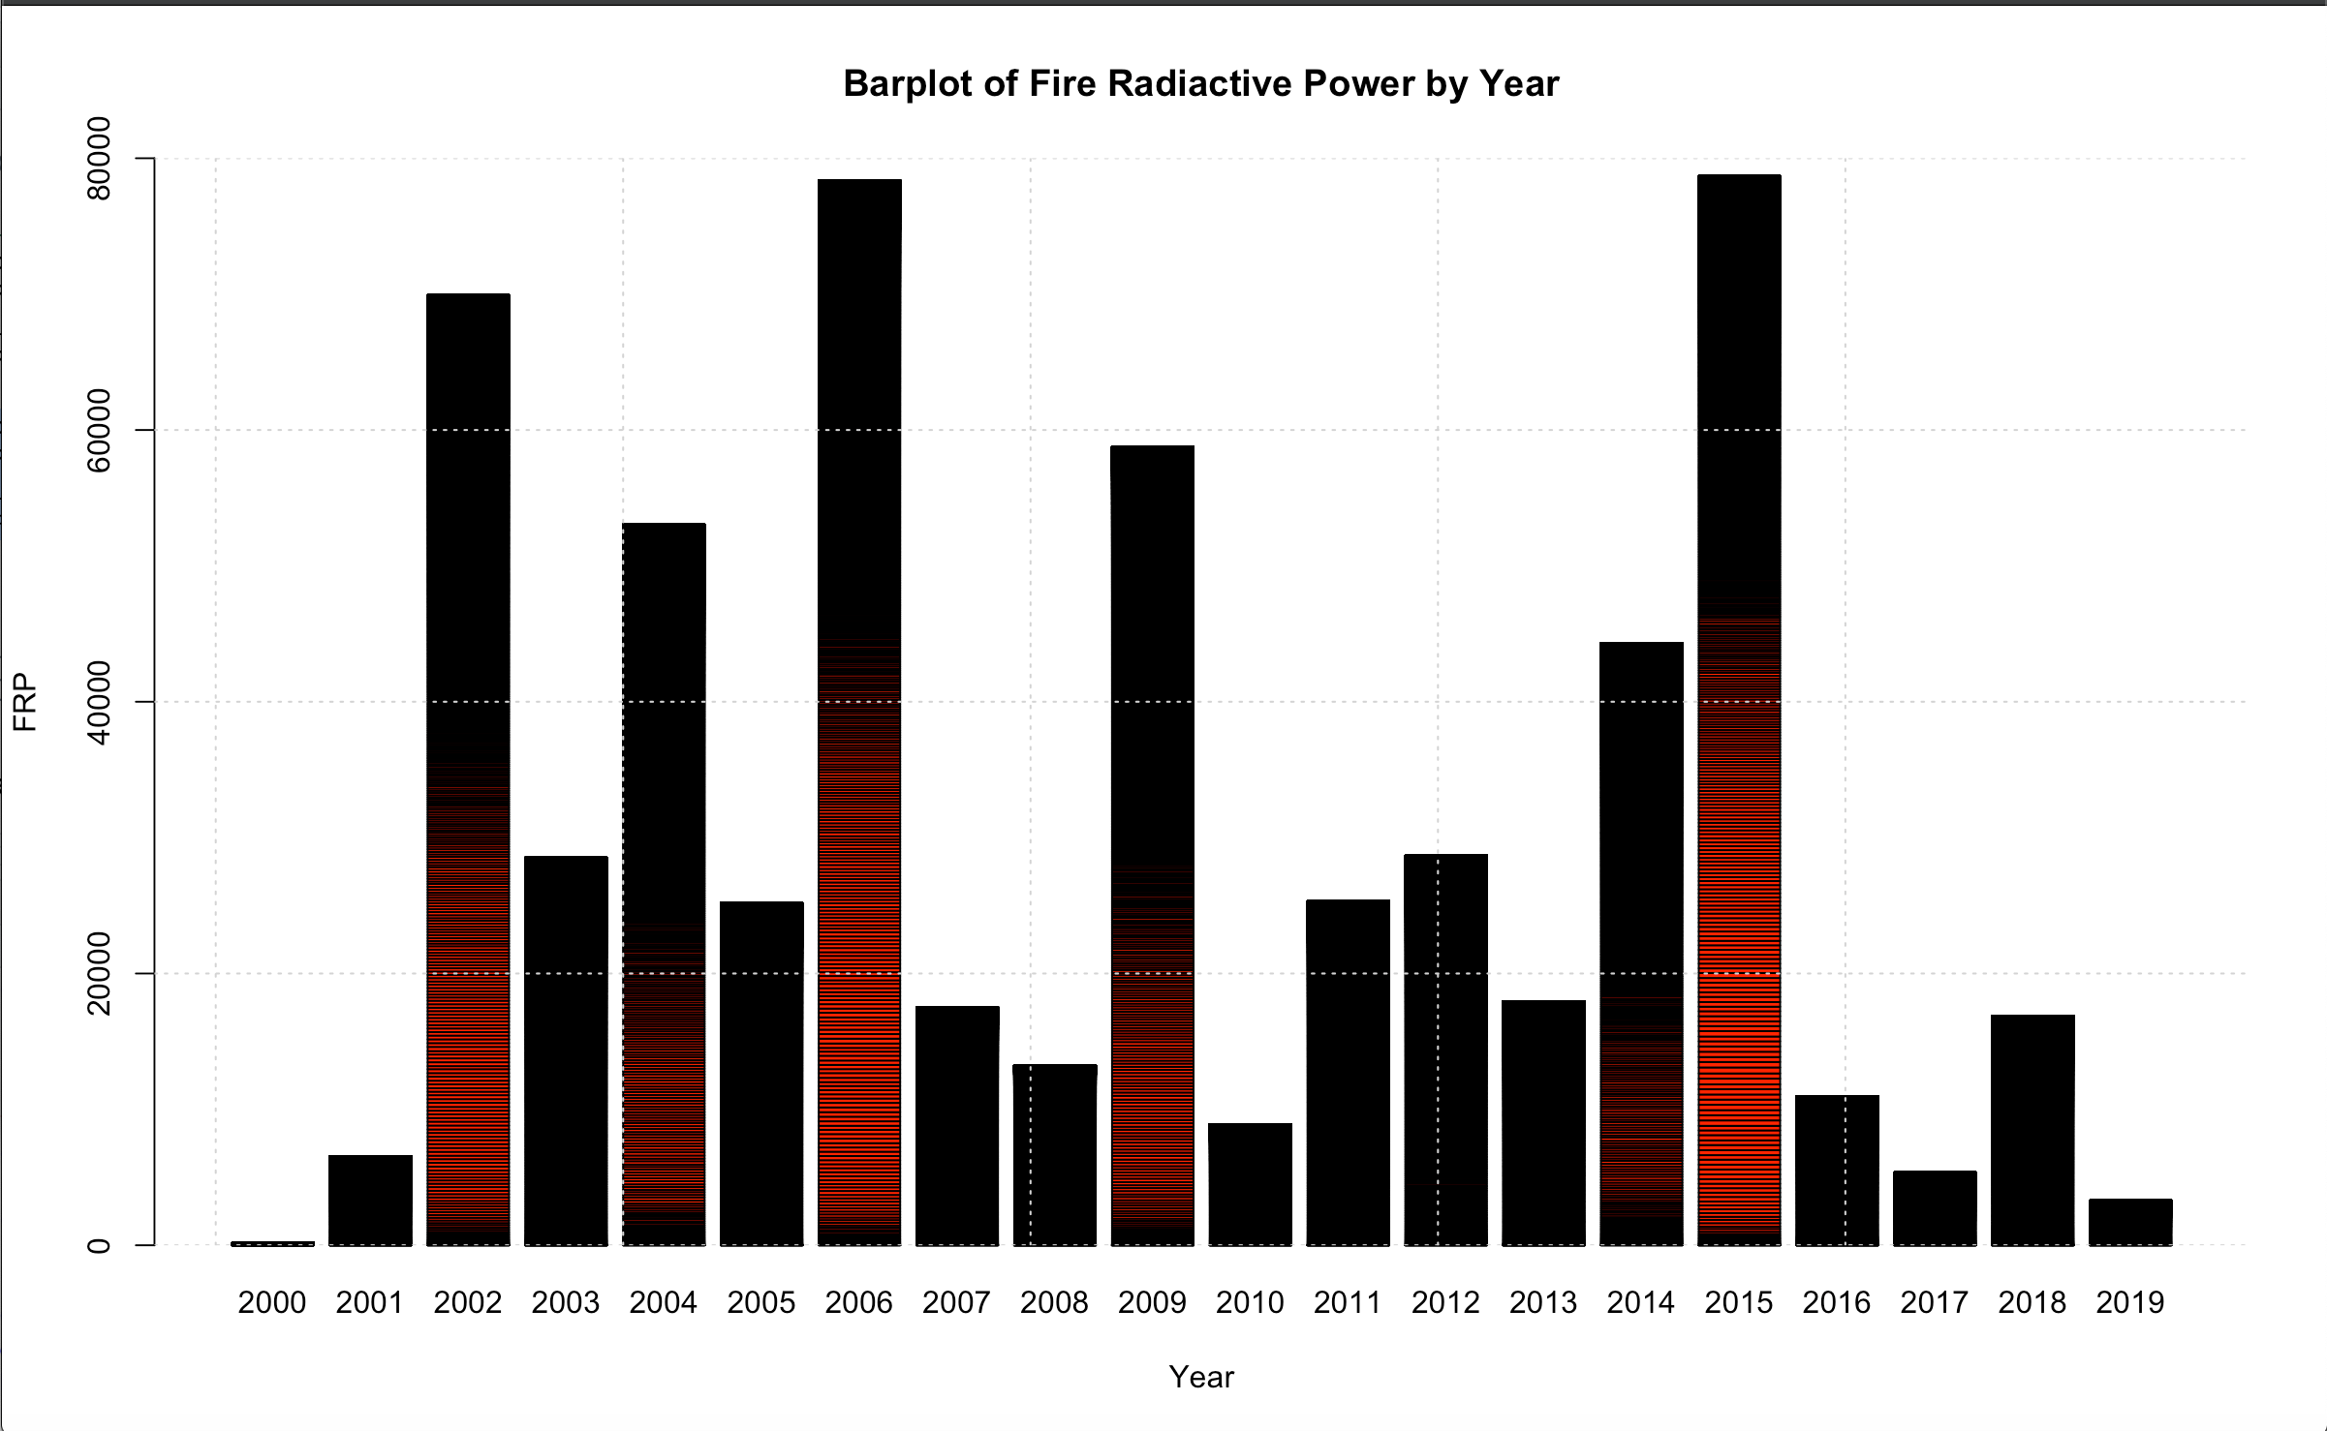
Fire Radiative Power by Year
(MODIS Satellite Archive)
FRP
The rate at which the actively burning fire is emitting radiative energy (Watts)

Slide 7
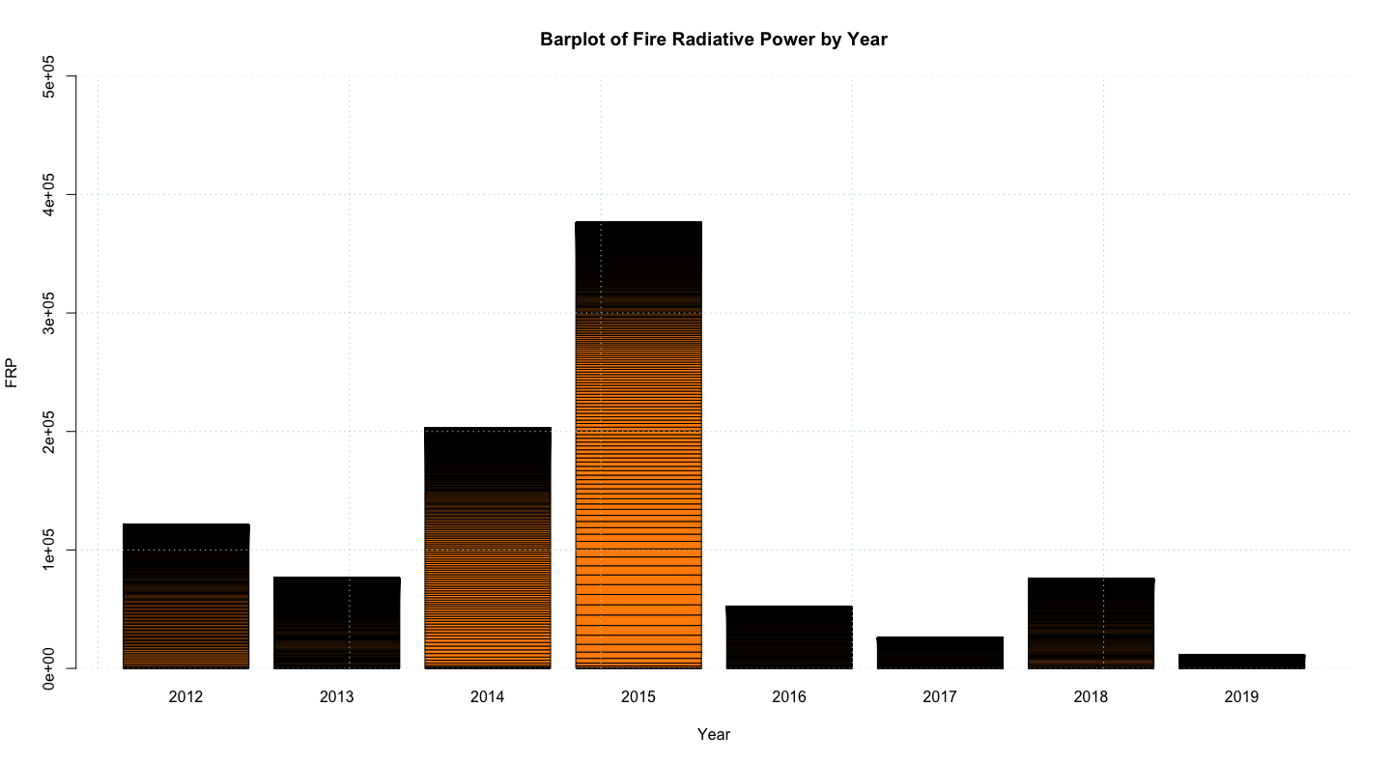
Fire Radiative Power per Year
(VIIRS Satellite Archive)

Slide 8
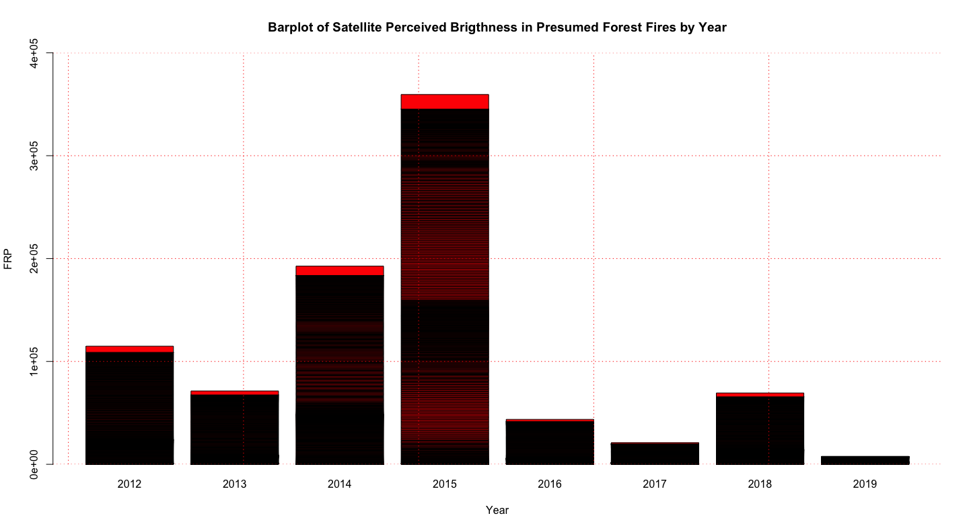
Brightness of fires as perceived by VIIRS

Slide 9
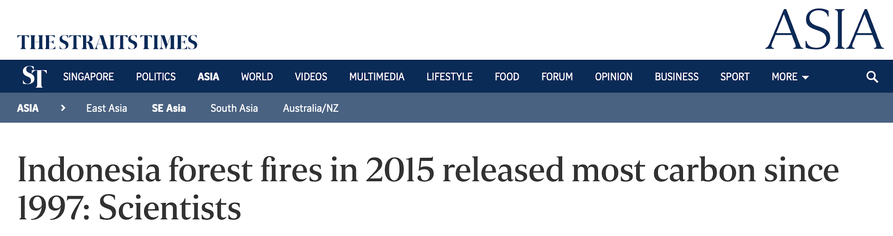
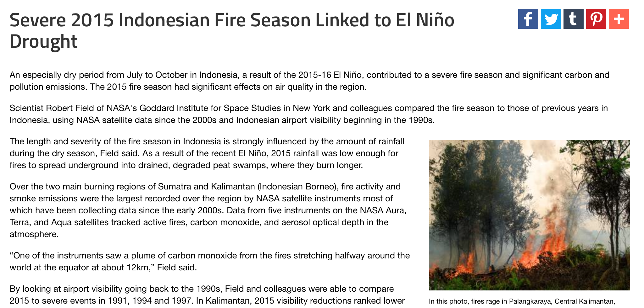
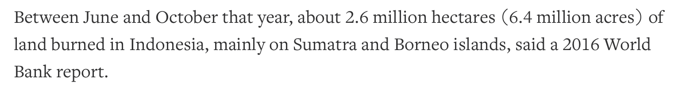
What happened in 2015?
https://www.theguardian.com/sustainable-business/2015/nov/11/indonesia-forest-fires-explained-haze-palm-oil-timber-burning
https://www.bbc.com/news/business-35109393

Slide 10
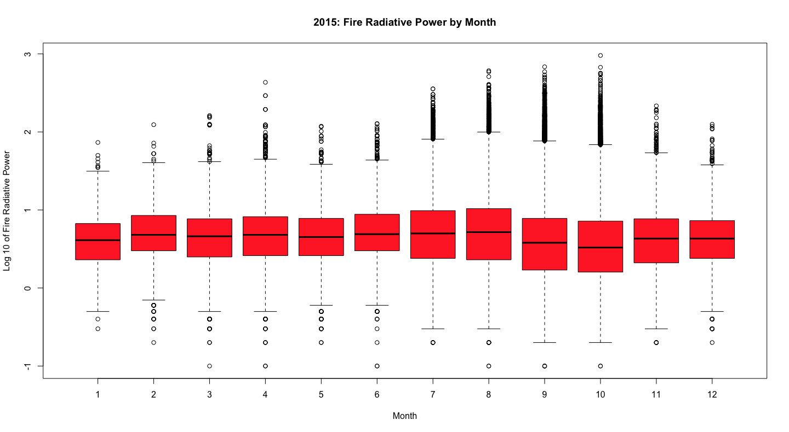

Slide 11
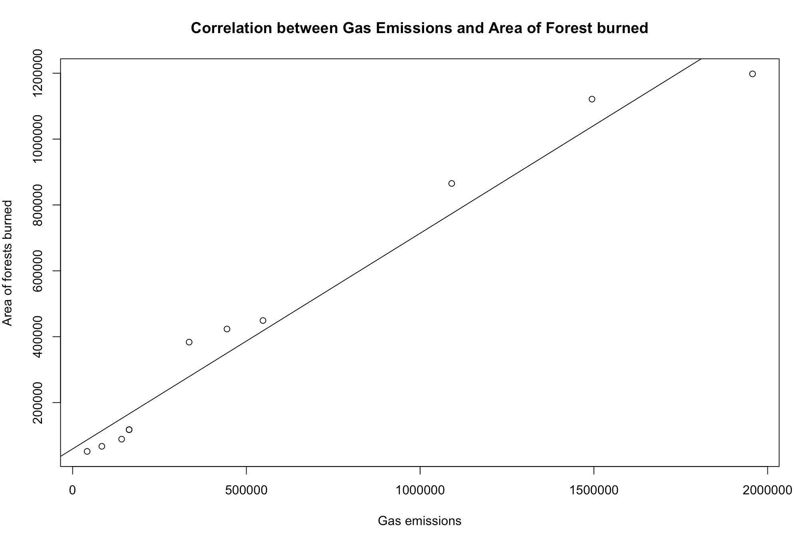
Correlation Coefficient: 0.982233

Slide 12
% of sustainable oil production
Country | Not RSPO Certified | RSPO Certified | percent_RSPO_ Certified
Group | Not RSPO Certified | RSPO Certified | Percent_ RSPO_ Certified
1 | Agropalma Group | 0 | 2 | 100.000000
1 | BRA | 1 | 2 | 66.66667
2 | CIV | 0 | 1 | 100.00000
40 | Unknown | 712 | 72 | 9.183673
All listed oil company groups are 100% RSPO certified. All non RSPO certified companies are in “unknown” groups
Mean % RSPO Certified: 28.05045
Ctys that fall below mean are mostly in Latin America (except Ghana, Malaysia, Indonesia, India)

Slide 13
Recommendations
Demand global accountability for unsustainable palm oil production
Legal
Economic
Target countries that fall below the mean percentage of RSPO-certified mills
Especially Malaysia and Indonesia
Boycotting of products (target firms) that use oil from unsustainable methods of production
Notes:
Reward farmers who don’t use slash and burn techniques so the benefits of these techniques (peat for cultivation) are minimised

Slide 14
Effects!
Notes:
So now we will be moving on to the effects of haze.

Slide 15
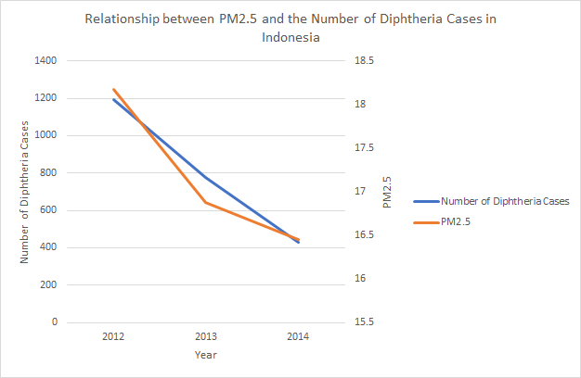
Effects of the Haze - Health
Correlation coefficient = 0.974
Notes:
Effects on health - Diphtheria is one of the many respiratory-related illnesses that can lead to death. As you can see, there is a strong relation between them, meaning we can infer that haze does have some association with respiratory health.

Slide 16
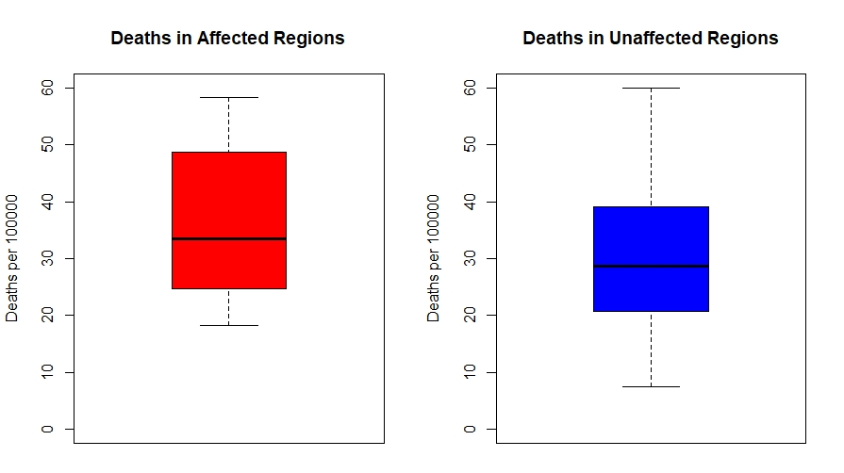
Effects of Haze - Deaths due to Air Pollution (by Region)
Notes:
The boxplot here indicates a higher interquartile range for number of deaths due to air pollution per 100000 per country in affected regions, compared to that in unaffected regions. Shorter lower-bound whiskers and higher minimum number of deaths due to air pollution in affected regions further contributes to the
(Data: death-rates-from-ambient-particulate-air-pollution.csv (given))

Slide 17
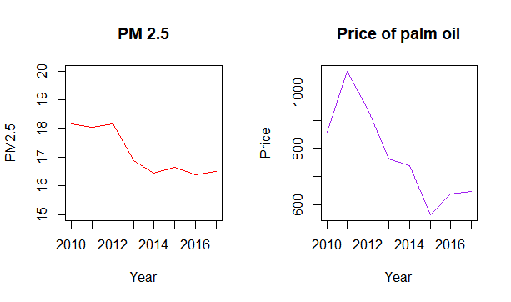
Effects of Haze - Palm Oil Industry
Correlation Coefficient = 0.861
Notes:
Bee: We compared PM2.5 and global palm oil prices, of which we then calculated to see the strength of its linear correlation.

Slide 18
Effects of Haze - Palm Oil Industry
Though the correlation between the global price of palm oil and PM 2.5 is strong, there is no proof that the relationship is one of causation.
Hypothesis
The dry season hinders production of palm oil, allowing for global prices to rise due to shortage in supply
The haze plays a part in exacerbating the price spike, but there is a lurking variable i.e. the dry season and recent El Nino climate pattern
Haze + dry weather → low supply → increase in price → increase in production → demand for land → burning of lands → more haze
(Cyclical)
Notes:
We know that palm oil industry is a cause to haze, but we would also like to take a reverse approach to ponder if haze causes changes to the price palm oil industry, since the correlation between two variables does not imply causation, meaning their relation can be dynamic. We propose that there is a lurking variable - something more to just haze at play. Palm oil industry thrive in the short-term because of the upward pressure on prices.

Slide 19
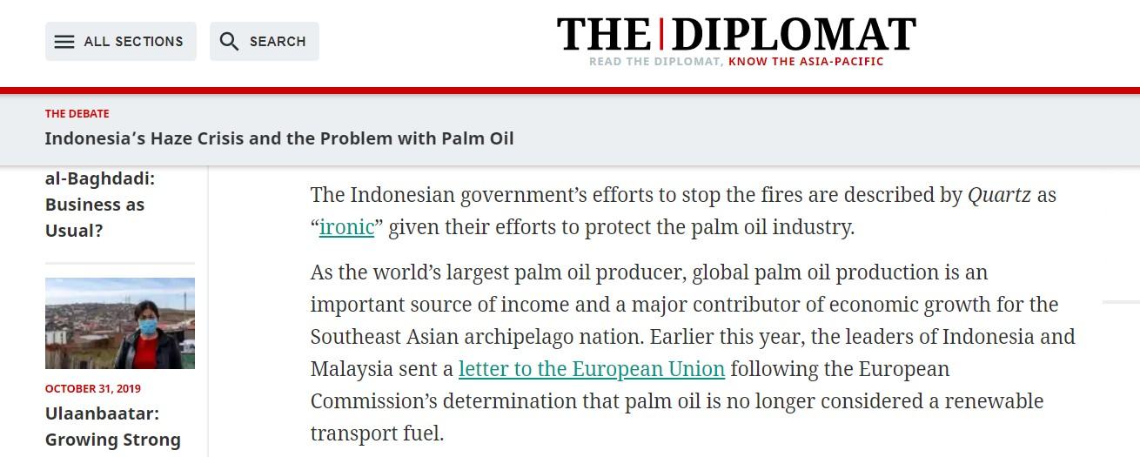
Effects of Haze - Palm Oil Industry
R-squared = 0.741
Notes:
A potential switch from palm oil to other sources of fuel, at least in Europe.

Slide 20
Effects of Haze - Palm Oil Industry
Palm oil prices are falling after the initial spike in 2012
We can use the relation between PM2.5 and Global Palm Oil Prices as a predictor to extrapolate the future of the palm oil industry
Notes:
Downward trend in prices because of increase in supply in next cycle pushes prices downward. The losses caused by haze-cutting-production may in time outweight that of the profits earned from driving prices high by limiting supply.

Slide 21
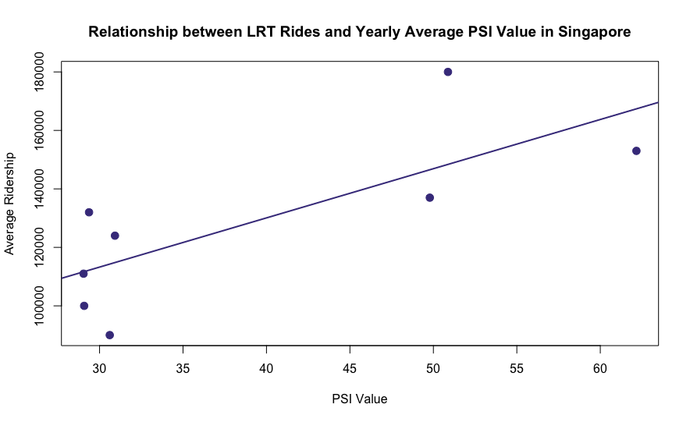
Effects of the Haze - Transport
An increase in PSI value leads to an increase in passengers taking public transport.
Correlation coefficient = 0.762 (LRT)
= 0.815 (Bus)
= 0.737 (MRT)
Notes:
In Singapore, a neighbouring country. Move to indoors to avoid the haze, to avert the potential health effects. But we realise the shift to air-conditioned environments can lead to problems in another non-related, but still environmental issue, global warming.

Slide 22
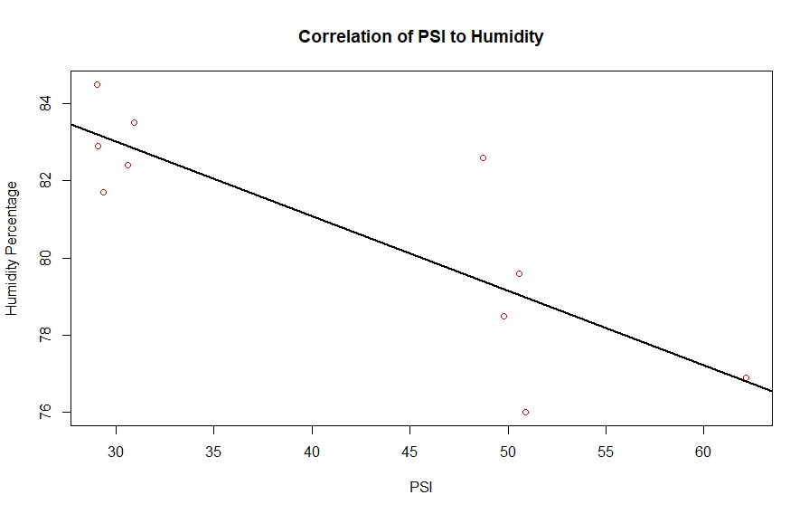
Effects of Haze - Humidity
Correlation = -0.826
R-squared value = 0.682
Notes:
Humidity = less chance for rain
Less humidity = people not used to it = fall sick
Source of humidity data: data.gov.sg (https://data.gov.sg/dataset/relative-humidity-annual-mean?view_id=4cfa6aa5-1541-473a-916c-39835d3c3c29&resource_id=77b9059f-cc9a-4f4f-a495-9c268945191b)

Slide 23
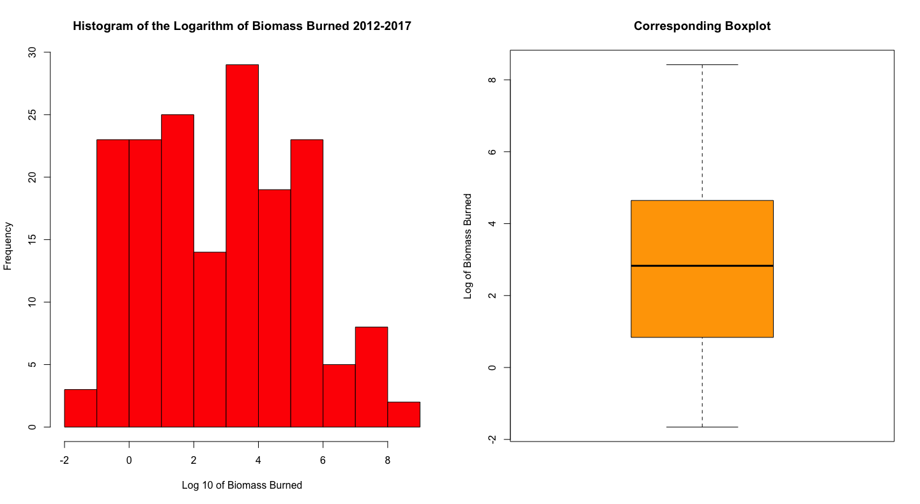
Effects of Haze - Ecosystem
Notes:
Loss of bio-diversity, damages on eco-system, potential medicinal plants and endangered species/animals. Ecosystem collapses may have devastating effects on humans eventually.

Slide 24
Example of Boycotting in Singapore
SEC Involvement (2015)
Decertified NTUC, ColdStorage, Giant, Sheng Siong - stopped selling Asia Pulp & Paper Products
Asked supermarkets to stop selling products contributing to haze
Old Chang Kee adopts Sustainable Palm Oil in Production (2018)
8000 customers signed a petition calling on Old Chang Kee to use responsibly-sourced oil
Result: $75,000 palm oil / year switched to a sustainable source (and to support sustainable farmers)
To give an idea of the scale of impact that collective action has, to achieve the same result through individual families choosing responsible cooking oil, would require 28,000 households to purchase responsible palm oil from the supermarket.
Notes:
Singapoore Environmental Council
Government and people do have power in the matter.
times 2015:
https://www.straitstimes.com/singapore/environment/ntuc-fairprice-sheng-siong-prime-supermarket-remove-all-asia-pulp-paper-group
https://www.theonlinecitizen.com/2018/02/18/old-chang-kee-switches-to-sustainable-oil/
Old Chang Kee, local purveyor of curry puffs and other local snacks, has switched to using a more sustainable palm oil after a petition started by local students accumulated over 8000 signatures. According to the latest petition update, the organisers of the petition received an email from Old Chang Kee at the beginning of February informing them they have switched to RSPO palm oil in all Old Chang Kee stores in Singapore.
As previously reported, this petition calling for Old Chang Kee and Polar Puffs to stop using unsustainable oil was organised by Students Of Singapore Against Haze, which was then started by Gauri Shukla. Shukla had saw first-hand how beautiful rainforests were being burnt down to make way for palm oil plantations. She also investigated and found that local companies, Old Chang Kee and Polar Puffs & Cakes, used non-RSPO palm oil.

Slide 25
Recommendations
Government intervention in production levels, stricter law enforcement on illegal slash and burn method.
Restrictions on using products with palm oil as an ingredient
Uphold the Principles of the RSPO- Environmental responsibility and conservation of natural resources and biodiversity and Responsible development of new plantings
Notes:
However, we also realise that these are rather shallow solutions. Due to time-constraints, we have chosen to ponder more on limitations of our short study.
People do have a part to play as well. We don’t have solid solutions except for the typical ones you may see, for now.

Slide 26
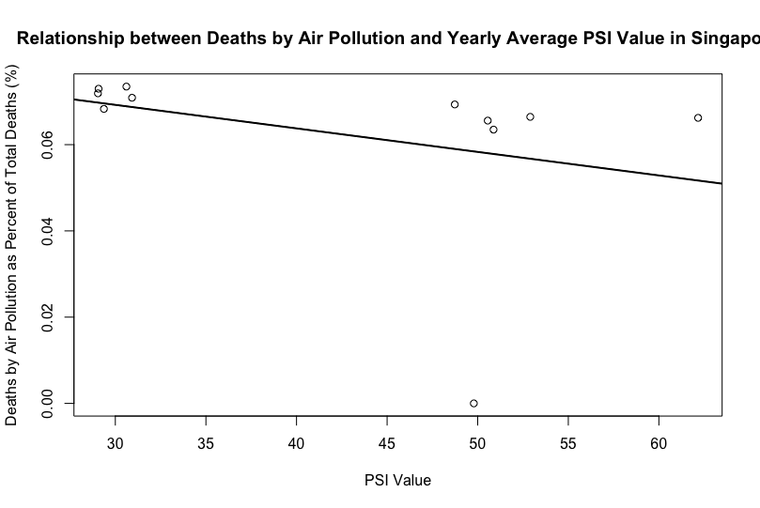
Limitations
Limited and unconsolidated data
Lurking factors that requires more research
Effect of haze varies across different countries
Lack of qualitative data to explain
Notes:
We do agree that boycotting is difficult and this is made complex since palm oil is a major economic contributor to Indonesia. So we appreciate that this does not only concern the air we have in Singapore/neighbouring regions, but also the livelihoods of those in Indonesia who are of a poorer background. So we don’t believe that it is feasible to eradicate palm oil altogether, but rather we should, as the representative from PMHaze and Unilever mentioned, seek to find a balance, a sustainable way to the palm oil industry. Some countries are not as affected because their affluence means more alternative forms of shelter against the haze e.g. Singapore vs. Indonesia/Malaysia. These are also the qualitative things we are missing.

