Slide 1
Jupyter Notebooks
Python

Slide 2
Introduction to Jupyter Notebooks
The Jupyter Notebook is an open-source web application
It allows you to create and share documents that contain
live code,
equations,
visualizations
and narrative text.
Uses include: data cleaning and transformation, numerical simulation, statistical modeling, data visualization, machine learning, and much more.
http://jupyter.org/

Slide 3
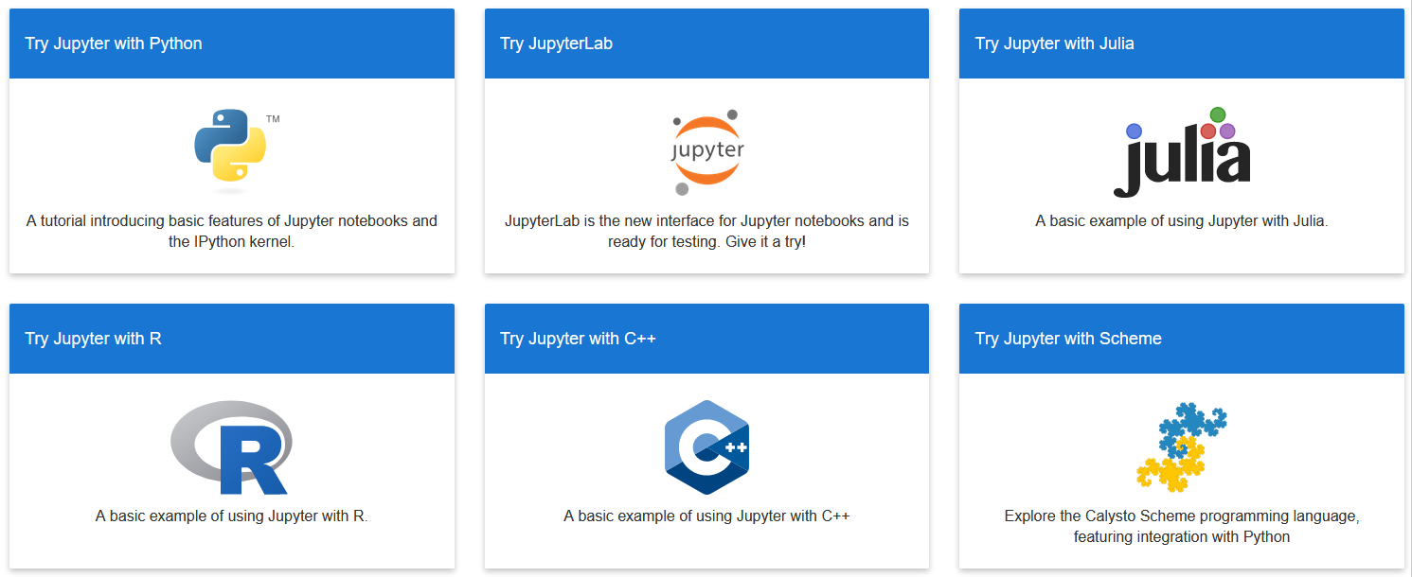
Jupyter Notebooks
Support of several languages

Slide 4
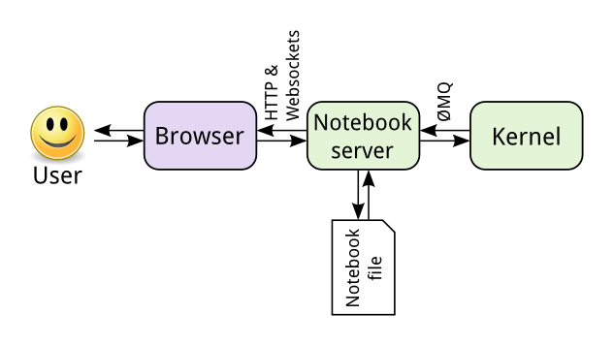
How Jupyter works

Slide 5
Work with Jupyter Notebooks
https://notebooks.azure.com
https://notebooks.azure.com/Microsoft/libraries/samples
Data Science Virtual Machine
Integrated examples

Slide 6
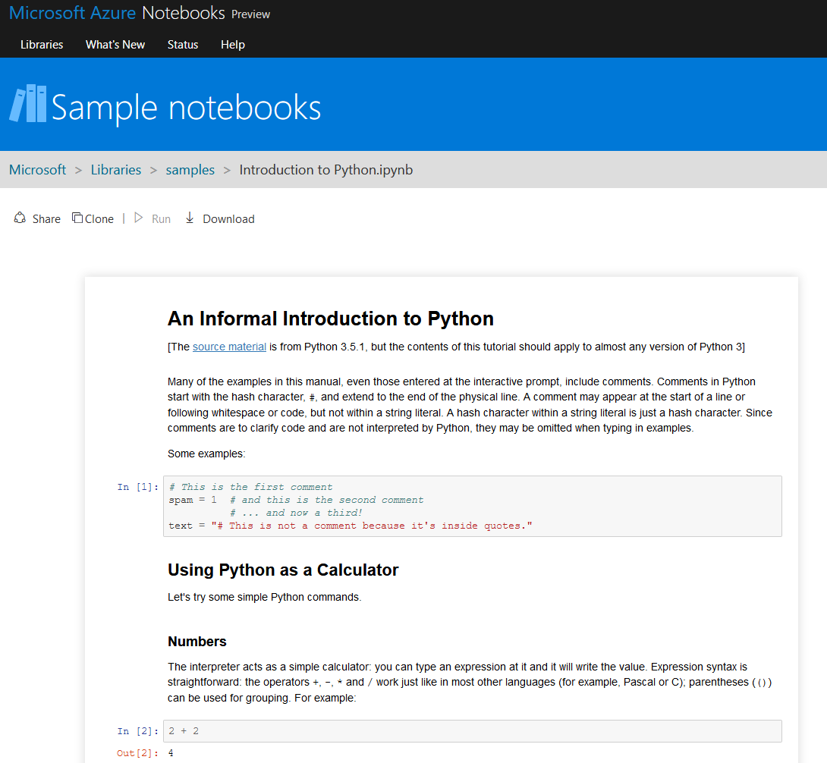
Introduction to Python
https://notebooks.azure.com/Microsoft/libraries/samples/html/Introduction%20to%20Python.ipynb

Slide 7
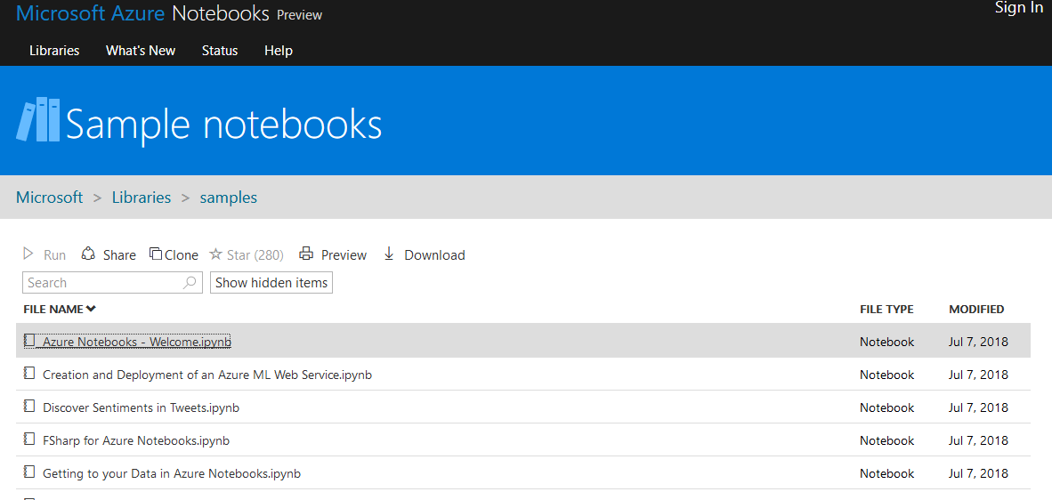
Introduction to Python with Azure notebooks
https://notebooks.azure.com/Microsoft/libraries/samples

Slide 8
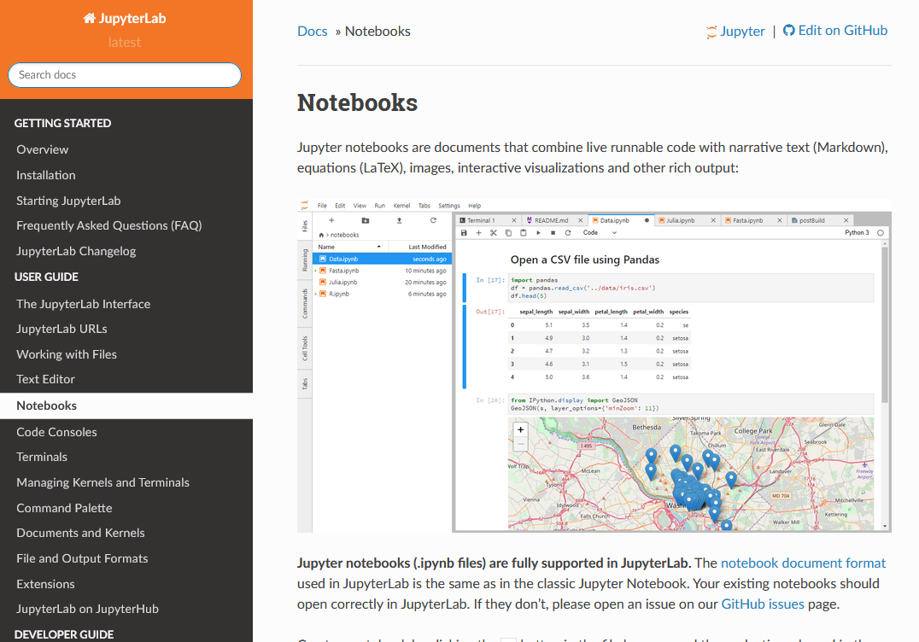
Jupyter Documentation
Documentation
https://jupyter.org/documentation
Jupyter Labs
https://jupyterlab.readthedocs.io/en/latest/user/notebook.html

