Slide 1
Container

Slide 2
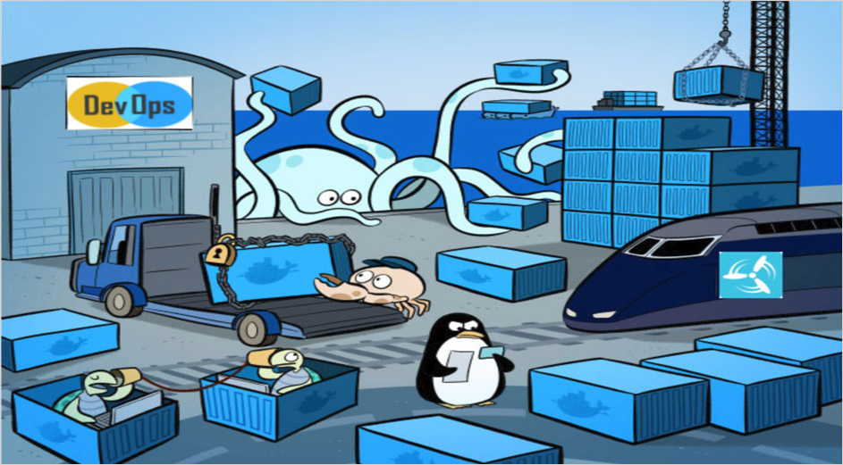
Container and Docker
Docker is a platform for developers and sysadmins
to develop, deploy, and run applications with containers.
The use of Linux containers to
deploy applications is called
containerization.
Containers are not new, but their
use for easily deploying applications is.

Slide 3
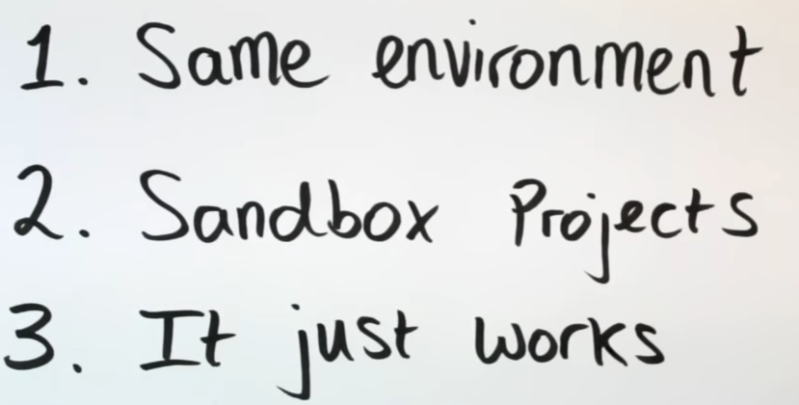
Why Container ?

Slide 4
Docker Concepts
Containerization is increasingly popular because containers are:
Flexible: Even the most complex applications can be containerized.
Lightweight: Containers leverage and share the host kernel.
Interchangeable: You can deploy updates and upgrades on-the-fly.
Portable: You can build locally, deploy to the cloud, and run anywhere.
Scalable: You can increase and automatically distribute container replicas.
Stackable: You can stack services vertically and on-the-fly.

Slide 5
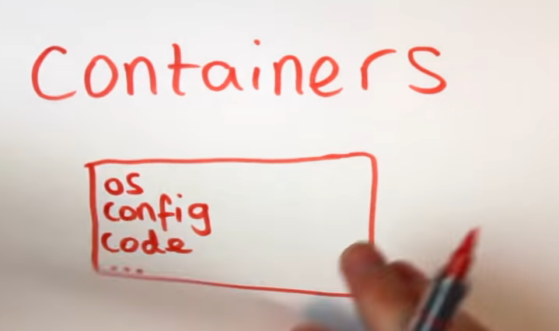
Why Containers?

Slide 6
Images and Containers
A container is launched by running an image.
An image is an executable package that includes everything needed to run an application
the code,
a runtime,
libraries,
environment variables, and configuration files.
A container is a runtime instance of an image
what the image becomes in memory when executed (that is,
an image with state, or a user process).
You can see a list of your running containers with the command,
docker ps, just as you would in Linux.

Slide 7
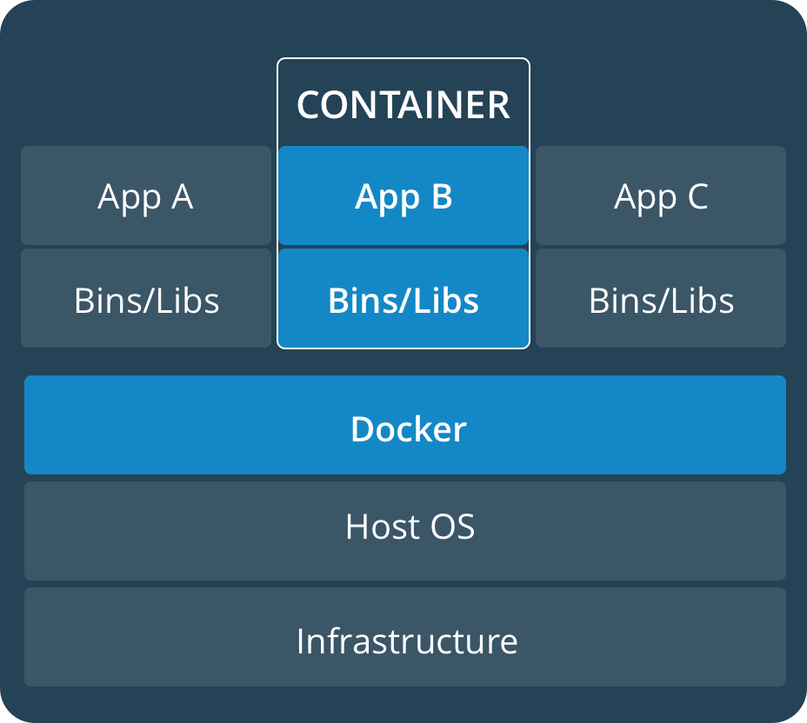
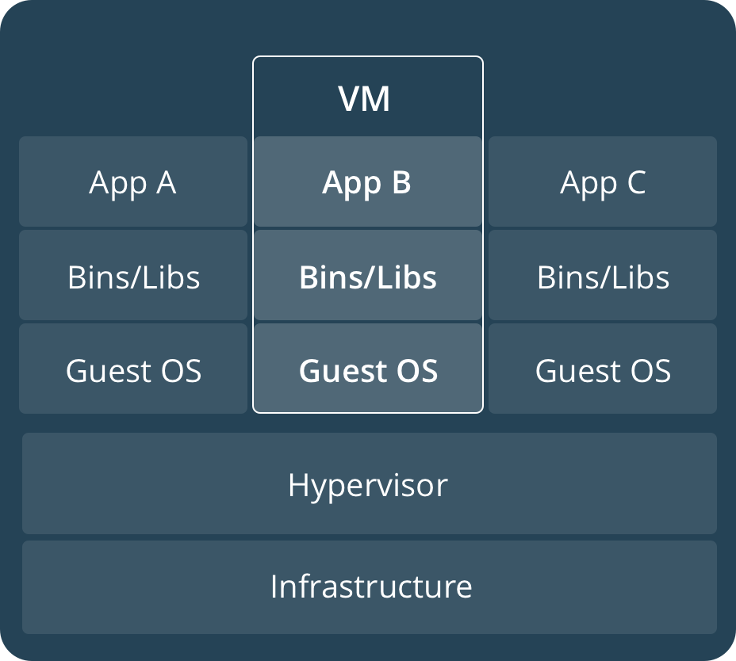
Container and Virtual Machines
A container runs natively on Linux and shares the kernel of the host machine with other containers. It runs a discrete process, taking no more memory than any other executable, making it lightweight.
A virtual machine (VM) runs a full-blown “guest” operating system with virtual access to host resources through a hypervisor. In general, VMs provide an environment with more resources than most applications need.

Slide 8
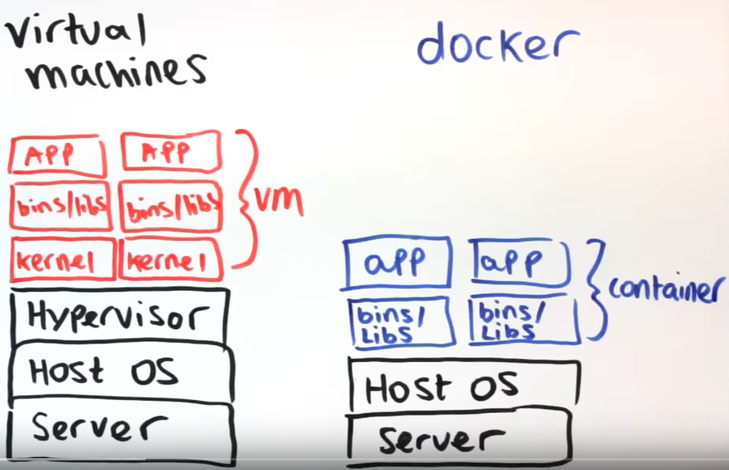
Containers and Virtual Machines

Slide 9
Containers
Containers:
What’s inside the container is of no concern to the delivery system
the uniform exterior of the container means distribution is easily standardized each step of the way.
the Dockerized App does not care
if it’s on a Kubernetes cluster
or a lone server
it will be able to run on any environment, anywhere, so long as the Docker platform is installed.

Slide 10
Images
Think of it this way: an image is like a powered-down computer.
Starting up a container is like creating a brand new exact copy of that computer, software and all, only one that is running.
The original computer (the image) remains on your desk, still powered down, while the new one (the container) hums away busily with its assigned tasks.
in other words, if an image is running, then it is a container.

Slide 11
Images and Container
To turn an image into a container, the Docker engine
takes the image,
adds a read-write filesystem on top
and initializes settings (container name, ID, network ports, etc.).
A running container has a currently executing process,
but a container can also be stopped (or, in Docker terminology, exited).
An exited container is not running, but that does not mean it has become an image: It can be restarted and will retain all settings and any filesystem changes.
Remember, though, that you can save any given container as an image.

Slide 12
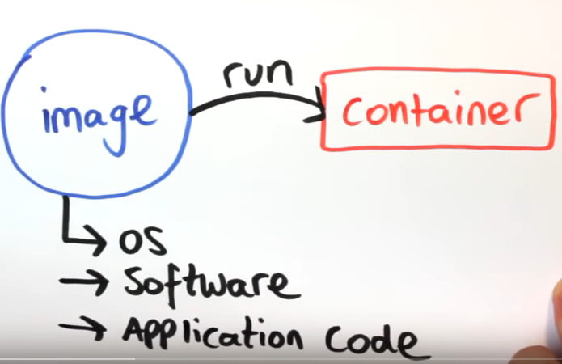
Images and Container

Slide 13
Container and Volumes
When starting up a Docker container you can specify directories as mount points for volumes,
directories are repositories for shared or persistent data that remain even if a container gets removed.
you don’t need to know anything about the host: you designate a volume, and Docker makes sure it’s saved somewhere on, and retrievable from, the host system.
When a container is exited, any volumes it was using persist — so if you start a second container it can use all the data from the previous one.

Slide 14
Dockerfiles
A Dockerfile is a simple text file that contains a list of commands the Docker client calls (on the command line) when assembling an image.
This essentially automates the image creation process because these special files are, basically, scripts that automatically perform actions on a chosen base image.
Dockerfiles are essentially the build instructions for a new project, written in executable code.
A Dockerfile is similar in concept to the recipes and manifests found in infrastructure automation (IA) tools like Chef.
A Dockerfile installs the operating system, all relevant components, and then makes sure all necessary dependencies are in place.

Slide 15
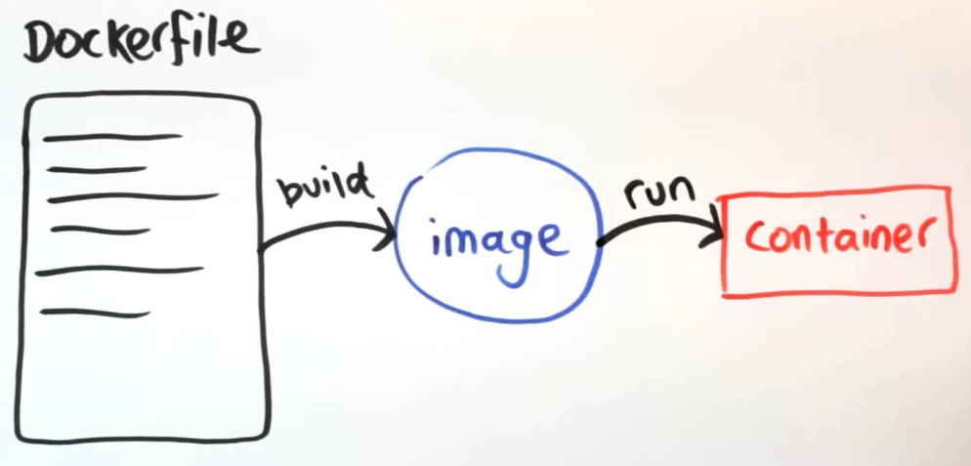
Dockerfiles

Slide 16
Docker in 12 Minutes
https://www.youtube.com/watch?v=YFl2mCHdv24

Slide 17
Registry
The registry is the central distribution point for deploying Docker containers.
You can orchestrate distribution directly from your Docker host, or use an agent like Kubernetes or Docker Swarm to gain features such as automated deployment and scaling.
The registry works basically like a git repository, allowing you to push and pull container images.
For example, a project’s DevOps person would likely be in charge of creating the Dockerfile, building the relevant container image, and then pushing it to the registry.
Any other developer working on the project can now simply pull the latest version from the registry and use it.

Slide 18
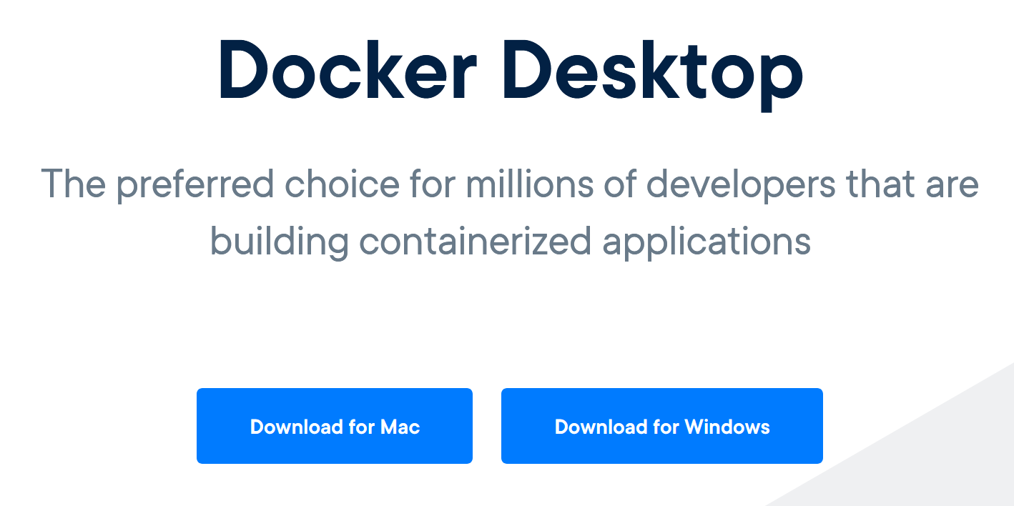
Install Docker
https://www.docker.com/products/docker-desktop

Slide 19
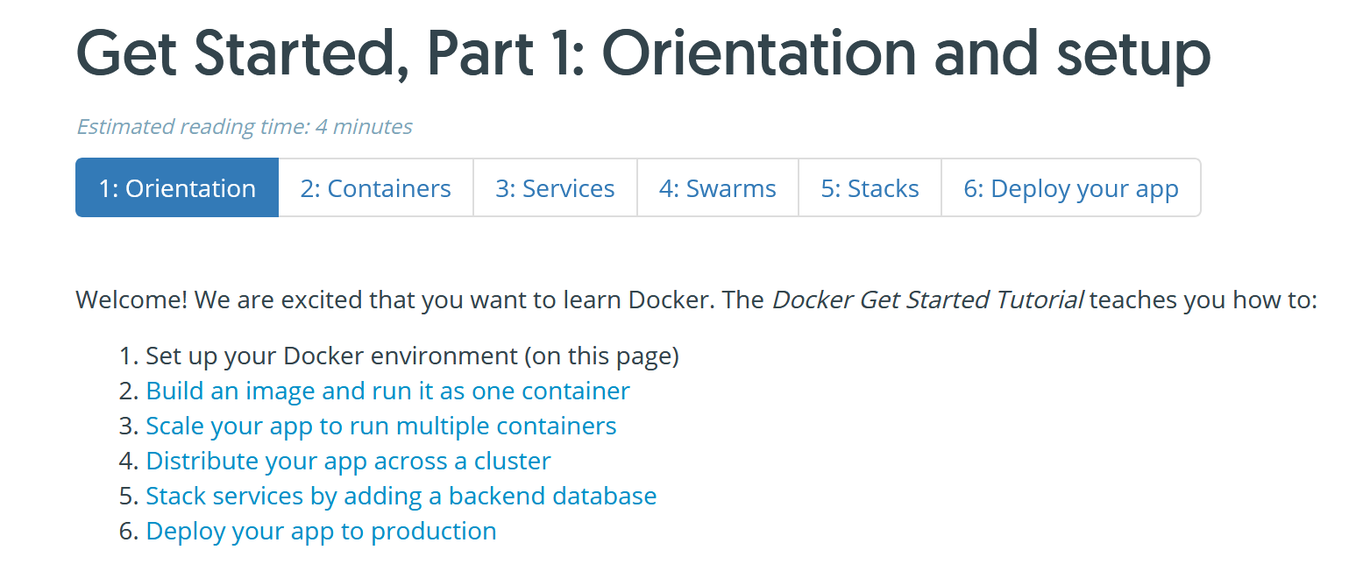
Look at the tutorials
https://docs.docker.com/get-started/

