Slide 1


In collaboration with:
➲
Feature-based defect prediction
using machine learning methods
Interim report
Winter semester 2019 / 2020
February 12th, 2020
Stefan Strüder
1

Slide 2
Summary
aim of the thesis
prediction technique for software defects
in consideration of software features
based on methods of machine learning
data basis: commits of versioning systems (Git)
commit: provision of an updated version of a software product
faulty and defect-free commits for learning of classifiers
three research objectives
1. creation of data set | 2. training of classifiers | 3. evaluation of classifiers
Stefan Strüder
Master thesis: feature-based defect prediction
2

Slide 3
1
Time scheduling
3

Slide 4
Time scheduling
applied machine learning
method
input data
…
input data
complete data set
normalization of data
optimized data set + calculation of metrics
DT
KNN
LR
NB
NN
RC
RF
SGD
SVM
training of classifiers
testing
evaluation
(Ceylan, Kutlubay, & Bener, 2006)
Stefan Strüder
Master thesis: feature-based defect prediction
4

Slide 5
Time scheduling
applied machine learning
method
input data
…
input data
complete data set
normalization of data
optimized data set + calculation of metrics
DT
KNN
LR
NB
NN
RC
RF
SGD
SVM
training of classifiers
testing
evaluation
(Ceylan, Kutlubay, & Bener, 2006)
Stefan Strüder
Master thesis: feature-based defect prediction
5

Slide 6
Time scheduling
Registration of thesis
01.11.2019
Stay in Gothenburg
Preparation
01.11.2019 – 21.11.2019
RO1
22.11.2019 – 11.12.2019
RO2
12.12.2019 – 09.01.2019
RO3
10.01.2020 – 23.02.2020
24.02.2020 – End
Follow-up
26.04.2020
Submission of thesis
11
12
01
02
03
04
05
01.11.2019
01.05.2020
Stefan Strüder
Master thesis: feature-based defect prediction
6

Slide 7
Time scheduling
Registration of thesis
01.11.2019
Stay in Gothenburg
Preparation
01.11.2019 – 21.11.2019
RO1
22.11.2019 – 31.12.2019
RO2
01.01.2020 – 31.01.2020
RO3
24.01.2020 – 29.02.2020
24.02.2020 – End
Follow-up
26.04.2020
Submission of thesis
11
12
01
02
03
04
05
01.11.2019
01.05.2020
Stefan Strüder
Master thesis: feature-based defect prediction
7

Slide 8
2
Creation of the data set
8

Slide 9
Creation of the data set
usage of PyDriller for repository mining
Python framework by (Spadini, Aniche, & Bacchelli, 2018)
available on GitHub under Apache License 2.0 licence
extraction of commits, developers, diffs and source code (and more)
well documented (https://pydriller.readthedocs.io)
1
2
3
4
5
6
7
8
for commit in RepositoryMining("link_to_repo").traverse_commits():
for m in commit.modifications:
print(
"Author {}".format(commit.author.name),
" modified {}".format(m.filename),
" with a change type of {}".format(m.change_type.name),
" and the complexity is {}".format(m.complexity)
)
Stefan Strüder
Master thesis: feature-based defect prediction
9

Slide 10
Creation of the data set
historical data of 13 software projects
feature-based software (based on preprocessor conditionals)
selection criterion: previous use in literature (Hunsen et al., 2016; Liebig et al., 2010; Queiroz et al., 2017)
extracted from Git, GitHub, GitLab und Sourceforge repositories
divided into commits per release
based on tag structure of git repositories
Blender | Busybox | Emacs | GIMP | Gnumeric | gnuplot | Irssi
libxml2 | lighttpd | MPSolve | Parrot | Vim | xfig
Stefan Strüder
Master thesis: feature-based defect prediction
10

Slide 11
Creation of the data set
data was stored in MySQL database
one table for each software project
Column | Description | Column | Description
change_type | type of change (added, deleted, modified, renamed) | filename | name of changed file
commit_author | responsible developer | lines_added | number of lines added to file
commit_hash | unique identifier of commit | lines_removed | number of lines removed from file
commit_msg | commit message | name | software name
cycomplexity | cyclomatic complexity of changed file | nloc | lines of code of file
diff | diff of changed file | release_number | associated release number based on tags
feature | features, that were modified | status | normal (false) or corrective (true) commit
Stefan Strüder
Master thesis: feature-based defect prediction
11

Slide 12
Creation of the data set
further steps: preparation + optimization of data set
extract modified features from diffs
identify bug-fixing commits
identify bug-introducing commits
remove "false" features manually
done via SQL queries and Python scripts
ERGÄNZEN!
bis 12.02
Stefan Strüder
Master thesis: feature-based defect prediction
12

Slide 13
Creation of the data set
 | Purpose | Data source | #Releases | #Commits | #Corrective | #Bugintrod. | #Features
Blender | 3D modelling tool | GitHub mirror | 11 | 19119 | 8258 | 1418 | 4637
Busybox | UNIX tool package | Git repository | 14 | 4984 | 1408 | 142 | 702
Emacs | text editor | GitHub mirror | 7 | 12805 | 6959 | 685 | 863
GIMP | photo editor | GitLab repository | 14 | 7240 | 1703 | 272 | 1620
Gnumeric | spreadsheet | GitLab repository | 8 | 6025 | 1591 | 136 | 725
gnuplot | plotter | GitHub mirror | 5 | 6619 | 880 | 1323 | 625
Irssi | IRC client | GitHub repository | 7 | 253 | 77 | 1 | 17
libxml2 | XML parser | GitLab repository | 10 | 732 | 409 | 37 | 225
lighttpd | webserver | Git repository | 6 | 2597 | 1202 | 555 | 323
MPSolve | polynomial solver | GitHub repository | 8 | 668 | 158 | 69 | 130
Parrot | VM | GitHub repository | 7 | 16245 | 3437 | 824 | 559
Vim | text editor | GitHub repository | 7 | 9849 | 1033 | 2571 | 1227
xfig | graphics editor | Sourceforge | 7 | 18 | 0 | 0 | 205
Stefan Strüder
Master thesis: feature-based defect prediction
13

Slide 14
Creation of the data set
calculation of metrics on feature- and file-level
5 metrics taken from (Queiroz et al., 2017, marked with [q])
6 additional metrics
calculated via SQL query or via Python script
Metric | Description
comm [q] | number of commits dedicated to the affected feature / file in a release
adev [q] | number of developers who have worked on the affected feature / file in a release
ddev [q] | cumulative number of developers who have worked on the affected feature / file in a release
exp [q] | geometric mean of the "experience" of all developers who have worked on the affected feature / file in a release
oexp [q] | "experience" of the developer who has contributed most to the affected feature / file in a release
Stefan Strüder
Master thesis: feature-based defect prediction
14

Slide 15
Creation of the data set
Metric | Description
modd | "modification degree": Number of edits to the affected feature / file within a release
mods | "modification scope": number of unique features / files edited in one release
nloc | average lines of code of the edits of the affected feature / file in a release
cyco | average cyclomatic complexity of modifications on the affected feature / file in a release
addl | average number of lines added to the affected feature / file in a release
reml | average number of lines deleted from the affected feature / file in a release
Stefan Strüder
Master thesis: feature-based defect prediction
15

Slide 16
3
Training of the classifiers
16

Slide 17
Training of the classifiers
integration of scikit-learn and WEKA
scikit-learn (https://scikit-learn.org/)
best known Python library for machine learning
selection of various classification algorithms
comprehensive integration of further Python libraries
WEKA (https://www.cs.waikato.ac.nz/ml/weka/)
developed at the University of Waikato (New Zealand)
comprehensive selection of classification- and attribute-selection-algorithms
graphical interface
Stefan Strüder
Master thesis: feature-based defect prediction
17
Notes:
erklären was der Anlass war zwei verschiedene Frameworks zu nutzen

Slide 18
Training of the classifiers
scikit-learn | WEKA
Decision Trees | J48
k-Nearest-Neighbor | k-Nearest-Neighbor
Ridge Classifier | Logistic Regression
Naïve Bayes | Naïve Bayes
Neural Networks | Neural Networks
Random Forest | Random Forest
Stochastic Gradient Descent | Stochastic Gradient Descent
Support Vector Machines | Support Vector Machines
J48 is a DT-algorithm
both based on regression
each classifier has been configured before final training
Stefan Strüder
Master thesis: feature-based defect prediction
18

Slide 19
Training of the classifiers
file dataset is imbalanced
label "clean" is strongly overrepresented
balance is a prerequisite for correct training of classifiers
unbalanced data results in misleading accuracy
application of the SMOTE method
Synthetic Minority Over-sampling Technique (Chawla, Bowyer, Hall, & Kegelmeyer, 2002)
oversampling of the underrepresented class
integrated "filter" in WEKA
Stefan Strüder
Master thesis: feature-based defect prediction
20
Notes:
weil die meisten Datensätze korrekt der überrepräsentierten Klasse zugeordnet werden

Slide 20
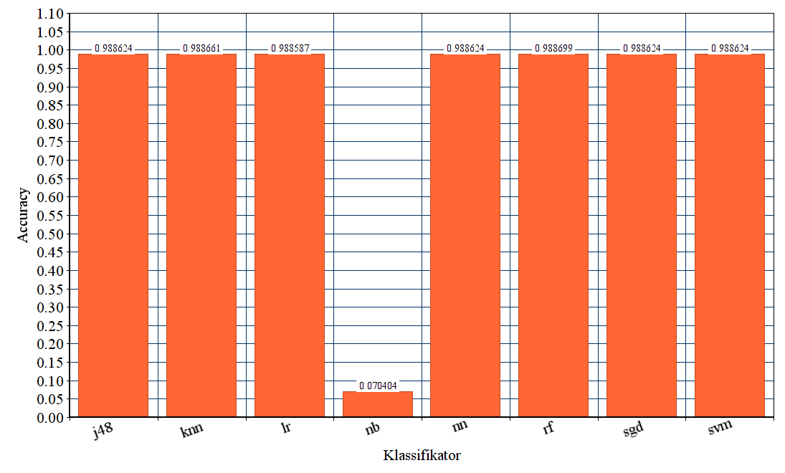
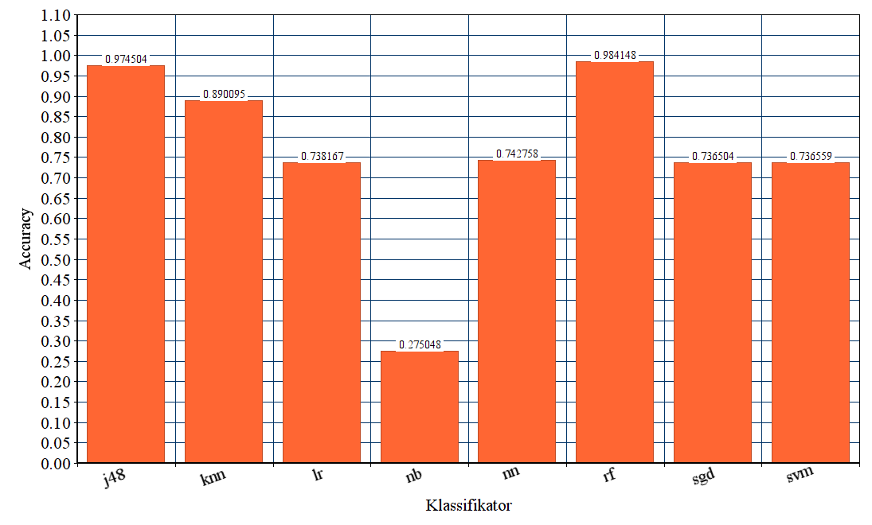
Comparison of classifiers before and after applying the SMOTE method
before
after
Classifier
Classifier
Abb. | Classifier | Abb. | Classifier
j48 | Decision Trees | nn | Neural Networks
knn | k-Nearest-Neighbor | rf | Random Forest
lr | Logistic Regression | sgd | Stochastic Gradient Descent
nb | Naïve Bayes | svm | Support Vector Machines
21

Slide 21
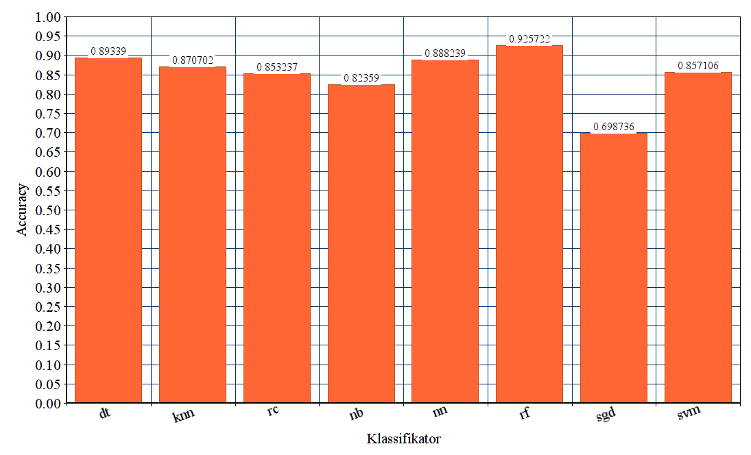
Final analysis of the feat-classifiers of scikit-learn
Abb. | Classifier
dt | Decision Trees
knn | k-Nearest-Neighbor
rc | Ridge Classifier
nb | Naïve Bayes
nn | Neural Networks
rf | Random Forest
sgd | Stochastic Gradient Descent
svm | Support Vector Machines
Classifier
22

Slide 22
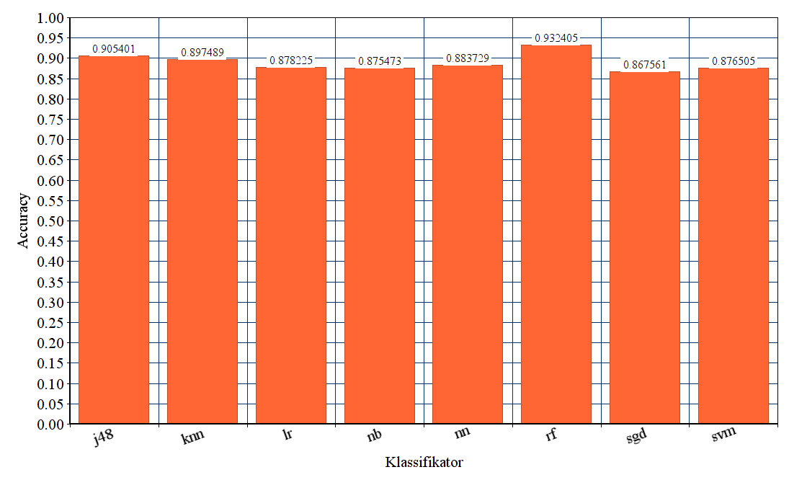
Final analysis of the feat-classifiers of WEKA
Abb. | Classifier
j48 | Decision Trees
knn | k-Nearest-Neighbor
lr | Logistic Regression
nb | Naïve Bayes
nn | Neural Networks
rf | Random Forest
sgd | Stochastic Gradient Descent
svm | Support Vector Machines
Classifier
23

Slide 23
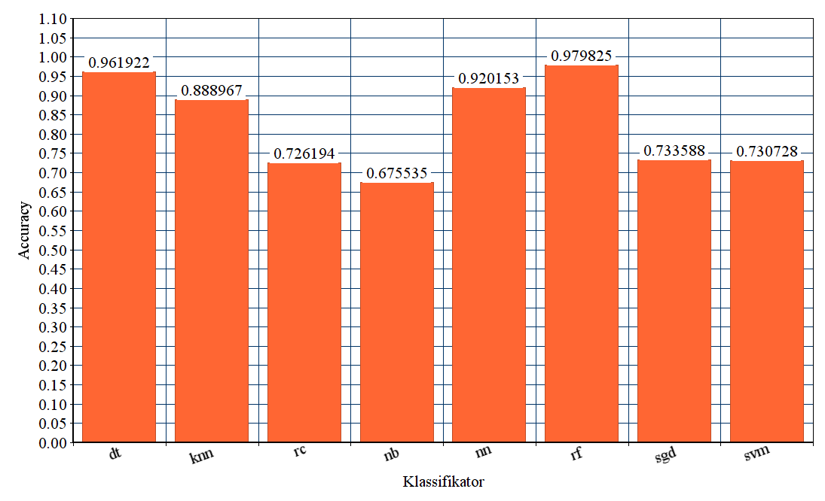
Final analysis of the file-classifiers of scikit-learn
Abb. | Classifier
dt | Decision Trees
knn | k-Nearest-Neighbor
rc | Ridge Classifier
nb | Naïve Bayes
nn | Neural Networks
rf | Random Forest
sgd | Stochastic Gradient Descent
svm | Support Vector Machines
Classifier
24

Slide 24
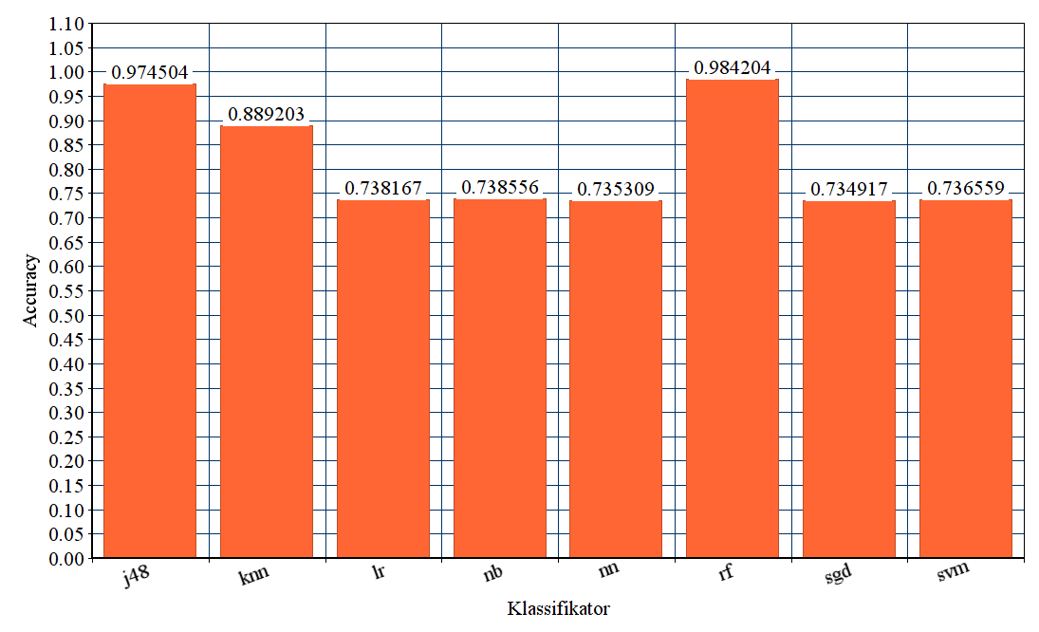
Final analysis of the file-classifiers of WEKA
Abb. | Classifier
j48 | Decision Trees
knn | k-Nearest-Neighbor
lr | Logistic Regression
nb | Naïve Bayes
nn | Neural Networks
rf | Random Forest
sgd | Stochastic Gradient Descent
svm | Support Vector Machines
Classifier
25

Slide 25
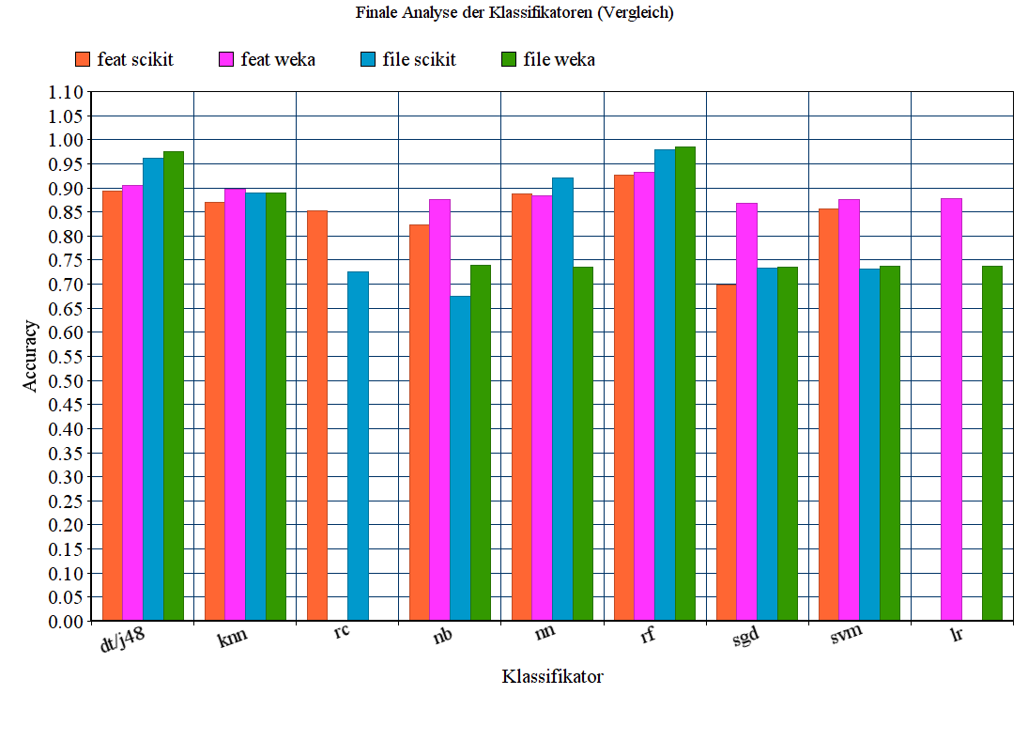
Comparison of the classifiers
Abb. | Classifier
dt | Decision Tree
j48 | Decision Tree
knn | k-Nearest-Neighbor
rc | Ridge Classifier
nb | Naïve Bayes
nn | Neural Networks
rf | Random Forest
sgd | Stochastic Gradient Descent
svm | Support Vector Machines
lr | Logistic Regression
Classifier
26

Slide 26
4
Outlook
27

Slide 27
Outlook
exclusion of "header-features"
features to be found in .h-files are not meant to be edited
identifiable by featurename_h_
redo training and evaluation steps
evaluation of classifiers
evaluation based on classical metrics found in literature
continue written part of thesis
ERGÄNZEN!
bis 12.02
Stefan Strüder
Master thesis: feature-based defect prediction
28

Slide 28
Outlook
applied machine learning
method
input data
…
input data
complete data set
normalization of data
optimized data set + calculation of metrics
ERGÄNZEN!
bis 12.02
DT
KNN
LR
NB
NN
RC
RF
SGD
SVM
training of classifiers
testing
evaluation
(Ceylan, Kutlubay, & Bener, 2006)
Stefan Strüder
Master thesis: feature-based defect prediction
29

Slide 29
Outlook
 | Purpose | Data source | #Releases | #Commits | #Corrective | #Bugintrod. | #Features
Blender | 3D modelling tool | GitHub mirror | 11 | 19119 | 8258 | 1418 | 4637 | 3394
Busybox | UNIX tool package | Git repository | 14 | 4984 | 1408 | 142 | 702 | 628
Emacs | text editor | GitHub mirror | 7 | 12805 | 6959 | 685 | 863 | 718
GIMP | photo editor | GitLab repository | 14 | 7240 | 1703 | 272 | 1620 | 204
Gnumeric | spreadsheet | GitLab repository | 8 | 6025 | 1591 | 136 | 725 | 637
gnuplot | plotter | GitHub mirror | 5 | 6619 | 880 | 1323 | 625 | 558
Irssi | IRC client | GitHub repository | 7 | 253 | 77 | 1 | 17 | 9
libxml2 | XML parser | GitLab repository | 10 | 732 | 409 | 37 | 225 | 200
lighttpd | webserver | Git repository | 6 | 2597 | 1202 | 555 | 323 | 230
MPSolve | polynomial solver | GitHub repository | 8 | 668 | 158 | 69 | 130 | 54
Parrot | VM | GitHub repository | 7 | 16245 | 3437 | 824 | 559 | 397
Vim | text editor | GitHub repository | 7 | 9849 | 1033 | 2571 | 1227 | 1158
xfig | graphics editor | Sourceforge | 7 | 18 | 0 | 0 | 205 | 137
Stefan Strüder
Master thesis: feature-based defect prediction
30

Slide 30
Thank you for your attention.
Question time.
31

Slide 31
Bibliography
Ceylan, E., Kutlubay, F. O., & Bener, A. B. (2006). Software defect identification using machine learning techniques. Proceedings - 32nd Euromicro Conference on Software Engineering and Advanced Applications, SEAA, 240–246. https://doi.org/10.1109/EUROMICRO.2006.56
Chawla, N. V., Bowyer, K. W., Hall, L. O., & Kegelmeyer, W. P. (2002). SMOTE: Synthetic Minority Over-sampling Technique. Journal of Artificial Intelligence Research, 16, 321–357. https://doi.org/10.1613/jair.953
Hunsen, C., Zhang, B., Siegmund, J., Kästner, C., Leßenich, O., Becker, M., & Apel, S. (2016). Preprocessor-based variability in open-source and industrial software systems: An empirical study. In Empirical Software Engineering (Vol. 21). https://doi.org/10.1007/s10664-015-9360-1
Liebig, J., Apel, S., Lengauer, C., Kästner, C., & Schulze, M. (2010). An analysis of the variability in forty preprocessor-based software product lines. Proceedings - International Conference on Software Engineering, 1, 105–114. https://doi.org/10.1145/1806799.1806819
Queiroz, R., Passos, L., Valente, M. T., Hunsen, C., Apel, S., & Czarnecki, K. (2017). The shape of feature code: an analysis of twenty C-preprocessor-based systems. Software and Systems Modeling, 16(1), 77–96. https://doi.org/10.1007/s10270-015-0483-z
Spadini, D., Aniche, M., & Bacchelli, A. (2018). PyDriller: Python framework for mining software repositories. Proceedings of the 2018 26th ACM Joint Meeting on European Software Engineering Conference and Symposium on the Foundations of Software Engineering - ESEC/FSE 2018, 908–911. https://doi.org/10.1145/3236024.3264598
Stefan Strüder
Master thesis: feature-based defect prediction
32

