Slide 1


In collaboration with:
➲
Feature-based defect prediction
using machine learning methods
Interim report
Winter semester 2019 / 2020
February 12th, 2020
Stefan Strüder
1

Slide 2
Summary
aim of the thesis
prediction technique for software defects
in consideration of software features
based on methods of machine learning
data basis: commits of versioning systems (Git)
faulty and defect-free commits for training of classifiers
three research objectives
1. creation of data set | 2. training of classifiers | 3. evaluation of classifiers
Stefan Strüder
Master thesis: feature-based defect prediction
2

Slide 3
1
Time scheduling
3

Slide 4
Time scheduling
applied machine learning
method
input data
…
input data
complete data set
normalization of data
optimized data set + calculation of metrics
DT
KNN
LR
NB
NN
RC
RF
SGD
SVM
training of classifiers
testing
evaluation
(Ceylan, Kutlubay, & Bener, 2006)
Stefan Strüder
Master thesis: feature-based defect prediction
4

Slide 5
Time scheduling
applied machine learning
method
input data
…
input data
complete data set
normalization of data
optimized data set + calculation of metrics
DT
KNN
LR
NB
NN
RC
RF
SGD
SVM
training of classifiers
testing
evaluation
(Ceylan, Kutlubay, & Bener, 2006)
Stefan Strüder
Master thesis: feature-based defect prediction
5

Slide 6
Time scheduling
Registration of thesis
01.11.2019
Stay in Gothenburg
with break over the holidays
Preparation
01.11.2019 – 21.11.2019
RO1
22.11.2019 – 11.12.2019
RO2
12.12.2019 – 09.01.2019
RO3
10.01.2020 – 23.02.2020
24.02.2020 – End
Follow-up
written part
27.04.2020
Submission of thesis
11
12
01
02
03
04
05
01.11.2019
01.05.2020
Stefan Strüder
Master thesis: feature-based defect prediction
6

Slide 7
Time scheduling
Registration of thesis
01.11.2019
Stay in Gothenburg
with break over the holidays
Preparation
01.11.2019 – 21.11.2019
RO1
22.11.2019 – 31.12.2019
RO2
01.01.2020 – 31.01.2020
RO3
24.01.2020 – 29.02.2020
24.02.2020 – End
Follow-up
written part
27.04.2020
Submission of thesis
11
12
01
02
03
04
05
01.11.2019
01.05.2020
Stefan Strüder
Master thesis: feature-based defect prediction
7

Slide 8
2
Creation of the data set
8

Slide 9
Creation of the data set
usage of PyDriller for repository mining
Python framework by (Spadini, Aniche, & Bacchelli, 2018)
available on GitHub under Apache License 2.0 licence
extraction of commits, developers, diffs and source code (and more)
well documented (https://pydriller.readthedocs.io)
1
2
3
4
5
6
7
8
for commit in RepositoryMining("link_to_repo").traverse_commits():
for m in commit.modifications:
print(
"Author {}".format(commit.author.name),
" modified {}".format(m.filename),
" with a change type of {}".format(m.change_type.name),
" and the complexity is {}".format(m.complexity)
)
Stefan Strüder
Master thesis: feature-based defect prediction
9

Slide 10
Creation of the data set
historical data of 13 software projects
feature-based software (based on preprocessor conditionals)
selection criterion: previous use in literature (Hunsen et al., 2016; Liebig et al., 2010; Queiroz et al., 2017)
extracted from Git, GitHub, GitLab and Sourceforge repositories
divided into commits per release
based on tag structure of Git repositories
Blender 3D modelling tool | Busybox UNIX tool package | Emacs text editor | GIMP photo editor | Gnumeric spreadsheet | gnuplot plotter | Irssi IRC client
libxml2 XML parser | lighttpd webserver | MPSolve polynomial solver | Parrot VM | Vim text editor | xfig graphics editor
Stefan Strüder
Master thesis: feature-based defect prediction
10

Slide 11
Creation of the data set
data was stored in MySQL database
one table for each software project
Column | Description | Column | Description
change_type | type of change (added, deleted, modified, renamed) | filename | name of changed file
commit_author | responsible developer | lines_added | number of lines added to file
commit_hash | unique identifier of commit | lines_removed | number of lines removed from file
commit_msg | commit message | name | software name
cycomplexity | cyclomatic complexity of changed file | nloc | lines of code of file
diff | diff of changed file | release_number | associated release number based on tags
feature | features, that were modified | status | normal (false) or corrective (true) commit
Stefan Strüder
Master thesis: feature-based defect prediction
11

Slide 12
Creation of the data set
further processing of data
extract modified features from diffs
usage of regular expressions to detect #IFDEF and #IFNDEF
identify bug-fixing commits
does commit-message contain "bug", "error", "fail" or "fix"?
identify bug-introducing commits
application of the SZZ-algorithm (Śliwerski, Zimmermann, & Zeller, 2005)
remove "false" features manually
e.g. from #IFDEFs found in comments
Stefan Strüder
Master thesis: feature-based defect prediction
12

Slide 13
Creation of the data set
further processing of data
exclusion of "header-features"
in certain C-patterns: header files included with #IFDEFs like features
identifiable by featurename_h_
previously considered falsely as features
metrics calculation and classifier training had to be redone
all done via SQL queries and / or Python scripts
Stefan Strüder
Master thesis: feature-based defect prediction
13

Slide 14
Creation of the data set
 | Purpose | Data source | #Releases | #Commits | #Corrective | #Bugintrod. | #Features
Blender | 3D modelling tool | GitHub mirror | 11 | 19119 | 8258 | 1418 | 3394
Busybox | UNIX tool package | Git repository | 14 | 4984 | 1408 | 142 | 628
Emacs | text editor | GitHub mirror | 7 | 12805 | 6959 | 685 | 718
GIMP | photo editor | GitLab repository | 14 | 7240 | 1703 | 272 | 204
Gnumeric | spreadsheet | GitLab repository | 8 | 6025 | 1591 | 136 | 637
gnuplot | plotter | GitHub mirror | 5 | 6619 | 880 | 1323 | 558
Irssi | IRC client | GitHub repository | 7 | 253 | 77 | 1 | 9
libxml2 | XML parser | GitLab repository | 10 | 732 | 409 | 37 | 200
lighttpd | webserver | Git repository | 6 | 2597 | 1202 | 555 | 230
MPSolve | polynomial solver | GitHub repository | 8 | 668 | 158 | 69 | 54
Parrot | VM | GitHub repository | 7 | 16245 | 3437 | 824 | 397
Vim | text editor | GitHub repository | 7 | 9849 | 1033 | 2571 | 1158
xfig | graphics editor | Sourceforge | 7 | 18 | 0 | 0 | 137
Stefan Strüder
Master thesis: feature-based defect prediction
14

Slide 15
Creation of the data set
calculation of metrics on feature- and file-level
5 metrics taken from (Queiroz et al., 2017, marked with [q])
6 additional metrics
calculated via SQL queries and / or via Python scripts
Metric | Description
comm [q] | number of commits dedicated to the affected feature / file in a release
adev [q] | number of developers who have worked on the affected feature / file in a release
ddev [q] | cumulative number of developers who have worked on the affected feature / file in a release
exp [q] | geometric mean of the "experience*" of all developers who have worked on the affected feature / file in a release
oexp [q] | "experience*" of the developer who has contributed most to the affected feature / file in a release
* number of added, modified and removed files
Stefan Strüder
Master thesis: feature-based defect prediction
15

Slide 16
Creation of the data set
Metric | Description
modd | "modification degree": number of edits to the affected feature / file within a release
mods | "modification scope": number of unique features / files edited in one release
nloc | average lines of code of the edits of the affected feature / file in a release
cyco | average cyclomatic complexity of modifications on the affected feature / file in a release
addl | average number of lines added to the affected feature / file in a release
reml | average number of lines deleted from the affected feature / file in a release
Stefan Strüder
Master thesis: feature-based defect prediction
16

Slide 17
3
Training of the classifiers
17

Slide 18
Training of the classifiers
usage of scikit-learn and WEKA
scikit-learn (https://scikit-learn.org/)
best known Python library for machine learning
selection of various classification algorithms
comprehensive integration of further Python libraries
WEKA (https://www.cs.waikato.ac.nz/ml/weka/)
developed at the University of Waikato (New Zealand)
comprehensive selection of classification- and attribute-selection-algorithms
graphical interface
two tools to compare the results of the respective implementations of the algorithms
Stefan Strüder
Master thesis: feature-based defect prediction
18

Slide 19
Training of the classifiers
scikit-learn | WEKA
Decision Trees | J48
k-Nearest-Neighbor | k-Nearest-Neighbor
Ridge Classifier | Logistic Regression
Naïve Bayes | Naïve Bayes
Neural Networks | Neural Networks
Random Forest | Random Forest
Stochastic Gradient Descent | Stochastic Gradient Descent
Support Vector Machines | Support Vector Machines
J48 is a DT-algorithm
both based on regression
each classifier has been configured before final training
Stefan Strüder
Master thesis: feature-based defect prediction
19

Slide 20
Training of the classifiers
file dataset is imbalanced
label "clean" is strongly overrepresented
balance is a prerequisite for correct training of classifiers
unbalanced data results in misleading accuracy
most data records are correctly assigned to the overrepresented class
application of the SMOTE method
Synthetic Minority Over-sampling Technique (Chawla, Bowyer, Hall, & Kegelmeyer, 2002)
oversampling of the underrepresented class
integrated "filter" in WEKA
Stefan Strüder
Master thesis: feature-based defect prediction
20

Slide 21
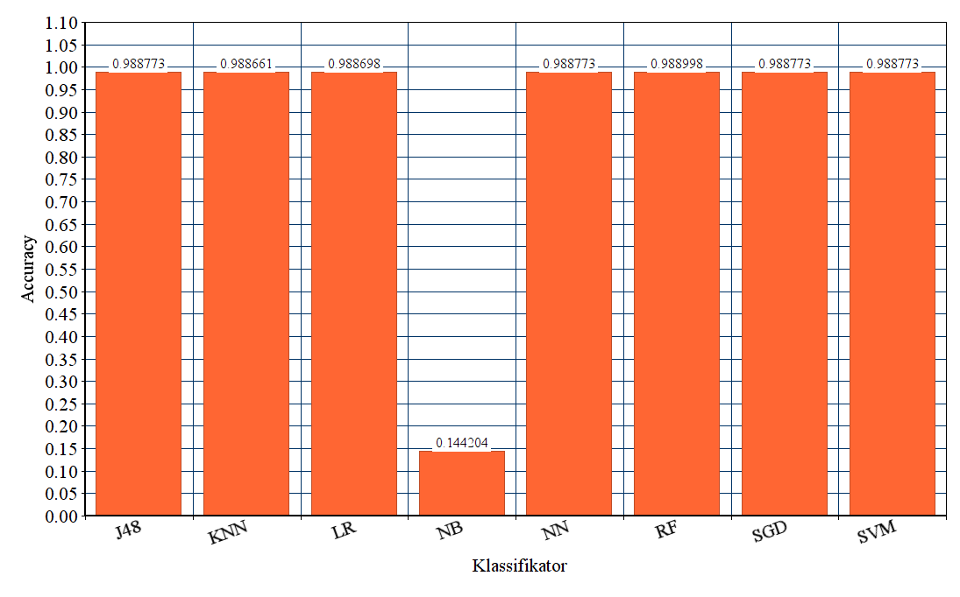
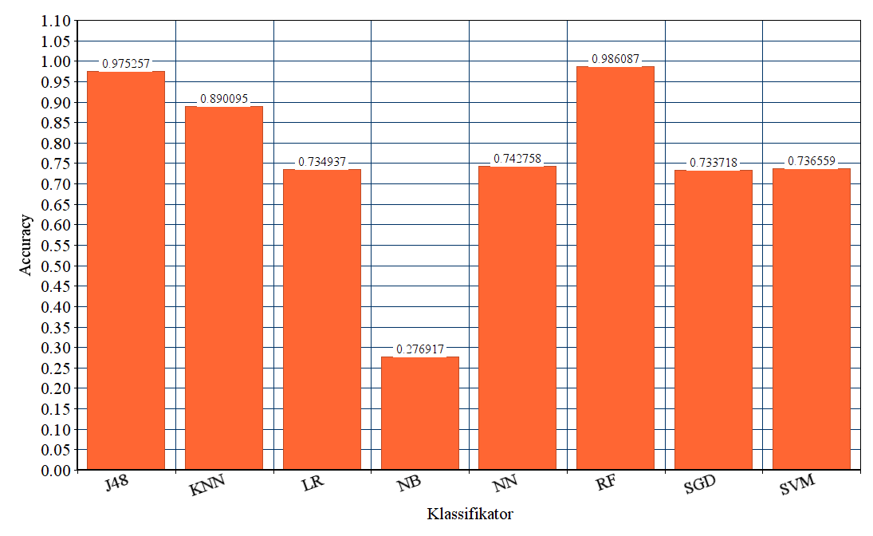
Comparison of WEKA-classifiers before and after applying the SMOTE method
before
after
Classifier
Classifier
Abb. | Classifier | Abb. | Classifier
J48 | Decision Trees | NN | Neural Networks
KNN | k-Nearest-Neighbor | RF | Random Forest
LR | Logistic Regression | SGD | Stochastic Gradient Descent
NB | Naïve Bayes | SVM | Support Vector Machines
21

Slide 22
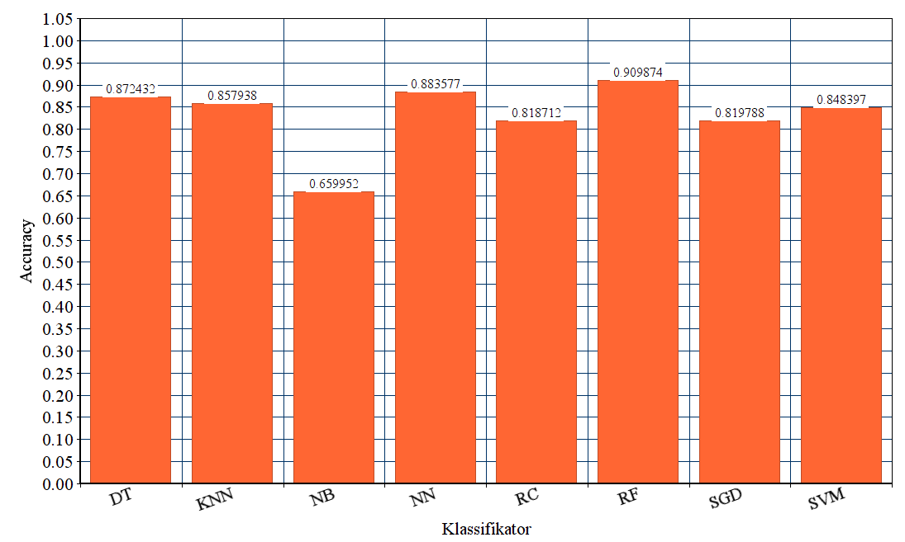
Final analysis of the feat-classifiers of scikit-learn
Abb. | Classifier
DT | Decision Trees
KNN | k-Nearest-Neighbor
RC | Ridge Classifier
NB | Naïve Bayes
NN | Neural Networks
RF | Random Forest
SGD | Stochastic Gradient Descent
SVM | Support Vector Machines
Classifier
22

Slide 23
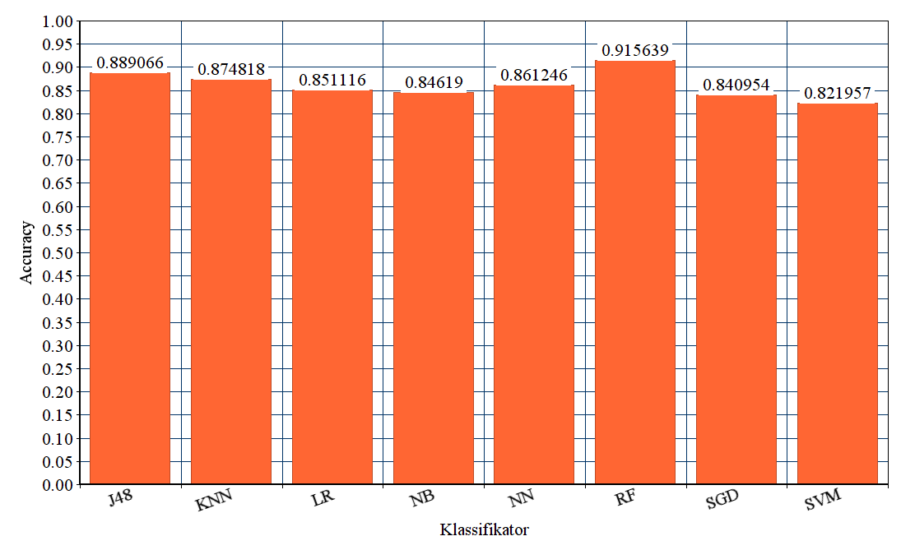
Final analysis of the feat-classifiers of WEKA
Abb. | Classifier
J48 | Decision Trees
KNN | k-Nearest-Neighbor
LR | Logistic Regression
NB | Naïve Bayes
NN | Neural Networks
RF | Random Forest
SGD | Stochastic Gradient Descent
SVM | Support Vector Machines
Classifier
23

Slide 24
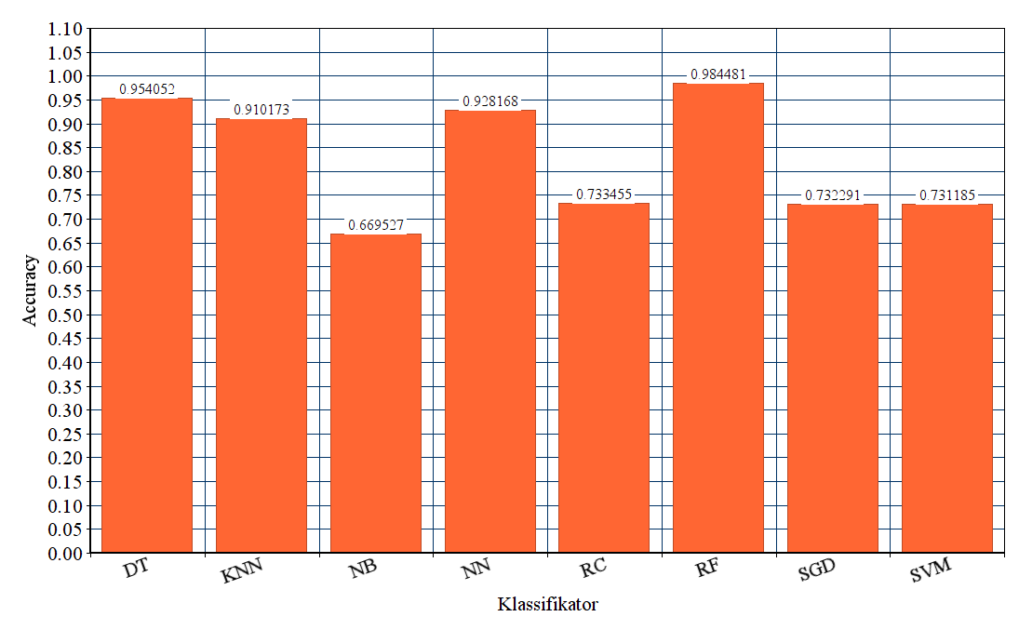
Final analysis of the file-classifiers of scikit-learn
Abb. | Classifier
DT | Decision Trees
KNN | k-Nearest-Neighbor
RC | Ridge Classifier
NB | Naïve Bayes
NN | Neural Networks
RF | Random Forest
SGD | Stochastic Gradient Descent
SVM | Support Vector Machines
Classifier
24

Slide 25
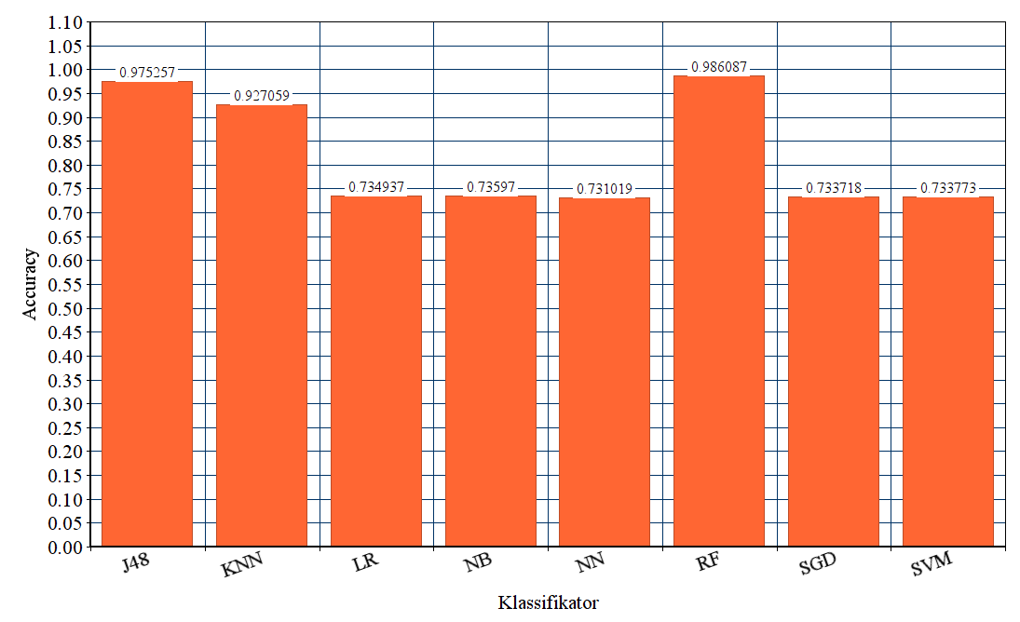
Final analysis of the file-classifiers of WEKA
Abb. | Classifier
J48 | Decision Trees
KNN | k-Nearest-Neighbor
LR | Logistic Regression
NB | Naïve Bayes
NN | Neural Networks
RF | Random Forest
SGD | Stochastic Gradient Descent
SVM | Support Vector Machines
Classifier
25

Slide 26
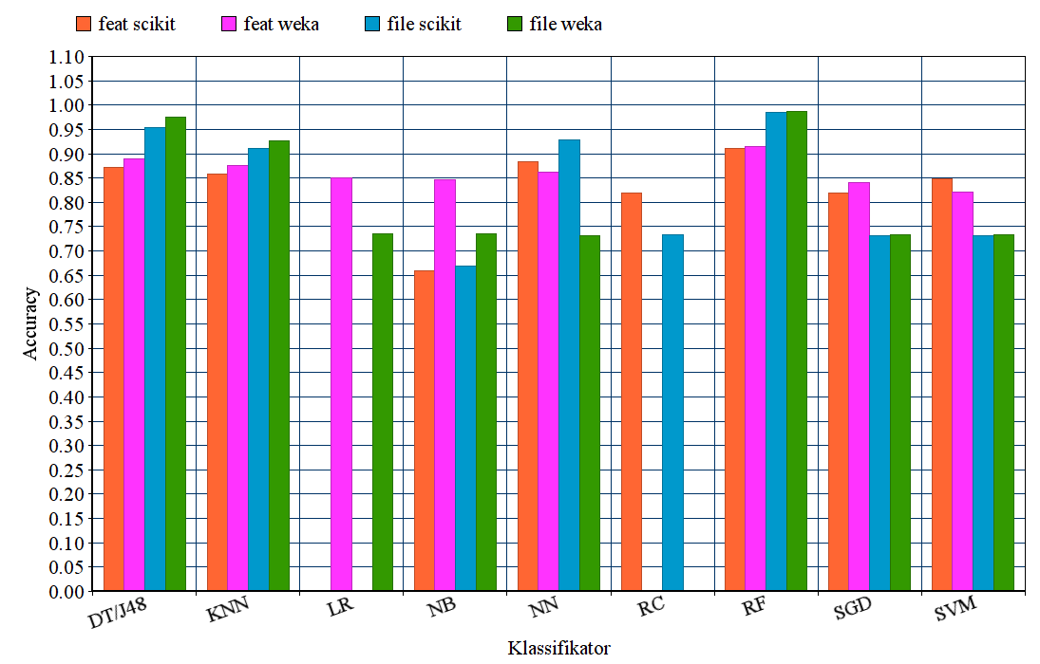
Comparison of the classifiers
Abb. | Classifier
DT | Decision Tree
J48 | Decision Tree
KNN | k-Nearest-Neighbor
LR | Logistic Regression
NB | Naïve Bayes
NN | Neural Networks
RC | Ridge Classifier
RF | Random Forest
SGD | Stochastic Gradient Descent
SVM | Support Vector Machines
Classifier
26

Slide 27
4
Outlook
27

Slide 28
Outlook
evaluation of classifiers
research of suitable evaluation metrics
calculate evaluation metrics
evaluation and comparision based on classical metrics found in literature
continue written part of thesis
Stefan Strüder
Master thesis: feature-based defect prediction
28

Slide 29
Thank you for your attention.
Question time.
29

Slide 30
Bibliography
Ceylan, E., Kutlubay, F. O., & Bener, A. B. (2006). Software defect identification using machine learning techniques. Proceedings - 32nd Euromicro Conference on Software Engineering and Advanced Applications, SEAA, 240–246. https://doi.org/10.1109/EUROMICRO.2006.56
Chawla, N. V., Bowyer, K. W., Hall, L. O., & Kegelmeyer, W. P. (2002). SMOTE: Synthetic Minority Over-sampling Technique. Journal of Artificial Intelligence Research, 16, 321–357. https://doi.org/10.1613/jair.953
Hunsen, C., Zhang, B., Siegmund, J., Kästner, C., Leßenich, O., Becker, M., & Apel, S. (2016). Preprocessor-based variability in open-source and industrial software systems: An empirical study. In Empirical Software Engineering (Vol. 21). https://doi.org/10.1007/s10664-015-9360-1
Liebig, J., Apel, S., Lengauer, C., Kästner, C., & Schulze, M. (2010). An analysis of the variability in forty preprocessor-based software product lines. Proceedings - International Conference on Software Engineering, 1, 105–114. https://doi.org/10.1145/1806799.1806819
Queiroz, R., Passos, L., Valente, M. T., Hunsen, C., Apel, S., & Czarnecki, K. (2017). The shape of feature code: an analysis of twenty C-preprocessor-based systems. Software and Systems Modeling, 16(1), 77–96. https://doi.org/10.1007/s10270-015-0483-z
Śliwerski, J., Zimmermann, T., & Zeller, A. (2005). When do changes induce fixes? Proceedings of the 2005 International Workshop on Mining Software Repositories, MSR 2005, 1–5. https://doi.org/10.1145/1082983.1083147
Spadini, D., Aniche, M., & Bacchelli, A. (2018). PyDriller: Python framework for mining software repositories. Proceedings of the 2018 26th ACM Joint Meeting on European Software Engineering Conference and Symposium on the Foundations of Software Engineering - ESEC/FSE 2018, 908–911. https://doi.org/10.1145/3236024.3264598
Stefan Strüder
Master thesis: feature-based defect prediction
30

