Slide 1
Cahit - Spiral chains
Personal notes
(Mario Stefanutti)
Started: 30/Gen/2012

Slide 2
What I’ve planned to do
Done
  Get hands-on confidence with the problem of finding chains
What I’m doing now
  Study Cahit’s algorithm to find spirals chains for regular maps (rectangular or circular)

Slide 3
Initial notes
I am working only with simplified maps, with all F having more than 4 edges (>= F5)

Slide 4
New requirements/fix for the Java program
TODO
  Study a way to run a deep analisys on a specific map to get all different four coloring of a map
  Export a graph using standard file formats (to find)
  Integrate a library such a JUNG or JGraphT
  Add the algorithm to compute spiral chains
DONE
  When saving multiple maps, reopen the “save window” on the last used location (will be available from version 1.8)
  Save the string that represents a map (“1b+, 2b+, 2e+, 1e+”) whitin the png metadata, to recreate the map from a saved image (will be available from version 1.8)
  The functionality to preset and force the color of some faces becomes more urgent. I need it to find all different four colorings of a selected map (from version 1.7 of the Java program)
    When the color of a face has been pinned, the coloring algorithm can be speeded up

Slide 5
SECTION 1
Get hands-on confidence with the problem.

Slide 6
Notes about chains
Starting from a four colored map, which chains (not necessarily “spiral chains”) can be identified?
Are two chains always sufficient?
  For some colored maps (see maps with the label “not found” in the title) two chains seems not to be enough!
    Before to dismiss this question, I need to verify with a different four coloring of the same map. The different coloring may permit the use of only two chains
    Addition (24/Feb/2012): For the cases I analyzed (CASE-A), with a different coloring, 2 chains always exist
Are two of the ends of the chains always neighbors?

Slide 7
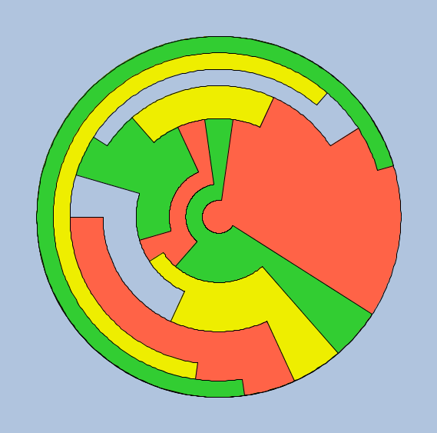
12 faces all F5

Slide 8
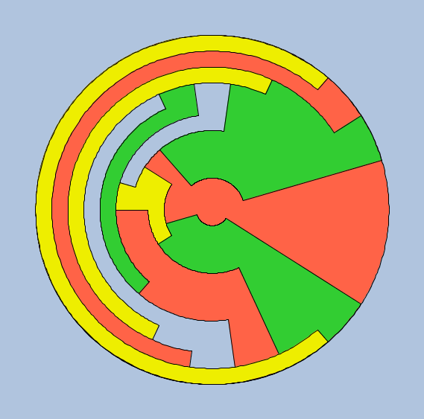
12 faces all F5

Slide 9
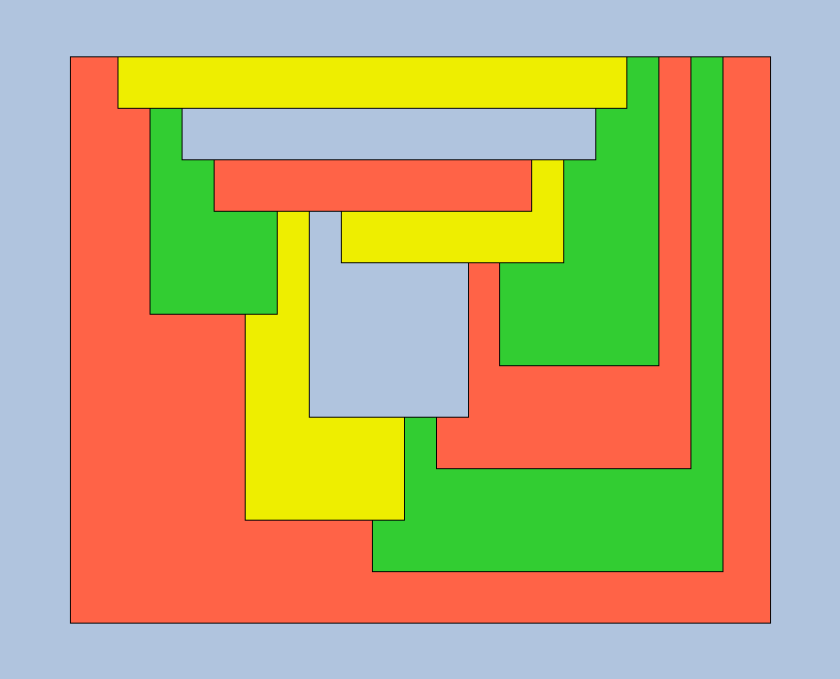
12 faces all F5
1b+, 11b+, 7b-, 10b-, 9b-, 3b-, 7e-, 5b-, 8b-, 2b-, 3e-, 4b-, 5e-, 6b-, 9e-, 8e-, 10e-, 11e+, 6e+, 4e+, 2e+, 1e+

Slide 10
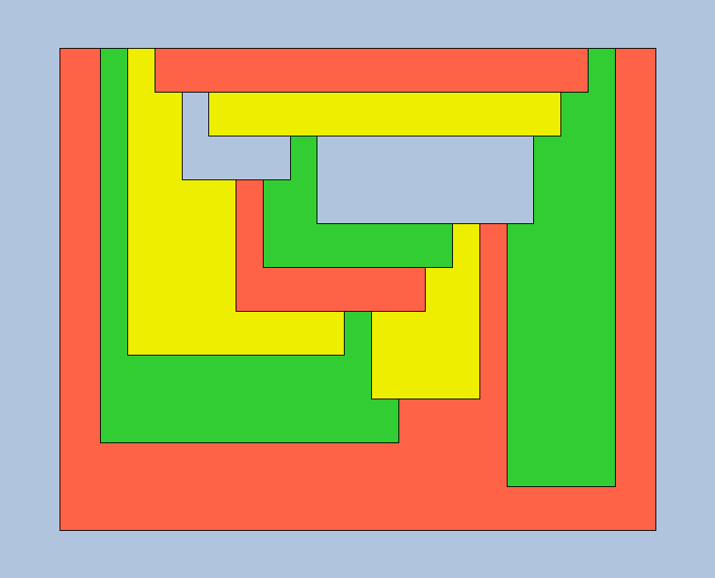
12 faces all F5
1b+, 3b+, 5b+, 11b+, 9b-, 10b-, 6b-, 7b-, 9e-, 8b-, 5e-, 4b-, 3e-, 6e-, 7e-, 4e-, 2b-, 8e-, 10e-, 11e+, 2e+, 1e+

Slide 11
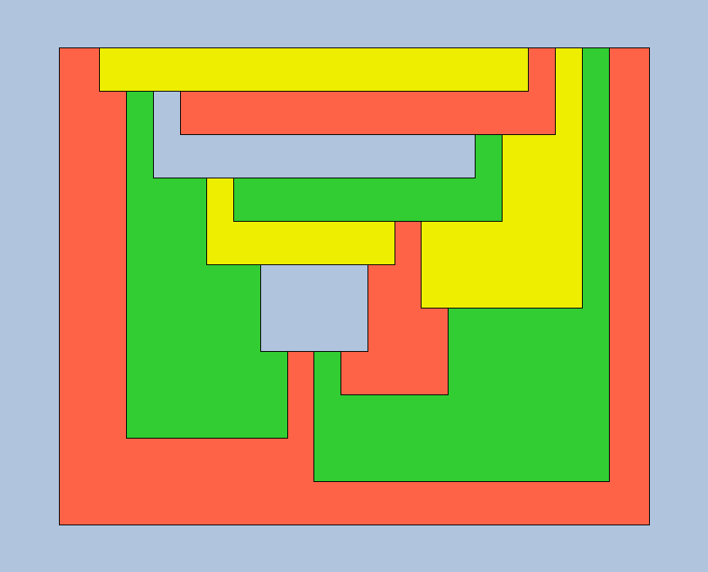
12 faces all F5

Slide 12
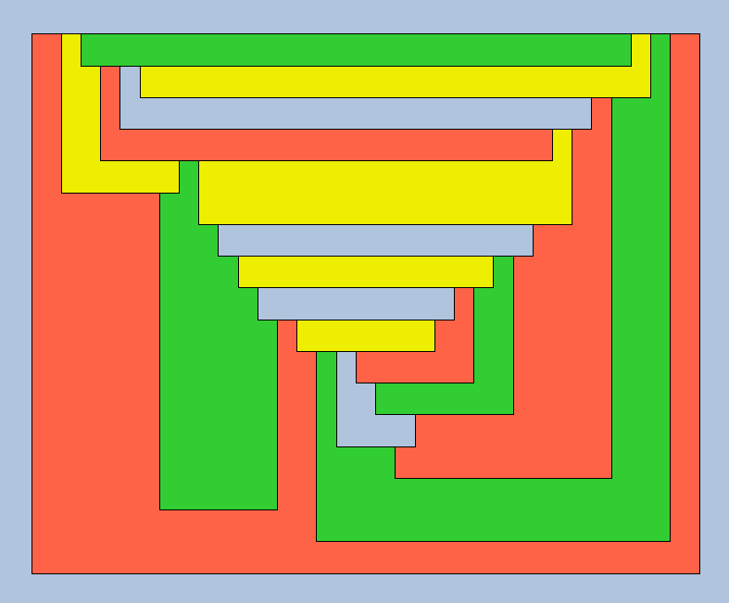
18 faces all >= F5
1b+, 13b+, 17b+, 14b-, 15b-, 16b-, 3b-, 13e-, 12b-, 11b-, 10b-, 9b-, 3e-, 8b-, 2b-, 5b-, 7b-, 6b-, 4b-, 5e-, 8e-, 9e-, 7e-, 10e-, 6e-, 11e-, 14e-, 12e-, 15e-, 4e-, 17e+, 16e+, 2e+, 1e+

Slide 13
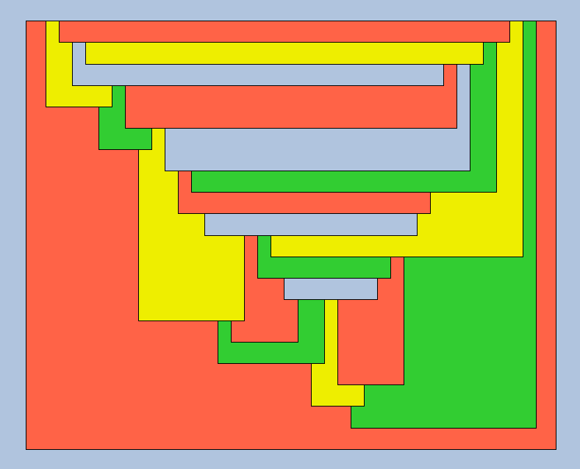
21 faces all >= F5
1b+, 17b+, 20b+, 18b-, 19b-, 15b-, 17e-, 16b-, 7b-, 15e-, 14b-, 12b-, 13b-, 11b-, 5b-, 6b-, 7e-, 9b-, 10b-, 8b-, 6e-, 3b-, 5e-, 4b-, 2b-, 3e-, 8e-, 9e-, 4e-, 11e-, 12e-, 18e-, 16e-, 14e-, 19e-, 13e-, 20e+, 10e+, 2e+, 1e+

Slide 14
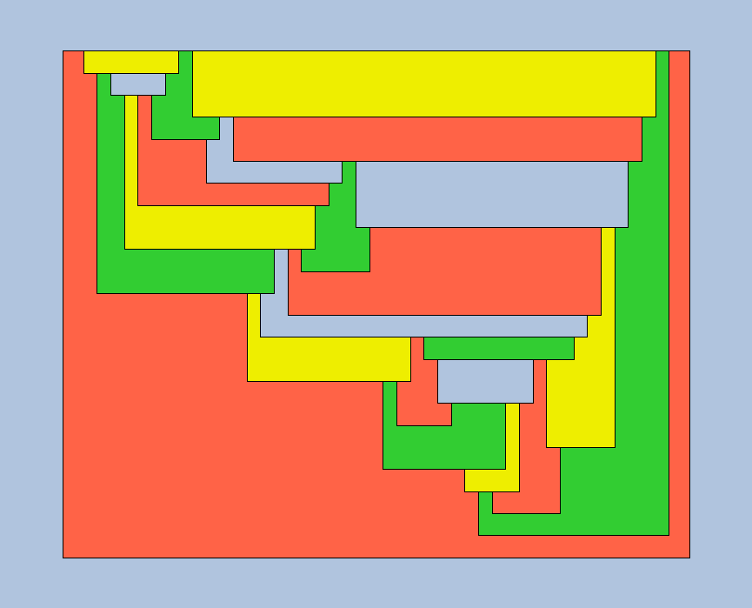
CASE-A: 24 faces all >= F5 (Not found with coloring-1)
1b+, 23b+, 13b-, 22b-, 15b-, 17b-, 20b-, 22e-, 23e+, 21b+, 18b-, 20e-, 19b-, 9b-, 11b-, 13e-, 12b-, 14b-, 15e-, 17e-, 18e-, 16b-, 14e-, 5b-, 7b-, 9e-, 10b-, 8b-, 7e-, 4b-, 2b-, 3b-, 5e-, 4e-, 8e-, 6b-, 3e-, 10e-, 11e-, 12e-, 6e-, 16e-, 19e-, 21e+, 2e+, 1e+

Slide 15
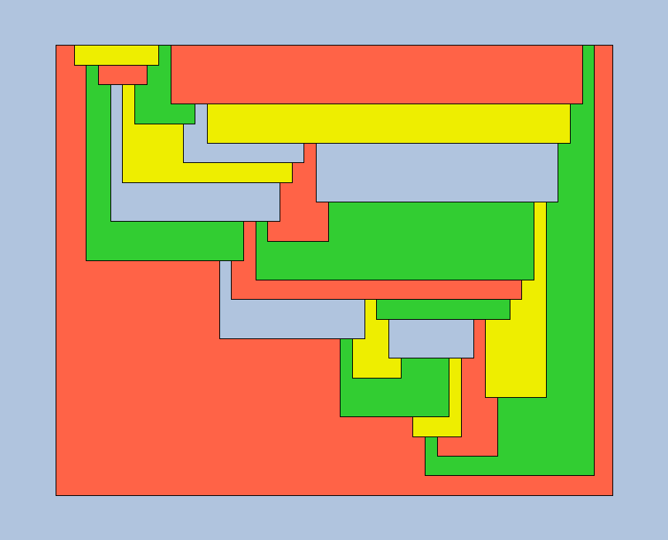
CASE-A: 24 faces all >= F5 (Found with coloring-2)
1b+, 23b+, 13b-, 22b-, 15b-, 17b-, 20b-, 22e-, 23e+, 21b+, 18b-, 20e-, 19b-, 9b-, 11b-, 13e-, 12b-, 14b-, 15e-, 17e-, 18e-, 16b-, 14e-, 5b-, 7b-, 9e-, 10b-, 8b-, 7e-, 4b-, 2b-, 3b-, 5e-, 4e-, 8e-, 6b-, 3e-, 10e-, 11e-, 12e-, 6e-, 16e-, 19e-, 21e+, 2e+, 1e+

Slide 16
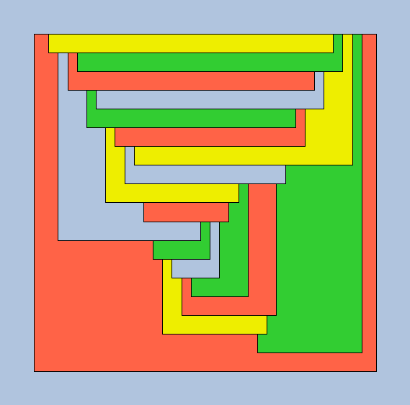
CASE-B: 20 faces all >= F5 (Not found with coloring-1)
1b+, 18b+, 8b-, 16b-, 17b-, 14b-, 15b-, 10b-, 13b-, 11b-, 12b-, 9b-, 7b-, 3b-, 6b-, 4b-, 5b-, 8e-, 7e-, 6e-, 9e-, 10e-, 5e-, 2b-, 3e-, 4e-, 11e-, 14e-, 13e-, 16e-, 15e-, 18e+, 17e+, 12e+, 2e+, 1e+

Slide 17
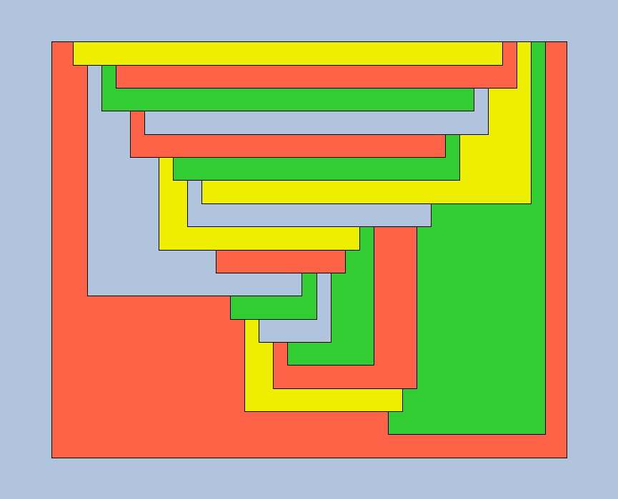
CASE-B: 20 faces all >= F5 (Not found with coloring-2)
1b+, 18b+, 8b-, 16b-, 17b-, 14b-, 15b-, 10b-, 13b-, 11b-, 12b-, 9b-, 7b-, 3b-, 6b-, 4b-, 5b-, 8e-, 7e-, 6e-, 9e-, 10e-, 5e-, 2b-, 3e-, 4e-, 11e-, 14e-, 13e-, 16e-, 15e-, 18e+, 17e+, 12e+, 2e+, 1e+

Slide 18
CASE-B: 20 faces all >= F5 (Not found with coloring-2)
1b+, 18b+, 8b-, 16b-, 17b-, 14b-, 15b-, 10b-, 13b-, 11b-, 12b-, 9b-, 7b-, 3b-, 6b-, 4b-, 5b-, 8e-, 7e-, 6e-, 9e-, 10e-, 5e-, 2b-, 3e-, 4e-, 11e-, 14e-, 13e-, 16e-, 15e-, 18e+, 17e+, 12e+, 2e+, 1e+

Slide 19
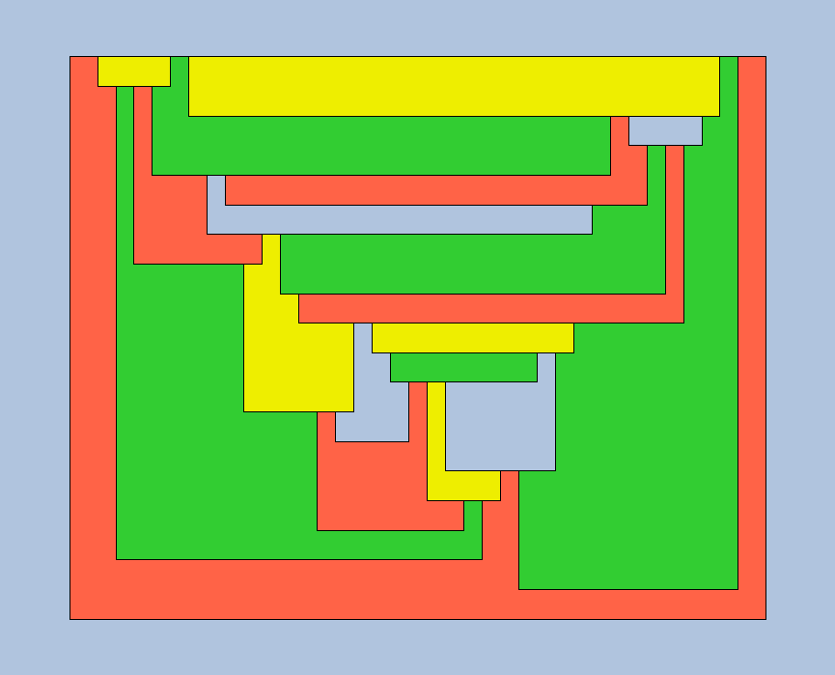
20 faces all >= F5 (Not found with this coloring)
1b+, 19b+, 3b-, 13b-, 16b-, 19e+, 18b+, 14b-, 15b-, 8b-, 13e-, 12b-, 11b-, 4b-, 7b-, 8e-, 10b-, 9b-, 7e-, 5b-, 6b-, 4e-, 3e-, 5e-, 2b-, 9e-, 6e-, 10e-, 14e-, 16e-, 17b-, 15e-, 12e-, 11e-, 17e-, 18e+, 2e+, 1e+

Slide 20
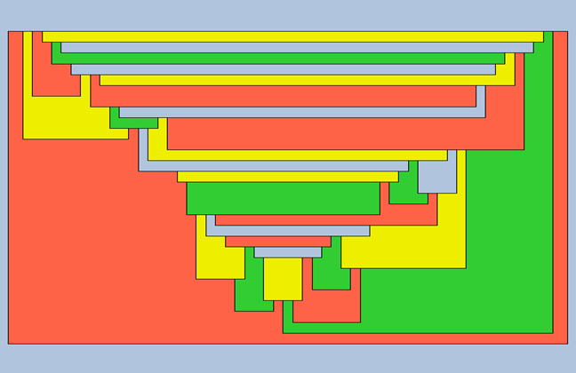
30 faces all >= F5 (Not found with this coloring)
1b+, 20b+, 24b+, 29b+, 27b-, 28b-, 26b-, 24e-, 23b-, 25b-, 21b-, 22b-, 20e-, 17b-, 18b-, 21e-, 19b-, 16b-, 13b-, 7b-, 11b-, 12b-, 10b-, 4b-, 7e-, 9b-, 5b-, 4e-, 2b-, 3b-, 5e-, 6b-, 9e-, 10e-, 8b-, 6e-, 3e-, 11e-, 13e-, 14b-, 16e-, 17e-, 15b-, 14e-, 12e-, 18e-, 15e-, 8e-, 23e-, 22e-, 26e-, 27e-, 25e-, 19e-, 28e-, 29e+, 2e+, 1e+

Slide 21
SECTION 2:
Study the Cahit’s algorithm to find spirals chains

Slide 22
Notes about spiral chains and 4ct
I’m a bit confused on how can I apply Spiral chains to 3-regular planar graphs? Do I have to make the graph triangular first, as in the example EX-A? Is there a way to apply spiral chains directly to “non triangular” graphs?
  Answer: Trinagularization is not necessary. Spiral chains can be applyed directly to 3-regular planar graphs! See the blog notes about “tait coloring”
Is it better to apply spiral chains to the original graph that represents the map itself and find the “edge coloring” or is it better to apply it to the dual graph and find “vertex coloring”? Or is it the same?
  Answer: I prefer “edge coloring” because in this way I don’t have to get the dual of the graph representing the map
Is there another map representation, other than rectangular and circular, that visually simplify the triangularization of a map?
  Answer: Trinagularization is not necessary!
Triangularization of rectangular maps: in the example EX-A, I started the triangularization always from the vertex at the upper-left corner. Try to start from a position that depends on the number of neighbours of the face (odd = up-left, even = up-right for example)
  Answer: Trinagularization is not necessary!

Slide 23
Notes about spiral chains and 4ct
How much spiral chains change if we start from different vertexes of the outer cycle? Is there a “best” starting point?
  Answer: They change a lot! See the examples of Tutte’s graph
In case of chockwise spirals, isn’t it the left-most edge to consider?
  From the paper “The Proofs of Tait’s and Tutte’s Three-Edge-Coloring Conjectures”: “Without loss of generality select the edges starting from vertex v1ends at vertex vk in the clockwise direction (or anti-clockwise-direction) in the plane. That is we have selected the path from vertex v1 to vk on the B. We can do this always by selecting unused right-most edge in the plane, that is if the vertex vi is in the spiral S then vi+1 will be in the S only if (vi, vi+1) is the right-most edge incident at vi”
In case the first spiral does not cover all the vertexes of the map, from which vertex do I have to start the second spiral?
  Answer: From the closest vertex of the last vertex of the last spiral: d(v_i, v_j)
After the spiral chains are calculated some edges are not covered by the spirals. In this case, which color will be used for them?
Verify “≥” : Es = E(Ps) ∪ {E(Ps) : {vi, vj} | vi, vj ∈ V (Ps) and d(vi, vj ) ≥ 2}.
Just a curiosity: Why G is the primary color and not R (first color in the list)?
  From the paper “The Proofs of Tait’s and Tutte’s Three-Edge-Coloring Conjectures”: “Let C = {R, O, G}. ... The color green G is called as the "primary" color while the colors orange and red R are called the "secondary" colors.”

Slide 24
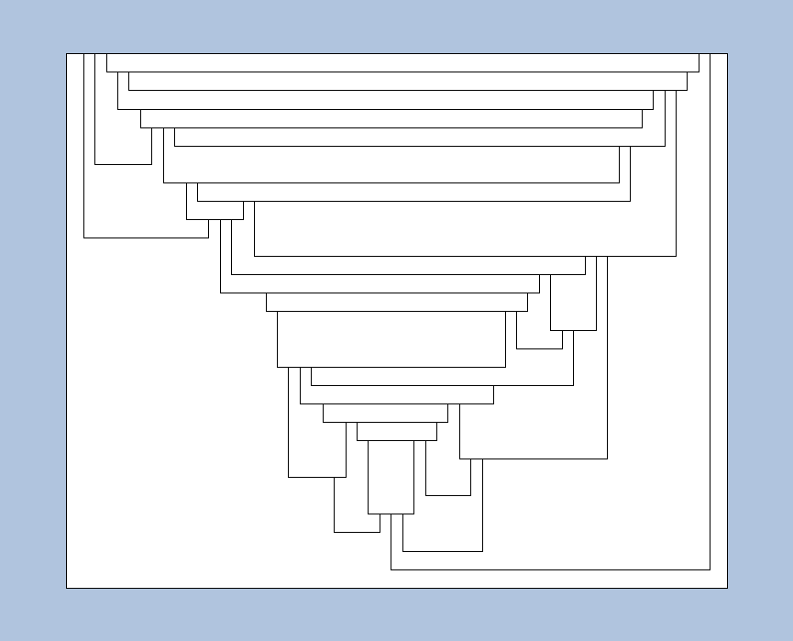
CASE-S1: original map with 30 faces
1b+, 20b+, 24b+, 29b+, 27b-, 28b-, 26b-, 24e-, 23b-, 25b-, 21b-, 22b-, 20e-, 17b-, 18b-, 21e-, 19b-, 16b-, 13b-, 7b-, 11b-, 12b-, 10b-, 4b-, 7e-, 9b-, 5b-, 4e-, 2b-, 3b-, 5e-, 6b-, 9e-, 10e-, 8b-, 6e-, 3e-, 11e-, 13e-, 14b-, 16e-, 17e-, 15b-, 14e-, 12e-, 18e-, 15e-, 8e-, 23e-, 22e-, 26e-, 27e-, 25e-, 19e-, 28e-, 29e+, 2e+, 1e+

Slide 25
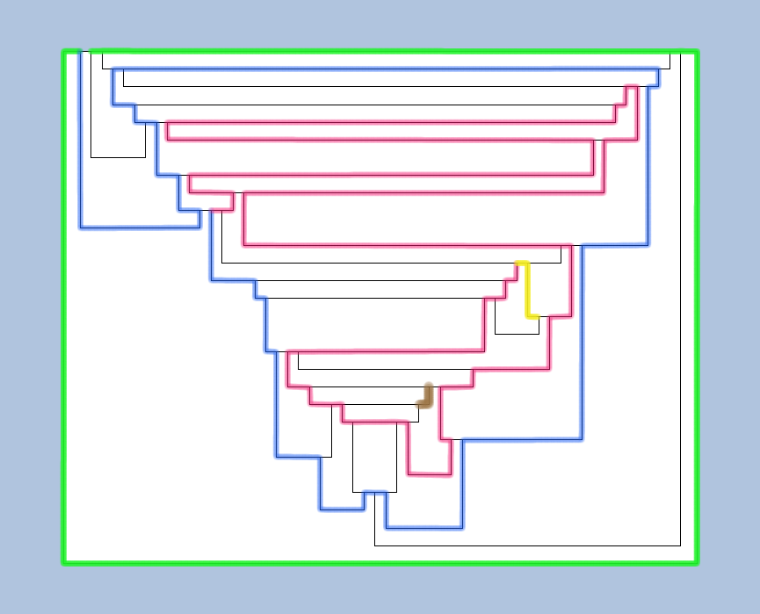
CASE-S1: First spiral chains
For the first chain the different colors are used for each boundary cycle
1b+, 20b+, 24b+, 29b+, 27b-, 28b-, 26b-, 24e-, 23b-, 25b-, 21b-, 22b-, 20e-, 17b-, 18b-, 21e-, 19b-, 16b-, 13b-, 7b-, 11b-, 12b-, 10b-, 4b-, 7e-, 9b-, 5b-, 4e-, 2b-, 3b-, 5e-, 6b-, 9e-, 10e-, 8b-, 6e-, 3e-, 11e-, 13e-, 14b-, 16e-, 17e-, 15b-, 14e-, 12e-, 18e-, 15e-, 8e-, 23e-, 22e-, 26e-, 27e-, 25e-, 19e-, 28e-, 29e+, 2e+, 1e+

Slide 26
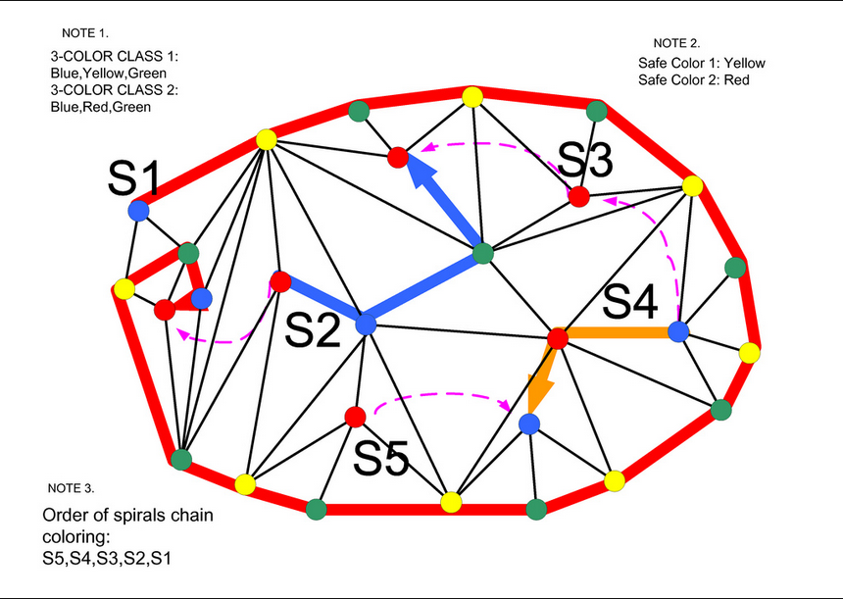
Multiple spirals

Slide 27
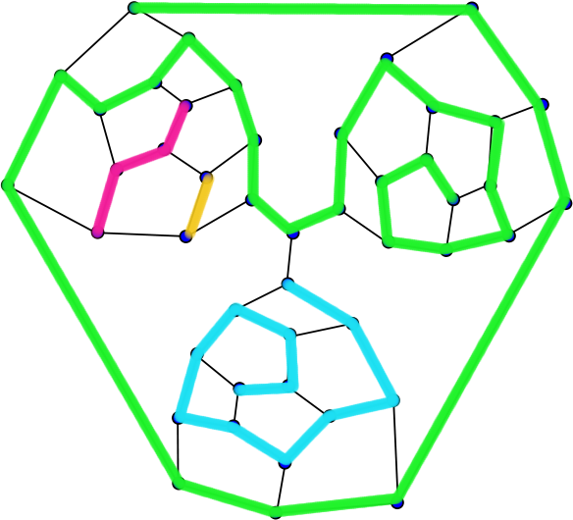
Tutte’s graph – 4 Spiral chains – Starting point 1

Slide 28
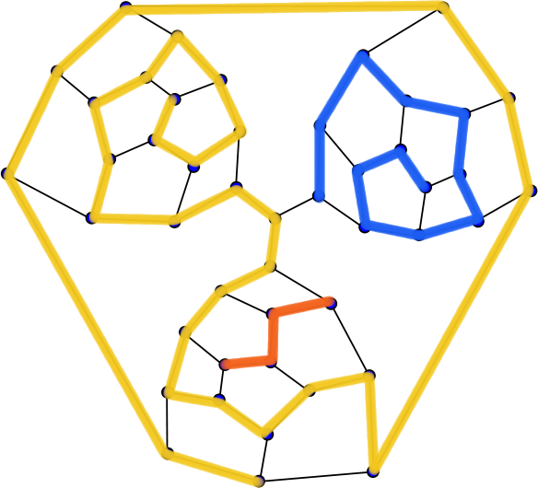
Tutte’s graph – 3 Spiral chains – Starting point 2

Slide 29
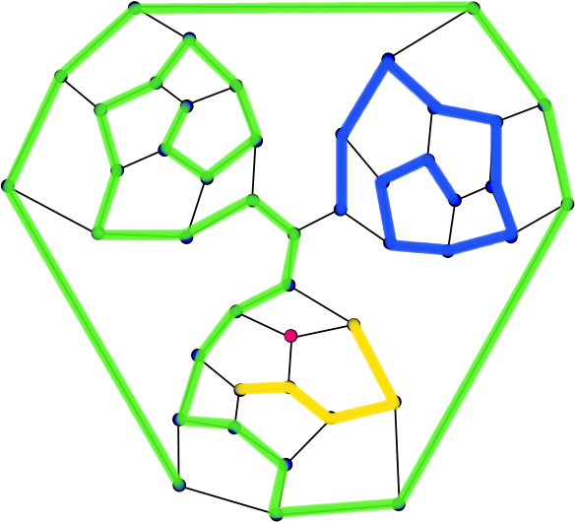
Tutte’s graph – 3+1 Spiral chains – Starting point 3

Slide 30
END OF DOCUMENT

Slide 31
Addendum

Slide 32
Different four coloring of a map
CASE-A: 24 faces all >= F5
1b+, 23b+, 13b-, 22b-, 15b-, 17b-, 20b-, 22e-, 23e+, 21b+, 18b-, 20e-, 19b-, 9b-, 11b-, 13e-, 12b-, 14b-, 15e-, 17e-, 18e-, 16b-, 14e-, 5b-, 7b-, 9e-, 10b-, 8b-, 7e-, 4b-, 2b-, 3b-, 5e-, 4e-, 8e-, 6b-, 3e-, 10e-, 11e-, 12e-, 6e-, 16e-, 19e-, 21e+, 2e+, 1e+
Started: 22/Feb/2012

Slide 33
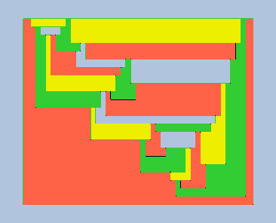
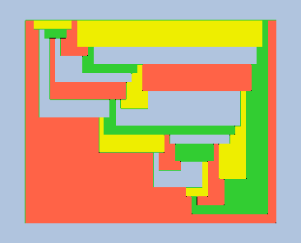
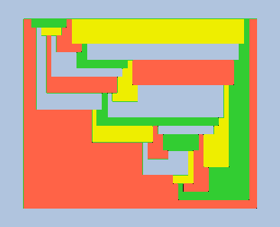

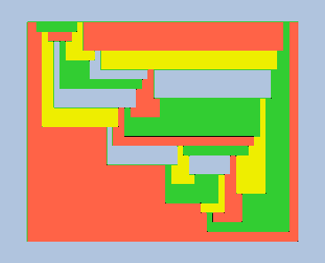
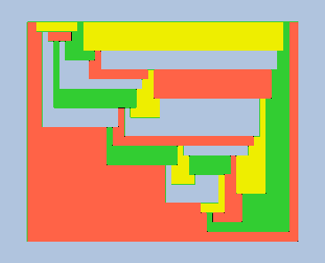
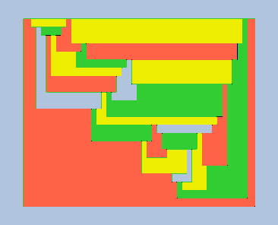
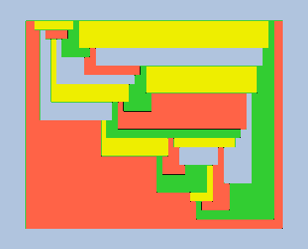
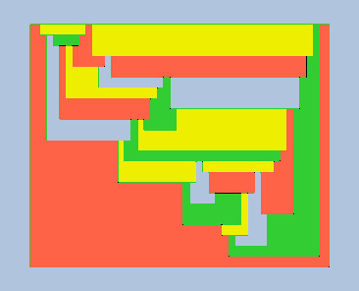
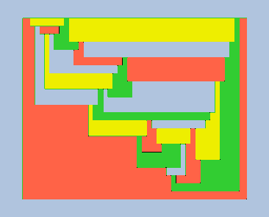
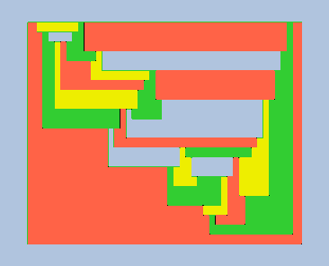
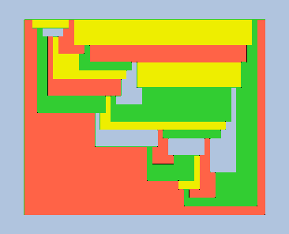
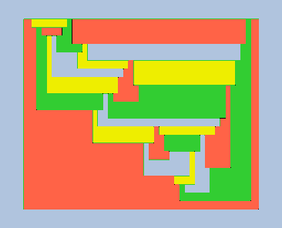
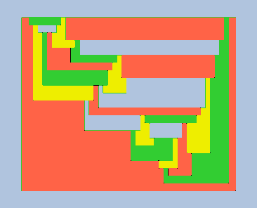
Different four coloring of a map (to finish)

Slide 34
Triangularization
Started: 23/Feb/2012

Slide 35
Triangularization

Slide 36
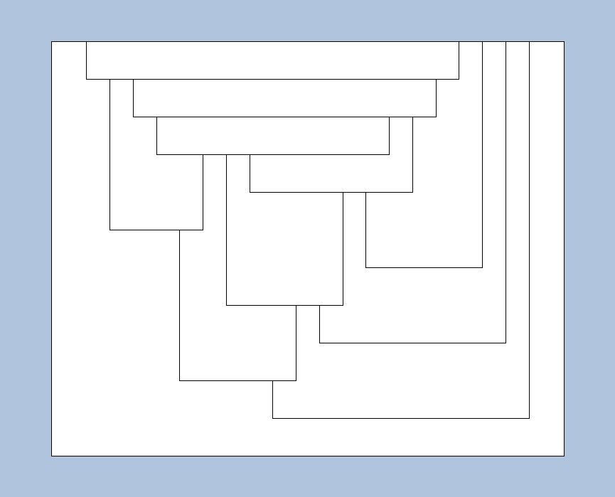
EX-A: Triangularization starting from vertex up-left
3v − 6 edges and 2v − 4 faces = 12 original faces → 36 faces, 20 vertexes, 54 edges

Slide 37
Xxx

Slide 38
Xxx

Slide 39
Xxx

Slide 40
Xxx

Slide 41
Xxx

Slide 42
Xxx

Slide 43
Xxx

Slide 44
Xxx

