Slide 1
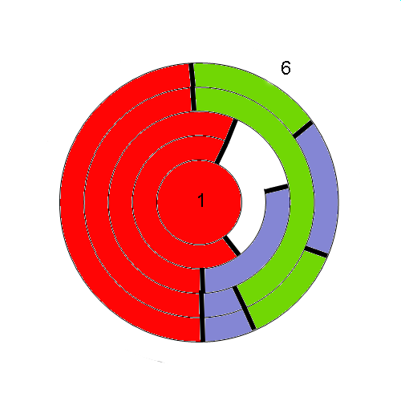
1
2
3
A
4
5
A
6
A

Slide 2
1
1
2
3
4
5
A
6
A
6

Slide 3
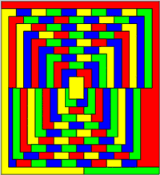
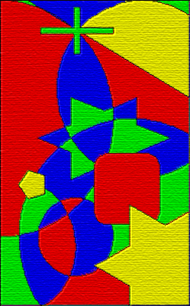
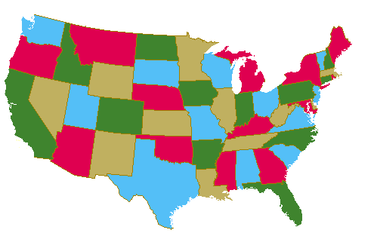
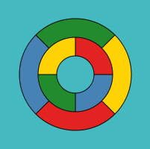
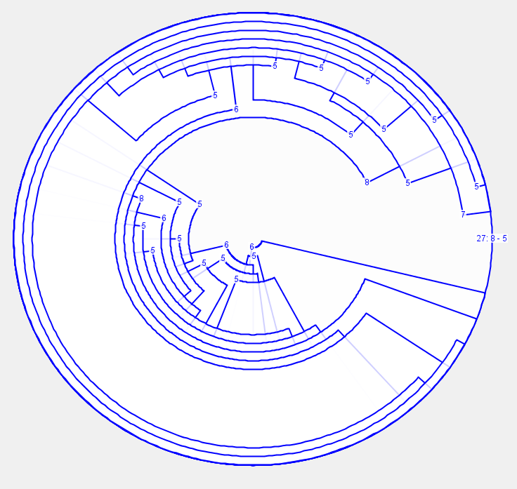
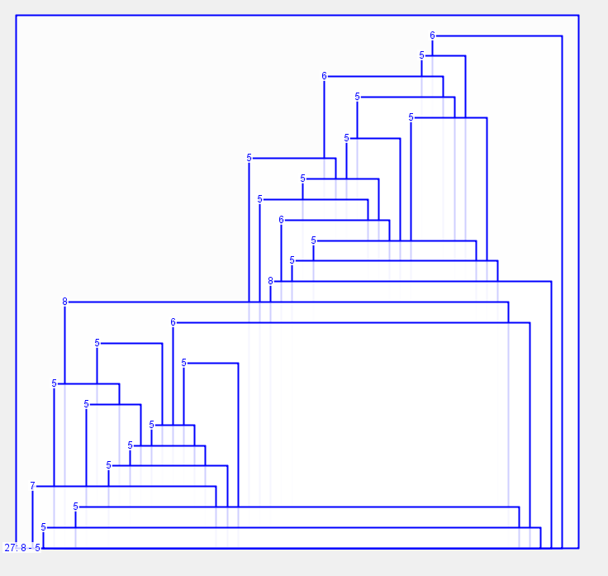

Slide 4
1
1
2
3
4
5
6
6

Slide 5
A
1
2
3
4
5
B
6
A
B

Slide 6
1
1
2
3
4
5
6
6

Slide 7
4
6
5
4
2
5
2
1
4
3
3

Slide 8
4
Walk the borders counterclockwise
A
B
C
3
D
2
1
E
5
5
4
A
4
B
A
F
3
B
2
C
D
1
A
E
6
F
D
G
G
A
5
4
4
3
2
1

