Slide 1
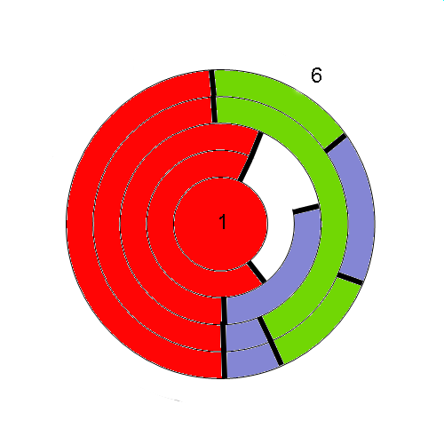
5 E visible …
3 E visible …
3 E visible …
2 E visible from outside of the partial map with 2 faces + the ocean
1 E visible from outside of the partial map with 1 face + the ocean

