Slide 1
5
5
4
4
3
2
2
1
3
1

Slide 2
5
4
5
3
4
2
1
2
5
1
3
4
3
2
1

Slide 3
4
3
2
1
4
4
3
2
2
1
1
3
4
3
2
1

Slide 4
1.1.1 1.1.2 1.1.3 1.1.4 1.1.5
1.1
1.1.6 1.1.7 1.1.8 1.1.9 1.1.10
1.2
1.2.1 1.2.2 1.2.3 1.2.4
1.3.1 1.3.2 1.3.3
1.3
1.3.4 1.3.5 1.3.6

Slide 5
1.1.1 1.1.2 1.1.3 1.1.4 1.1.5
1.1
1.1.6 1.1.7 1.1.8 1.1.9 1.1.10
1.2
1.2.1(1.1.7) 1.2.2(1.1.3) 1.2.3 1.2.4
1.3.1 1.3.2 1.3.3
1.3
1.3.4(1.1.8) 1.3.5(1.1.4) 1.3.6

Slide 8
Maps, duals and edges to connect the ocean.
Edges that connect to the ocean can be drawn as wanted.
If you think to the map on the sphere, the ocean is the face that has be holed.
For this reason, the two graphs have to be considered the same.

Slide 10
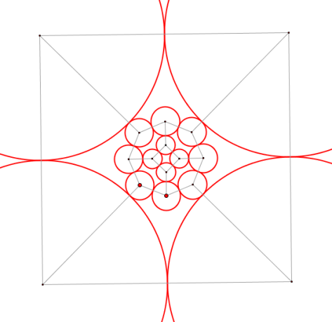
10
2
3
8
1
5
9
4
7
6
Original
Fáry's theorem
Homeomorphic
with
Original
Circle packing theorem
Intersection graph
is
homeomorphic
with
Original
Rectilinear cartogram
Homeomorphic
with
Original

Slide 11
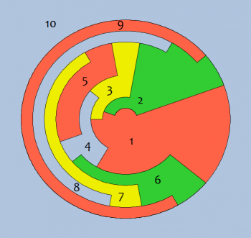
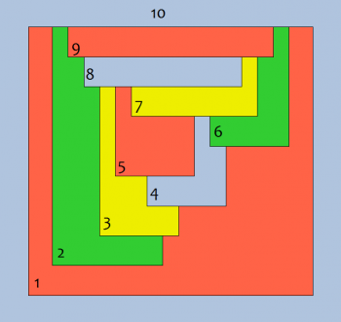
10
Ocean
2
3
8
1
5
9
4
7
6
Canonical
Dual of Natural
Original
Natural
Homeomorphic
with
Original
Clefs
Pipes
Circular
Homeomorphic
with
Original
Rectangular
Homeomorphic
with
Original

