Slide 1
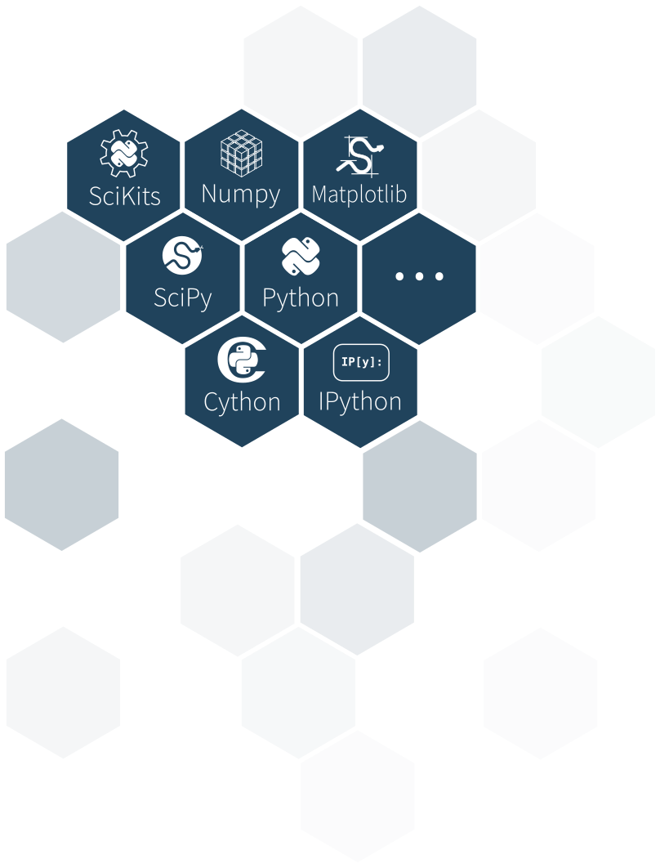

The Scientific Python Ecosystem
Hands-on discussion & overview
USF/CS 10/19/2017
Stéfan van der Walt
@stefanvdwalt
http://mentat.za.net
stefanv@berkeley.edu

Slide 2
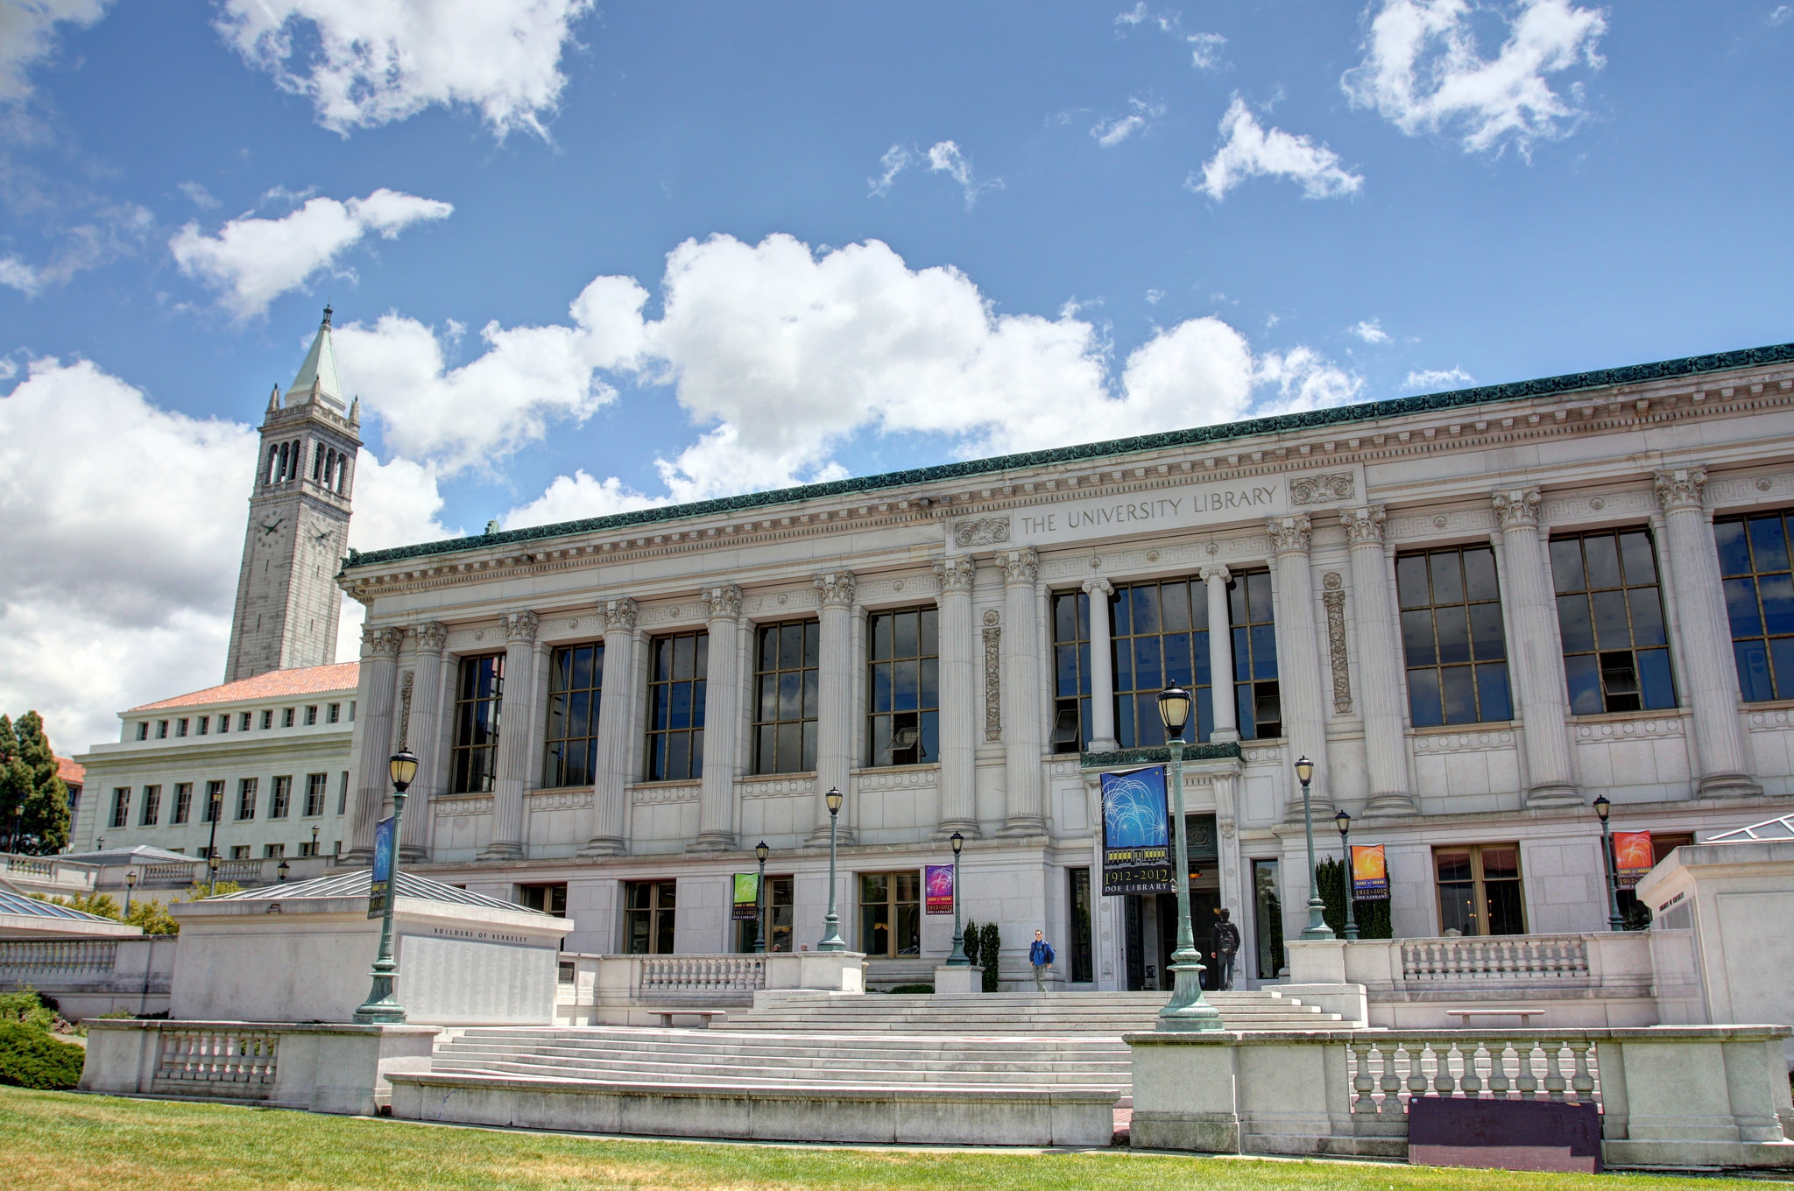
John Morgan, Flickr:https://flic.kr/p/ccFqGE

Slide 3
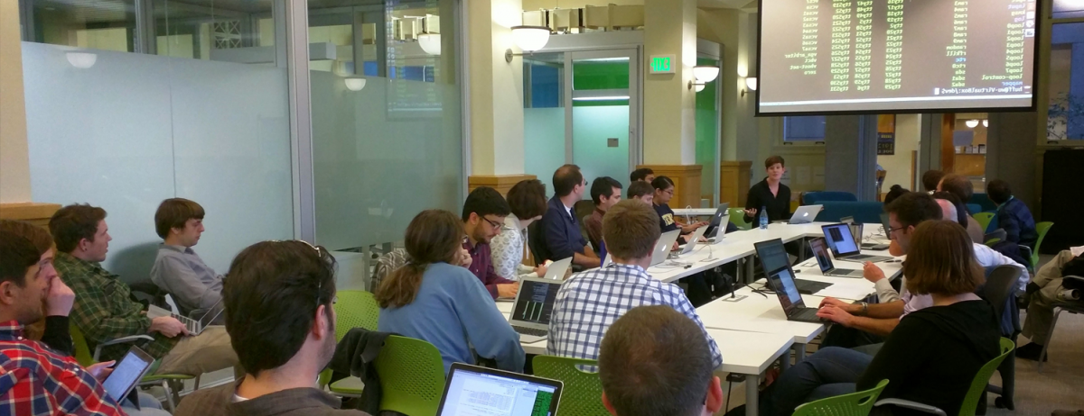

Slide 4
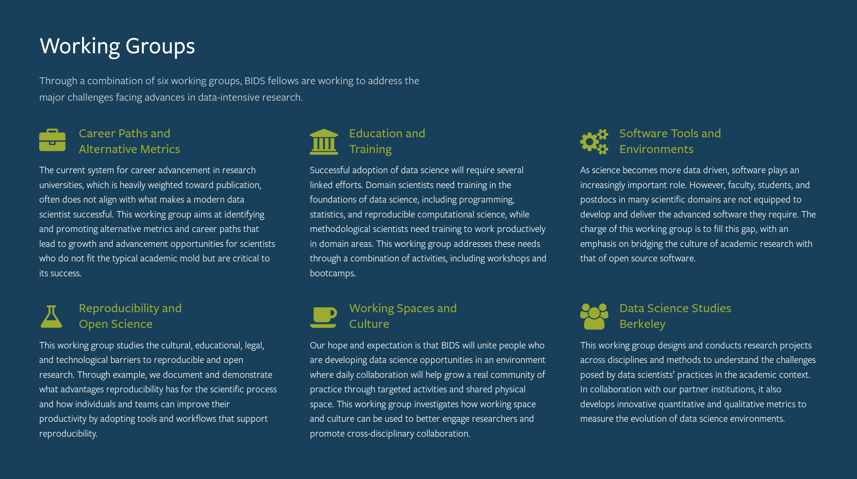

Slide 5


Slide 6
Participate
Docathon
DS4DS (Data Structures for Data Science)
*xd → ImageXD, GraphXD, TextXD, TimeXD
Tuesdays: distinguished lecture series
Open Source Development (skimage, numpy grant, …)
(this is just the Software Working Group; also Education, Jupyter, Reproducible Research, etc.)

Slide 7
Why am I here?
(Setting aside philosophical
considerations.)
Let’s talk:
Python
Science.
Python & Science.
… and the phenomenon of Data Science.
AMA!

Slide 8
https://data.berkeley.edu/education

Slide 9
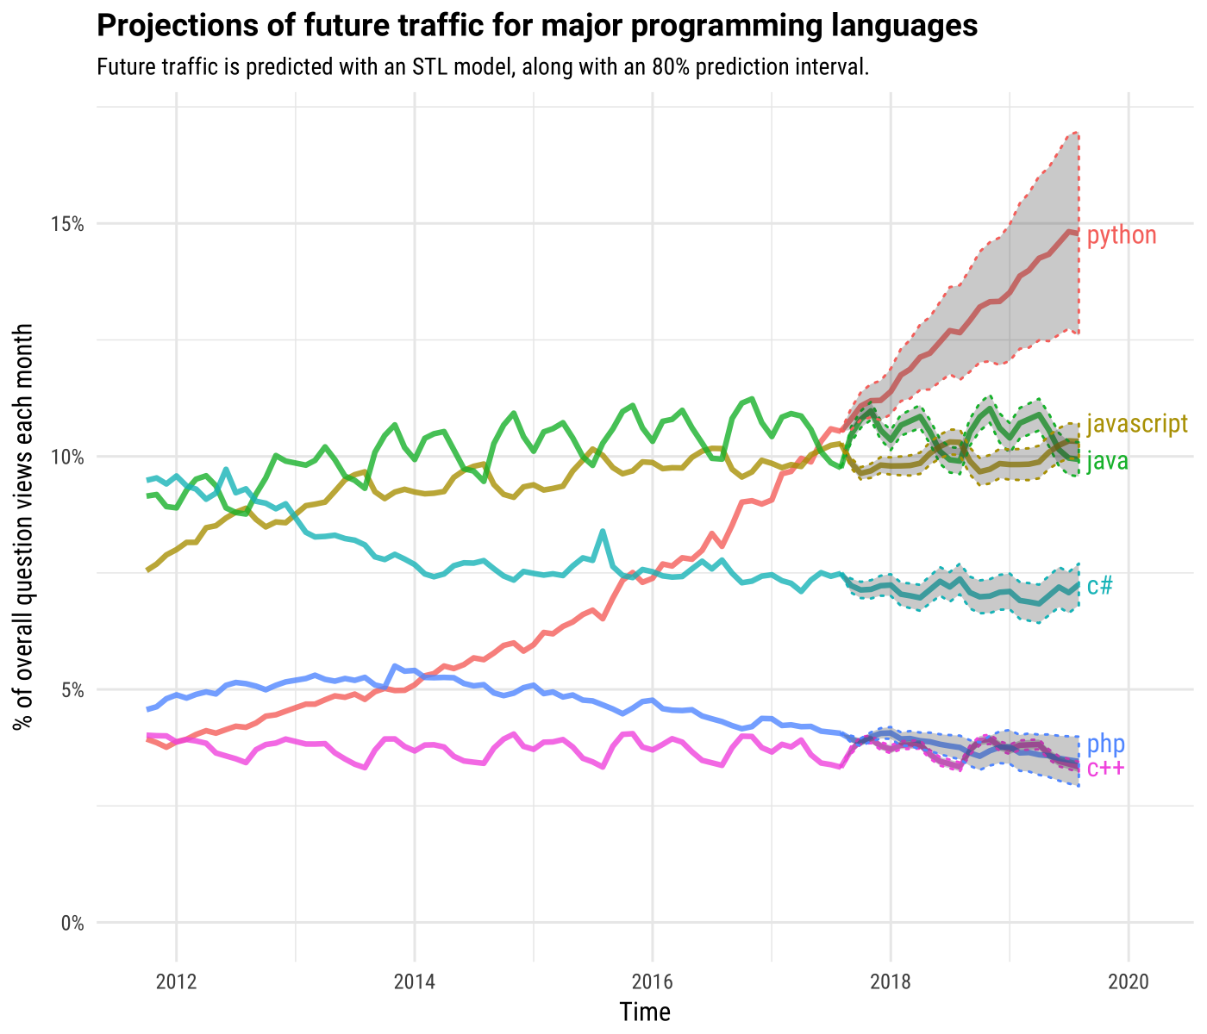
https://stackoverflow.blog/2017/09/06/incredible-growth-python/

Slide 10
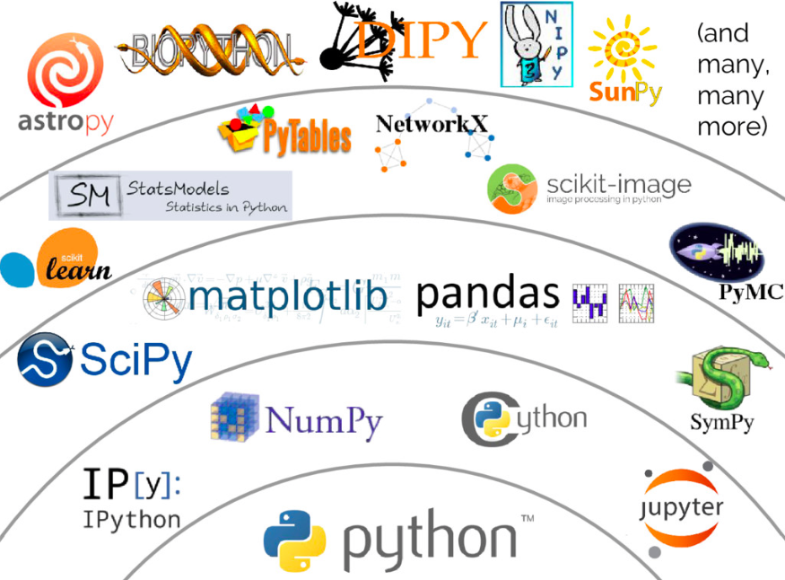
Credit: Jake VanderPlas

Slide 11
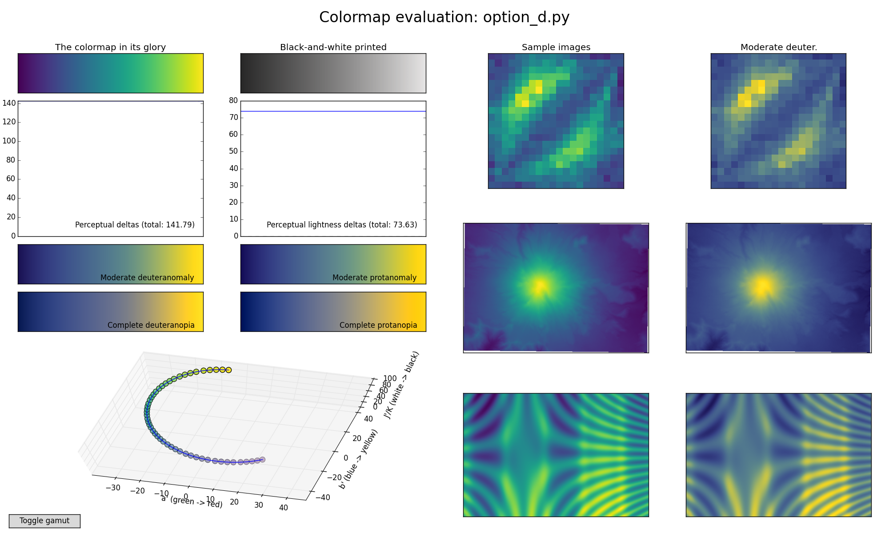

Slide 12
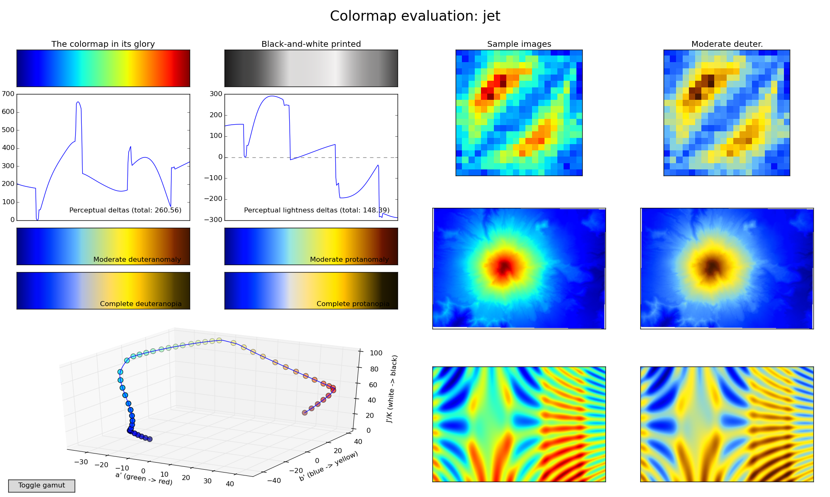

Slide 13
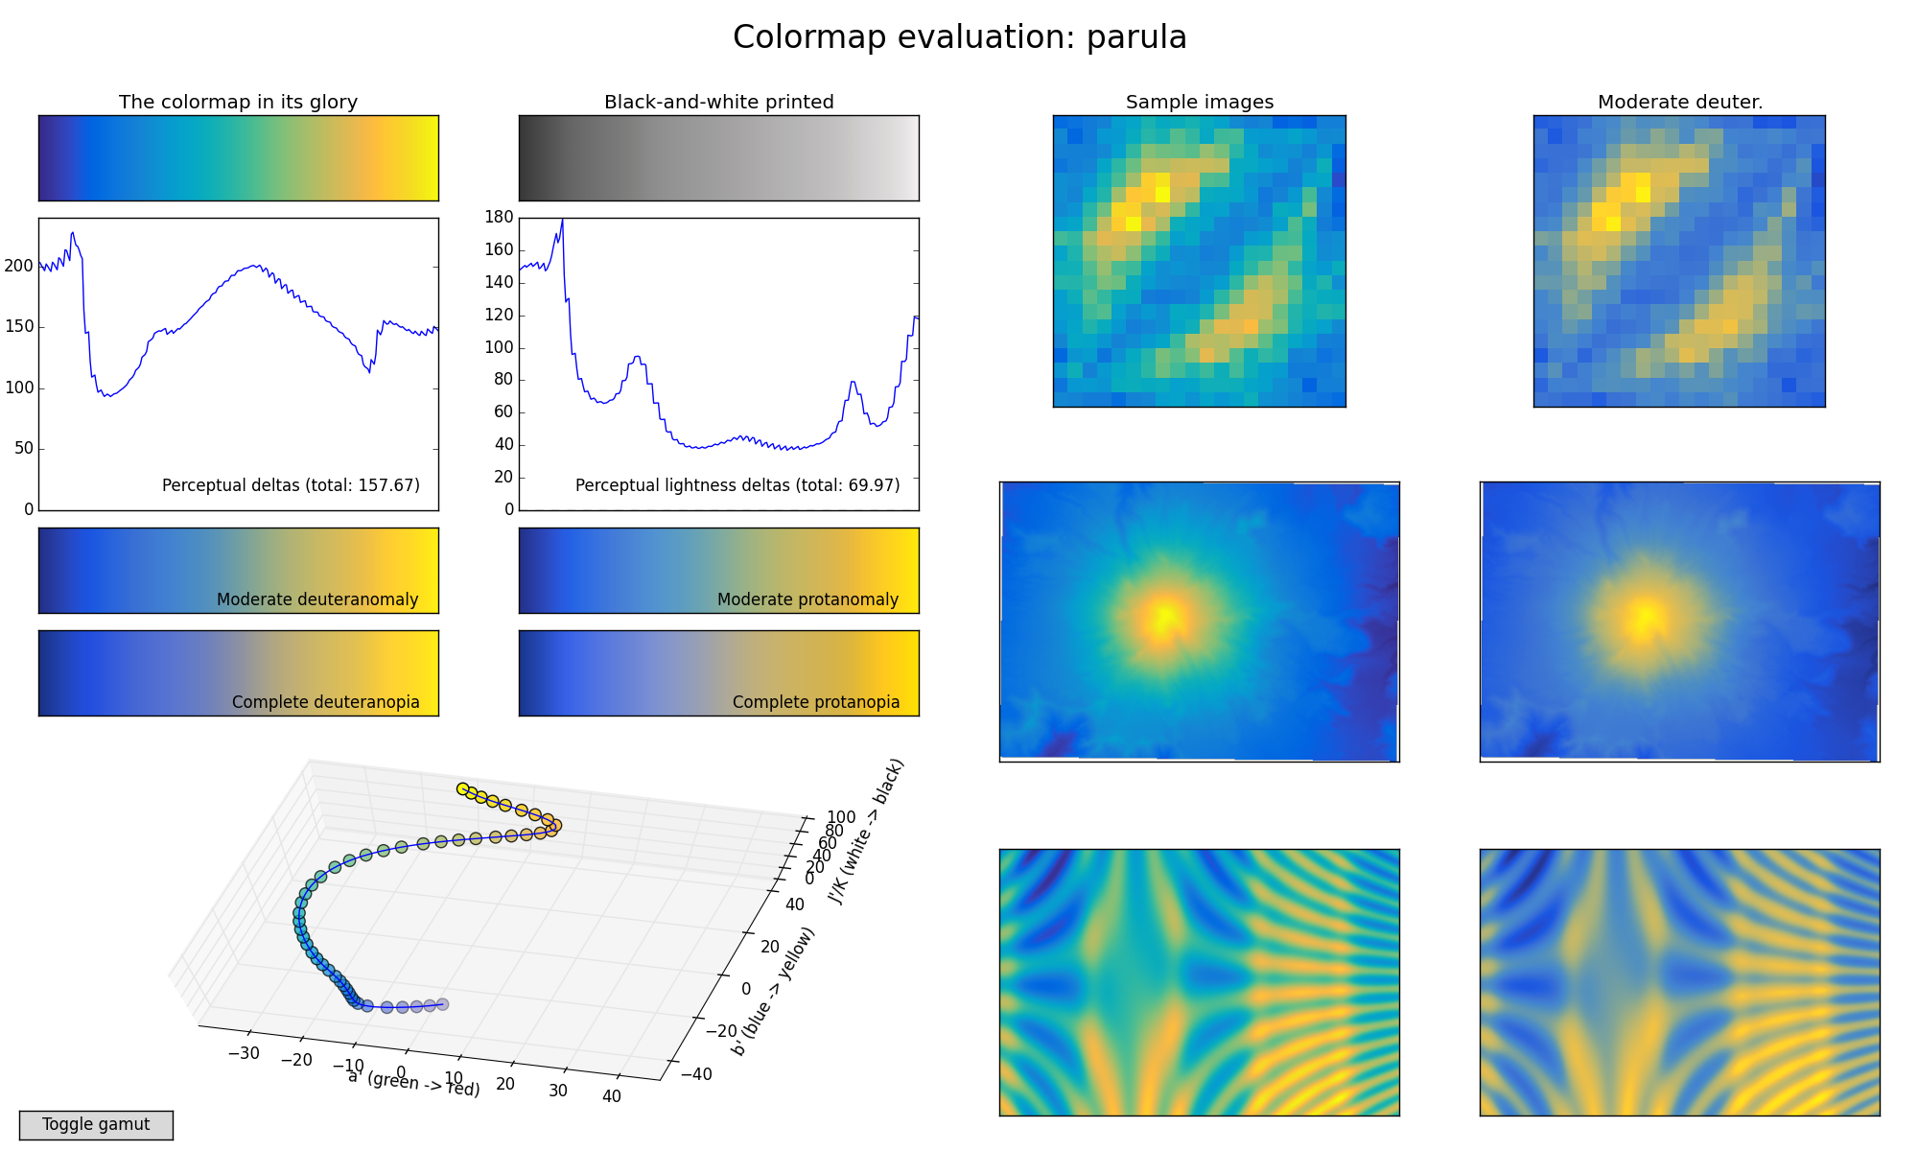

Slide 15
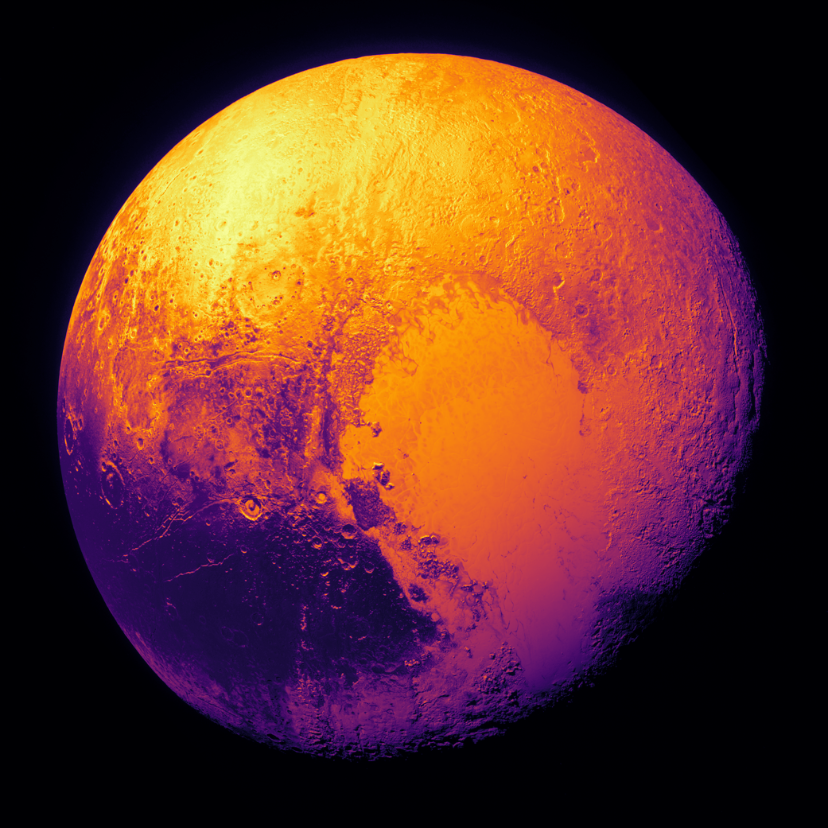

Slide 16
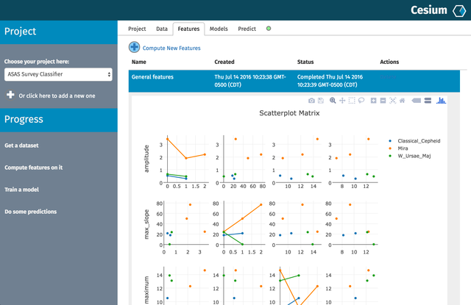
Cesium-ML
http://cesium-ml.org/docs/feature_table.html

Slide 17
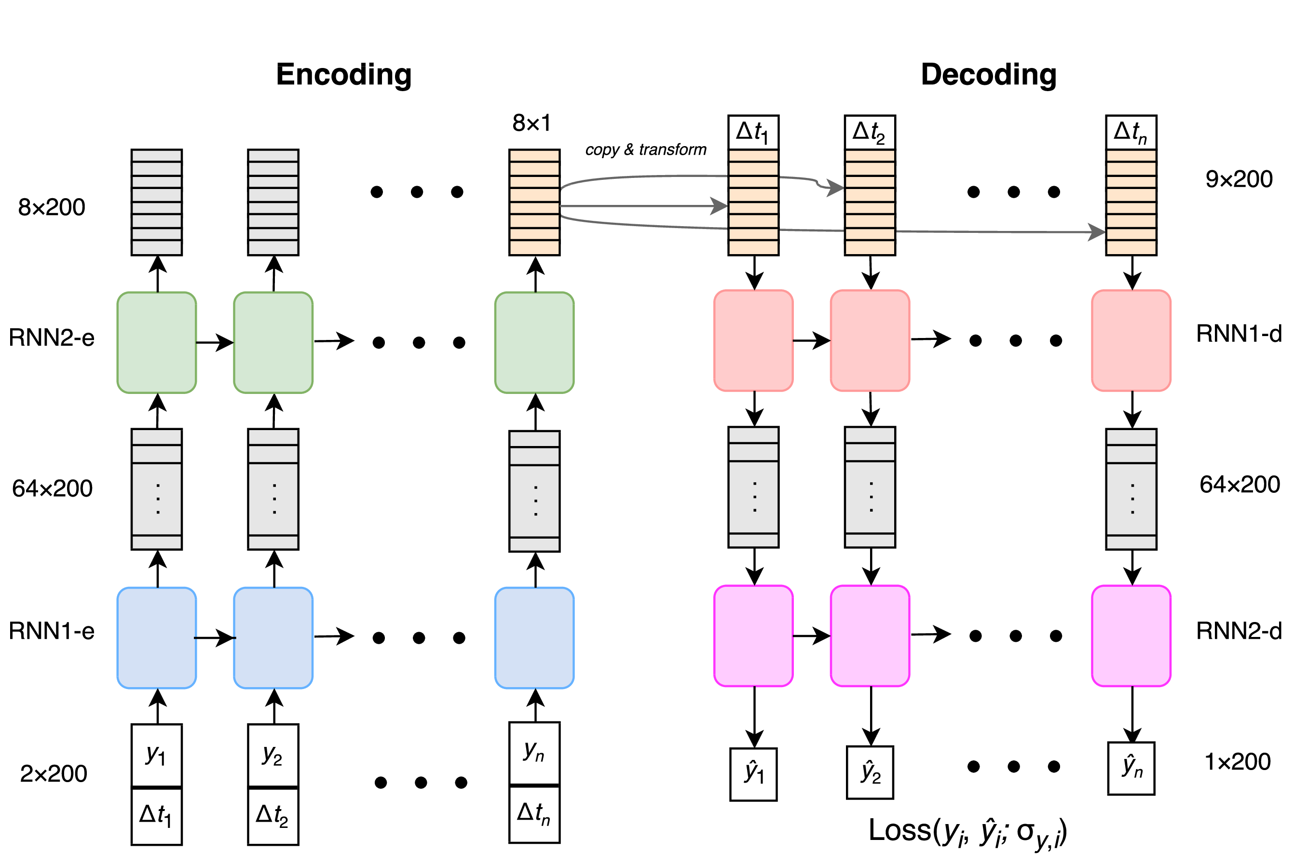

Slide 18
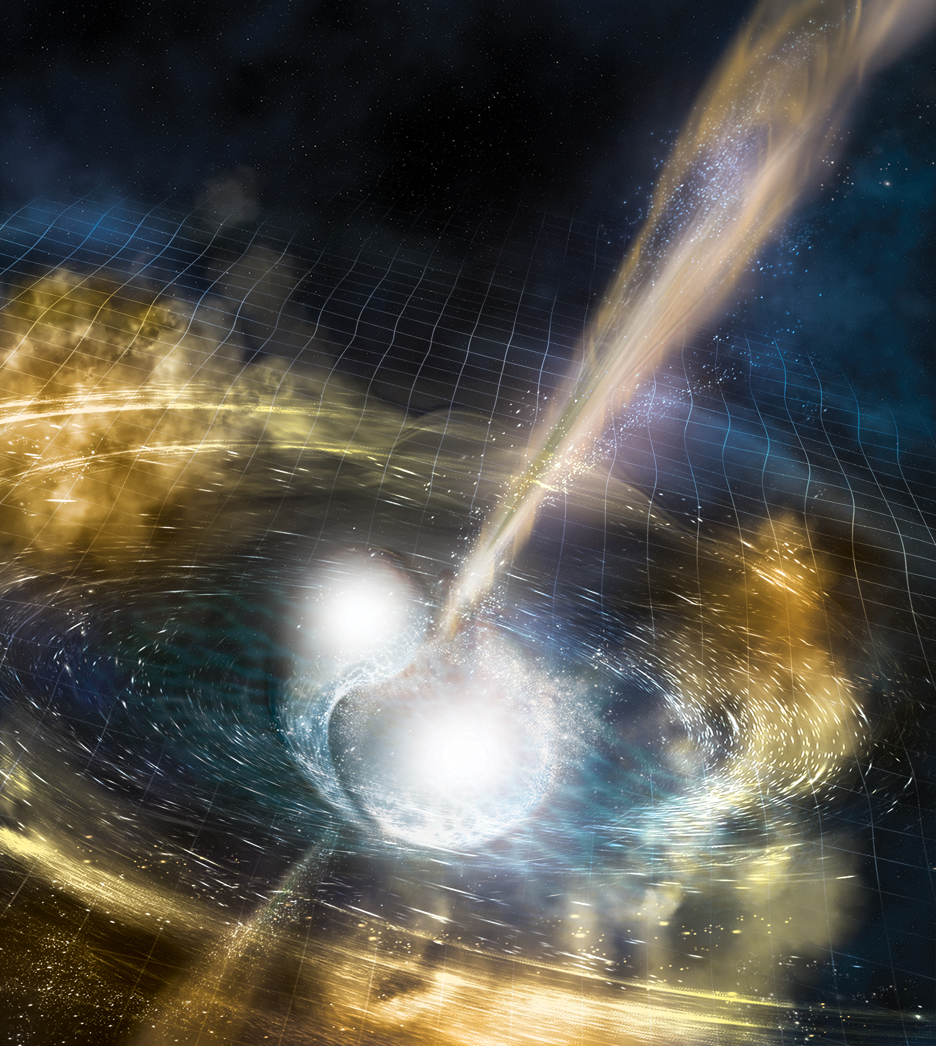

Slide 19
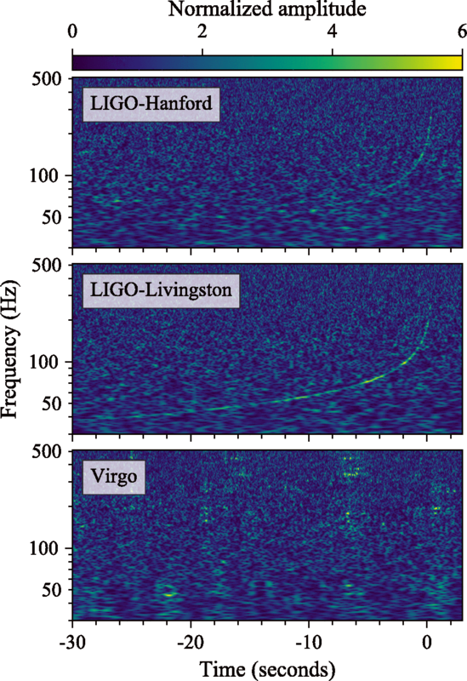

Slide 20
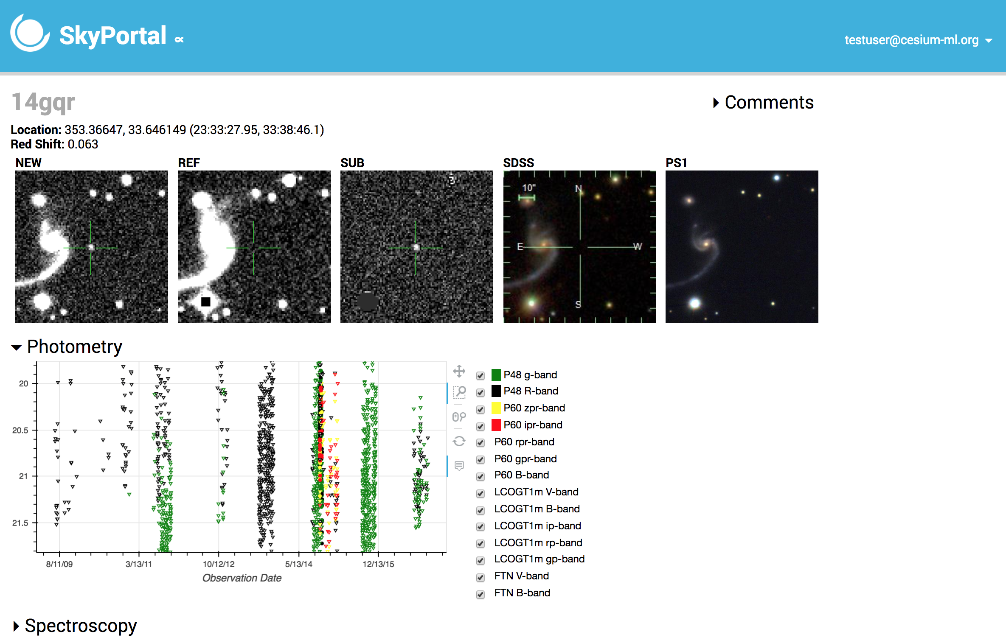

Slide 21
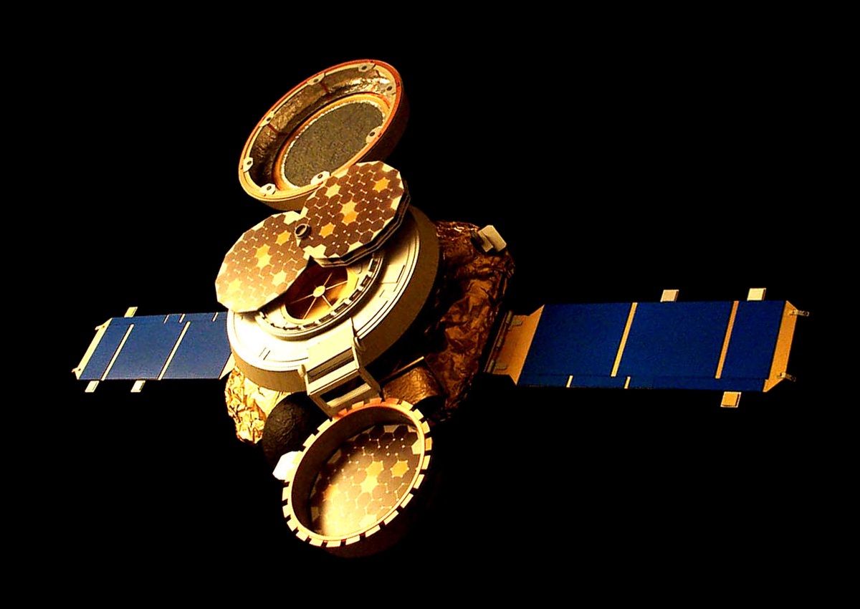
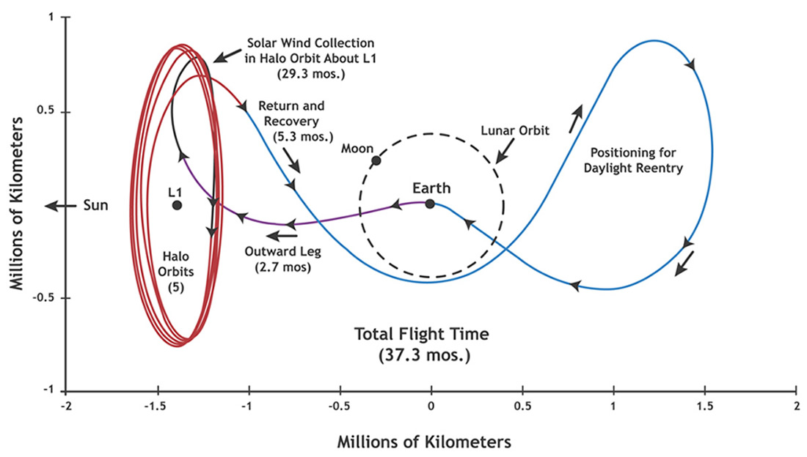

Slide 22
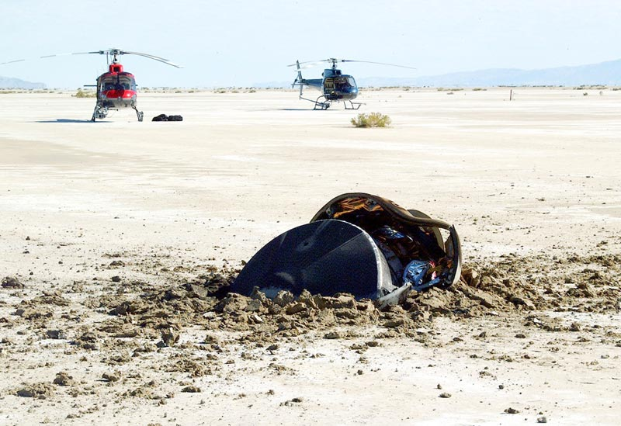

Slide 23
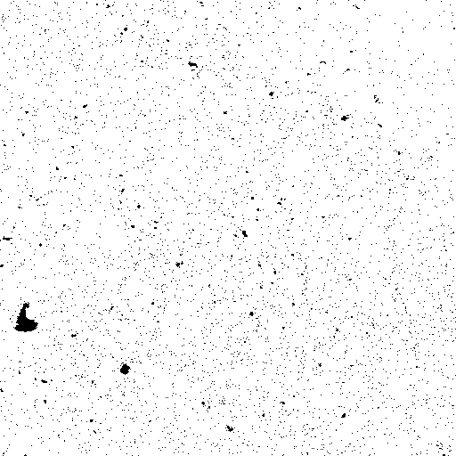
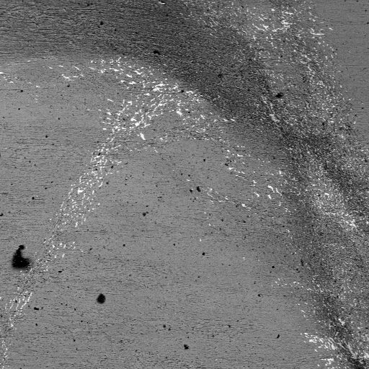

Slide 24
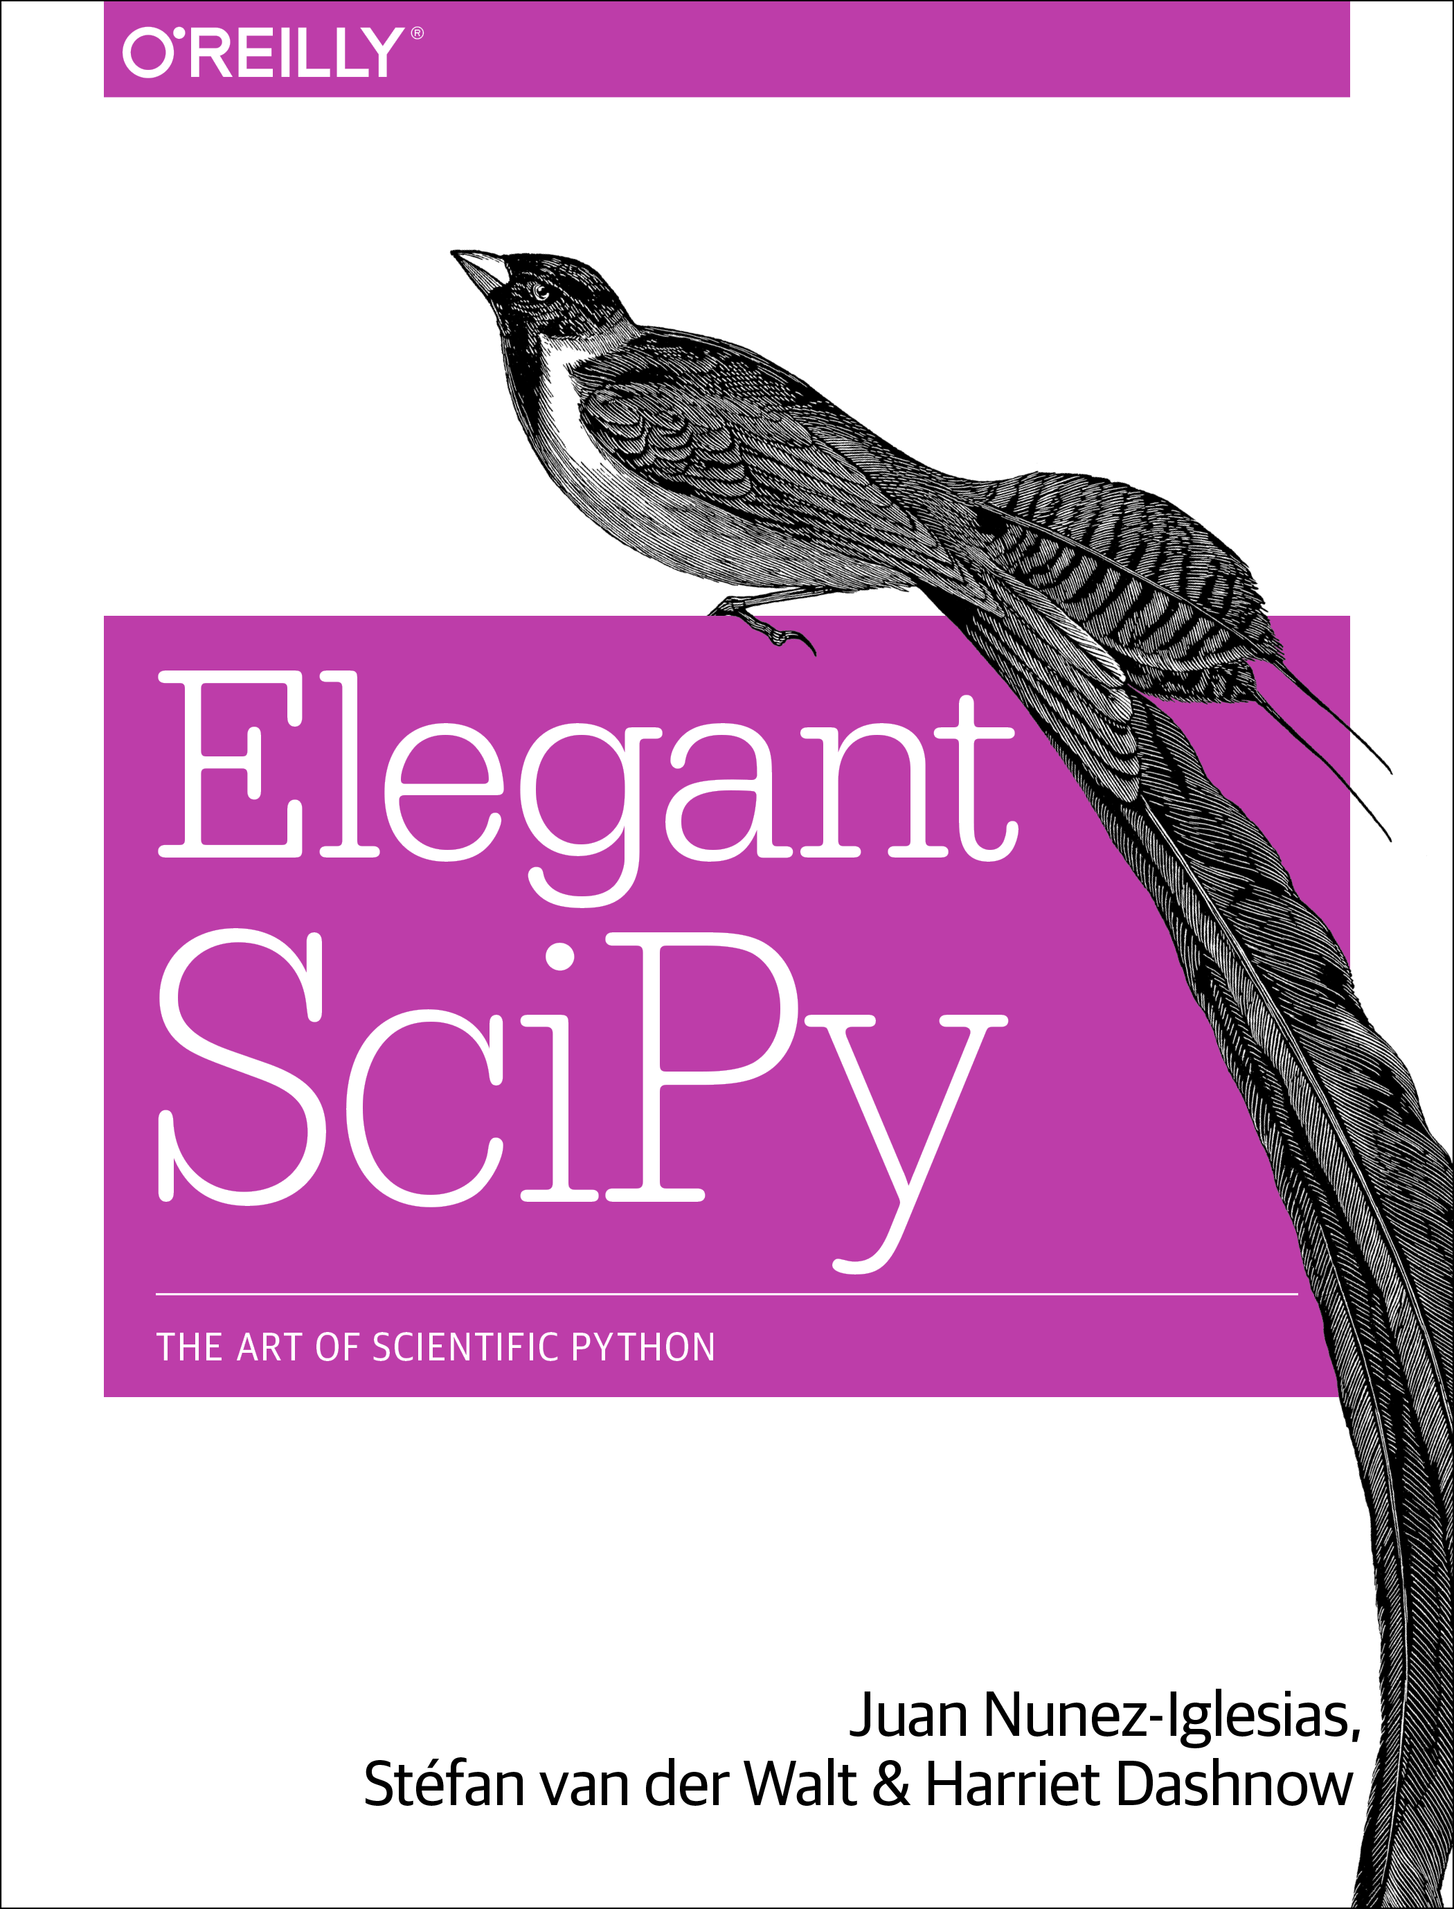
https://github.com/elegant-scipy/elegant-scipy

Slide 25

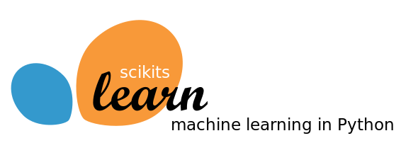

Demo Time!

Slide 26
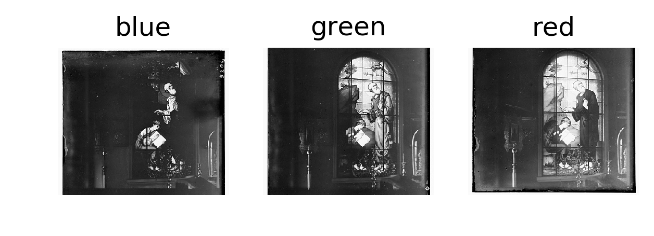
Prudin-Gorskii Collection

