Slide 1

http://scikit-image.org

Slide 2
Overview
im·age proc·ess·ing
Noun: The analysis and manipulation of a
digitized image, esp. in order to improve
its quality.

Slide 3
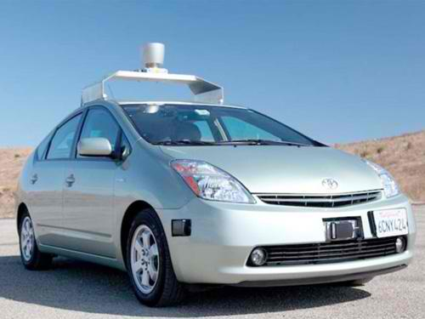
Overview

Slide 4
Overview
im·age proc·ess·ing
Noun: The analysis and manipulation of a
digitized image, esp. in order to improve
its quality.
In order to understand what it's trying to tell us

Slide 5

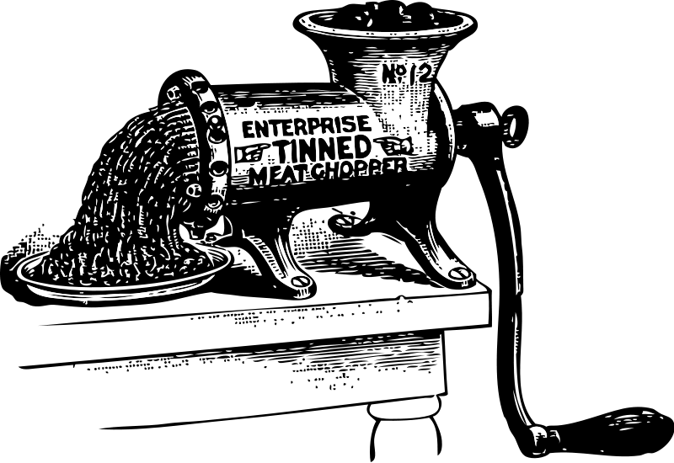
Overview
1 10 8 7 6 2 12 ...

Slide 6
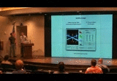
History
Gathering of image processing scripts from mailing list, own archives
Mainly Chris Colbert's OpenCV wrapper
ndimage hard to maintain

Slide 7
Solutions
Implementations of common and fundamental algorithms
More importantly perhaps: the tools around those
E.g.
  I/O across all platforms via plugins
  Pipelines that Just Work (TM) [dtypes]
  Easy visualizations and inspection
Easy maintenance & development
Welcoming developer community

Slide 8
Aims
Education
  Learn from documentation, examples—explore!
  Learn through contributing (low entry-barrier)
Research
  Replicable & reproducible science
  Truly free and open source, very few restrictions
Industry
  Efficient, well-implemented “stock” algorithms
  Team of experts at hand

Slide 9
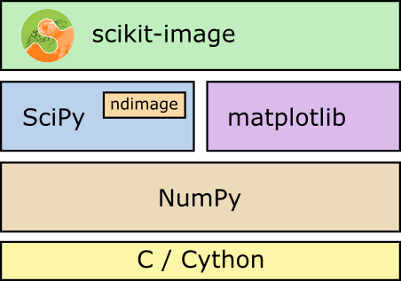
Building blocks

Slide 10
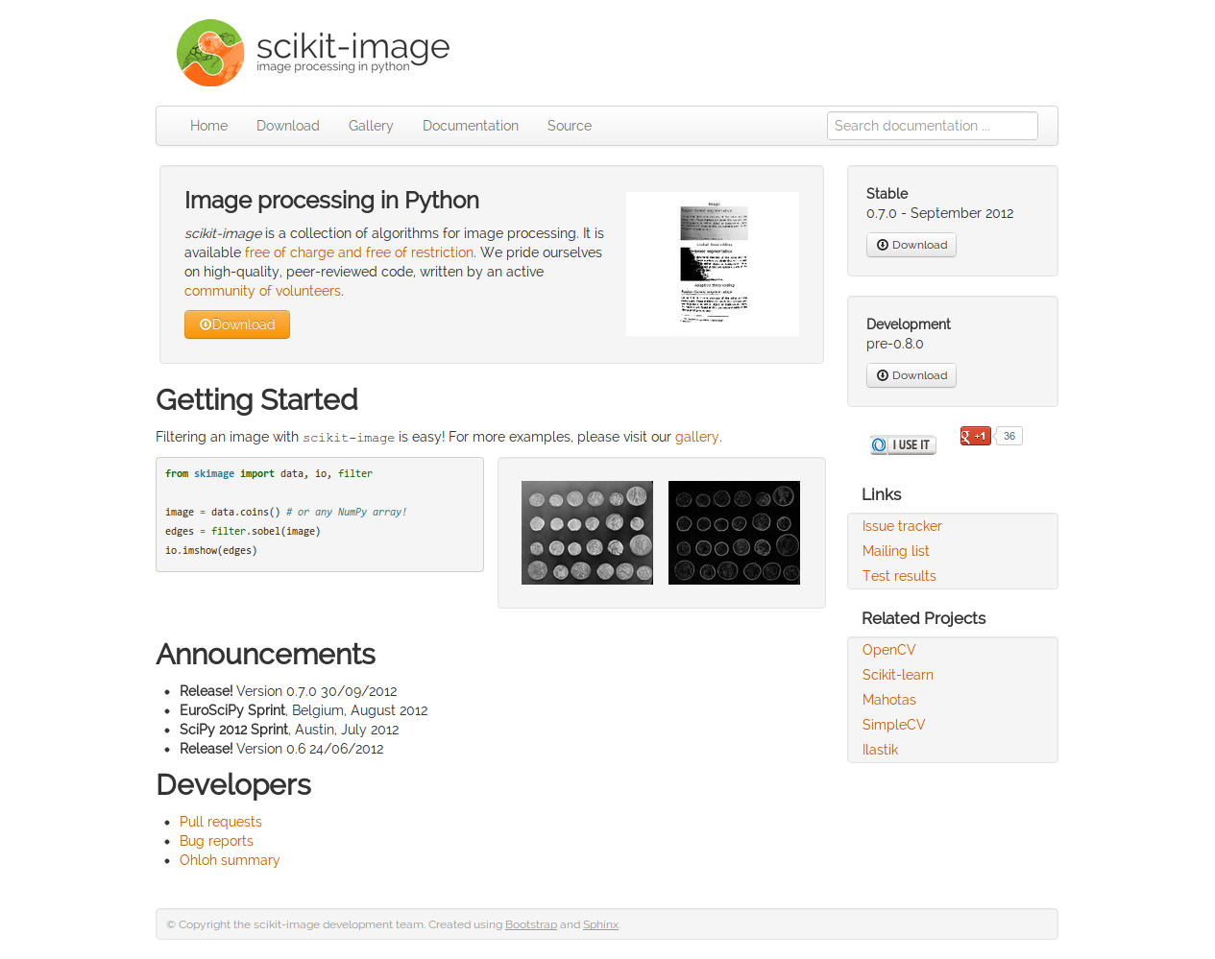
Webpage & gallery

Slide 11
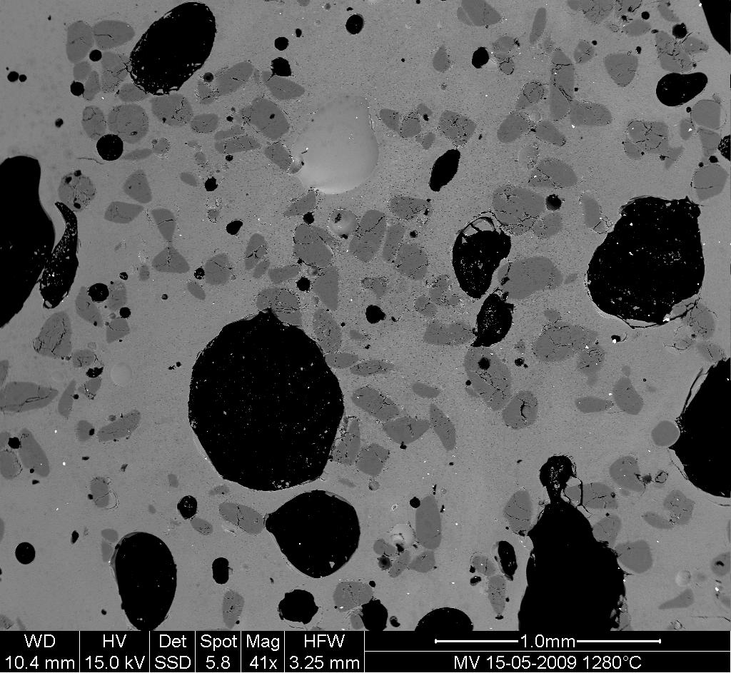
A typical image proc. problem

Slide 12
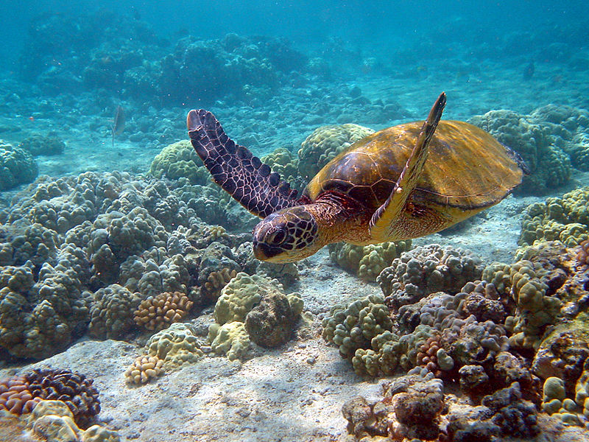
Color spaces

Slide 13
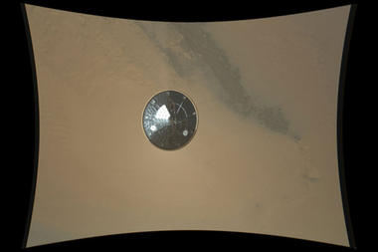
Demo

Slide 14
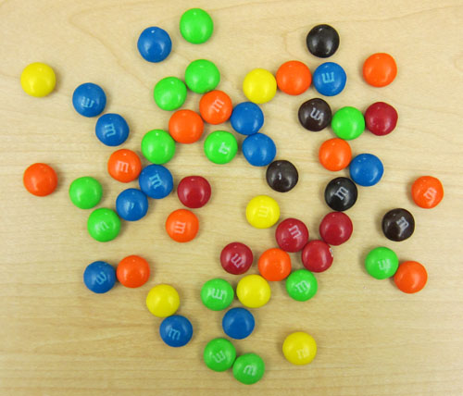
Demo

Slide 15
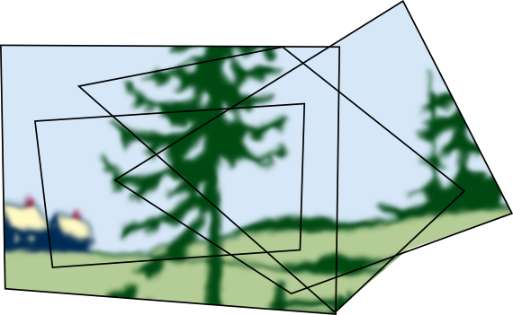
Demo

Slide 16

Demo

Slide 17
Demo
Fish eye warp

