Slide 1
An introduction to
NumPy
Travis Oliphant
Stéfan van der Walt

Slide 2

The ndarray data structure

Slide 3
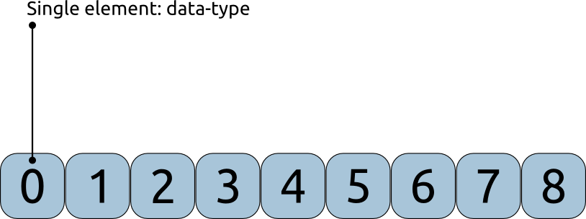
The ndarray data structure

Slide 4
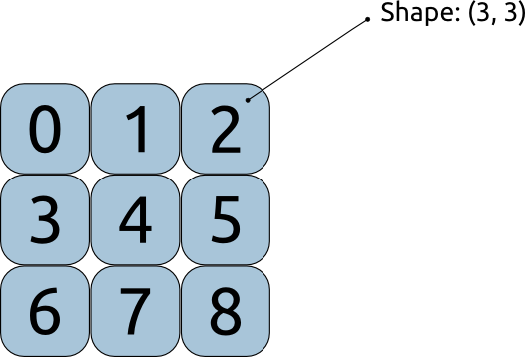
The ndarray data structure

Slide 5
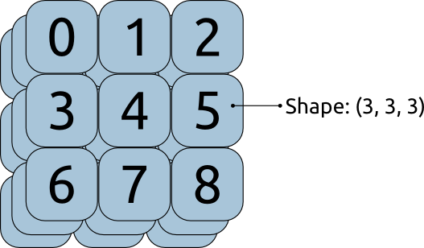
The ndarray data structure

Slide 6
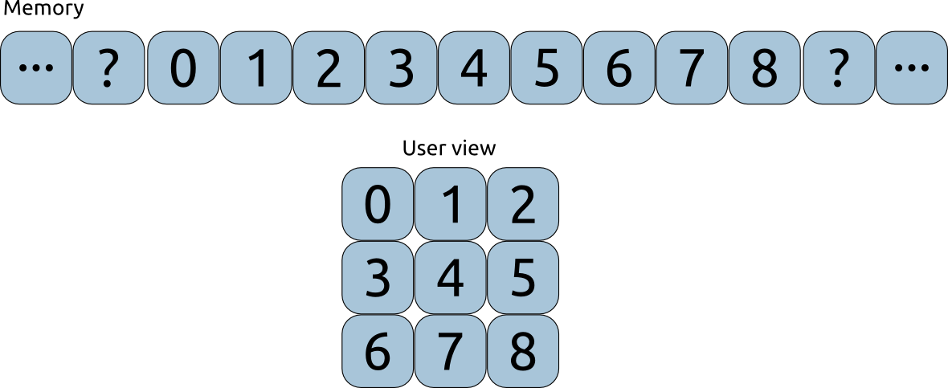
The ndarray data structure

Slide 7
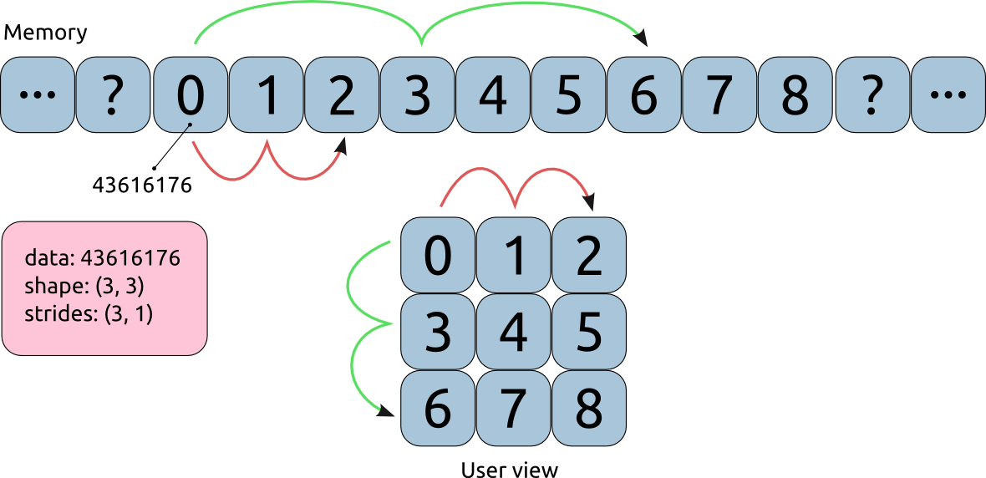
The ndarray data structure

Slide 8
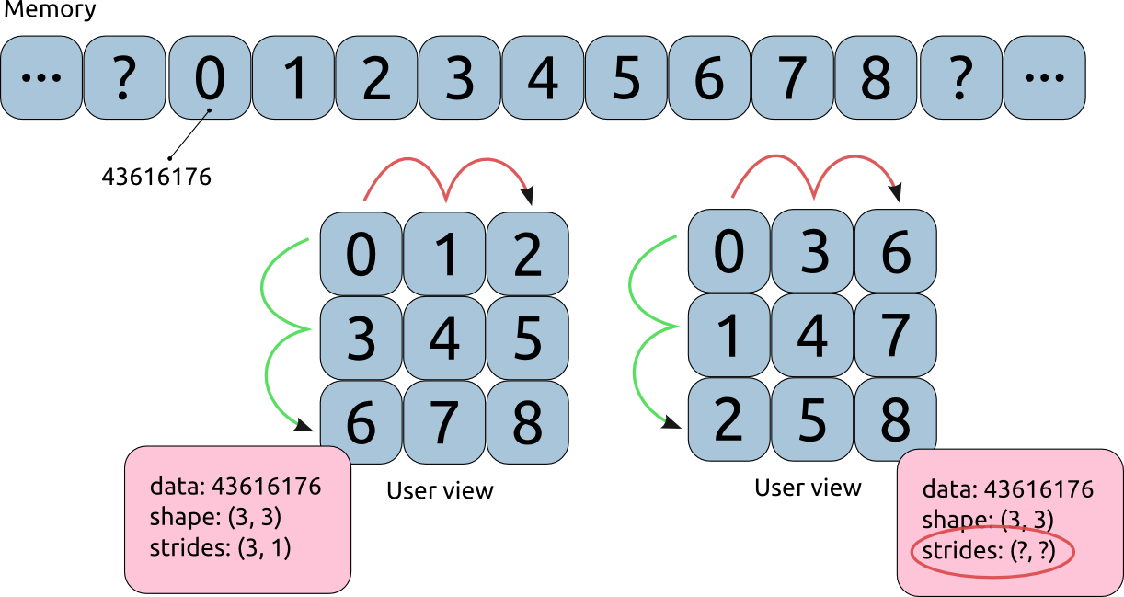
The ndarray data structure

Slide 9
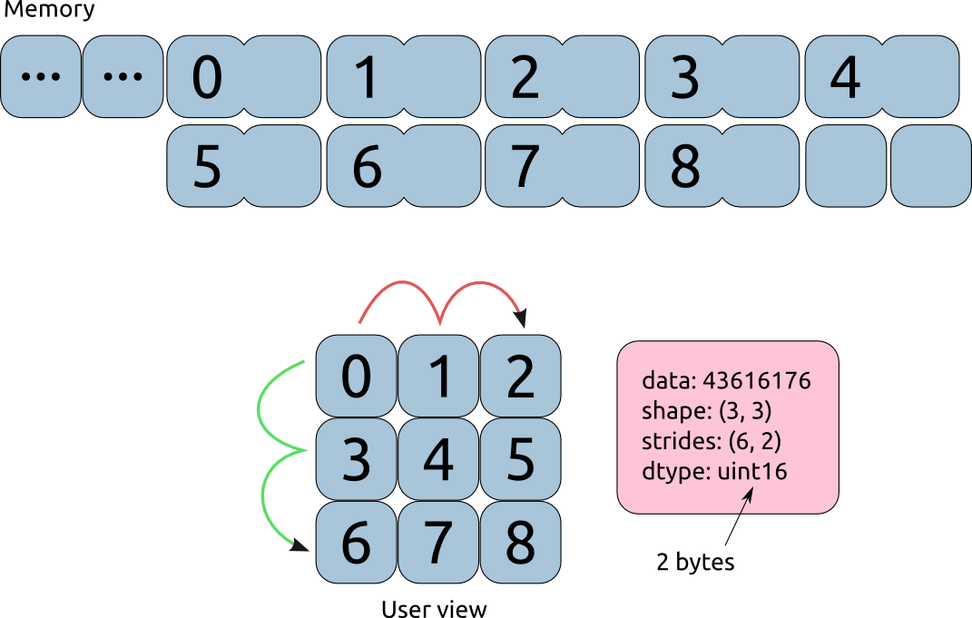
The ndarray data structure

Slide 10
Array methods
Construct:
np.zeros((3, 4)), np.arange(12), np.eye(3), np.array
Reductions, operations:
a.mean(), a.mean(axis=0), a.argmax()
Manipulation:
a.reshape((4, 3)), a.real, a.ravel(), a.fill(0),
a.clip(0, 1)
Structure: a.shape, a.dtype, a.strides, a.data

Slide 11
Demo

Slide 12
Beyond the ndarray
Available subpackages
---------------------
random
Random number generation
linalg
Linear algebra
fft
Fast Fourier transform
polynomial
Polynomials
f2py
Fortran to Python interface generator

Slide 13
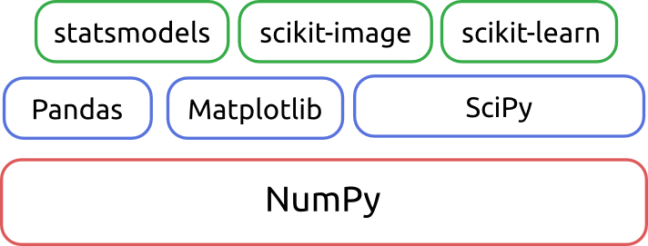
Beyond NumPy

