Slide 1

Completing the Puzzle: Lucene’s Missing Aggregation Engine

Slide 2


Shradha Shankar
Ștefan
Vodiță

Slide 3
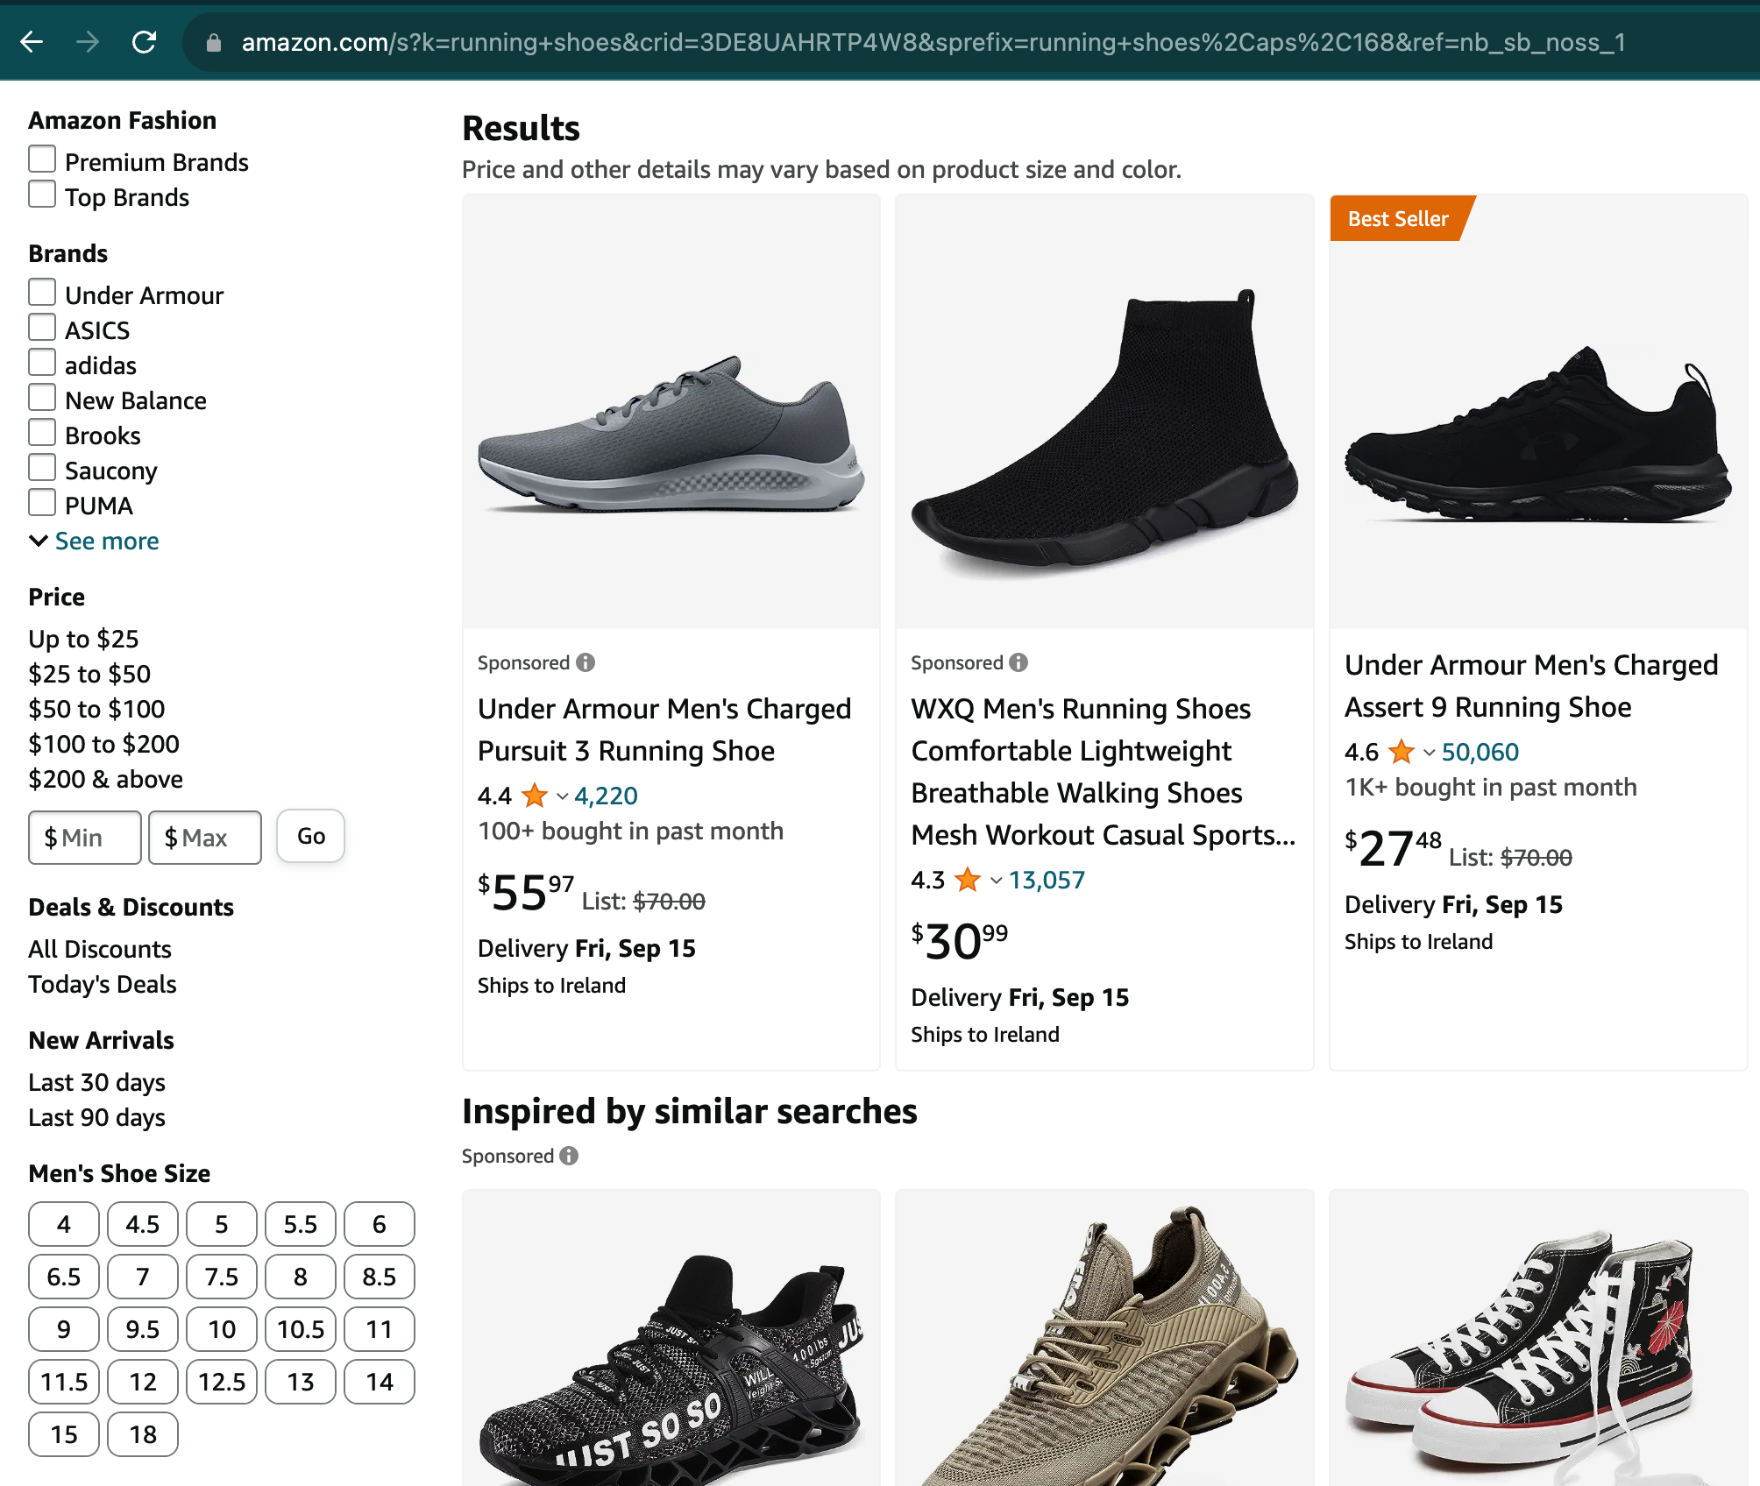

Slide 4

Dynamic
aggregation groups

Slide 5
Charles Dickens
Romance
Author
Genre
Jules Verne
Politics
All Books
French
Digital
Language
Format
English
Paper
back

Slide 6
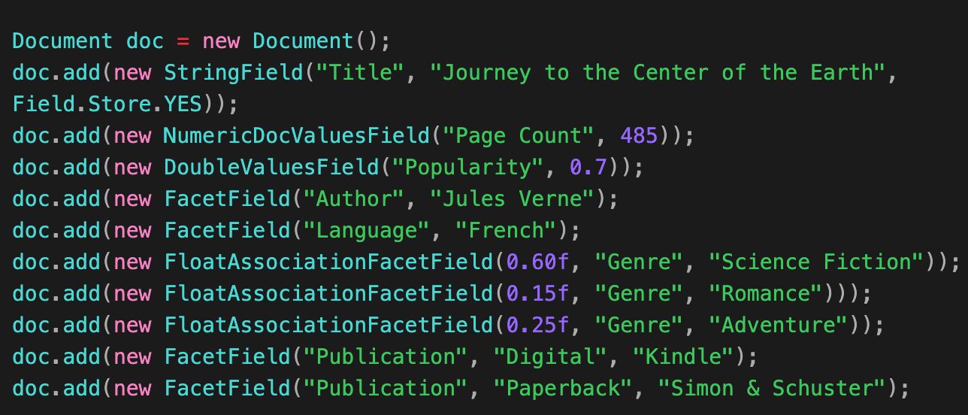
Facet Fields define groups in Lucene
Single-valued
Facet Fields
Association
Facet Fields
Hierarchical Facet Fields
Multi-valued

Slide 7

Dynamic aggregation groups
Type: Issue:
PR:
Needs:
Feature Identifying Gaps in Lucene’s Faceting (#12553)
null
Discussion

Slide 8
Dynamic
aggregation groups
Defining
aggregations

Slide 9
sum(page_count)
Accumulator
1378
880
1810
3058
0
Reducer
880
498
432
1248
Title: The Brothers
Karamazov Page Count: 880
Title: The Idiot Page Count: 498
Title: The
Silmarillion Page Count: 432
Title: The Lord of
the Rings Page Count: 1248

Slide 10
sum(page_count) acc = 0;
reduce(x, acc) = x + acc;
avg(page_count) acc = [0, 0]; // [sum, count] reduce(x, acc) = [x + acc[0], 1 + acc[1]];

Slide 11
Defining aggregations
Type: Issue:
PR:
Needs:
Improvement Identifying Gaps in Lucene’s Faceting (#12553)
null
Discussion – efficiency and genericity

Slide 12
Dynamic
aggregation groups
Defining
aggregations
Multiple aggregations

Slide 13
sum(page_count)
count()
2
880
2
1248
Dostoevsky
Tolkien
1
1
1
1
880
498
432
1248
Title: The Brothers
Karamazov Page Count: 880
Title: The Idiot Page Count: 498
Title: The
Silmarillion Page Count: 432
Title: The Lord of
the Rings Page Count: 1248

Slide 14
ord
36
7
ord
agg
36
7
51
68

Slide 15
Number of Aggregations | Speedup
2 | 1.28x
5 | 1.30x
10 | 1.35x

Slide 16
Multiple aggregations
Type: Issue:
PR:
Needs:
Optimization Compute multiple aggregations
in one iteration of the match-set (#12546)
Compute multiple float aggregations in one go (#12547)
Review

Slide 17
Dynamic
aggregation groups
Defining
aggregations
Multiple aggregations
Aggregation
expressions

Slide 18
sum(page_count) / count()
2
880
2
1248
Dostoevsky
Tolkien
1
1
1
1
880
498
432
1248
Title: The Brothers
Karamazov Page Count: 880
Title: The Idiot Page Count: 498
Title: The
Silmarillion Page Count: 432
Title: The Lord of
the Rings Page Count: 1248

Slide 19
Aggregating over an expression: max(log(2 * page_count / popularity + 42))
Arithmetic over aggregations: 2 * log(max(page_count) / sum(popularity)) + 42

Slide 20
2 * log(max(page_count) / sum(popularity)) + 42
41
44
max(page_count)
27
97
sum(popularity)
88
12

Slide 21
Aggregation expressions
Type: Issue:
PR:
Needs:
Feature Add "Expression" Facets Implementation (#12190)
Introduce ExpressionFacets along with a demo (#12184)
Design for expression syntax

Slide 22
Dynamic
aggregation groups
Defining
aggregations
Multiple aggregations
Aggregation
expressions
Flexible aggregation targets

Slide 23
Russian
British
Dostoevsky
Tolstoy
Tolkien
Lewis
The Brothers
Karamazov
The Idiot
War and Peace
The
Silmarillion
The Lord of
the Rings
The Screwtape Letters

Slide 24
Roll-up count()
3
2
2
3
Russian
British
2
1
1
1
2
1
Dostoevsky
Tolstoy
Tolkien
Lewis
1
1
1
1
1
1
The Brothers
Karamazov
The Idiot
War and Peace
The
Silmarillion
The Lord of
the Rings
The Screwtape Letters

Slide 25
Jump-up count()
2
3
1
1
3
2
Russian
British
2
2
1
1
1
1
Dostoevsky
Tolstoy
Tolkien
Lewis
1
1
1
1
1
1
The Brothers
Karamazov
The Idiot
War and Peace
The
Silmarillion
The Lord of
the Rings
The Screwtape Letters

Slide 26
Roll-ups
Jump-ups
Efficient over hierarchical groups
Efficient over less structured groups
Strictly hierarchical
Flexible
Short-circuit roll-ups
Group-to-aggregation mappings

Slide 27
Flexible aggregation targets
Type: Issue:
PR:
Needs:
Improvement Identifying Gaps in Lucene’s Faceting (#12553)
null
Discussion

Slide 28
Dynamic
aggregation groups
Defining
aggregations
Multiple aggregations
Aggregation
expressions
Flexible aggregation targets
Nested aggregations

Slide 29
max(count() for book in author) for author in nationality
13
40
Russian
British
13
6
29
40
Dostoevsky
Tolstoy
Tolkien
Lewis

Slide 30
max(count() for book in author) for author in nationality
18
8
13
5
18
4
8
5
6
count() for book in author

Slide 31
Nested aggregations
Type: Issue:
PR:
Needs:
Feature Identifying Gaps in Lucene’s Faceting (#12553)
null
Discussion

Slide 32
Dynamic
aggregation groups
Defining
aggregations
Multiple aggregations
Aggregation
expressions
Flexible aggregation targets
Nested aggregations
Data about aggregation groups

Slide 33
Dostoevsky
Tolkien
Title: The Brothers
Karamazov Page Count: 880
Popularity: 85
Title: The Idiot Page Count: 498
Popularity: 85
Title: The
Silmarillion Page Count: 432 Popularity: 92
Title: The Lord of
the Rings Page Count: 1248 Popularity: 92

Slide 34
Parent: -1
Full Path:
Parent: 0
Full Path: Author
Parent: 1
Full Path: Author/Dostoevsky
Parent: 1
Full Path: Author/Tolkien

Slide 35
Parent: -1
Full Path:
Parent: 0
Full Path: Author
Parent: 1
Full Path: Author/Dostoevsky
Popularity: 85
Parent: 1
Full Path: Author/Tolkien
Popularity: 92

Slide 36
popularity / count() for book in author
7
3
popularity
85
92
count()
13
29

Slide 37
max(popularity) for author in nationality
85
99
85
71
18
92
46
5
99
popularity

Slide 38
Data about aggregation groups
Type: Issue:
PR:
Needs:
Feature Index custom ordinal data in the taxonomy (#12336)
Index arbitrary fields in taxonomy docs (#12337)
Review

Slide 39
Dynamic
aggregation groups
Defining
aggregations
Multiple aggregations
Aggregation
expressions
Flexible aggregation targets
Nested aggregations
Data about aggregation groups

Slide 40
Contribute with us!
Where: https://github.com/apache/lucene/issues
Identifying Gaps in Lucene’s Faceting (#12553)
Compute multiple aggregations in one iteration of the match-set (#12546)
Add "Expression" Facets Implementation (#12190)
Index custom ordinal data in the taxonomy (#12336)
Should more Facets implementations be concurrent? (#12474)
Is it correct for facets to assume positive aggregation values? (#12585)

