Slide 1
A better zip bomb
Based on the paper by David Fifield

Slide 2

What is a zip bomb?
Malicious zip file
Unpacks to a very large size
Overwhelms the machine unzipping it
Example: 42.zip
Compressed size: 42 KB
Uncompressed size: 4.5 PB
Example: r.zip
Compressed size: 440 B
Uncompressed size: ∞

Slide 3

Why is this relevant?
It’s a security risk - usually used to disable antivirus software
Compression is similar to many subjects discussed in the course
M
Z
F
$$F^{−1}$$
m ∈ M
z ∈ Z
z = F(m)
|z| < |m|

Slide 4
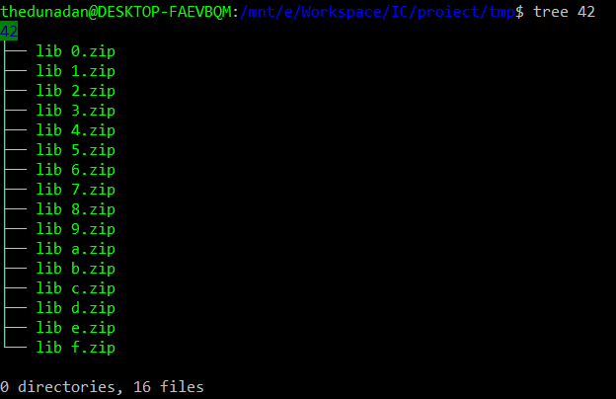
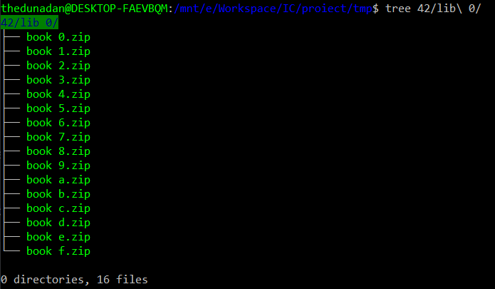
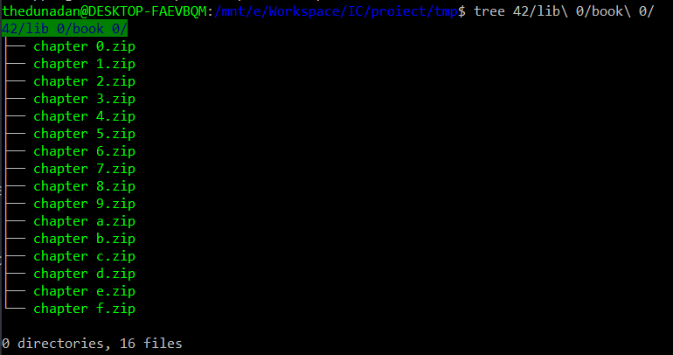
How to make a zip bomb
Recursion!
Put a file in a zip in a zip in a zip …

Slide 5
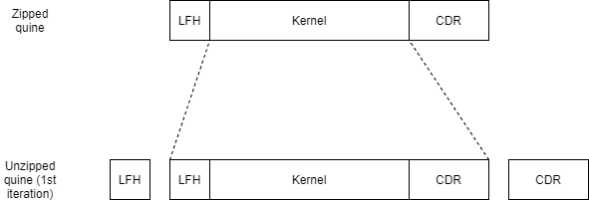
How to make a zip bomb
Quines!
This zip contains itself in zipped form

Slide 6
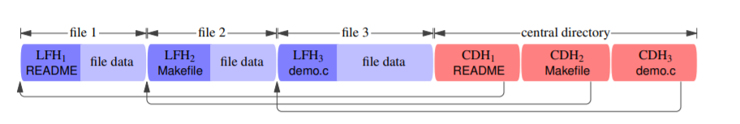
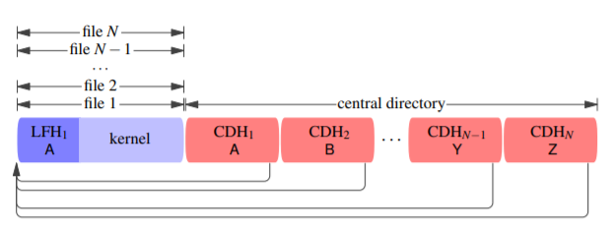
How to make a better zip bomb
Non-malicious zip file
Zip bomb

Slide 7
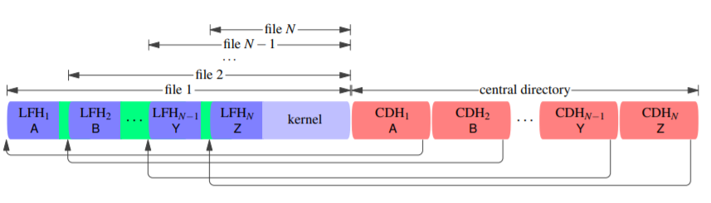
How to make a better zip bomb
Ideal zip bomb
Real zip bomb

Slide 8



What my implementation does
Sends a zip file
Intercepts Alice’s zip.
Modifies it into a zip bomb.
Forwards the bomb to Bob.
Receives a zip bomb

Slide 9
How it works
Local file header:
0 4 Local file header signature = 0x04034b50
4 2 Version needed to extract (minimum)
6 2 General purpose bit flag
8 2 Compression method
10 2 File last modification time
12 2 File last modification date
14 4 CRC-32 of uncompressed data
18 4 Compressed size
22 4 Uncompressed size
26 2 File name length (n)
28 2 Extra field length (m)
30 n File name
30+n m Extra field
Green – Some assumptions are made about this field (usually that it is 0 or empty)
Yellow – A more thorough implementation would deal with this field
Orange – If this field remains unchanged, it will result in an error
Red – If this field remains unchanged, it will result in a failed decompression

Slide 10
How it works
Central directory header:
0 4 Central directory file header signature = 0x02014b50
4 2 Version made by
6 2 Version needed to extract (minimum)
8 2 General purpose bit flag
10 2 Compression method
12 2 File last modification time
14 2 File last modification date
16 4 CRC-32 of uncompressed data
20 4 Compressed size
24 4 Uncompressed size
28 2 File name length (n)
30 2 Extra field length (m)
32 2 File comment length (k)
34 2 Disk number where file starts
36 2 Internal file attributes
38 4 External file attributes
42 4 Relative offset of local file header
46 n File name
46+n m Extra field
46+n+m k File comment
Green – Some assumptions are made about this field (usually that it is 0 or empty)
Yellow – A more thorough implementation would deal with this field
Orange – If this field remains unchanged, it will result in an error
Red – If this field remains unchanged, it will result in a failed decompression

Slide 11
How it works
End of central directory record
0 4 End of central directory signature = 0x06054b50
4 2 Number of this disk
6 2 Disk where central directory starts
8 2 Number of central directory records on this disk
10 2 Total number of central directory records
12 4 Size of central directory (bytes)
16 4 Offset of start of central directory
20 2 Comment length (n)
22 n Comment
Green – Some assumptions are made about this field (usually that it is 0 or empty)
Yellow – A more thorough implementation would deal with this field
Orange – If this field remains unchanged, it will result in an error
Red – If this field remains unchanged, it will result in a failed decompression

Slide 12
How it works
Quote
0 1 Start byte = 0x00
1 2 Quoted size
3 2 Quoted size XOR 0xffff
Green – Some assumptions are made about this field (usually that it is 0 or empty)
Yellow – A more thorough implementation would deal with this field
Orange – If this field remains unchanged, it will result in an error
Red – If this field remains unchanged, it will result in a failed decompression

Slide 14
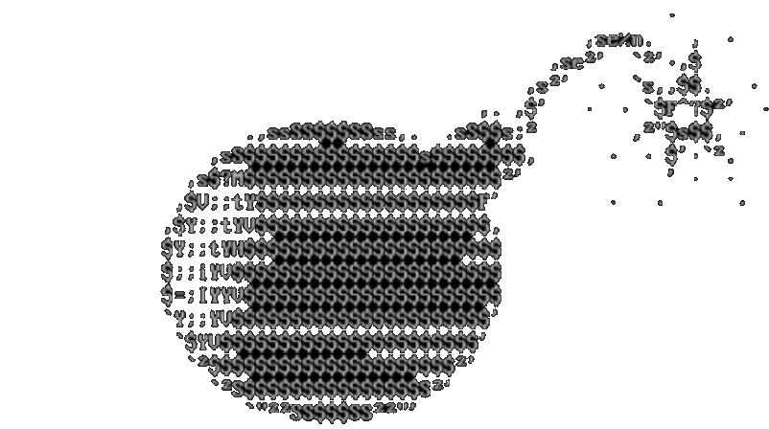
Conclusion
A zip bomb is a zip file that expands to a very large size, and it represents a security threat
One can be built recursively, but most zip tools will not fall for this
A more effective zip bomb can be built if you can unpack the same file multiple times

Slide 15
A second look
Non-malicious zip file
Zip bomb

Slide 16
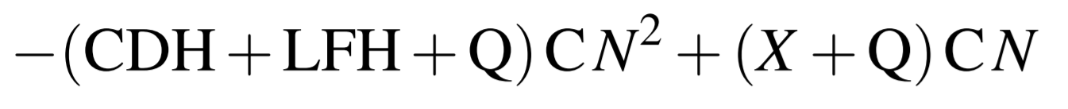
A second look

