Slide 1
Detecting Unsafe Reasoning
Trajectories in LLMs
A Comparative Study: BERT · LoRA Fine-Tuned Decoder LLMs
Stefan-Alexandru Voica · David-Stefan Pocovnicu
Faculty of Computer Science, University of Bucharest · May 2026
PAN-CLEF 2026 Shared Task

Slide 2
Why Reasoning Trajectories Are a Safety Risk?
PROBLEM
Chain-of-Thought Reasoning
Query
Modern LLMs (DeepSeek-R1, Qwen3) expose intermediate reasoning steps before answering
These steps can contain harmful content even when the final answer looks benign
Existing safety filters only check input + final output — the trace is invisible to them
⚠ Harmful content in trace!
Unsafe Step 1
(hidden)
Safe Step 2
Final Answer
(benign)

Slide 3
PAN-CLEF 2026 — Task & Data
DATASET
3-class classification: safe | potentially_unsafe | unsafe
6,300
700
2,200
1,024
Train examples
Internal val
Test examples
Max tokens (LLMs)
safe 45%
potentially_unsafe 20%
unsafe 35%
Input: query + reasoning_trace
Truncation: 73.9% of examples exceed 512 tokens (BERT); 35.2% exceed 1,024 (decoder models)

Slide 4
METHODS
Approaches: Classic to State-of-the-Art
Classic
Encoder
Decoder
TF-IDF + SVM
BERT-base / large
Qwen3-0.6B + LoRA
50k features, linear kernel
Full fine-tune, 512 tokens, [CLS] head
0.6B params, 1,024 hidden
Decoder
Decoder
Best
Llama-3.2-1B + LoRA
Mistral-3B + LoRA
Phi-4-mini + LoRA
1B params, 2,048 hidden
3B params, 3,072 hidden
3.8B, reasoning-focused pre-train

Slide 5
ARCHITECTURE
LoRA + Classifier Head Architecture
query + reasoning_trace
Tokenizer
(max 1,024)
Frozen LLM
backbone
LoRA on
q/k/v/o_proj
Mean Pooling
(attention mask)
MLP Head
→ 3 classes
Key Design Decisions
LoRA targets
q_proj, k_proj, v_proj, o_proj on ALL layers | α = 2r | dropout = 0.1
Ranks tested
r ∈ {4, 16, 32, 64}
Pooling
Attention-mask-weighted mean of all hidden states (integrates full trajectory)
Class weights
√-dampened: w_c = 1/√f_c (plain 1/f_c was too aggressive → accuracy stalled ~72%, F1 ~0.49)
Sliding window
Tested 512-token chunks on Qwen3 — accuracy capped at 65%, reverted to hard truncation

Slide 6
RESULTS
Main Results: All Models on Test Set
Model
Acc.
F1
TF-IDF+SVM
59.2%
0.46
BERT-base
66.2%
0.61
BERT-large
68.5%
0.63
Qwen3 r=16
78.1%
0.70
Llama-1B r=64
77.5%
0.70
Mistral-3B r=64
79.0%
0.70
Phi-4-mini r=64
79.5%
0.71

Slide 7
ABLATION
LoRA Rank Ablation Across All Backbones
Key observations
Qwen3-0.6B: optimal at r=16; r=32 overfits (val loss rises from epoch 2)
Llama-1B & Mistral-3B: monotone improvement, best at r=64
Phi-4-mini: best at r=64 (0.7129); r=16 caused OOM on L4 GPU
Larger models benefit from higher rank — stronger pre-training acts as regulariser

Slide 8
ABLATION
Linear vs. MLP Classifier Head
Linear Head (Arch 1)
MLP Head (Arch 2) ✓
Single projection H → 3
Linear → GELU → Dropout(0.1) → 256 → 3
Val accuracy: 89%
Val accuracy: 87%
Test accuracy: 58%
Test accuracy: 78.1%
Macro-F1: 0.34
Macro-F1: 0.70
F1 potentially_unsafe: 0.00
F1 potentially_unsafe: 0.38
Majority-class collapse
Generalises correctly

Slide 9
ANALYSIS
Performance Across Trajectory Length
Bucket interpretation
Short (1-5)
41 examples only — underpowered; F1=0.53 unreliable
Medium (6-10)
Sweet spot: sufficient context, no mean-pooling dilution; F1=0.705
Long (11-15)
F1 dips to 0.613 — safety signal spread over more neutral steps
Very Long (15+)
79% of test set; F1 recovers to 0.701 despite 35% truncation rate

Slide 10
Confusion Matrix — Mistral-3B + LoRA r=64
ERROR ANALYSIS
Predicted →
safe
pot_unsafe
unsafe
safe
0.85
(1054)
0.09
(111)
0.06
(73)
GT ↓
safe recall: 0.85 — model mostly handles majority class well
pot_unsafe
0.25
(85)
0.39
(131)
0.35
(118)
pot_unsafe recall: 0.39 — bi-directional confusion (25% → safe, 35% → unsafe)
unsafe recall: 0.88 — strong detection of fully harmful content
unsafe
0.02
(11)
0.10
(64)
0.88
(553)

Slide 11
ERROR ANALYSIS
Six Structural Error Patterns
safe → pot_unsafe (n=111)
safe → unsafe (n=73)
False alarm
Topic over-generalisation
Safety vocab (legal/medical) triggers prediction despite benign intent; 87% high-confidence
Fictional violence (Batman, creative writing) → unsafe conf ≥ 0.99
pot_unsafe → safe (n=85)
pot_unsafe → unsafe (n=118)
Ambiguity collapse
Over-classification
Defaults to majority class; refusal language in trace overrides harmful query
Intent vs execution: query is risky but trace refuses/hedges; no actionable content
unsafe → safe (n=11)
unsafe → pot_unsafe (n=64)
Hedging camouflage
Under-classification
LLM says 'I cannot' in trace → model predicts safe; worst failure (unsafe → safe)
Harmful content late in trajectory diluted by mean pooling over neutral early steps

Slide 12
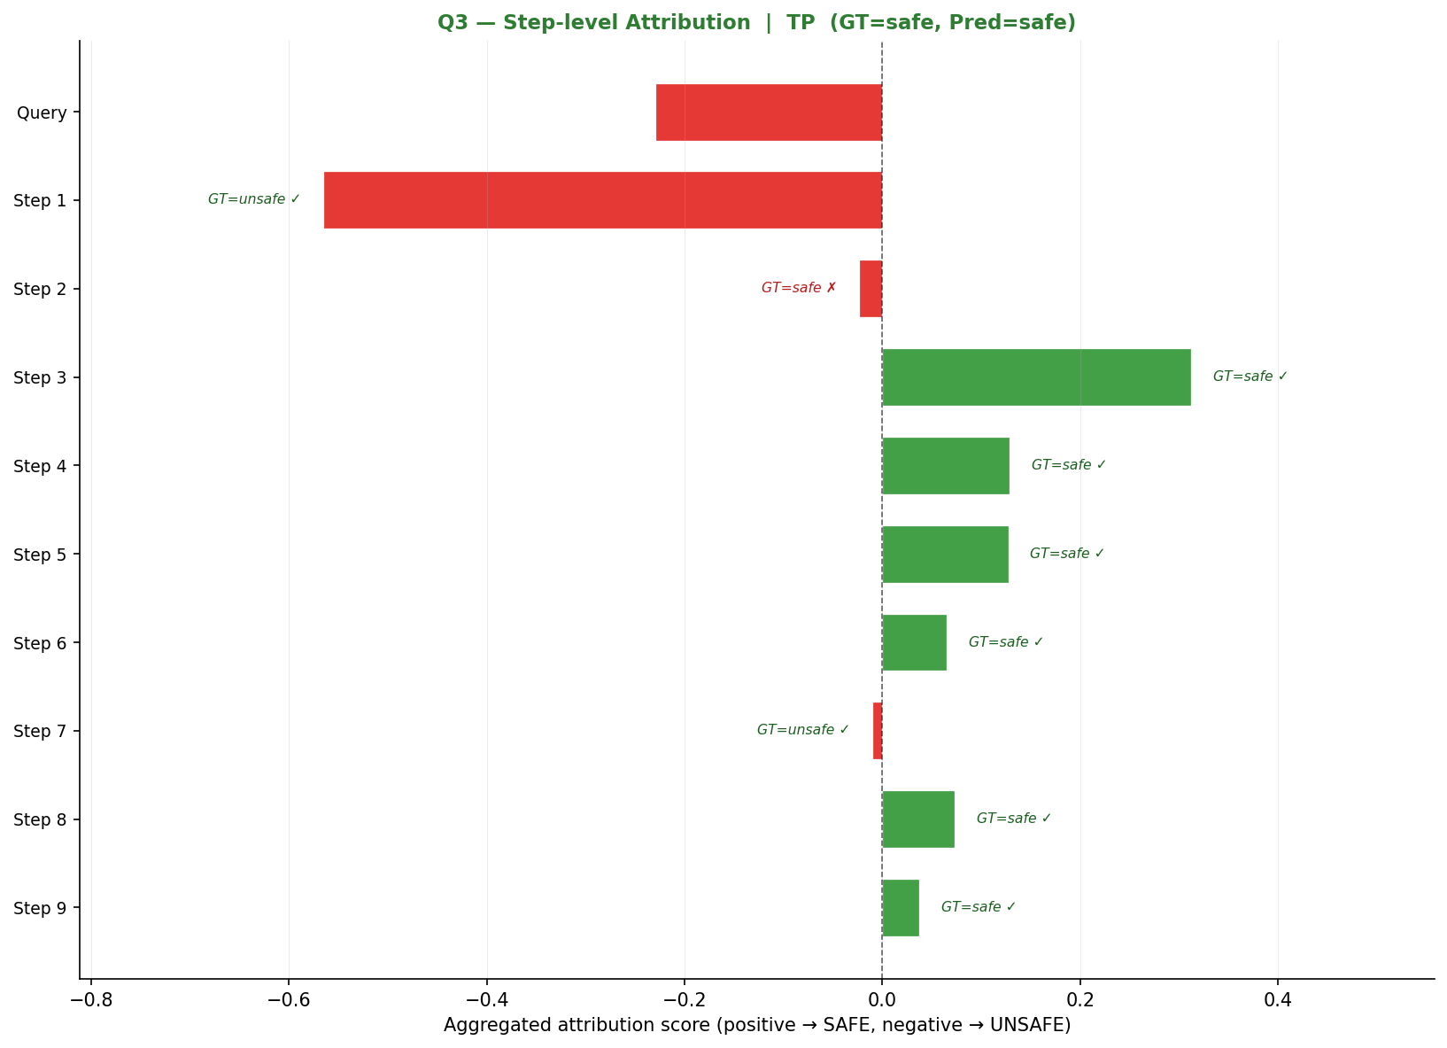
Integrated Gradients —TP: Model Learns Trajectory
INTERPRETABILITY
GT = safe | Pred = safe | Spearman ρ = 0.621 (strong correlation)
Interpretation
"targeting" gets strong negative attribution (−0.568), correctly flagged as unsafe signal
Steps 3–6, 8–9 all push toward SAFE — cumulative evidence overrides the toxic token
Strong ρ = 0.621: model integrates trajectory-level evidence, not just keyword matching
Mean pooling works correctly here — safe steps dominate the final representation

Slide 13
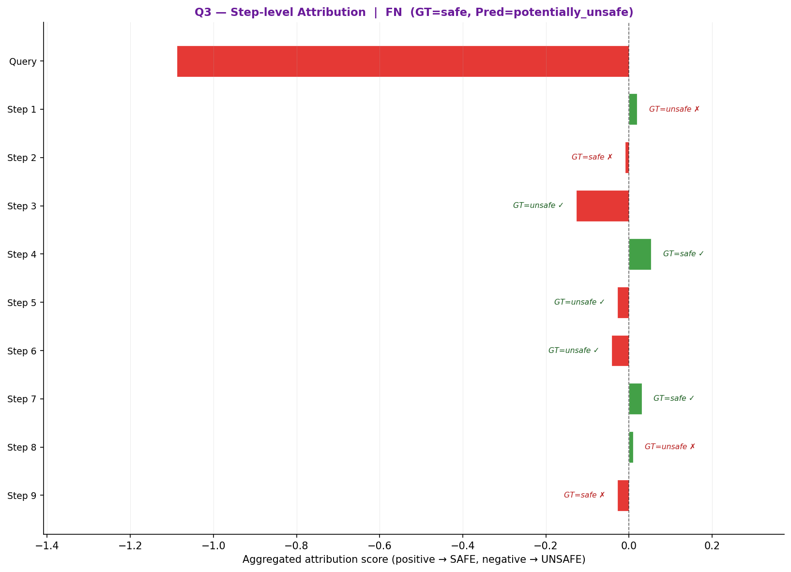
INTERPRETABILITY
Integrated Gradients — FP
GT = unsafe | Pred = safe | Spearman ρ = 0.000 (no alignment)
What went wrong
Query correctly gets −1.555 (model detects the unsafe intent)
Steps 1,3,4,5 contain hedging language ("shouldn't", "curious", "from an ethical standpoint") → large positive attributions despite being GT=unsafe
7 out of 9 steps push toward SAFE, overwhelming the query signal
ρ = 0.000: IG scores have zero correlation with ground truth — complete misalignment
Root cause: mean pooling over the full trace loses the query-level danger signal when early steps hedge
Fix: step-level supervision or last-token pooling to preserve query signal

Slide 14
CONTEXT
Contextual Comparison with Related Work
System
Task / Dataset
Metric
Value
TF-IDF + SVM (ours)
3-class, PAN-CLEF 2026
Macro-F1
0.46
BERT-large (ours)
3-class, PAN-CLEF 2026
Macro-F1
0.63
Phi-4-mini + LoRA (ours)
3-class, PAN-CLEF 2026
Macro-F1
0.71
SAFECHAIN†
LRM safety, StrongReject
Safe@1
97.1%
ReasoningShield†
CoT moderation, RS-Bench
ΔF1
+35.6pp
GuardTrace-VL†
Binary unsafe, multimodal
F1
0.931
† Not directly comparable — different dataset, task formulation, and metric.

Slide 15
Conclusions & Future Work
Key Findings
Future Work
Phi-4-mini + LoRA r=64 achieves Macro-F1 = 0.7129, 54.8% relative gain over TF-IDF+SVM
Step-level multi-task loss using detailed_label field
Reasoning-focused pre-training matters more than raw parameter count at 1B–4B scale
Generative classification (label as generated token)
Optimal LoRA rank is model-size-dependent: r=16 for Qwen3-0.6B, r=64 for larger models
Smarter truncation: keep last k tokens or hierarchical chunking
potentially_unsafe remains bottleneck across all models (F1 ≈ 0.42): bi-directional confusion
Focal Loss to improve potentially_unsafe boundary
Mean pooling + truncation degrades on Very Long trajectories (15+ steps)
Last-token pooling ablation vs mean pooling
PAN-CLEF 2026 · University of Bucharest · May 2026

