Slide 1
Design of Networks and Communication Systems
Comparison of TCP Congestion Control Protocols
RENO vs BBR
Student
Artuso Stefano
Accademic Year
2018/2019

Slide 2
What is a TCP Congestion Control Protocol? In Information Networks, the Congestion Control Protocol is a funtionality that allow the network to reduce the loss of data-packets through the network, and modelling the flow adapting it to the state of congestion of the network. Many TCP C.C.P. rely to the Congestion Window (CWD), a factor indicating the size of the packet that the sender can send. When a device enter a network his congestion window is set to 1, and start to increase for every ACK the sender receive, until it reach the ssthresh value (maximum size of the congestion window) and start increase by a value called MSS«MSS/c.w.» factor until it receive a time-out.
RENO Features
This protocol consider both events of retransmission timeout and three duplicated ACK received. In the case of timeout, the worst scenario in Reno TCP, the ssthresh value is set to half of the cwd and the CWD is set back to 1. In the case of three duplicated ACK instead, the fast retransmit of the duplicated packet, associated with the halve of the cwd and the sshtresh value, and increasing the cwd by 3MSS.
All these features can describe Reno as a static and procedural algorithm.
BBR Features
BBR is a congestion control protocol developed by Google in 2016, and his main feature is the full use of the banwidth of the network and the bufferbloat event as only indicator of the network congestion. Its a protocol that can learn the bottlenecks of the network and so redistribute the bandwidth between devices.
BBR is becomed the Congestion Control Protocol used in Google Cloud Platform and it can made the network become up to 2000 times faster and return a total data-loss of 1%.

Slide 3
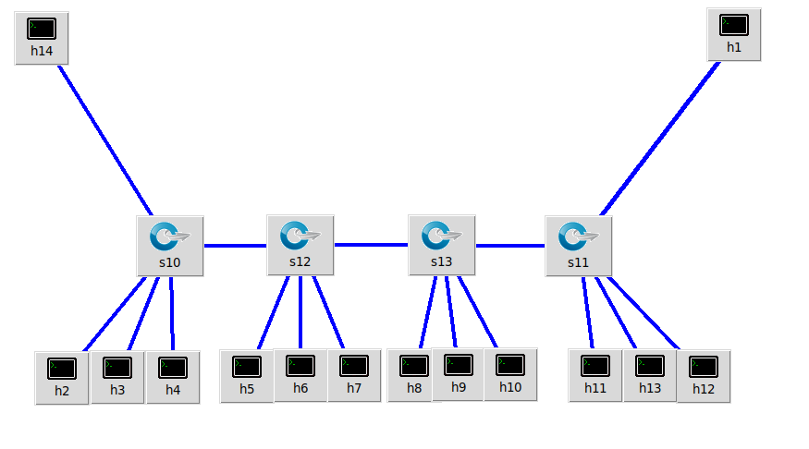
For the test of the BBR Congestion Control Protocol, for this project is used the Mininet software inside a UNIX System. Mininet is a software which virtually create a network made of host, switch and routers inside a computer. We will use a custom topology that can emulate the network of a small company.
Testing Environment -- Abstract
In the upper corners of the figure, «h1» and «h14» will be the routers that go outside and they will emulate the internet router traffic through «iperf» servers. All of the hosts at the bottom will send and receive data to the 2 hosts.
For bandwidth verification, in this project are used unix softwares bwn-ng, a package which allow to see live bitrate usage of all the interfaces in the system; captcp, a packet sniffer similar to wireshark, and make unix command, which provide with the texlive-font-utils package, a smart way to convert the data given from the sniffer to graphs.
For this test we will take a look just at the Round Trip Time, since the CWND has show no difference between tests.

Slide 4
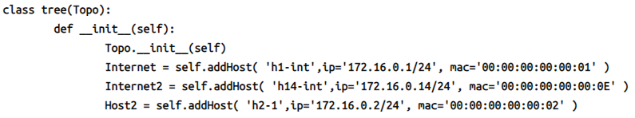

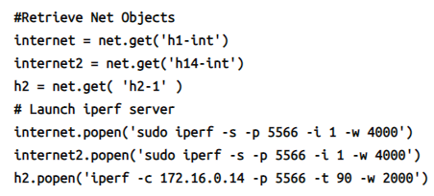

Testing Environment -- Brief Set-Up Informations
Setting the host and switches in a python script with a static IP and MAC
Setting the links between host and switch. We set 100 Mbps as bandwidth, a standard delay of 1ms, a packet-loss ratio of 3% and and maximum number of packet in the queue before the host start drop them
Setting the iperf servers and clients. The client will keep transmitting and receiving packets for 90 seconds
In another window, we launch bwn-ng to show runtime RX/TX rate of our network
We create a folder to put the result of the sniffing, and we set captcp to capture 5 packets por second.
Launching python script. When in bwn-ng we see nothing is going through the network, we exit the scrypt with CTRL-C
We create the graphs in png format with our statistic returned out from captcp

Slide 5
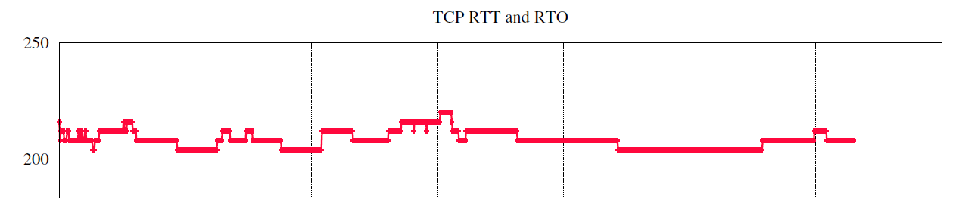

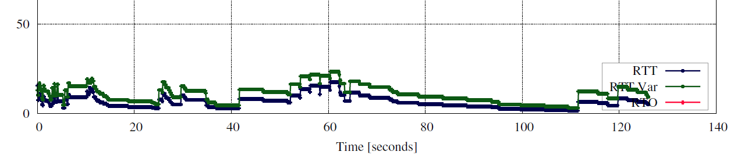
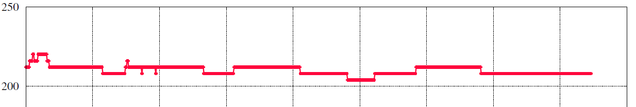
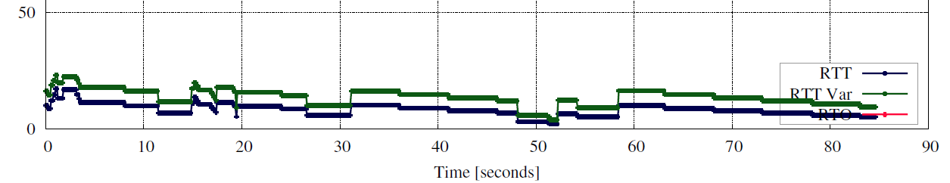
Results
TCP RTT
Round Trip Time
RENO
NOTES
It’s not possible to test two different protocols on the same machine at the same time, these graphs are mean to show the regular and constant trending and response of the BBR protocol against the procedural and «fast response» of RENO
BR

