Slide 1

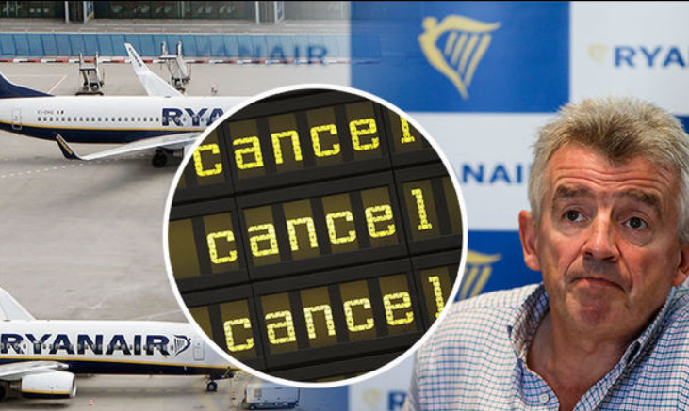
OOP Project Presentation
Flight booking Application Functionality
Ryanair cancelled flights: Michael O’Leary ADMITS ‘this is our mess'. [online] Express.co.uk. Available at: https://www.express.co.uk/travel/articles/855719/Ryanair-cancelled-flights-michael-o-leary [Accessed 6 Dec. 2017].

Slide 2
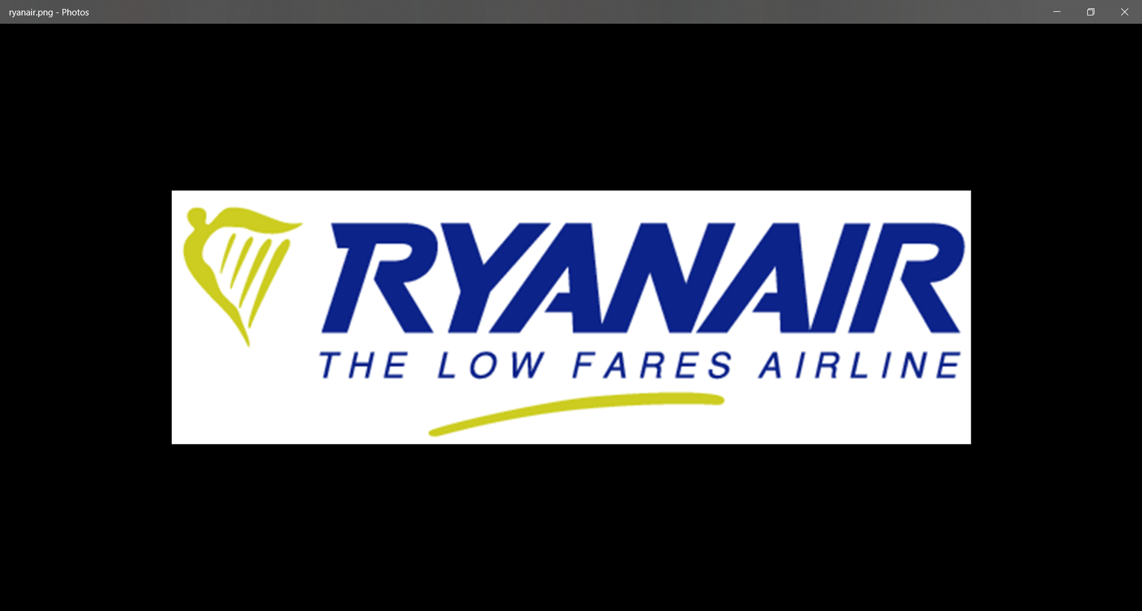
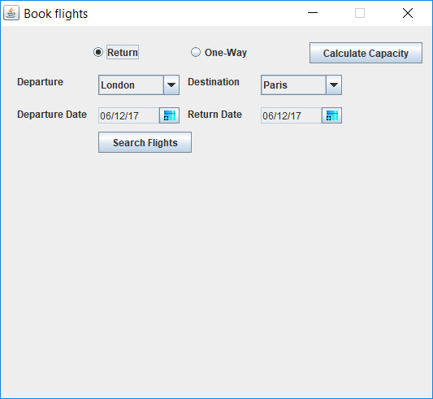
Our flight booking application will allow booking staff to enter large scale bookings for every flight available on their platform.
The first section of the main page gives the member of staff the ability to select:
return or one-way
Departure and Destination location
Departure & return dates

Slide 3
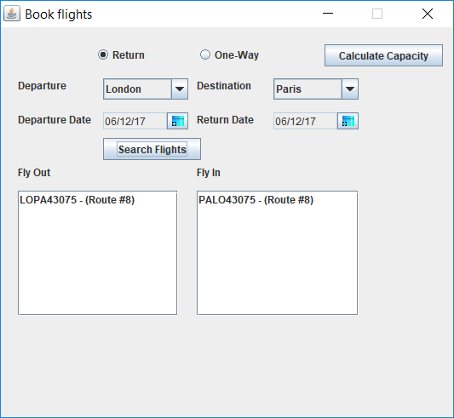
Once the “Search Flights” button has been selected the application will output the flights available.

Slide 4
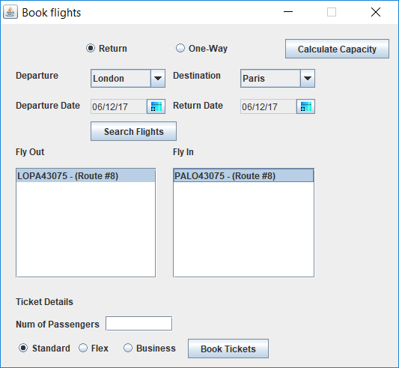
Then, the member of staff will select the flights available which will bring up further elements of the booking process:
Number of Passengers
Standard ticket
Flex ticket
Business ticket

Slide 5
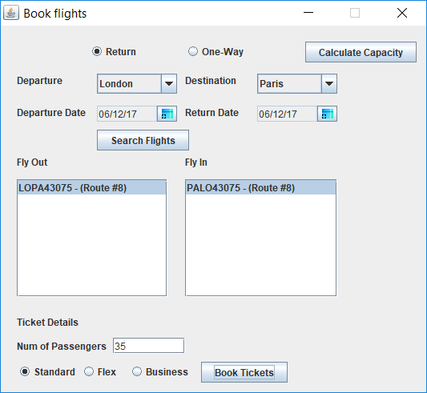
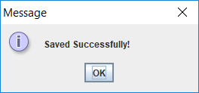
Once the user enters in the required details they will select the “Book Tickets” button.
Once clicked the user will receive either a confirmation like this one or an error message asking them to review their entries.

Slide 6
Once all flight details are input and saved the application will hold the information and apply pre-defined logic to calculate a number representable information.
All the user needs to do is select the “Calculate Capacity” button

Slide 7
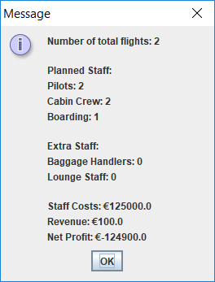
Once selected the following datasets are output for the user:
Number of flights currently booked
Staffing numbers required for the booked flights
Extra staff required based on the flight type selection
Data output to manage capacity planning frameworks
Flight crew cost
Flight booking revenue
Net Profit

