Slide 1
Speed for Free
Current state of auto-vectorization in GCC and Clang
Stefan Fuhrmann

Slide 2
The Hidden Dimension
Software gets faster by hardware getting faster
Core counts go up
Clocks go up
IPC goes up
Throughput = Cores x Clocks x IPC
Introduction

Slide 3
The Hidden Dimension
Software gets faster by hardware getting faster
Core counts go up
Clocks go up
IPC goes up
In 1997 (!) MMX started a silent revolution
1 op/instruction ⇒ 16 ops/instruction (today)
Not covered natively by C/C++ type system
90% of performance potentially left on the table by C++
Throughput = Cores x Clocks x IPC
Introduction

Slide 4
The Hidden Dimension
Software gets faster by hardware getting faster
Core counts go up
Clocks go up
IPC goes up
In 1997 (!) MMX started a silent revolution
1 op/instruction ⇒ 16 ops/instruction (today)
Not covered natively by C/C++ type system
90% of performance potentially left on the table by C++
Throughput = Cores x Clocks x IPC
Introduction
x Ops/instruction

Slide 5
My Angle
Motivation
I deeply care about performance; it's also my job
Hand-vectorization too expensive for many applications
Masking in AVX512 and SVE2 simplifies auto-vectorization
GCC 15 and Clang 20 enabled auto-vectorization in –O2
Questions
Will the compiler do all the work for me?
Gains in simple, STL-like loops
How much potential is there at all?
GCC and Clang are awesome!
Introduction

Slide 6
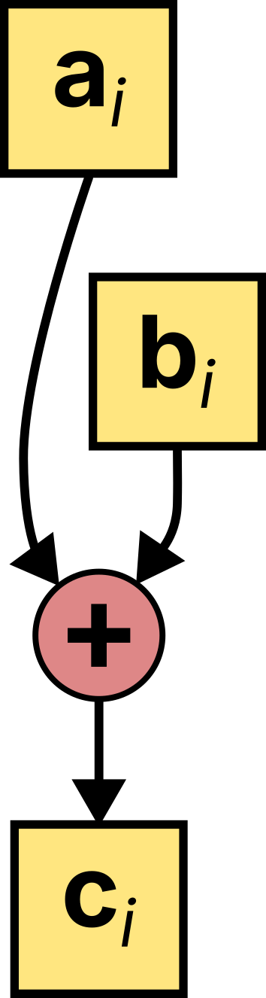
Recap: Vectorization = SIMD
Basic idea akin to loop unrolling:
Introduction

Slide 7
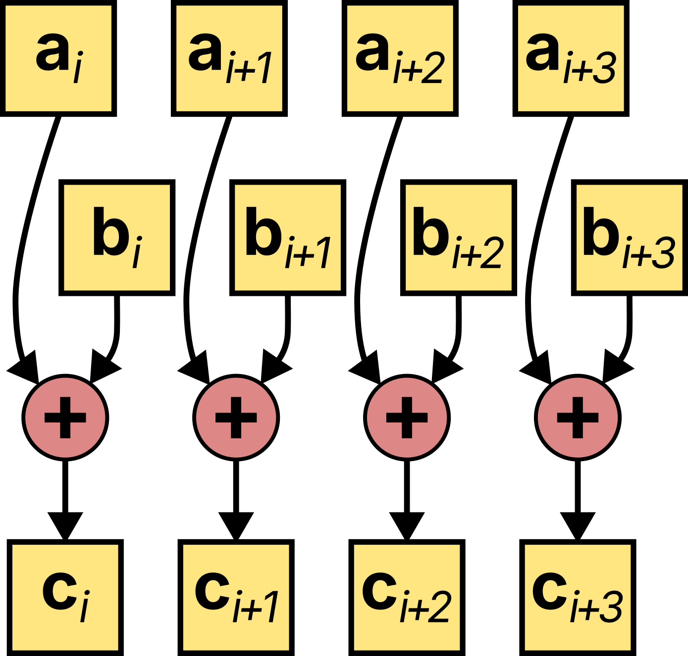
Recap: Vectorization = SIMD
Basic idea akin to loop unrolling:
Introduction
Fewer iterations
(loop overhead)
More code

Slide 8
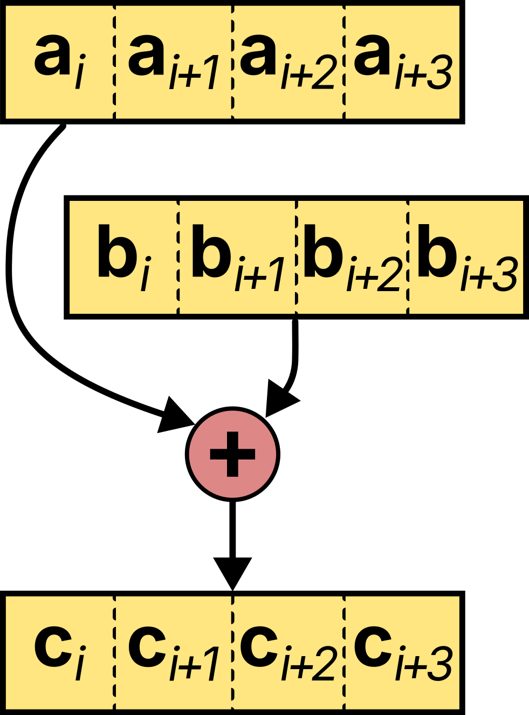
Recap: Vectorization = SIMD
Basic idea akin to loop unrolling:
Introduction
Fewer iterations
(loop overhead)
More code
More work done by each instruction
Code size similar to scalar

Slide 9
Vectorization = SIMD
Basic idea akin to loop unrolling
using Vec = std::array<int32_t, 4>;
Vec a, b, c;
for (size_t i = 0; i < 4; ++i) {
c[i] = a[i] + b[i];
}
auto a0 = a[0], b0 = b[0];
auto a1 = a[1], b1 = b[1];
auto a2 = a[2], b2 = b[2];
auto a3 = a[3], b3 = b[3];
auto c0 = a0 + b0;
auto c1 = a1 + b1;
auto c2 = a2 + b2;
auto c3 = a3 + b3;
c[0] = c0;
c[1] = c1;
c[2] = c2;
c[3] = c3;
auto av = _mm_loadu_epi32(a.data()),
bv = _mm_loadu_epi32(b.data());
auto cv = _mm_add_epi32(av, av);
_mm_storeu_epi32(c.data(), cv);
Introduction
Vector sizes 2 .. 64
"odd" iterations at the end would need special handling

Slide 10


The Repo
Introduction
https://github.com/stefeff/auto-vectorization

Slide 11
Linear Algebra
Well-known, regular structures
High gains, moderate effort
FP operations always use
vector units
HPC & benchmark relevant
Easy Mode

Slide 12
Linear Algebra
Well-known, regular structures
High gains, moderate effort
FP operations always use
vector units
HPC & benchmark relevant
16x16 matrix multiplication
Use specialized libs for larger problem sizes!
struct alignas(64) Matrix
{
float data[16][16];
};
Matrix mult(const Matrix& lhs, const Matrix& rhs)
{
Matrix result;
for (int i = 0; i < 16; ++i) {
for (int k = 0; k < 16; ++k) {
float sum = 0;
for (int n = 0; n < 16; ++n) {
sum += lhs.data[i][n] * rhs.data[n][k];
}
result.data[i][k] = sum;
}
}
return result;
}
Easy Mode

Slide 13
Linear Algebra
Well-known, regular structures
High gains, moderate effort
FP operations always use
vector units
HPC & benchmark relevant
16x16 matrix multiplication
Use specialized libs for larger problem sizes!
Expectation
Close to 32 Flops/cycle HW limit
struct alignas(64) Matrix
{
float data[16][16];
};
Matrix mult(const Matrix& lhs, const Matrix& rhs)
{
Matrix result;
for (int i = 0; i < 16; ++i) {
for (int k = 0; k < 16; ++k) {
float sum = 0;
for (int n = 0; n < 16; ++n) {
sum += lhs.data[i][n] * rhs.data[n][k];
}
result.data[i][k] = sum;
}
}
return result;
}
Easy Mode

Slide 14


Generated Code
Easy Mode
https://godbolt.org/z/e737edGdY

Slide 15
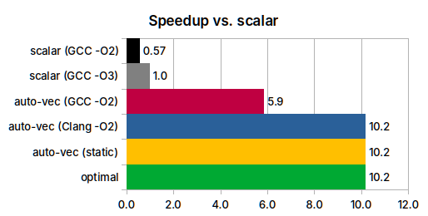
Results
Easy Mode
Flags for auto-vectorization:
-DNDEBUG -march=native -O3 -march=znver4
Flags for scalar:
-DNDEBUG -march=native -O3 -march=znver4 \
-fno-tree-vectorize

Slide 16
Results
GCC and Clang output near optimal
GCC may fail to perform pre-load optimization
Clang -O2 better than GCC -O2
Easy Mode
Flags for auto-vectorization:
-DNDEBUG -march=native -O3 -march=znver4
Flags for scalar:
-DNDEBUG -march=native -O3 -march=znver4 \
-fno-tree-vectorize

Slide 17
Results
GCC and Clang output near optimal
GCC may fail to perform pre-load optimization
Clang -O2 better than GCC -O2
Rating:
75% (log speedup : log optimal)
Under optimal conditions:
100%
Easy Mode
Flags for auto-vectorization:
-DNDEBUG -march=native -O3 -march=znver4
Flags for scalar:
-DNDEBUG -march=native -O3 -march=znver4 \
-fno-tree-vectorize

Slide 18
Unpack and Transform
Extract data from odd-sized struct
Still simple 1D operation
Data not nicely aligned to SIMD chunk
Tail handling required
RGB-to-grayscale conversion
Temporary expansion to FP32 changes vector capacity
Expectation
Optimal: 6 cycles / iteration (16 pixels)
Compiler will issue intermediate permutation instructions
Moderate

Slide 19
Unpack and Transform
Extract data from odd-sized struct
Still simple 1D operation
Data not nicely aligned to SIMD chunk
Tail handling required
RGB-to-grayscale conversion
Temporary expansion to FP32 changes vector capacity
Expectation
Optimal: 6 cycles / iteration (16 pixels)
Compiler will issue intermediate permutation instructions
struct RGB
{
uint8_t red;
uint8_t green;
uint8_t blue;
};
void rgb2gray(uint8_t* gray,
const RGB* rgb,
size_t n)
{
for (size_t i = 0; i < n; ++i) {
auto& pixel = rgb[i];
float gr = 0.299f * pixel.red
+ 0.587f * pixel.green
+ 0.114f * pixel.blue;
gray[i] = static_cast<uint8_t>(gr + 0.5f);
}
}
Moderate

Slide 20
Unpack and Transform
Extract data from odd-sized struct
Still simple 1D operation
Data not nicely aligned to SIMD chunk
Tail handling required
RGB-to-grayscale conversion
Temporary expansion to FP32 changes vector capacity
Expectation
Optimal: 6 cycles / iteration (16 pixels)
Compiler will issue intermediate permutation instructions
struct RGB
{
uint8_t red;
uint8_t green;
uint8_t blue;
};
void rgb2gray(uint8_t* gray,
const RGB* rgb,
size_t n)
{
for (size_t i = 0; i < n; ++i) {
auto& pixel = rgb[i];
float gr = 0.299f * pixel.red
+ 0.587f * pixel.green
+ 0.114f * pixel.blue;
gray[i] = static_cast<uint8_t>(gr + 0.5f);
}
}
Moderate

Slide 21
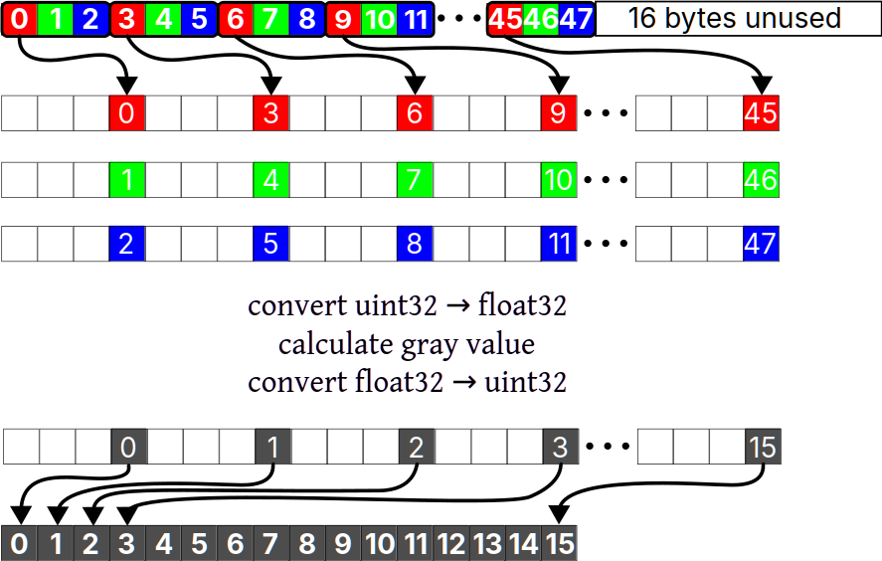
What the Compiler Should Produce
Masking to load only 16 x 3
bytes
Tail iteration may require "shorter" mask
"permute" to pick every 3rd put into every 4th
Masking to fill leading bytes with 0
Moderate

Slide 22

Generated Code
Moderate
https://godbolt.org/z/c5YeaG96s
Copyright © Efficientware GmbH, All rights reserved.

Slide 23
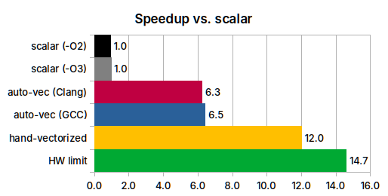
Results
Moderate

Slide 24
Results
Only minor differences between
GCC and Clang, -O2 and -O3
Loads 3 chunks instead of just 1 (input vector larger than processing capacity)
No masked tail handling
Moderate

Slide 25
Results
Only minor differences between
GCC and Clang, -O2 and -O3
Loads 3 chunks instead of just 1 (input vector larger than processing capacity)
No masked tail handling
Rating:
70% of HW limit
Moderate

Slide 26
2D Operation std::find_first_of
Innermost of nested loops
Usually the most costly
May be too short for vectorization
Challenging

Slide 27
2D Operation std::find_first_of
Innermost of nested loops
Usually the most costly
May be too short for vectorization
Operations on strings
Often, much faster solutions exist
LibC should cover more of those
auto findFirstOf(
const std::string& s,
const std::string& to_find)
{
auto first1 = s.begin();
auto last1 = s.end();
auto first2 = to_find.begin();
auto last2 = to_find.end();
// logic from glibc std_algo.h's implementation
// of std::find_first_of()
for (; first1 != last1; ++first1)
for (auto it = first2; it != last2; ++it)
if (*first1 == *iter)
return first1;
return last1;
}
Challenging

Slide 28
2D Operation std::find_first_of
Innermost of nested loops
Usually the most costly
May be too short for vectorization
Operations on strings
Often, much faster solutions exist
LibC should cover more of those
Expectation
Approach HW limit for long to_find
HW limit is 64 comparisons/cycle
auto findFirstOf(
const std::string& s,
const std::string& to_find)
{
auto first1 = s.begin();
auto last1 = s.end();
auto first2 = to_find.begin();
auto last2 = to_find.end();
// logic from glibc std_algo.h's implementation
// of std::find_first_of()
for (; first1 != last1; ++first1)
for (auto it = first2; it != last2; ++it)
if (*first1 == *iter)
return first1;
return last1;
}
Challenging

Slide 29

Generated Code
Challenging
https://godbolt.org/z/344En8nzT

Slide 30
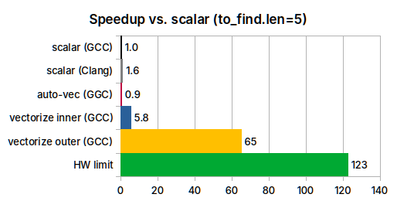
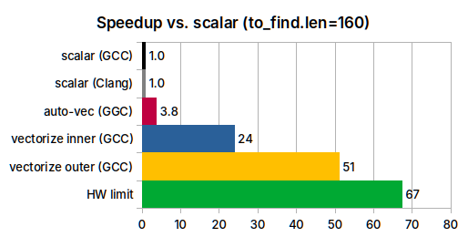
Results
Challenging

Slide 31
Results
Clang will often not vectorize
Regression for short,
modest gains for large inputs
Effective inner loop vectorization requires masking
Vectorizing outer loop much more efficient, but also uses masks
Challenging

Slide 32
Results
Clang will often not vectorize
Regression for short,
modest gains for large inputs
Effective inner loop vectorization requires masking
Vectorizing outer loop much more efficient, but also uses masks
Rating:
-2% .. 32% of HW limit
Compared to LibC-like solution:
-1% .. 17%
Challenging

Slide 33
Compacting Vectors std::remove_copy_if
Frequent in vectorized code
Filter, split or reformat data
Output shall be compact to process it further with full vector efficiency
More efficient than gather / scatter
Hard

Slide 34
Compacting Vectors std::remove_copy_if
Frequent in vectorized code
Filter, split or reformat data
Output shall be compact to process it further with full vector efficiency
More efficient than gather / scatter
Breaks vector lane mapping
More difficult than masking
// tell the compiler that input and output
// buffers don't overlap
float* sanitize(float* __restrict__ out,
const float* __restrict__ in,
size_t count)
{
return std::remove_copy_if(
in,
in + count,
out,
[](auto v) {
return v <= 0.f;
});
}
Hard

Slide 35
Compacting Vectors std::remove_copy_if
Frequent in vectorized code
Filter, split or reformat data
Output shall be compact to process it further with full vector efficiency
More efficient than gather / scatter
Breaks vector lane mapping
More difficult than masking
Expectation
No auto-vectorization
Unaligned store limit: ~3 cycles / 64B
// tell the compiler that input and output
// buffers don't overlap
float* sanitize(float* __restrict__ out,
const float* __restrict__ in,
size_t count)
{
return std::remove_copy_if(
in,
in + count,
out,
[](auto v) {
return v <= 0.f;
});
}
Hard

Slide 36
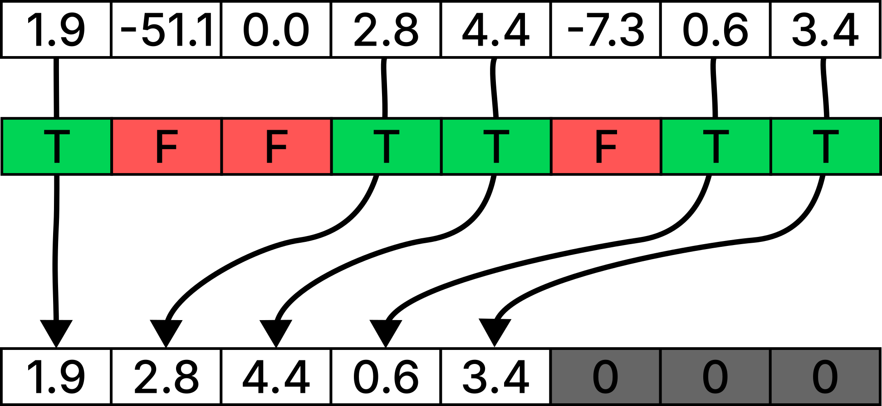
Illustration
in
mask
out
Hard
out = _mm256_maskz_compress_ps(mask, in)

Slide 37

Generated Code
Hard
https://godbolt.org/z/xj53fG3nP
Copyright © Efficientware GmbH, All rights reserved.

Slide 38
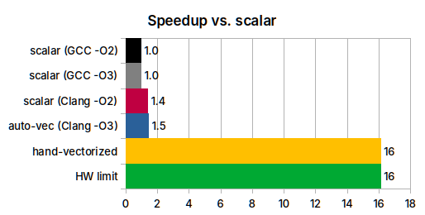
Results
Hard

Slide 39
Results
Same performance -O2 & -O3
Clang faster due to unrolling
No auto-vectorization
Hard

Slide 40
Results
Same performance -O2 & -O3
Clang faster due to unrolling
No auto-vectorization
Rating:
0% of HW limit
Hard

Slide 41
Throughput Relative to GCC -O2
Could it be worth going from GCC -O2 to -O3 or Clang?
Summary

Slide 42
Conclusion
Clang has edge over GCC on scalar code and -O2
Simple, linear loops get meaningful speedups
Linear algebra saw biggest performance increase (small matrices)
Summary

Slide 43
Conclusion
Clang has edge over GCC on scalar code and -O2
Simple, linear loops get meaningful speedups
Linear algebra saw biggest performance increase (small matrices)
GCC -O3 may still be required for auto-vectorization
GCC somewhat better at AVX512 code (auto- and hand-vectorized)
Summary

Slide 44
Conclusion
Clang has edge over GCC on scalar code and -O2
Simple, linear loops get meaningful speedups
Linear algebra saw biggest performance increase (small matrices)
GCC -O3 may still be required for auto-vectorization
GCC somewhat better at AVX512 code (auto- and hand-vectorized)
Meaningful next step: generating masked loads and stores
Masked operations in general
Inner / outer loop trade-offs
Summary

