Slide 1
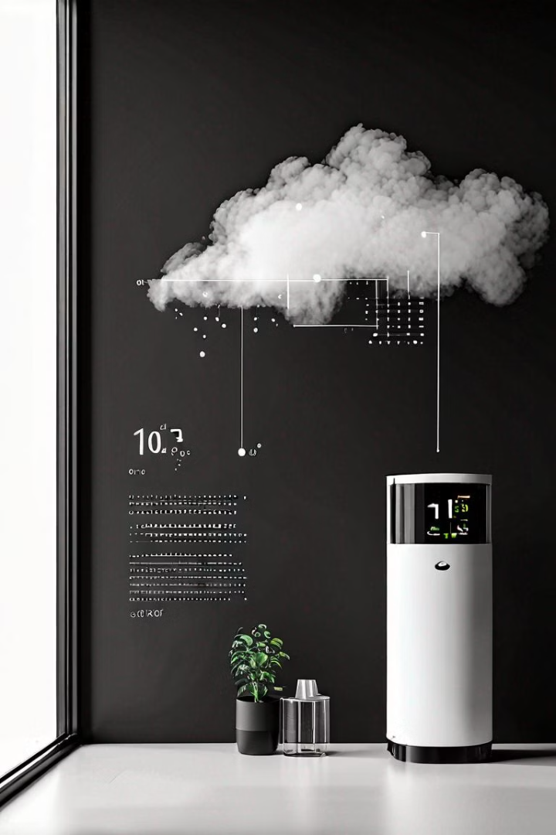

Air Quality Tracking using WSN
In this mini project, we were able to present an IoT-based approach for monitoring air quality in indoor environments. By utilizing various sensors connected to a Raspberry Pi microcontroller, they collect data on temperature, humidity and carbon dioxide levels. This data is then stored in the cloud and analyzed using mathematical formulas and visualization tools like ThingSpeak. The system provides a comprehensive solution for assessing indoor air quality, which is crucial for maintaining a healthy living and working environment.
by ARON ABRAHAM-2021BEC0006 STEFFIN GEORGE -2021BEC0016
THOMAS M-2021BEC0031 SACHU TOM-2021BEC0032

Slide 2
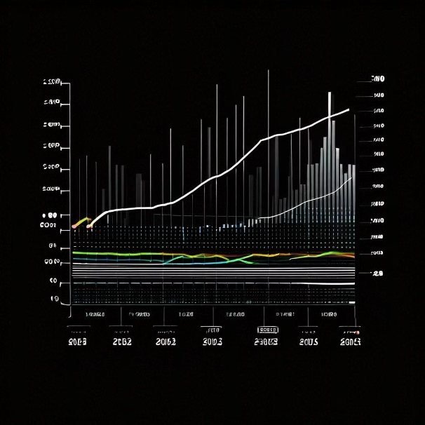
Temperature and Humidity Monitoring
Temperature Measurement
The DHT11 sensor is used to measure the temperature in the indoor environment. The temperature is represented in degrees Celsius, and the graphs reveal fluctuations due to factors like hot weather conditions and the use of air conditioning.
Humidity Monitoring
The DHT11 sensor also measures the humidity level in the indoor environment. The humidity is represented as a percentage, and the graphs show changes due to factors like hot weather and the use of air conditioning.

Slide 3
Air Quality and Gas Detection
Carbon Dioxide Levels
The MQ135 sensor is used to measure the level of carbon dioxide in the air. The members present graphs showing the variation of carbon dioxide over time at different locations. The graphs reveal fluctuations due to factors like the presence of cigarette smoke and the level of population in the area.

Slide 4
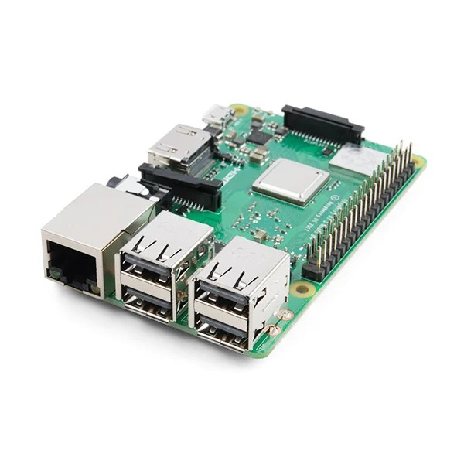
Raspberry Pi 3 Model: Powerful Platform for Temperature and Humidity Measurement
The Raspberry Pi 3 Model B+ is a versatile single-board computer that has found widespread use in various applications, including precise temperature and humidity monitoring. This powerful yet compact device offers an ideal solution for engineers, developers, and hobbyists seeking to integrate robust environmental sensing capabilities into their projects.

Slide 5

Sensor Compatibility and Data Acquisition
Sensor Compatibility: The Raspberry Pi 3 is compatible with a wide range of specialized sensors designed for accurate temperature and humidity measurements, such as DHT11, DHT22, and DS18B20.
Data Acquisition: Through the GPIO pins, the Raspberry Pi seamlessly interfaces with these sensors, enabling real-time data acquisition on environmental conditions.
Python Integration: Python scripts are commonly used to interact with the sensors and collect the temperature and humidity data, leveraging the Raspberry Pi's processing capabilities.

Slide 6

Cloud Data Storage and Monitoring
The data collected from the various sensors is stored in the cloud using an internet connection. The members used the ThingSpeak platform, an IoT analytics platform, to store and visualize the sensor data.
The stored data in the cloud can be accessed and monitored for analyzing the air quality in the indoor environment under study. The members used ThingSpeak to visualize and analyze the data, providing insights into the environmental conditions.

Slide 7
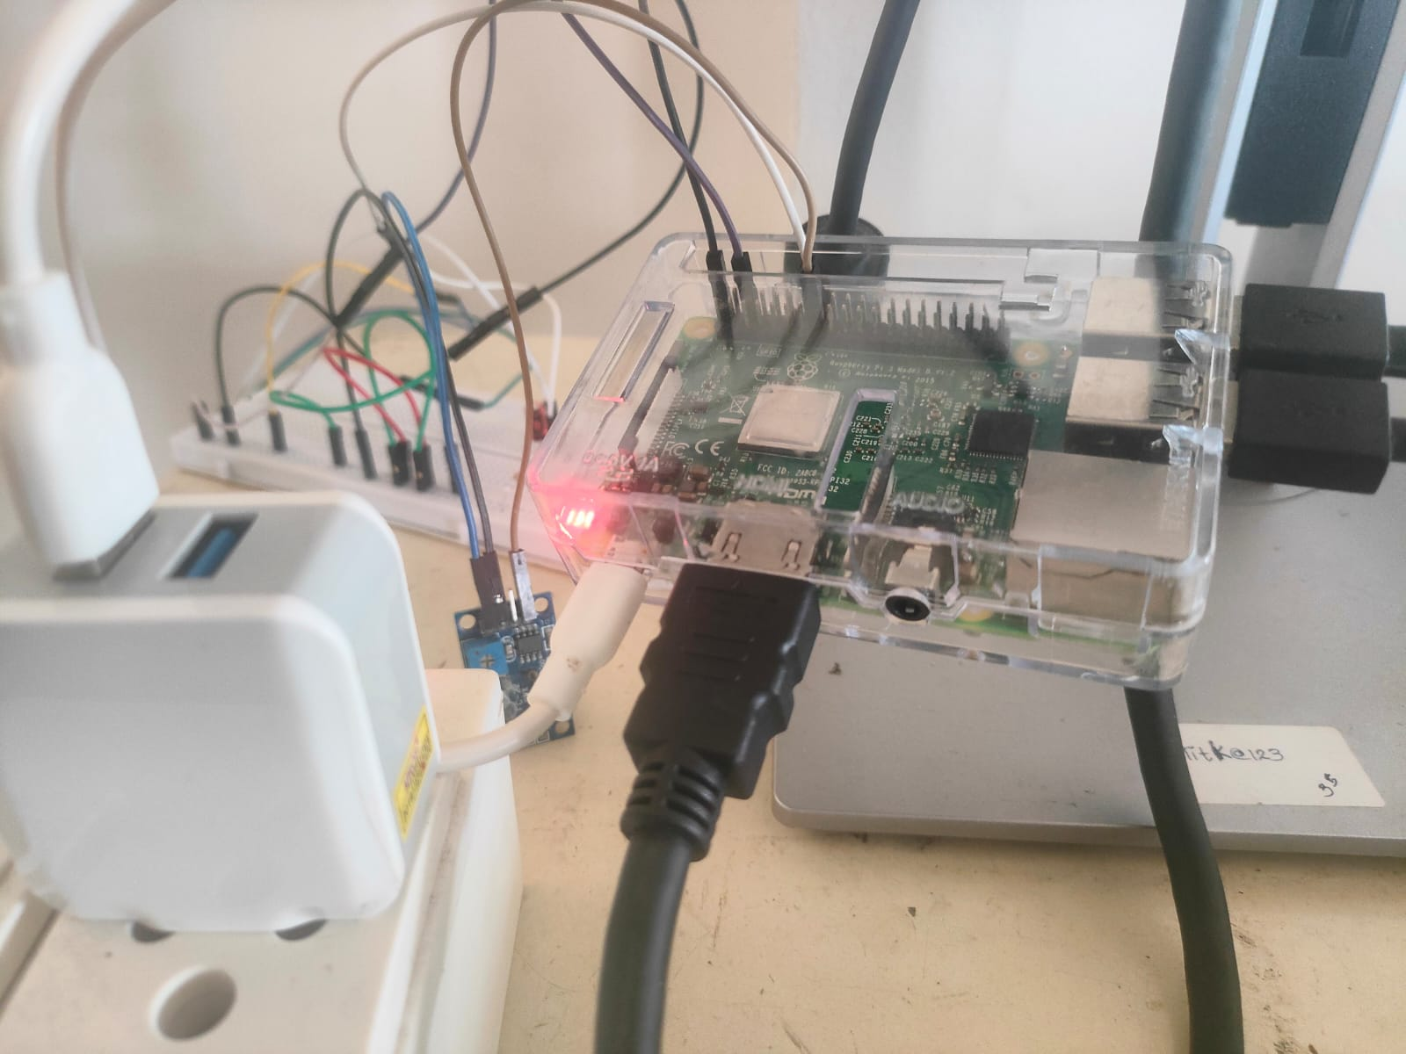
EXPERIMENTAL SETUP

Slide 8
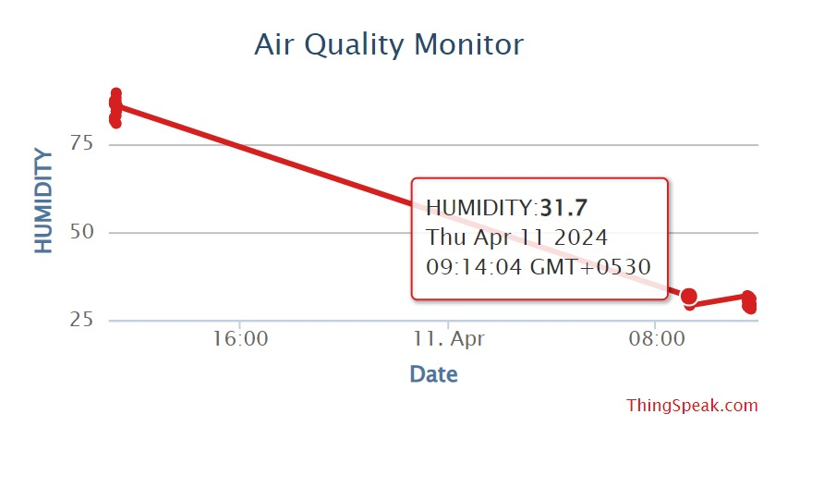
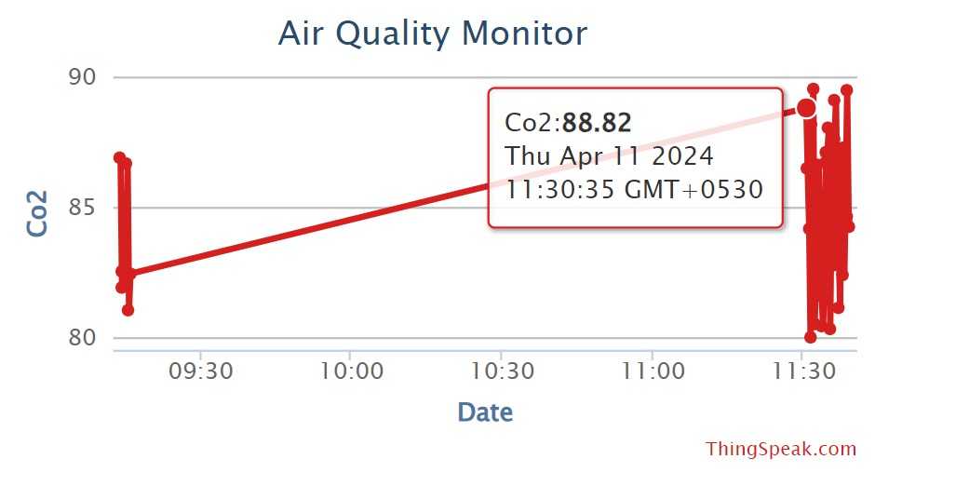
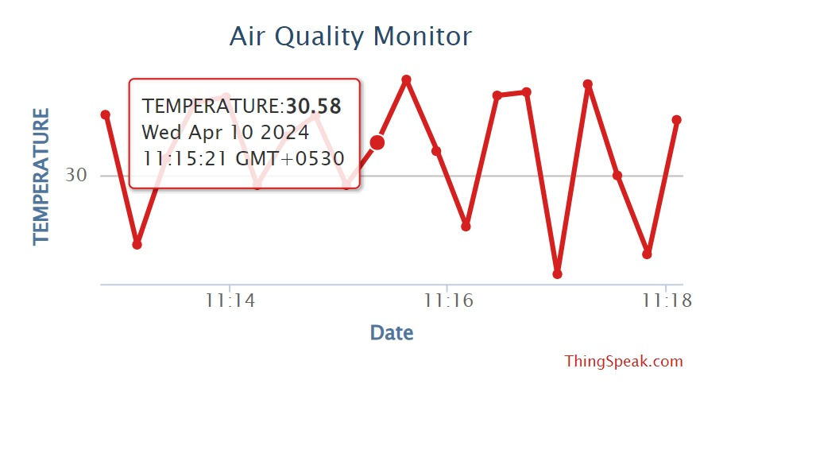
RESULTS
Temperature
C02 DETECTION
Humidity

Slide 9
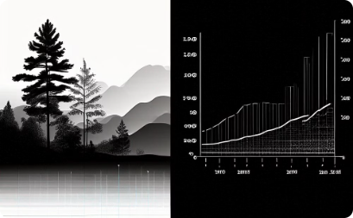
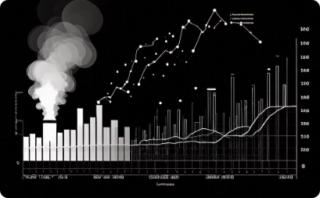
Experimental Results and Discussion
Temperature and Humidity
Air Quality and Gas Detection
We were able to present experimental results for temperature and humidity variations in different indoor environments. The graphs show fluctuations due to factors like hot weather, air conditioning, and the time of day.
The experimental results for air quality and gas detection are presented through graphs showing variations in carbon dioxide levels over time. The fluctuations are attributed to factors like the presence of cigarette smoke, gas leaks, and population density.

Slide 10
Conclusion
IoT-Based Air Quality Monitoring
Cloud Data Storage and Analysis
Visualization and Insights
The members developed an IoT-based system for monitoring air quality in indoor environments. By utilizing various sensors connected to a Raspberry Pi microcontroller, they collected data on temperature, humidity and carbon dioxide levels
The collected sensor data was stored in the cloud using the ThingSpeak platform. Mathematical formulas were used to analyze the data and assess the air quality in the indoor environment under study.
The members presented their experimental results through graphs and visualizations, providing insights into the fluctuations of various air quality parameters over time. These visualizations aid in understanding the impact of factors like weather conditions, population density, and the presence of pollutants on indoor air quality.

