Slide 1
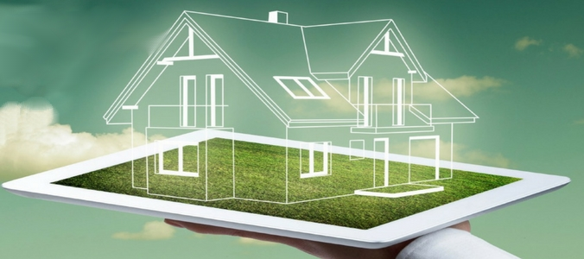
BLACKWELL
Data Analytics
Applications for SmartSubmeters

Slide 2
Agenda
1. Review: Smart Home and Smart Submeters
2. Applications
- Forecasting Energy Costs
- Energy Consumption & Temperature
- Energy Consumption & Flexible Electricity Tariffs
- Clean Energy: National Energy Mix & Private Consumption
- Warnings: Damaged Appliances

Slide 3
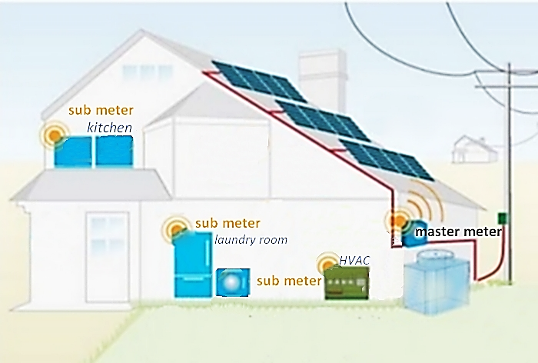
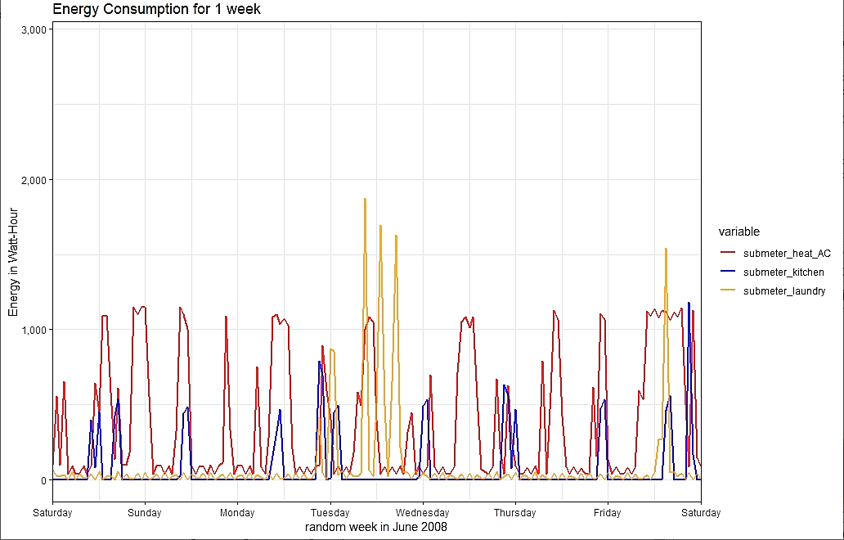
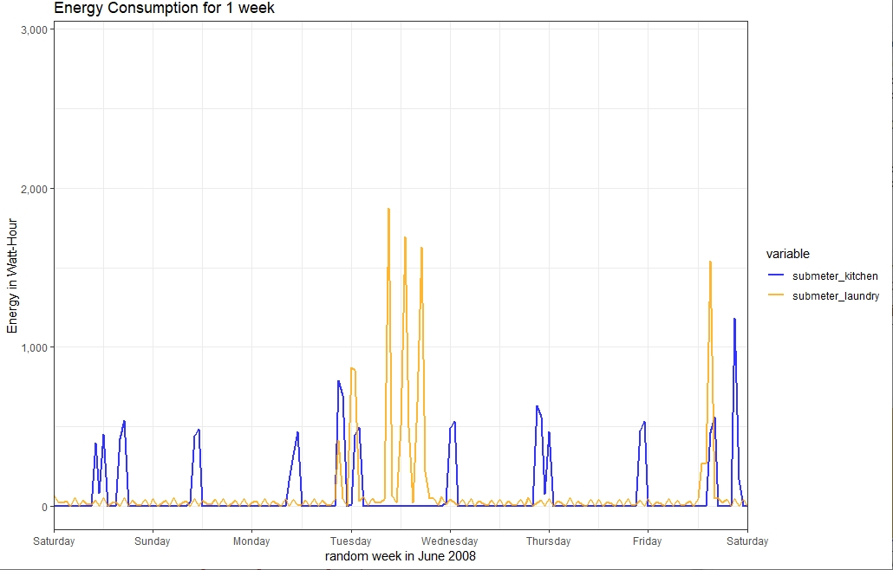
Review: Smart Homes/Submeters
3 Submeters
Kitchen: dishwasher, oven, microwave
Laundry: washing machine, tumble dryer refrigerator
HVAC: electric water heater and AC
Kitchen : lunch & dinner
Laundry : laundry day, refigerator constantly used
HVAC : heating in the morning

Slide 4
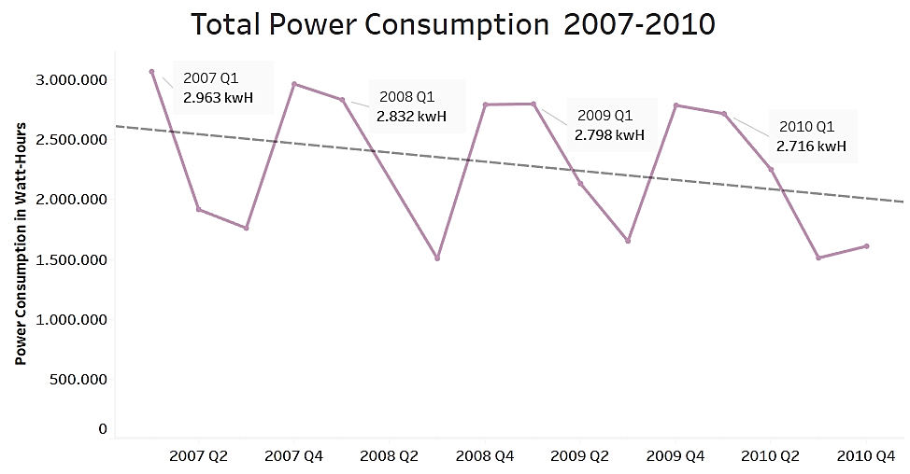
Total Power Consumption
Year | Total Consumption
2007 | 9.710 kwH
2008 | 9.415 kwH
2009 | 9.370 kwH

Slide 5
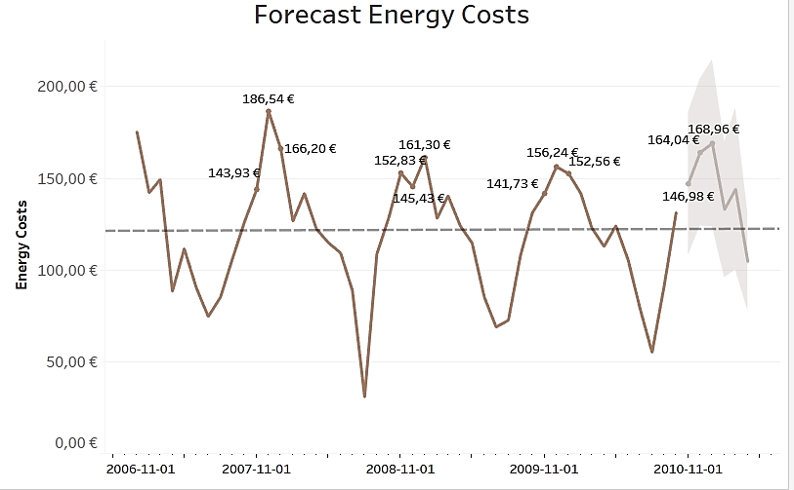
I. Application
Forecasting Energy Costs
Submeter Data + Costs
Electricity Tariff for Paris (EDF)
0.1244 €/kwH (00:00-07:00)
0.1593 €/kwH (07:00-00:00)
Forecasting Method: Expon. Smoothing
- regular pattern continued into future
- Weighted average of past values
transparency of annual costs

Slide 6
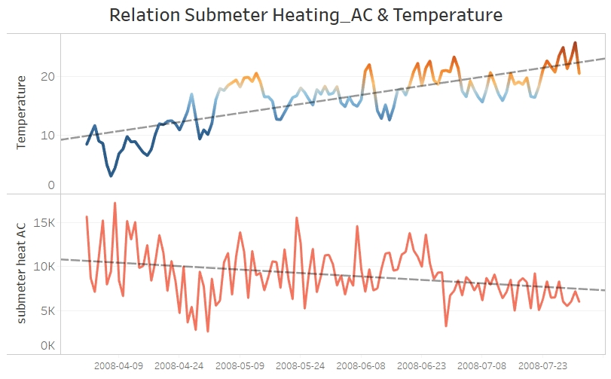
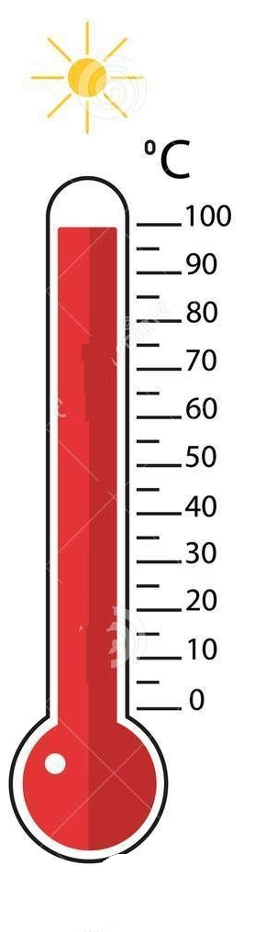
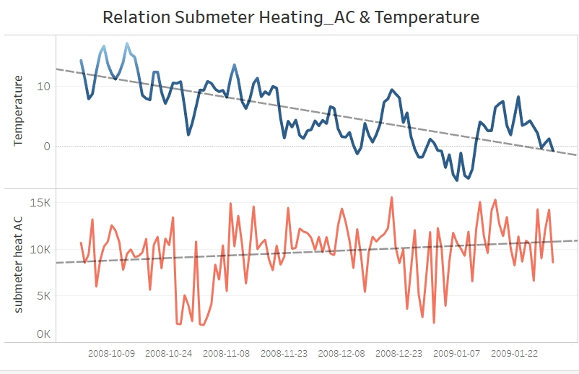
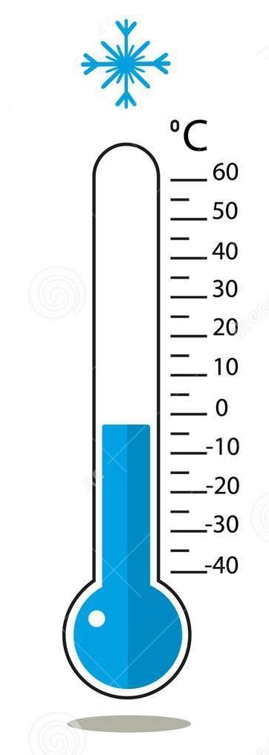
II. Application
Adjustment to Temperature
Spring &
Summer
-Submeter combining Heating and AC
-Average household: 1/3 of energy for HVAC
-Heating dominates power consumption
-Separation for deeper analysis necessary
Autumn &
Winter

Slide 7
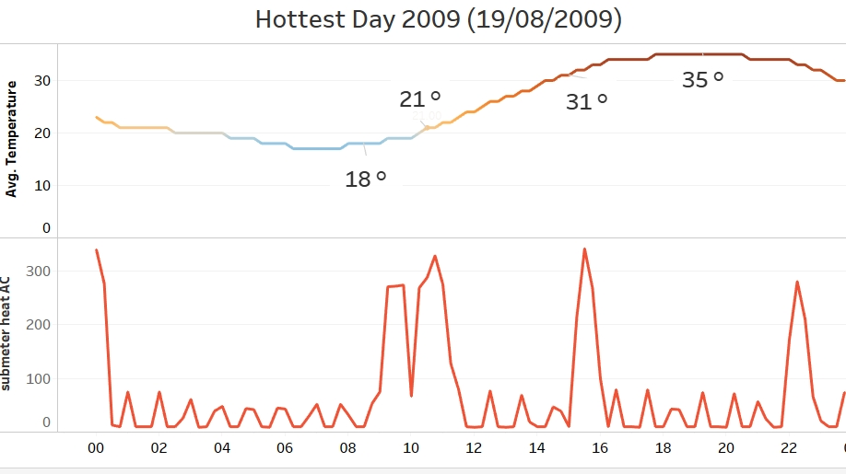
II. Application
Adjustment to Temperature
Submeter Data + Temperature
outside temperatures rise
AC has to work harder
adjusting T closer to outside T
saving energy

Slide 8
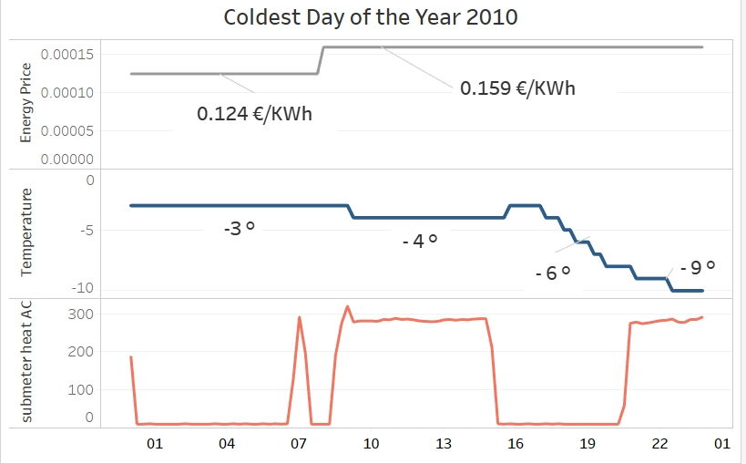
III. Application
Adjustment to flexible Tariffs
Submeter Data+ flexible Tariffs
Electricity Tariff for Paris (EDF)
0.1244 €/kwH (00:00-07:00)
0.1593 €/kwH (07:00-00:00)
saving costs

Slide 9
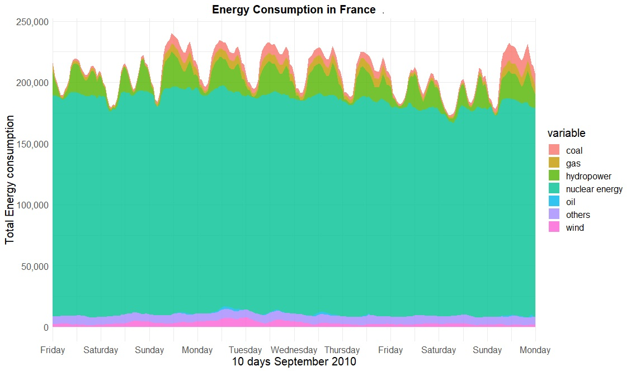
IV. Application
Clean Energy Mix
France‘s energy mix dominated by nuclear power
Hydropower very flexible used
Other markets more fitting: Germany, Denmark, Netherlands

Slide 10
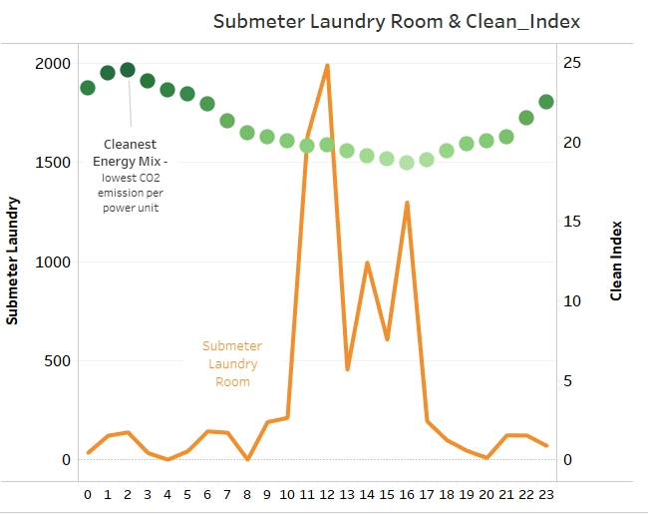
IV. Application
Clean Energy Mix
Clean Index = Power Units / CO2 Emission
cleaner energy, when less CO2 Emission
for 1 produced power unit is needed
using cleaner energy

Slide 11
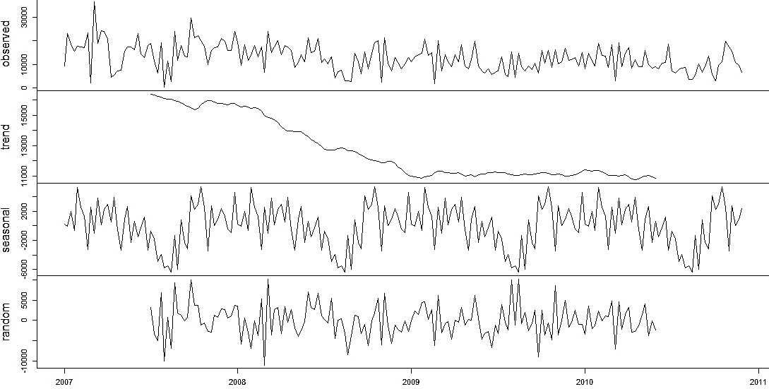
V. Application
Irregularities of Appliances
Decomposition Time Series – Submeter Laundry (2007-2010)
Decomposing Time Series identifies
patterns: trend, season and random
Defining threshold for warning messages
e.g. damaged refrigerator,washing machine
detecting irregularities

Slide 12
THANK YOU

