Slide 1
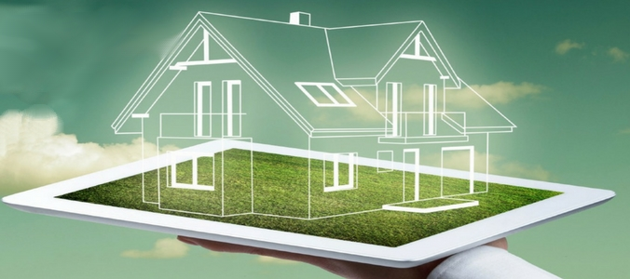
BLACKWELL
Data Analytics
Smart SubMetering &
Innovative Energy Management Systems

Slide 2

Agenda
1. Smart Homes & Electrical Submetering
2. IoT Data Analytics for Smart Homes
3. Initial Data Exploration of Electrical Submeters
4. Innovative Potentials and Recommendations

Slide 3
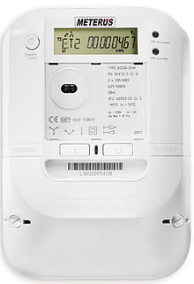

Business Challenge
smart submetering to monitor electricity consumption of specific rooms & appliances
tracks power usage continiously and transmits the data instantly to user
opens insights into energy consumption in details!
where energy is beeing used, how is it beeing used and who is it beeing using
peaks, wastage, inefficiencies, irregularities
Smart reduction and smoothing of energy consumption
Reducing costs and waste of ressources

Slide 4
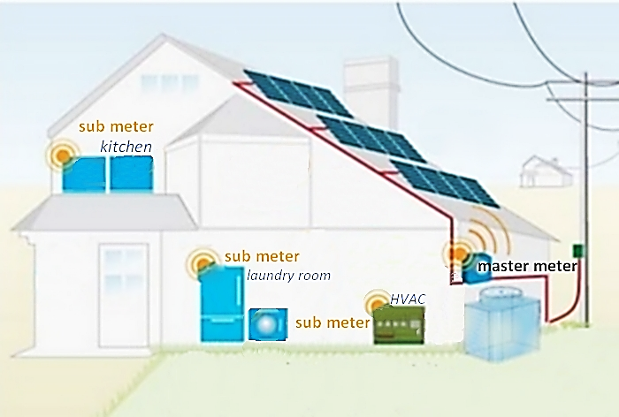
Smart Electrical Submeters
Master Meter connects to smart grid
for energy and information exchange
Submeters are connected to Master Meeter
3 Submeters
Kitchen: dishwasher, oven, microwave
Laundry: washing machine, tumble dryer,
refrigerator and a light
HVAC: electric water heater and air conditioner

Slide 5
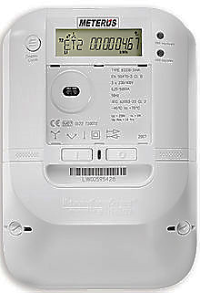
Data Analytics for Submeters
Technology isn‘t the problem, but decision what to measure
Continious flow of huge amount of private data
-data protection through anonymisation
-efficient data management and storage
Converting data into actionable items
Provide analysis and visualisations for Smart Home users
Task: uncovering energy conservation opportunities
Time
Active Power
Reactive Power
Voltage
Global Intensity
sub-meter 1
sub-meter 2
sub-meter 3

Slide 6
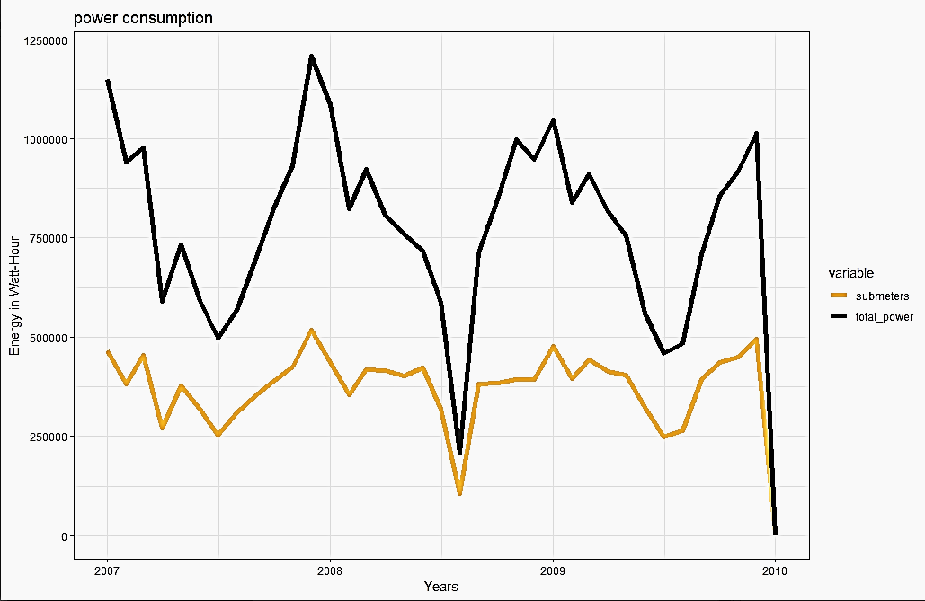
total energy consumption
Year | submeters | total power
2007 | 4519 kWh | 9710 kWh
2008 | 4427 kWh | 9416 kWh
2009 | 4741 kWh | 9371 kWh
Submeters contain only 50% of energy
consumption
Clearer definition of submeters and
allocation of electric appliances useful
Total power consumption 2010: 9710 kWh
Average househould in France:
2010: 6343 kWh
Source: World Energy Council

Slide 7
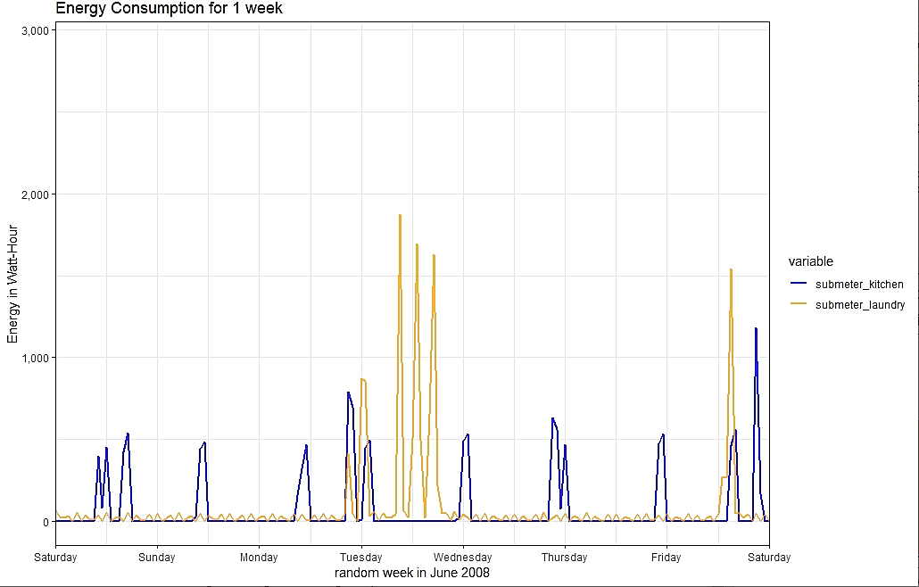
Example:
Energy consumption per week
Kitchen (oven, microwave,dishwasher)
during weekdays dinner
during weekend lunch & dinner
Laundry (Washing Machine, Dryer, Refrigerator,Light)
doing the laundry on Tuesday,
refrigerator pulls energy frequently

Slide 8
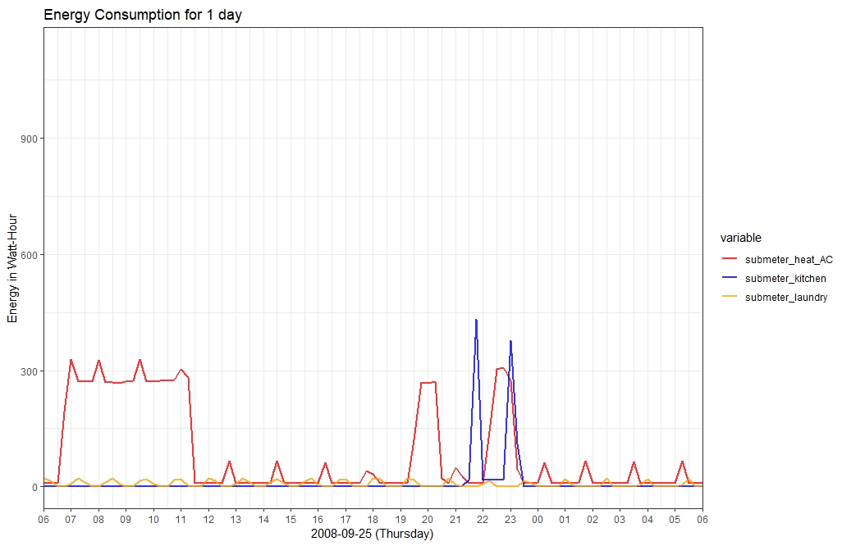
Example:
Energy Consumption of a day
Heater/AC
used in the morning
Kitchen(oven, microwave, dishwasher)
used late night for dinner
Laundry(washing machine, dryer, refrigerator, light)
not used except refrigerator

Slide 9
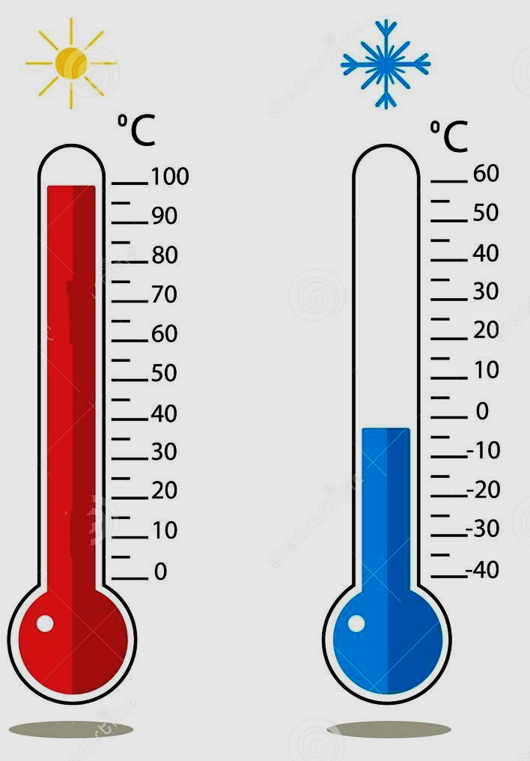
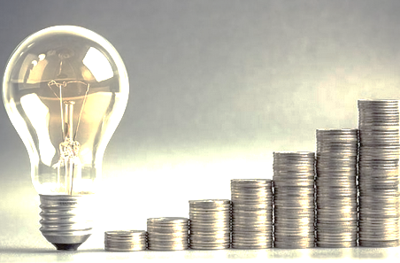
Change Data Configuration
separating water heating system from air conditioning system
Average household: 1/3 of energy for HVAC
Heating and AC anticyclical during season
Measure outdoor temperature, humditity
measuring energy costs
Important for customers applications
About 50% of energy consumption not captured
new submeter? New partitioning of appliances?

Slide 10
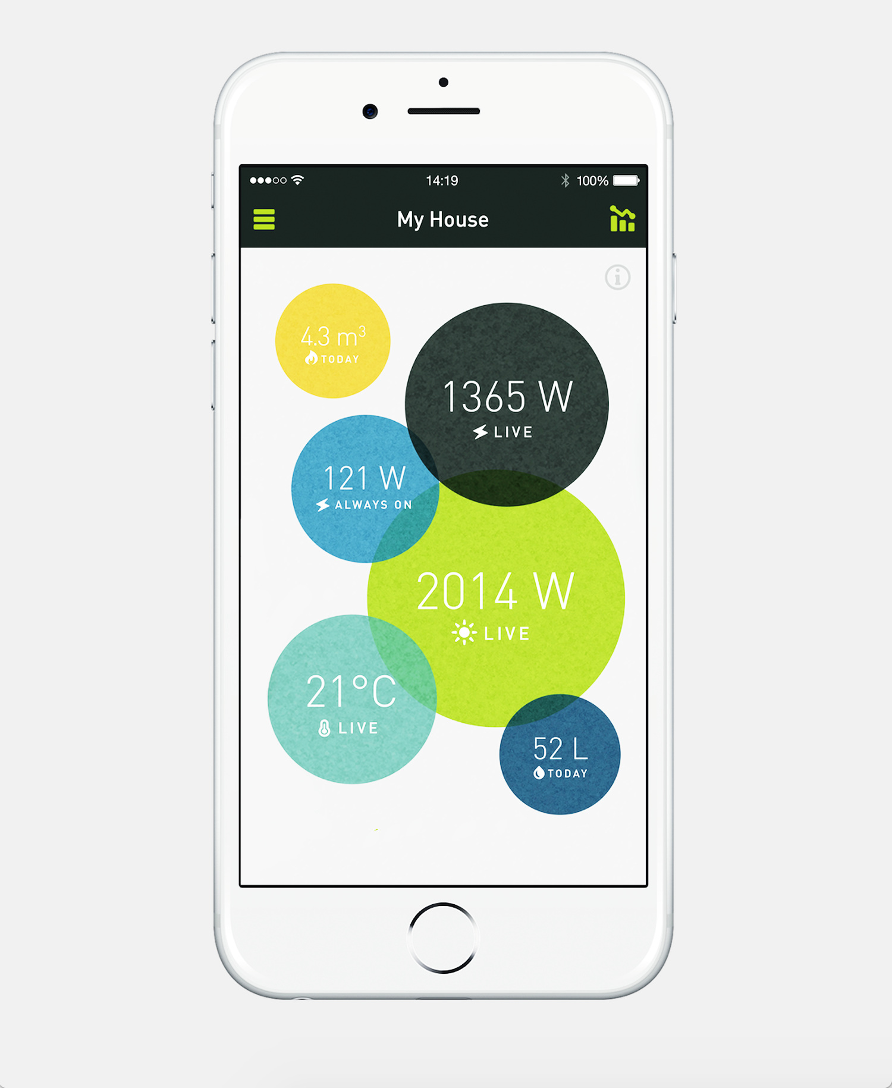
Potential Applications
Listing Submeters: App for energy consumption
Warning-System: energy peaks or unusual energy levels
Smart Self-Scheduling-System: appliances used when prices low
Security System: warning when power usage rises during absence

Slide 11
THANK YOU

