Slide 1

BLACKWELL
Data Analytics
WIFI LOCATIONING

Slide 2
Agenda
Wifi-Locationing
1. Wifi Locationing – How does it work?
2. Wifi Locationing – Research Project University Jaume (Spain)
Data Analysis and ML for Wifi Locationing Data Set
1. Data Preparation
2. Data Exploration
3. Modeling & Predicting Location of User (Building, Floor & Longitude/Latitude)

Slide 3
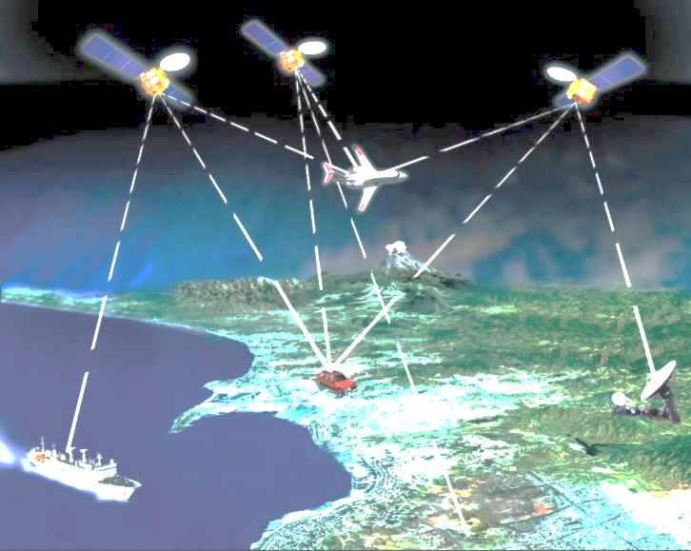

Wifi-Locationing
GPS
- many applications need to know location of users
- outdoor localization problem solved accurately with GPS sensors into the mobile devices
Wifi-Locationing
- indoor localization open problem due to loss of GPS signal
- estimating position of user (latitude, longitude and altitude)
by using WAPs and electronic device (mobile phone)

Slide 4
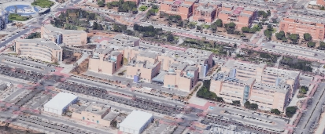
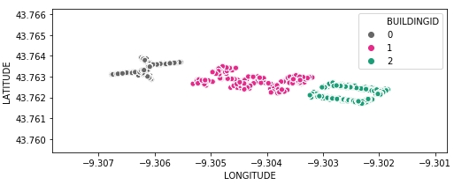
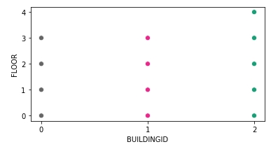

Wifi-Locationing by Univ. Jaume
- 3 buildings on university campus
(almost 110.000 m2)
- 3-4 floors per building
- 520 Wireless Access Points (WAPs)
- 20 different users with 25 Android devices
19.937 Wifi fingerprints for training
1.111 Wifi fingerprints for validation

Slide 5
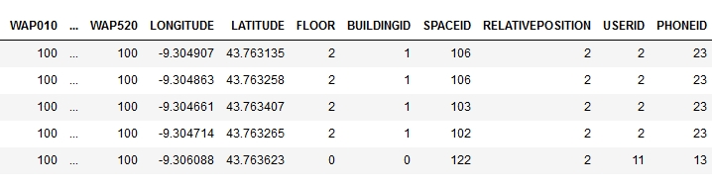
Cleaning Wifi Data Set I
Raw Data Set
520 WAP‘s
LONGITUDE
LATITUDE
FLOOR
BUILDINGID
SPACEID
RELATIVEPOSTION
USERID
PHONEID
TIMESTAMP
1. Step: Removing duplicate observations
Observations | Features
19.937 | 529
Observations | Features
19.300 | 529

Slide 6
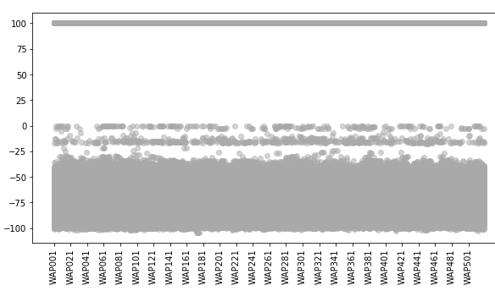
Cleaning Wifi Data Set II
Signal Strength of all WAPs
2. Step: Converting Signal Strength for „no signal“
from +100 to -105 (lowest signal is-104)
3. Step: Removing redundant features
- WAPs with no signal
- irrelevant features
Observations | Features
19.300 | 529
Observations | Features
19.300 | 469

Slide 7
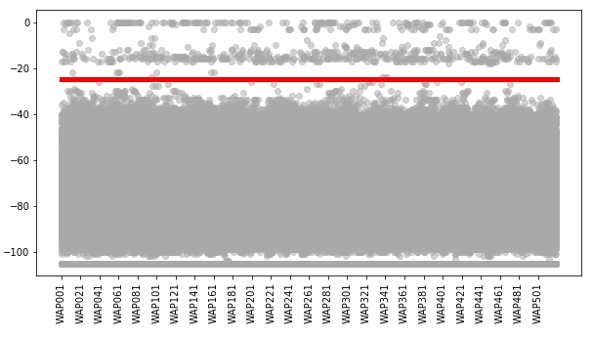
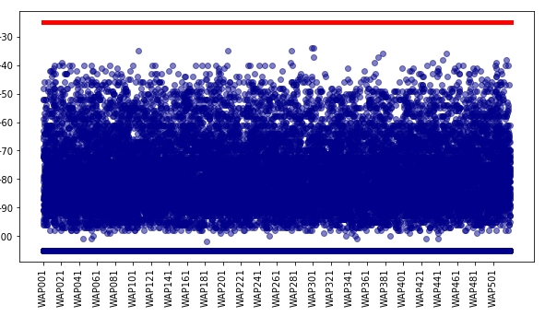
Cleaning Wifi Data Set III
4. Step: Removing Outliers
- definition of boundary by visualisation
- signal strength 0 until -25 outlier area
-removing observations in this area
Signal Strength of all WAPs in training data set
Validation
Data
Set
Observations | Features
19.300 | 469
Observations | Features
18.825 | 469

Slide 8
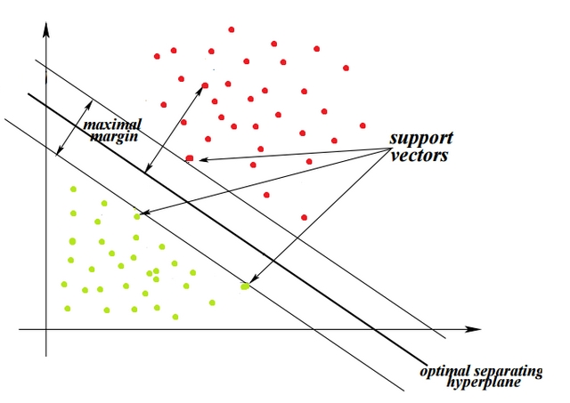
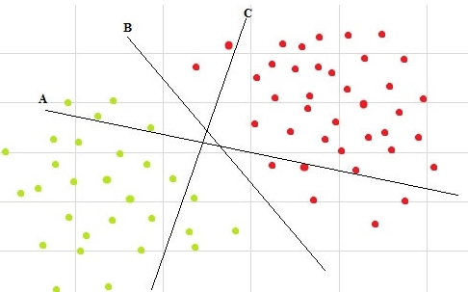
Predicting BUILDING ID I
Support Vector Machine
SVM: finds an optimal boundary between the possible outputs
to identify the optimal separating hyperplane
grid search for best parameter combination for SVM:
C=5, gamma=0.001, kernel='rbf'
accuracy_score: 63.7 %
kappa_score: 46.9 %

Slide 9
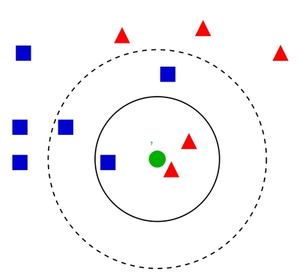
Predicting BUILDING ID II
K Nearest Neighbor
KNN assumes similar things exist in close proximity
-calculating the distance between points
-majority of K’s decide target class
grid search for best K : k_neighbors': 3
accuracy_score: 99.5 %
kappa_score: 99.3 %

Slide 10
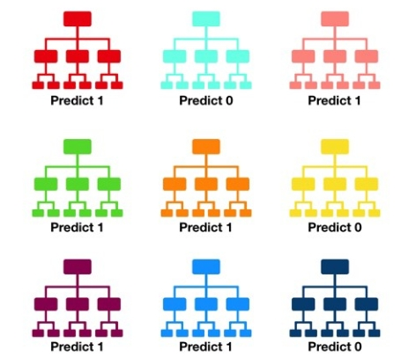
Predicting BUILDING ID III
Random Forest
-constructing a multitude of decision trees
-what features allow to split observations so
that the groups are as different as possible?
- Each tree gives prediction
- Class with most predictions -> model’s prediction
Random Forest
accuracy_score: 99.8 %
kappa_score: 99.8 %
n_estimators': 50 for best model

Slide 11
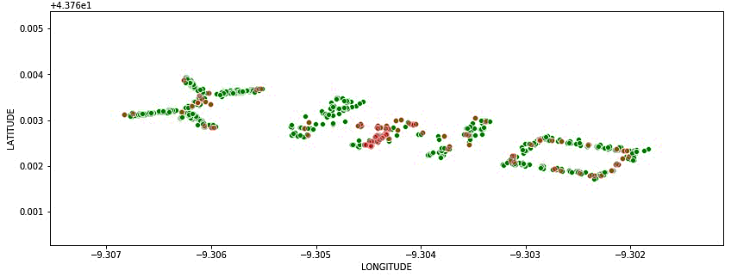
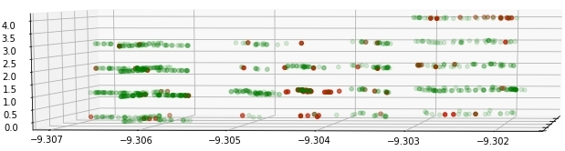
Predicting ‘FLOOR’
Random Forest
accuracy_score: 91.1 %
kappa_score: 87.6 %
BUILDING 0
accuracy_score: 97.6 %
BUILDING 1
accuracy_score: 79.8 %
BUILDING 3
accuracy_score: 90.7 %
reasons for wrong predictions:
-human error? confound floors?
-wrong placement of WAPs?
-> speculative

Slide 12
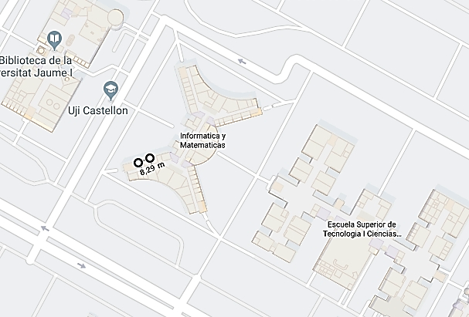
Predicting Longitude/Latitude
K-nearest neighbor (K=2)
Longitude
mean absolute error: 6.20 m
Latitude
mean absolute error: 5.58 m
average location error: 8.34 m

Slide 13
THANK YOU

