Slide 1
RCT Project Code Management
Steffen Erickson

Slide 2
Overview
System Map/ Workflow
Organizing Code
Data Pull do File
Task Management do file
Helpful Tips

Slide 3
System Map
Uses
_pull_data.do
01_master.do
02_*...0d_ *
00_*
Data access
Task manager
Task 1
Task d
Program
Program
Program

Slide 4
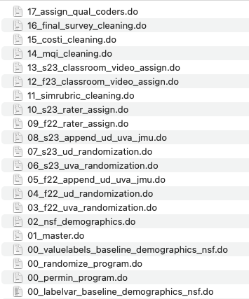
Code File Structure
_pull_data.do is the data access code
00_* are programs/sub-routines that are called on in various tasks
01_master.do is the task manager
02_*...0d_* are tasks
Access Data
Tasks
Task Manager
Programs

Slide 5
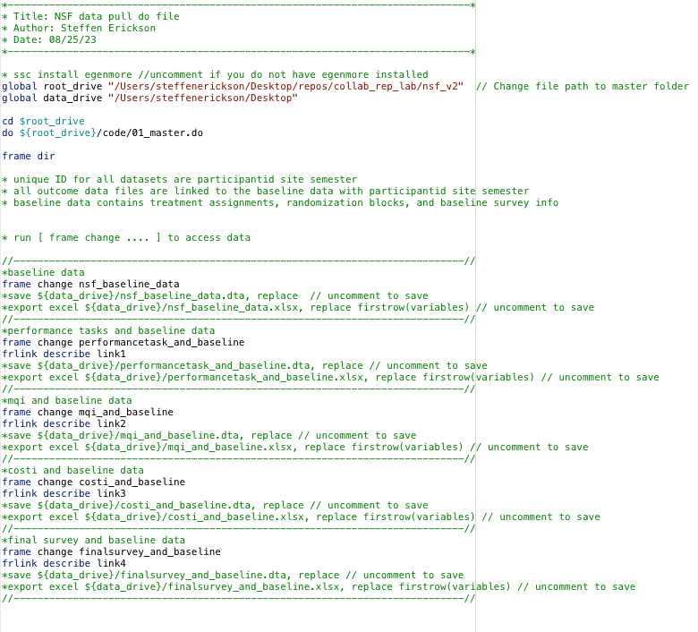
Data Pull do file
Only code to change
Runs task manager
List data frames in memory
Access and save data
Describes how data frames are linked

Slide 6
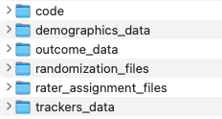
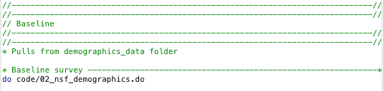
Task Management (master) do file
Each procedure lists (1) the task(s) and (2) the folder(s) that the task(s) use
Typing [do path/filename.do ] runs the task do file in the code folder

Slide 7
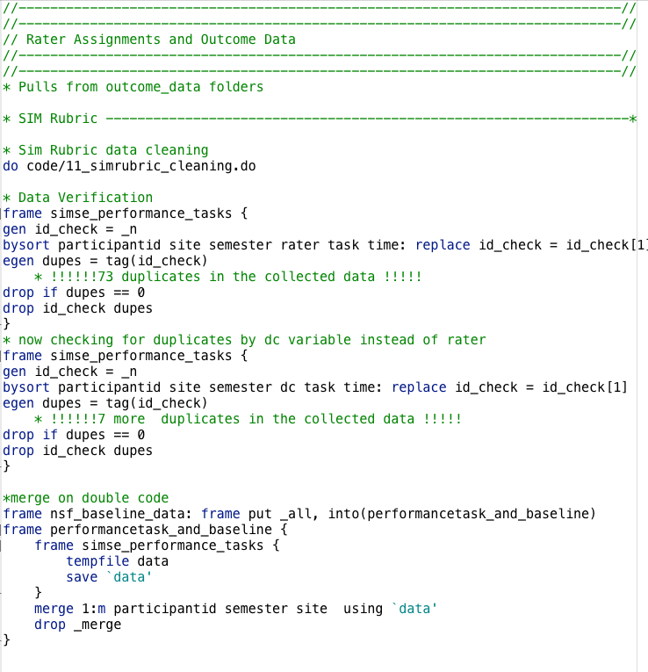
Task Management (master) do file
Small steps that do not need separate do files are written into the task management do file
Major Task
Checking for duplicate observations before merging two frames
Minor Tasks
Merging the baseline data with one of the outcome files to create one of the four final data frames

Slide 8
Tips
Use the [frames] commands
Make sure that all random assignments are reproducible
Store code in an online repository with version control and collaboration features

Slide 9
Tips - The Frames functions make data management more efficient
Type [help frames intro] for an introduction to Stata data frames
Frames allow you to hold multiple datasets in memory and keep track of datasets created in each task
I use the frame prefix commands extensively [frame : stata_command] and [frame { stata_commands} ] so that I do not have to load a dataset into working memory to manipulate it

Slide 10
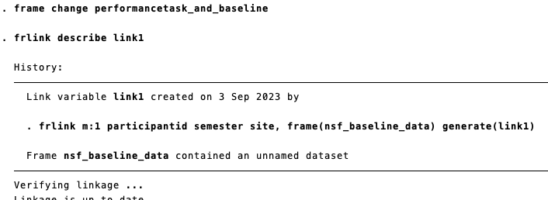
Tips- Linking Frames
All outcome data frames are linked to the baseline data frame
Frames are linked through a link variable containing information about how the frames are merged

Slide 11


Tips- Reproducible Randomizations
Randomize using participant trackers, not collected data
Save the original randomization file with treatment recipes
Use a standardized function for all randomizations.
Set a seed number so you can replicate a random assignment!

Slide 12
Tips – Use a platform that enables version control and collaboration
I use GitHub to store and manage project code
Allows for multiple people to collaborate and maintain project code
Workflow on GitHub
Team members can “fork” the main repository
Make an edit to the project code
Submit a pull request to the project owner to confirm the edit.
The GitHub desktop app makes the workflow a breeze!
Git and GitHub Intro
My GitHub

