Slide 1
Evaluating Evidence on Education Technology
Steffen Erickson — University of Virginia
[Course name and number] · [Date]
Notes:
This is a data-ethics class, so the question today is not only “does education technology work” but “who says so, and how should that change how much we trust the answer.”
Have students scan the QR code or type the URL. They enter the session code on the screen and pick a group letter. No name or email is collected; each phone gets a random token.
Timing target: 75 minutes. The run-of-show has the 60-minute cuts.

Slide 2
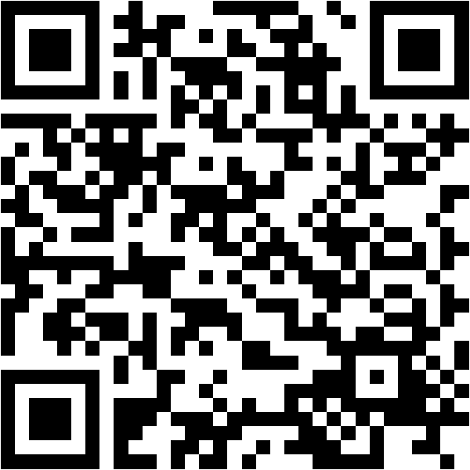
Join: steffenerickson.github.io/edtech-evidence-lab
Notes:
Leave this up until the join count on the dashboard matches the room. Students pick their group letter when they join; group letters are on the board.

Slide 3
Today’s Question
What evidence would convince a school district that an education technology improved student learning?
Define the technology and the outcome (10 min)
Read, rate, and present nine anonymized studies (35 min)
Reveal who produced them; discuss (10 min)
Agree on five evidence standards (20 min)
Notes:
Put the question on the board in these words and leave it there. Every activity returns to it.
The product of the class is five standards, written by the students and voted on, that a district could use. Say that now so the group work has a destination.

Slide 4
Poll 1: What Counts as Education Technology?
In one sentence, on your phone: what counts as education technology?
Join: steffenerickson.github.io/edtech-evidence-lab · Session code on the board
Notes:
Phase: defining. Give two minutes. Turn on “students can see results” and read four or five definitions aloud from the dashboard, choosing ones that disagree: one that includes any device, one that limits to instructional software, one that mentions AI.
The point to draw out: the breadth of the definition determines which evidence counts. A study of home computers is evidence about one definition and not another.

Slide 5
A Working Definition
Education technology: tools designed to support student learning.
Learning apps and practice platforms
Personalized or adaptive learning software
Technology-mediated tutoring
AI-enabled learning tools
Not today: devices in general, administrative systems, screen time as such.
Notes:
State the definition and the exclusions. AI is included but is not the focus; two of the nine studies are about AI tools.
One study in the set is about general screen time and one is about home computers. They are included so the class can ask whether evidence about the broader category transfers to purposeful instructional tools.

Slide 6
Which Outcome?
Possible outcomes of education technology:
Standardized test achievement
Course grades and completion
Engagement, attendance, time on task
Skills the tests do not measure, including skills with the technology itself
Teacher workload and practice
Today: achievement on standardized tests.
Notes:
Ask for two or three other outcomes before showing the list. Then restrict to standardized test achievement and say plainly what that costs: a technology could raise engagement or teach skills the tests do not measure and still show nothing here. Study E, the home computer study, found both lower grades and higher computer skills, which is the cleanest example of the restriction mattering.

Slide 7
The Activity
Groups of two or three. Each group has two studies on the Studies page, marked “your group.”
Read both studies (12 minutes).
For each study, agree on the direction of findings: positive, negative, mixed, null, or inconclusive.
Decide how credible the study is, and what you are unsure about (8 minutes).
Each group presents both studies in two minutes.
You may submit your individual ratings on the Rate page at any point before the lock.
Notes:
Phase: reading. Credibility is deliberately undefined. When a group asks what it means, say: that is part of the exercise; decide what it means to you and tell the class.
Studies are anonymized. There are no author names, products, or publications. Students will see those after the first vote.
While they read, watch the join count and the rating count on the dashboard.

Slide 8
Group Presentations
Two minutes per group:
What was studied and how
Direction of findings
How credible, and why
The one thing you most wanted to know and could not
Notes:
Phase: rating_pre. Keep strict time. Write each group’s “one thing you wanted to know” on the board; most will be about who did the study, how it was funded, or whether anyone replicated it. Those become standards later.
Remind everyone to submit individual ratings on the Rate page before the lock.

Slide 9
Poll 2: Rate Before the Reveal
On the Rate page, for each of your two studies:
Direction: positive / negative / mixed / null / inconclusive
Credibility: 1 (low) to 5 (high)
One sentence of reason, optional
Ratings lock when this step closes.
Notes:
Give 90 seconds, then press locked on the dashboard. The lock is enforced in the database: after this, a pre-reveal rating cannot be added or changed from any phone.
Do not advance to “revealed” until the lock is set. The dashboard asks for confirmation if you try.

Slide 10
Before the Reveal
[Live dashboard: direction counts and credibility distributions, by study]
Notes:
Show the dashboard or the Results page. Point to disagreements, not averages: a study where the same group split between “positive” and “inconclusive,” or where credibility ratings span 2 to 5.
Ask one or two students to say what drove their credibility rating without naming the study’s source, which they do not yet know.
Fallback if the database is down: tally paper ballots by show of hands.

Slide 11
The Reveal
[Live: citations, authors, affiliations, funders, and relationships for all eleven sources]
Open the Studies page: each card now shows its source.
Notes:
Phase: revealed. Give students a minute to scroll their own two cards. Then walk through four contrasts.
B and F. Study B is a correlational dosage analysis written by employees of the platform’s maker, cited on its sales page, and never peer reviewed. Study F is a randomized trial of 17,000 students by independent evaluators, funded by foundations that also fund tutoring. Which concern is bigger: company authorship, or funders with a stake in the answer?
A and N. Study A is the OECD report: a hill-shaped correlation that the report itself says cannot be read causally. N is the BBC headline: “Computers ‘do not improve’ pupil results.” Same evidence, different claim.
G and H. Both are randomized trials of the same kind of AI chatbot, both from 2025, both independent of the vendor. G found 0.23 standard deviations in English after six weeks of supervised sessions. H found a 17 percent drop on the unassisted exam. Independence did not produce agreement; the designs asked different questions.

Slide 12
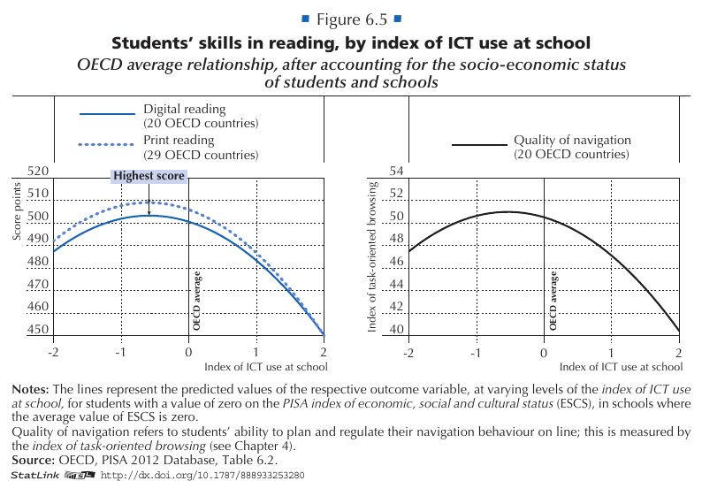
Headline, 15 Sept 2015: Computers ‘do not improve’ pupil results, says OECD
Notes:
This is Figure 6.5 of the OECD report, Study A: reading performance against an index of computer use at school, averaged across 20 to 29 countries and adjusted for socioeconomic status. The report calls it a hill shape and says on page 146 that the data cannot isolate cause and effect.
The headline above it is Source N. Ask: what would the headline have to say to be faithful to the figure? Then: which version reaches a school board?
Figure reproduced from OECD (2015) under the OECD’s terms for teaching materials, with attribution.

Slide 13
After the Reveal
[Live: pre-reveal credibility distributions by study, now with sources known]
Notes:
Ask which ratings students would change now, and why. Expect B to fall in their estimation and F to hold or rise.
Two cautions, said plainly. First, a conflict of interest is a reason for scrutiny, not dismissal. Study B’s design would be weak with any author; the company authorship tells you where to look, not what you will find. Second, independence is not causality. Study A has no vendor anywhere near it and still cannot support a causal claim. The question is always what the design can identify, and then who had reasons to shade it.

Slide 14
What Changed and What Did Not
[Three observations from the discussion, written live]
Notes:
Write three things the class noticed, in their words. Keep them on the board; the standards vote comes next and these are the raw material.
Transition: “You have just applied standards without naming them. Now name them.”

Slide 15
Poll 3: Propose a Standard
On the Standards page, one sentence: a standard the class should use to decide whether a study, or a body of studies, is credible evidence that an education technology changed student learning.
Notes:
Phase: standards_submit. Three minutes. One per student. Watch the count reach the number of students joined.

Slide 16
Sorting the Standards
Two kinds of standards:
For a single study. Example: a credible comparison group.
For the evidence base. Example: independent replication; publication of null results.
Notes:
Phase: standards_sort. Read submissions from the dashboard. Create a ballot option for each distinct idea, merge duplicates by assigning submissions to the same option, and mark the scope. Six minutes.
Name the distinction: a single study can be excellent and the evidence base still thin. Most student submissions will be single-study standards; ask whether anyone proposed one for the evidence base, and if not, whether the class wants one on the ballot.

Slide 17
Vote
On the Standards page, choose up to five.
Notes:
Phase: standards_vote. Four minutes. The database rejects more than five selections. Resubmitting replaces the earlier ballot.

Slide 18
Our Five Standards
[Live: the five standards with the most votes]
Notes:
Phase: final. Tick the five winners on the dashboard. If there is a tie at fifth place, show the tied options, take a voice vote, and tick the winner.
For each standard, one sentence on why it matters, using a study from today as the example. Then two questions: what did we leave out, and how would a district use these five when a vendor presents a study?
End on the five. Do not add a summary slide after this.

Slide 19
Sources (A–F)
A. OECD (2015). Students, Computers and Learning: Making the Connection. doi:10.1787/9789264239555-en
B. Weatherholtz, Grimaldi & Hill (2022). Use of MAP Accelerator associated with better-than-projected gains in MAP Growth scores. Khan Academy.
C. Dynarski et al. (2007). Effectiveness of Reading and Mathematics Software Products. NCEE 2007-4005.
D. Doss et al. (2025). AI Use in Schools Is Quickly Increasing but Guidance Lags Behind. RAND RR-A4180-1.
E. Malamud & Pop-Eleches (2011). Home computer use and the development of human capital. QJE, 126(2).
F. Bhatt et al. (2025). Personalized Learning Initiative Interim Report. UChicago Education Lab & MDRC. ::: notes Continued on the next slide. :::

Slide 20
Sources (continued)
G. De Simone et al. (2025). From Chalkboards to Chatbots. World Bank PRWP 11125.
H. Bastani et al. (2025). Generative AI without guardrails can harm learning. PNAS, 122(26).
I. Madigan et al. (2019). Screen time and developmental screening. JAMA Pediatrics, 173(3).
N. Coughlan (2015, Sept 15). Computers ‘do not improve’ pupil results, says OECD. BBC News.
Site and packet: steffenerickson.github.io/edtech-evidence-lab
Notes:
Full citations with links are on the Studies page after the reveal and in the packet. This deck’s source and the site’s source are at github.com/steffenerickson/edtech-evidence-lab.

