Slide 1
Introduction to Statistics for Ecology and Evolutionary Biology Bayesian Summary Statistics Sampling Distributions Week 07 25 October 2021

Slide 2
Recap
Prior: A priori assumption about the relative likelihood of different values of the parameter we want to estimate
We have used a proportion as a parameter to estimate, because we worked with binomially distributed outcomes.
Don’t confuse the possible values of p (proportion of water) in your grid with the probability with which these values are expected, which we obtain from our posterior distribution
Posterior: Relative likelihood of different values for the parameter of interest, given the assumed prior and available data
Posterior = Likelihood * Prior
Therefore, with a flat prior, the posterior equals the sampling distribution of the observed outcomes over all values of p

Slide 3
Thinking with Samples
Working with distributions and samples in different directions is common
We can draw samples from a distribution
Samples are often simpler to work with, allow for easy posterior summary
And some methods for Bayesian inference only produce posterior samples
We can also visualize the distribution of our samples
See sample code generating samples from a grid approximate posterior distribution
Notes:
Show sample code generating samples from a grid approximate posterior distribution

Slide 4
Summarizing posterior distributions
Intervals of defined boundaries:
How much posterior probability lies below some value?
How much posterior probability lies between two values?
Intervals of defined mass:
Which value marks the lower 5% of the posterior probability?
Which range of values contains 90% of posterior probability?
Point estimates:
Which parameter value has the highest posterior probability?

Slide 5
Keep in Mind
In Bayesian inference, the posterior distribution (in its entirety) is the statistical “estimate”
Intervals and point estimates are simply ways to summarize the posterior. However, it is often preferable to show the entire posterior distribution for a given parameter.

Slide 6
Sampling the posterior
## Using grid approximation:
p_grid <- seq(0, 1, length.out = 1000)
prior <- rep(1, 1000)
prob_data <- dbinom(x = 6, size = 9, prob = p_grid)
posterior <- prob_data * prior / sum(prob_data * prior)
## Take samples using sample() function
samples <- sample(p_grid,
prob = posterior,
size = 10000,
replace = TRUE)

Slide 7
Summarizing Samples: Intervals of Defined Boundaries
What is the posterior probability that the proportion of water is <0.5, given our data?
To answer this, we need to sum of all probabilities of values <0.5 in our posterior distribution.
sum(samples < 0.5) / length(samples)

Slide 8
Summarizing Samples: Intervals of Defined Mass
Percentile intervals (a.k.a. credible interval or compatibility interval)
Region that contains a certain % of the probability mass
Sensitive to skewed distributions as it assigns equal probability mass to each tail (see next slide)
Highest posterior density intervals (HPDI)
The narrowest interval containing a given probability mass
Best represents the parameter values most consistent with the data

Slide 9
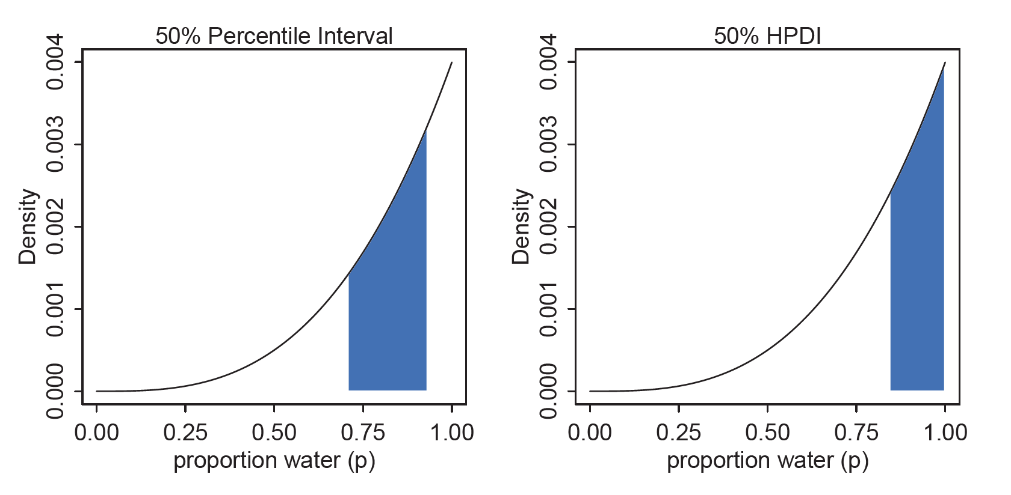
Summarizing Samples: Intervals of Defined Mass
See sample code calculating these intervals
Notes:
Percentile intervals can be misleading in cases with highly skewed posteriors

Slide 10
Sampling to Simulate Prediction
Samples from our model can also be used to help us generate model predictions
Critically, we must account for two major sources of uncertainty in our predictions
Parameter uncertainty: what are the true parameter values?
Observation uncertainty: outcome given a fixed parameter value?
When we properly account for these sources of uncertainty in our predictions, we have a posterior predictive distribution

Slide 11
Generating predicted observations
Likelihood functions work in both directions
Given an observation, the likelihood function allows us to calculate how likely / plausible the observation is assuming random draws from a population
Given the parameters of the distribution, the likelihood function allows us to define possible distributions of observations that would be consistent with the parameter values

Slide 12
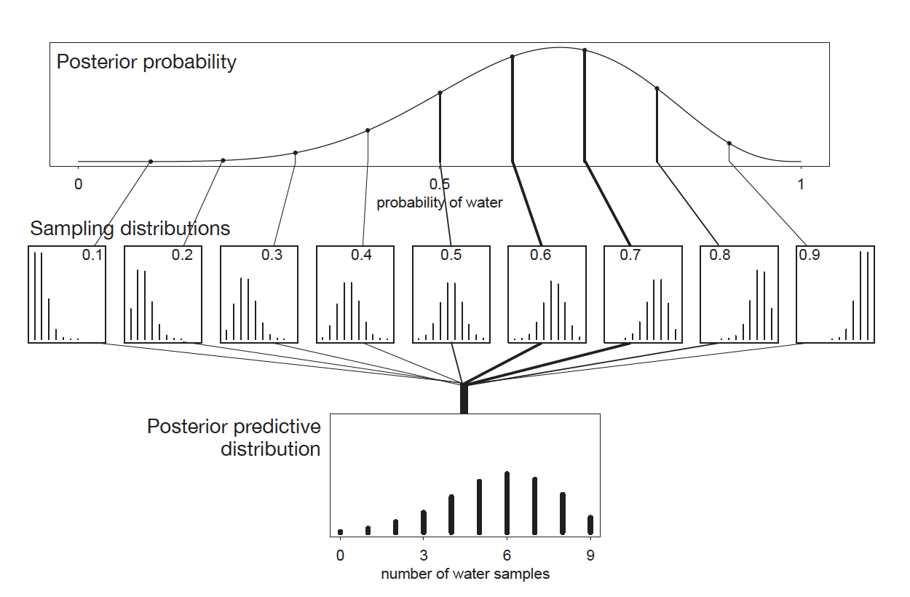
Propagating uncertainty about parameter estimates to make predictions about the observations

Slide 13
Propagating uncertainty about parameter estimates to make predictions
Observations: 6 water out of 9 tosses
Our posterior encapsulates uncertainty about the true value of p. The most likely value is between 0.6 – 0.7.
A value of p = 0.6 implies a distribution of predicted observations, because even with p fixed, there are many possible ways to generate data that are consistent with p = 0.6
To incorporate both the uncertainty surrounding the true p AND the uncertainty surrounding the sampling distributions for each value of p, we average sampling distributions for all possible values of p, using their relative posterior probability as sample weights.
The resulting predictive distribution tells us the relative frequency of expected water observations given all inherent uncertainties. While 6 (the actual observed value) is still the most likely, both 5 and 7 were almost as likely to have been observed.

Slide 14
Averaging over the posterior
rbinom(10000, size = 9, prob = samples)
Draws 10,000 random samples from a binomial distribution of outcomes of 9 trials
Probability of success is defined by the posterior distribution
Probabilities appear in the posterior relative to their likelihood given the data
Therefore, the simulated observations are “averaged” over the posterior distribution

Slide 15
Next time
Quadratic approximation

