Slide 1
Recap, week 9
Posterior predictive distribution (see lecture code)
MAP estimates (maximum a posteriori)
Interpretation of model outputs
Centering and standardizing variables

Slide 2
Gaussian Model for Height: Adding a Weight Predictor
Model output interpretation
Mean (mu): Mean is now modeled indirectly via the intercept and slope parameters
Intercept (a): Expected mean outcome when the predictor has a value of 0
Slope (b): Expected increase in the mean of the outcome for each one unit increase in the predictor

Slide 3
Data Considerations
Centering of variables
How: Subtract the raw variable mean from each value of the raw variable
Interpretation: a value of 0 for a centered variable corresponds to the mean value of the raw variable
Benefits:
Can improve model fitting
Can improve interpretability of the intercept parameter

Slide 4
Gaussian Model for Height: Centered Predictor
Model output interpretation
Mean (mu): Mean is now modeled indirectly via the intercept and slope parameters
Intercept (a): Expected mean outcome when the predictor is at its mean value
Slope (b): Expected increase in the mean of the outcome for each one unit increase in the predictor

Slide 5
Data Considerations
Standardizing of variables
How: Subtract the raw variable mean from each value of the raw variable and divide by the raw variable’s standard deviation
Interpretation: a value of 0 for a standardized variable corresponds to the mean value of the raw variable, and an increase in 1 unit of the standardized variable corresponds to a 1 standard deviation increase in the raw variable
Benefits:
Can improve model fitting
Can improve interpretability of the intercept parameter
Allows easier comparison among predictors

Slide 6
Gaussian Model for Height: Standardized Predictor
Model output interpretation
Mean (mu): Mean is now modeled indirectly via the intercept and slope parameters
Intercept (a): Expected mean outcome when the predictor is at its mean value
Slope (b): Expected increase in the mean of the outcome for each standard deviation increase in the predictor

Slide 7
Introduction to Statistics for Ecology and Evolutionary Biology Multiple Regression Week 10 15 November 2021

Slide 8
Roadmap for today
Adding multiple variables to your regression model and things to think about
Visualizing multiple regression fits
Multicollinearity issues
Categorical predictors

Slide 9
Benefits of Multiple Regression
Reveals instances of spurious correlation
Can occur when a truly causal predictor is associated with both the outcome and another (spurious) predictor variable
Including both variables together in a regression reveals an effect of the causal predictor and no effect of the spurious predictor
Reveals instances of masking
Can occur when two predictor variables are positively correlated with each other and both correlated with the outcome, but in different directions
Including both variables together in a regression results in increased strength of association for each

Slide 10
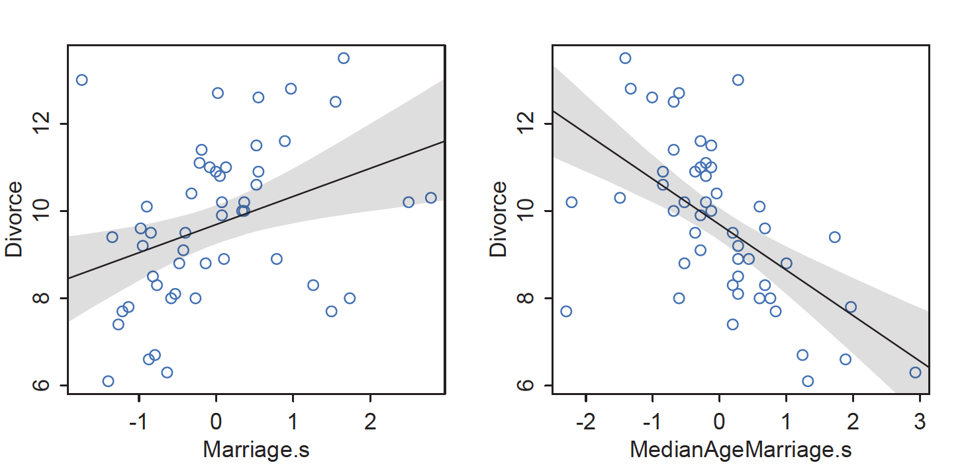
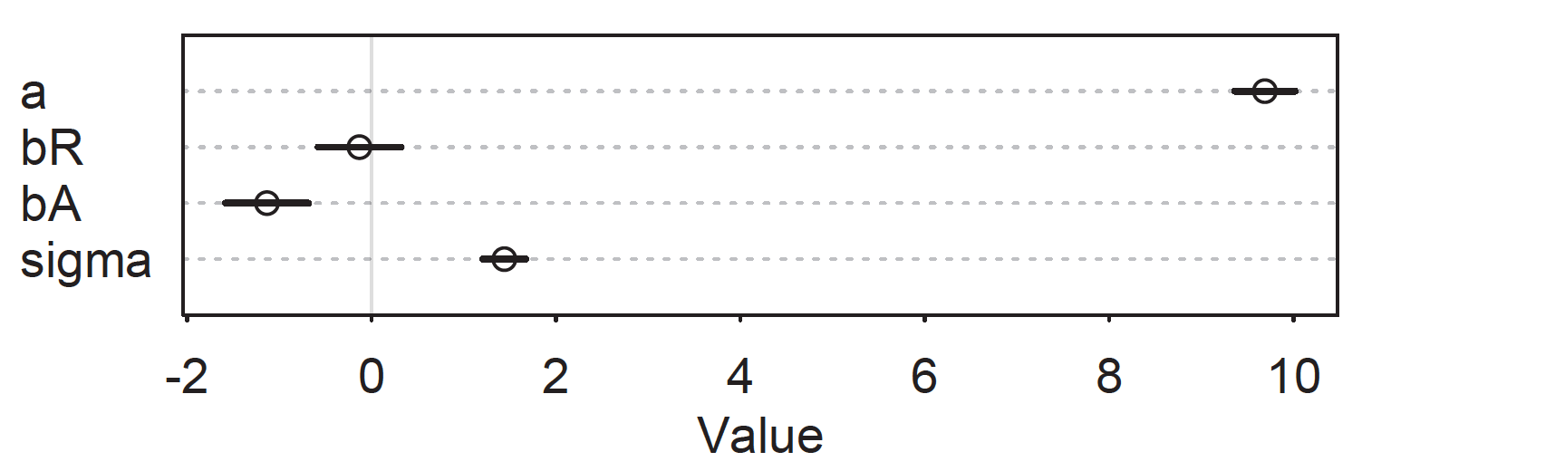
Spurious Correlation
McElreath 2016, Statistical Rethinking
Notes:
The bottom plot shows precis() output if both variables are included in the same model to predict divorce rate
Interpretation: “Once we know median age at marriage for a State, there is little or no additional predictive power in also knowing the rate of marriage in that State.”

Slide 11
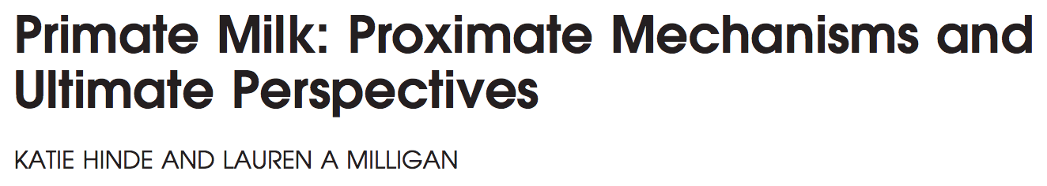
Milk synthesis, arguably the most physiologically costly component of rearing infants, remains the least studied.
Question: Is the energy content of milk related to the percentage of the brain that is neo-cortex and/or female body mass?
Hinde and Milligan 2011, Evolutionary Anthropology
Notes:
Image from: https://www.animalfactsencyclopedia.com/Gorilla-facts.html

Slide 12
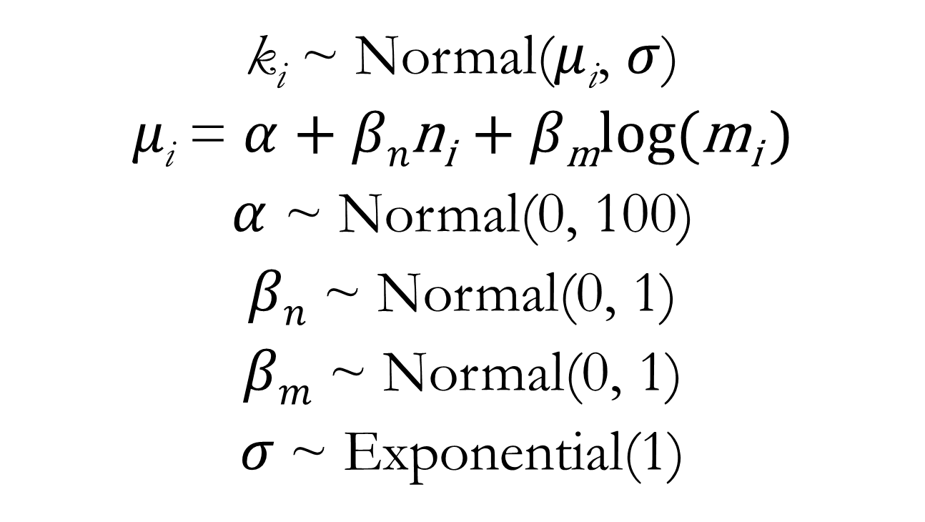
Multiple Regression for Milk Energy Data
k_{i} ~ Normal($μ$_{i}, $σ$)
$μ\text{i}$ = $α$ + $βn\text{n}\text{i}$ + $β\text{m}\text{log}\text{(}\text{m}\text{i}$ )
$α$ ~ Normal(0, 100)
$βn$ ~ Normal(0, 1)
$βm$ ~ Normal(0, 1)
$σ$~ Exponential(1)

Slide 13
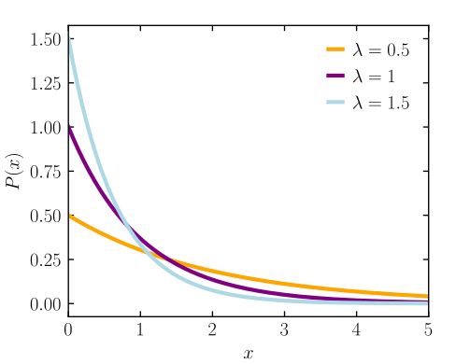
Exponential distribution
A probability distribution of the time between independent events occurring at a constant average rate.
λ: mean rate (>0)
Mean: 1/ λ
Example: An event that occurs, on average, at a rate of 2 events per hour, the average interval between events is 0.5 hours.

Slide 14
Multiple Regression for Milk Energy Data
m5x <- quap(
data = dcc, # specify data to fit
alist(
kcal.per.g ~ dnorm(mu, sigma),
mu <- a + bn*neocortex.perc + bm*log.mass,
a ~ dnorm(0, 100), # prior for the intercept
bn ~ dnorm(0, 1), # prior for the np effect
bm ~ dnorm(0, 1), # prior for the body mass effect
sigma ~ dexp(1) # prior for the standard deviation
)
)
See lecture code
Notes:
Note that “log.mass” here is the log of body mass, as previously calculated and saved as a new variable in the “dcc” data frame
Otherwise, it’s a very direct translation of the mathematical form of the model

Slide 15
Visualizations
1) Predictor Residual Plots
Show outcome data plotted against residual predictor values
Essentially replicates the calculation that happens automatically within a multiple regression model
2) Counterfactual Plots
Implied predictions for arbitrary predictor values
Especially critical for multiple regression since it allows us to imagine variation in one variable with the other held constant
3) Posterior Prediction Plots
Focuses on generating model-based predictions for the original observations and communicating error in those predictions

Slide 16
So Why Not Include All Predictors All The Time?
1) Multicollinearity
A very strong correlation between two predictor variables
In the extreme, this means the two variables contain the same information
2) Post-Treatment Bias
Including variables that are consequences of other variables
3) Overfitting
Focuses on the utility of a model for out-of-sample prediction
A motivating problem for model selection procedures
Notes:
Not going to discuss post-treatment bias very much and overfitting is for later in the class

Slide 17
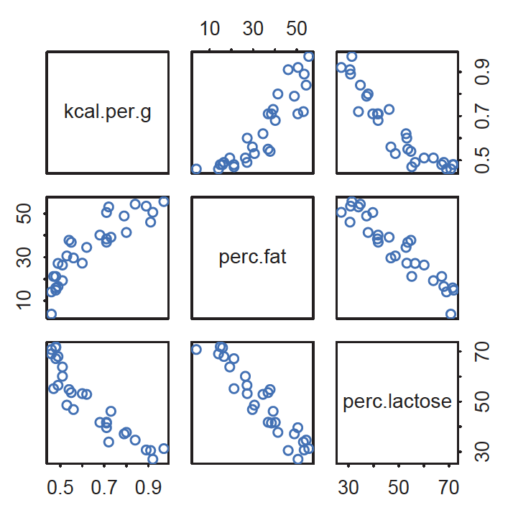
Multicollinearity
McElreath 2016, Statistical Rethinking
Notes:
What if the two predictor variables of interest were percent fat in the milk and percent lactose in the milk?

Slide 18
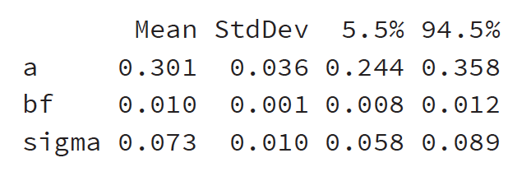
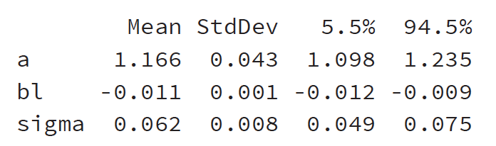
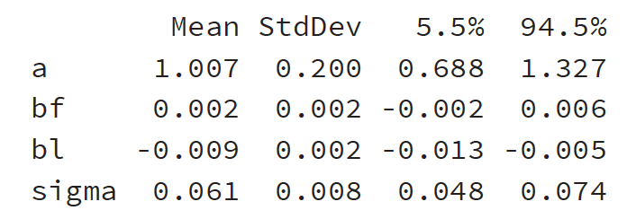
Model with percent fat alone:
Model with percent lactose alone:
Model with both:
Notes:
When both are included together in one model, the estimated effect of each is weaker
The intuitive explanation is that each variable does not help you too much IF you already know the other

Slide 19
Multicollinearity
Identifying multicollinearity:
Plot predictor variables against each other to visualize correlation before modeling
Can be diagnosed during model fitting via inflated parameter estimates
Addressing multicollinearity:
Varies by discipline and norms
Drop all but one of a cluster of variables that is highly correlated
Fit multiple models using the collinear variables in turn

Slide 20
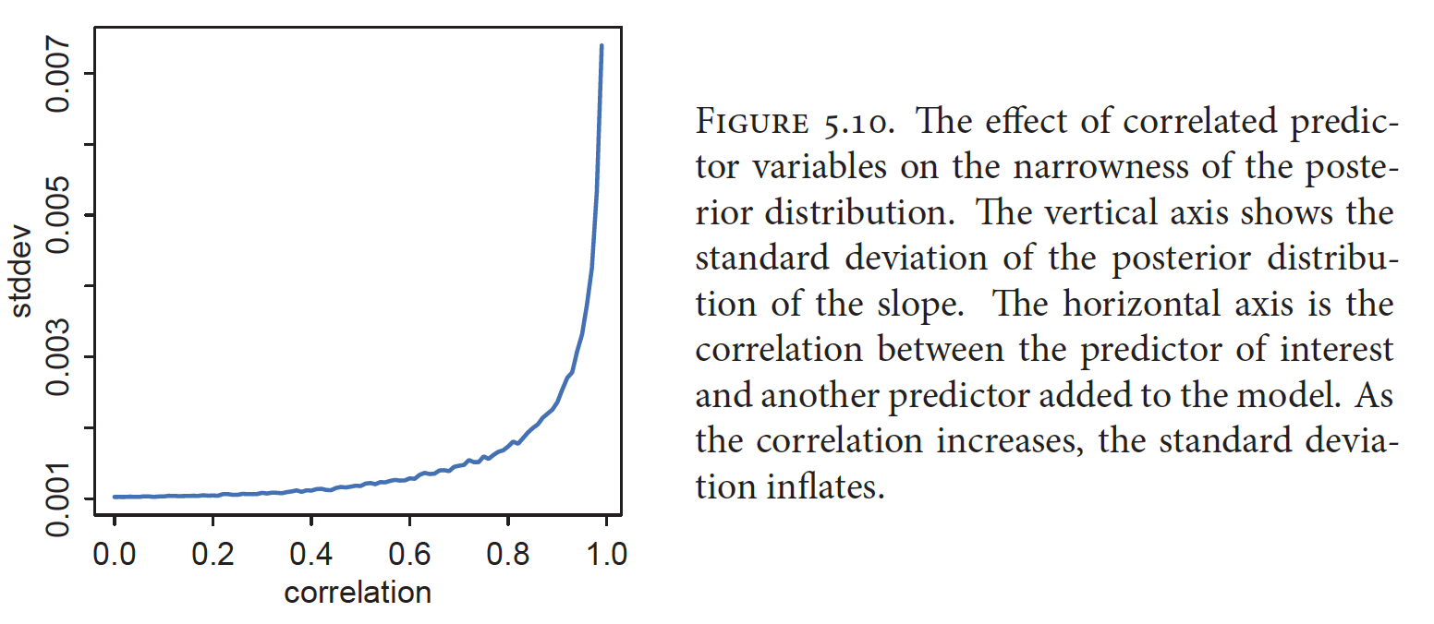
Multicollinearity
McElreath 2016, Statistical Rethinking
Notes:
In general the impact of multicollinearity on model inference will scale (but not linearly) with the magnitude of the correlation between the predictors

Slide 21
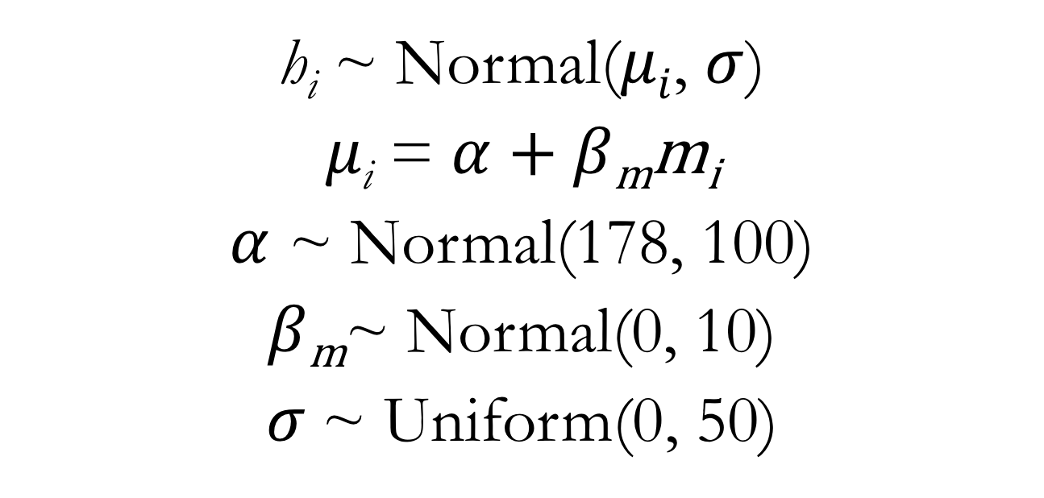
Categorical Predictors Linear Regression for Human Height
h_{i} ~ Normal($μi$, $σ$)
$μ\text{i}$ = $α$ + $β\text{m}\text{m}\text{i}$
$α$ ~ Normal(178, 100)
$β\text{m}$~ Normal(0, 10)
$σ$~ Uniform(0, 50)
Notes:
The critical difference here is that the predictor variable, ”m”, is simply a binary (dummy) variable that indicates whether or not an observation comes from a male individual

Slide 22
Linear Regression for Human Height: Categorical Predictor
m5x <- quap(
data = d, # specify data to fit
alist(
height ~ dnorm(mu, sigma),
mu <- a + bm*male,
a ~ dnorm(178, 100), # intercept prior
bm ~ dnorm(0, 10), # (male) dummy variable prior
sigma ~ dunif(0, 50) # standard deviation prior
))
See lecture code

