Slide 1
Introduction to Data
Sampling
Numerical Data
Categorical Data

Slide 2
Population and samples

Slide 3
Anecdotal evidence
“Anecdotal evidence typically refers to unusual observations that are easily recalled because of their striking characteristics. Physicians may be more likely to remember the characteristics of a single patient with an unusually good response to a drug instead of the many patients who did not respond. The dangers of drawing general conclusions from anecdotal information are obvious; no single observation should be used to draw conclusions about a population.”
(Julie Vu: Introductory Statistics for the Life and Biomedical Sciences)

Slide 4
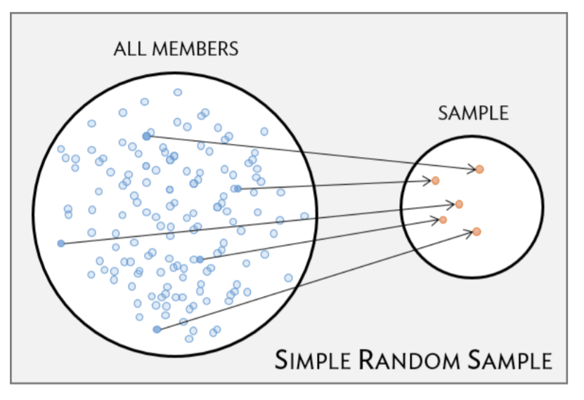
Sampling from a population
Simple random sample: each member of a population has the same chance of being sampled

Slide 5
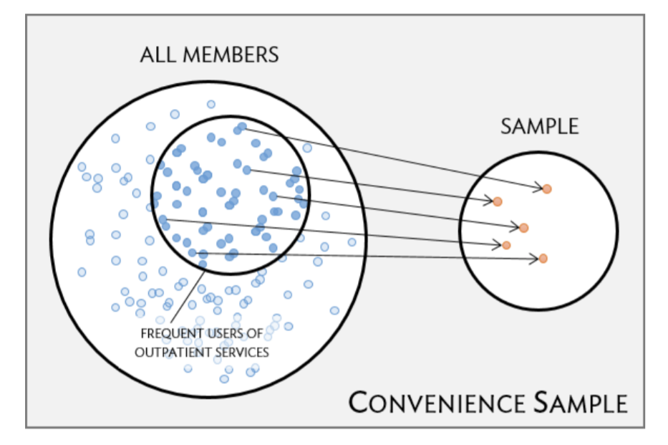
Sampling from a population
Convenience sample: Some individuals are easier to access / observe than others and are therefore more likely to be part of a study. They may not be an accurate representation of the larger population!

Slide 6
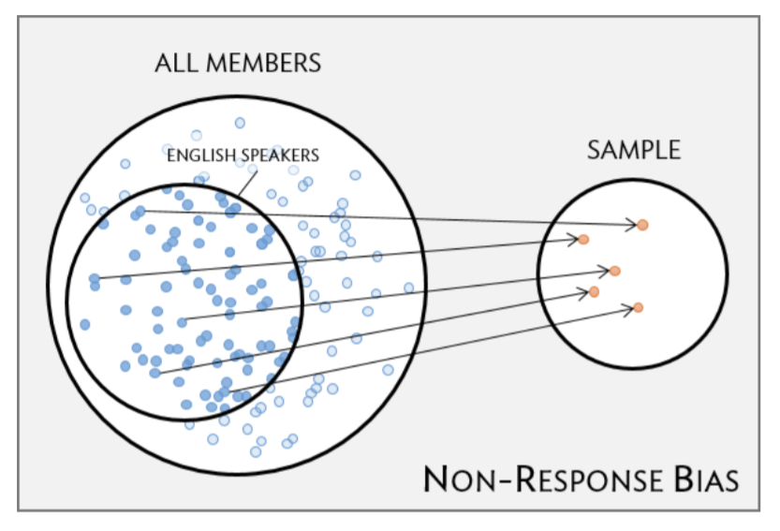
Sampling from a population
Non-response bias: Individuals with certain traits are not included in the same due to bias, like non-English speakers in a survey conducted in English.

Slide 7
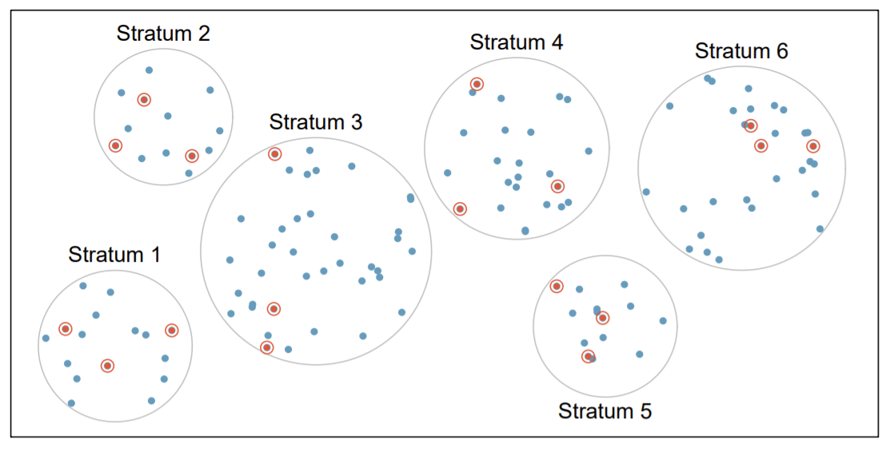
Stratified sampling
Useful when the population is broken into distinct groups that differ from each other in systematic ways.

Slide 8
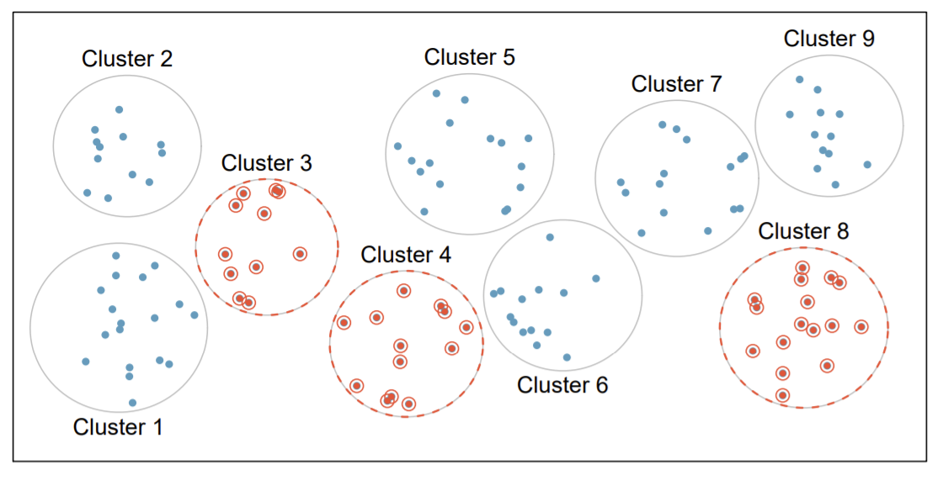
Cluster sampling
Randomly select a cluster and then sample all individuals within the selected clusters.

Slide 9
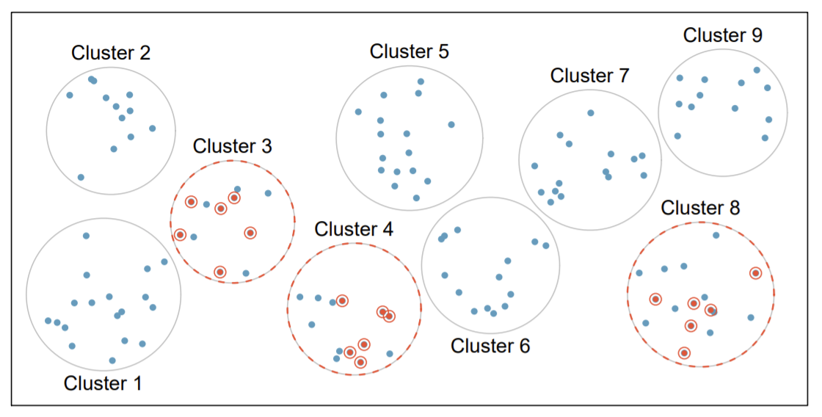
Multistage sampling
Randomly select a cluster and then sample a random selection of individuals within each cluster.

Slide 10
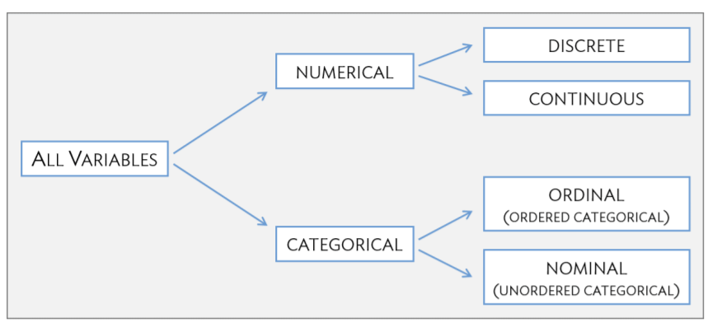
Variables

Slide 11
Categorical data

Slide 12
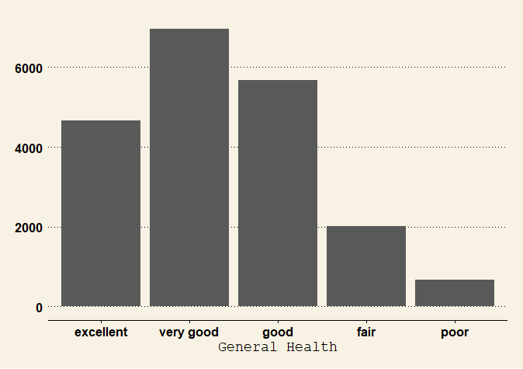
Frequency distribution
The most basic statistical summary of a list of numbers or categories is their distribution
A frequency table is the simplest form of a distribution
For more than two categories, we can use bar charts
Male | Female
9569 | 10431

Slide 13
Numerical data

Slide 14
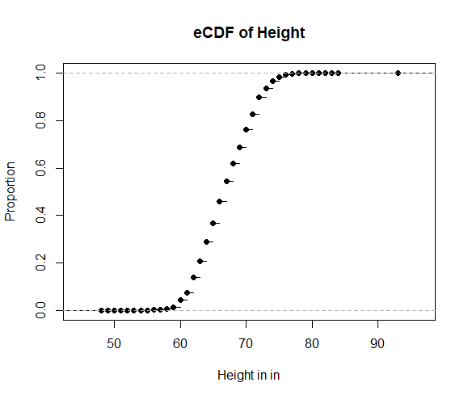
Cumulative distribution functions
When data is not categorical, reporting the frequency of each entry is not an effective summary since most entries are unique.
Cumulative distribution function (CDF): reports the proportion of the data below x for all possible values of x
Disadvantage: Doesn’t tell us where distribution is centered or how it is shaped.

Slide 15
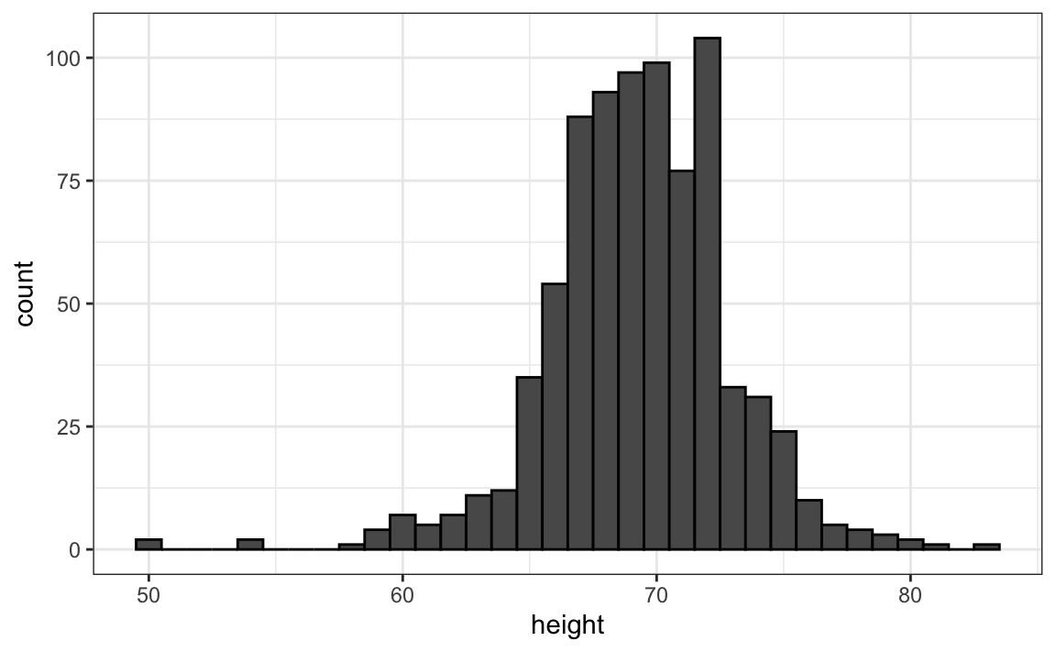
Histograms
Divide the span of our data into non-overlapping bins of the same size.
Then, for each bin, count the number of values that fall in that interval.
Example figure: the range of the data is from 50 to 84 with the majority between 63 and 75 inches; the heights are close to symmetric around 69 inches.

Slide 16
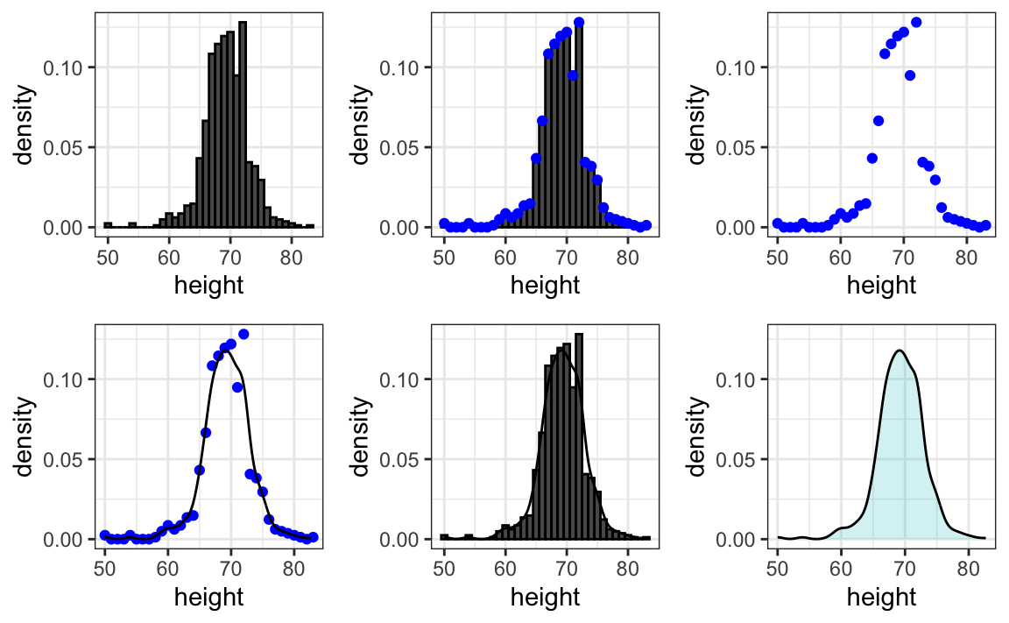
Smoothed density plots

Slide 17
Distributions
Reiterate:
The collection of values for a numerical, continuous variable (e.g., weight) is the distribution for that variable.
Numerical and graphical summaries convey characteristics of a distribution without listing all the values.
Important characteristics of distributions include. . .
Center: where is the middle of the distribution?
Measures of center: mean, median
Spread: how similar or varied are the values to each other?
Measures of spread: standard deviation, interquartile range

Slide 18
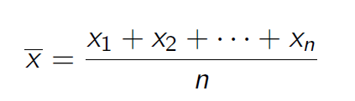
Measure of center: Mean
The sample mean of a variable is the sum of all observations divided by the number of observations:

Slide 19
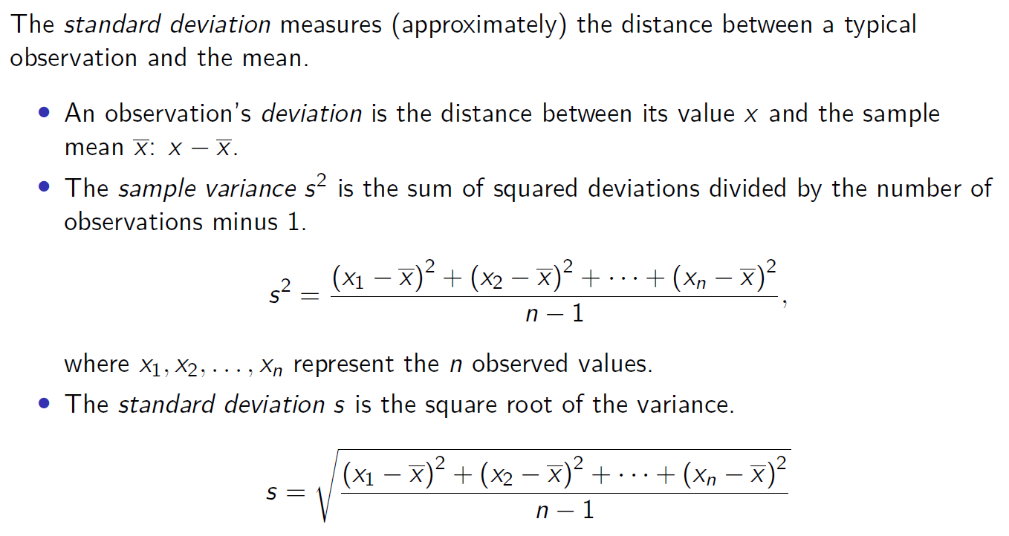
Measure of spread: Standard Deviation

Slide 20
Normal distribution
The reason why we use means and standard deviations so widely go back to properties of a specific type of distribution, the normal or Gaussian distribution
The normal distribution is one of the most famous mathematical concepts in history!
Approximately normal distributions occur in many situations, including gambling winnings, heights, weights, blood pressure, standardized test scores, and experimental measurement errors.

Slide 21
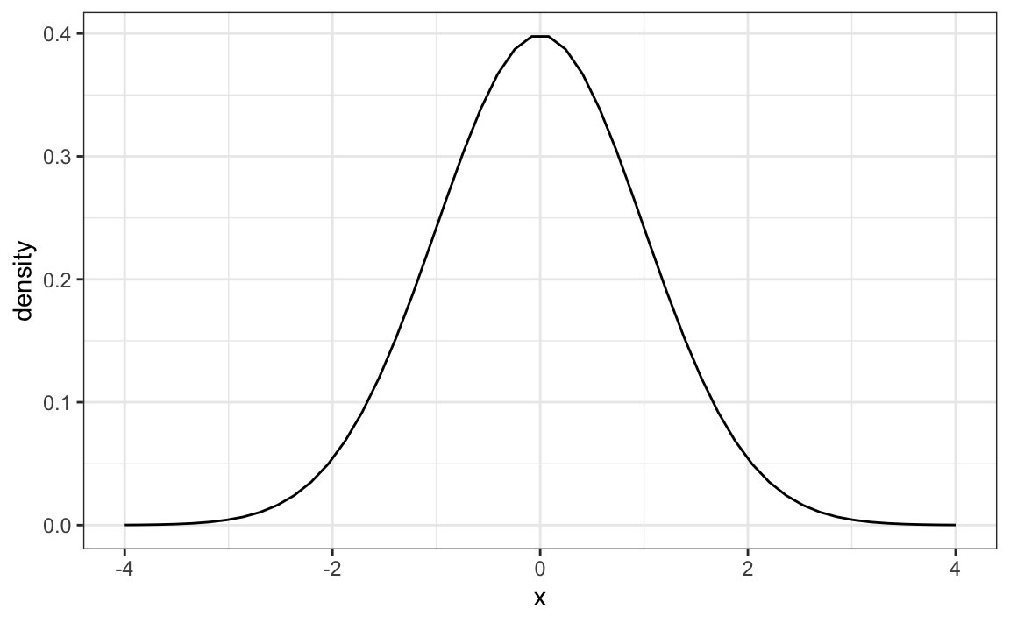
Normal distribution properties
symmetric, centered at the mean
most values (about 95%) are within 2 SDs from the average.
Standard normal distribution: mean = 0, SD = 1

Slide 22
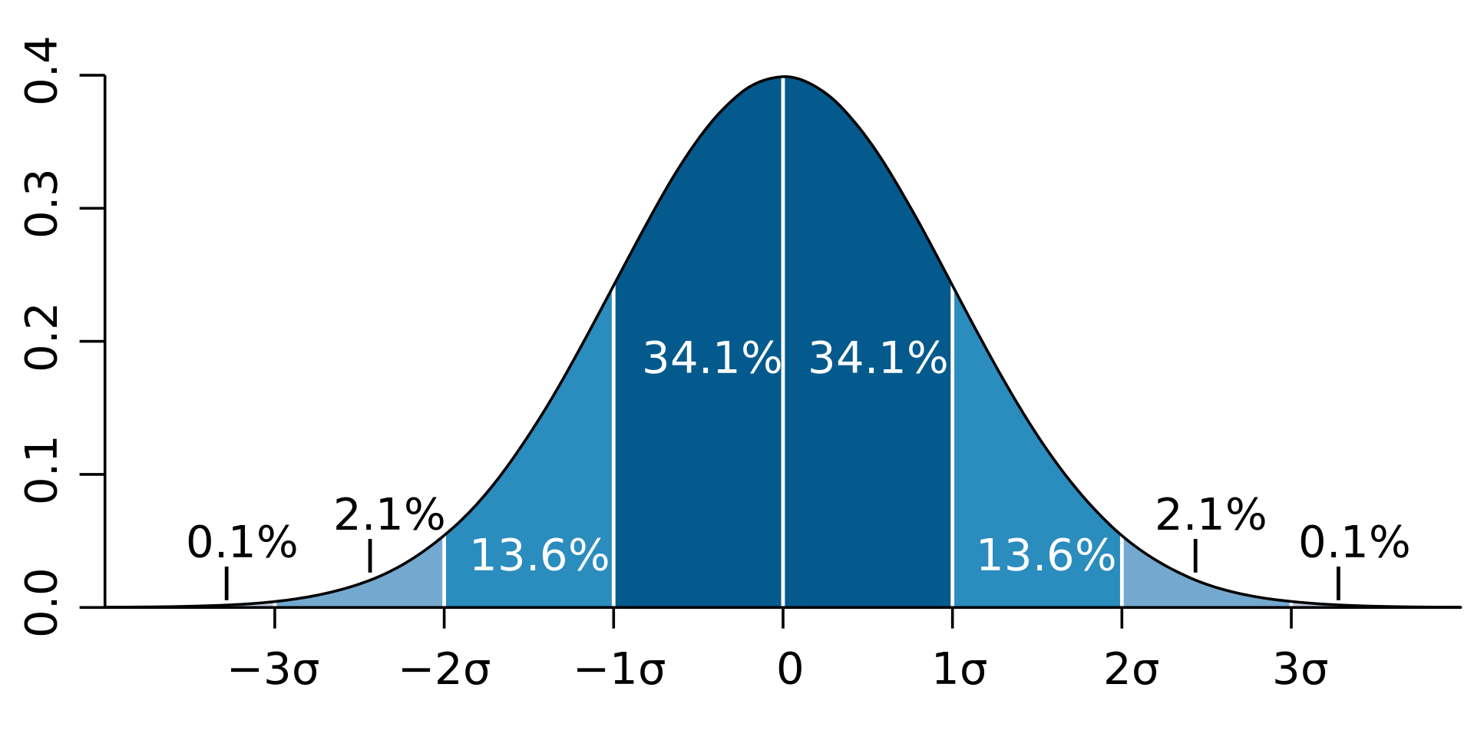
Normal distribution

Slide 23
More about distributions next week when we talk about probability

Slide 24
Measure of center: Median
The median is the value of the middle observation in a sample.
If the number of observations is
Odd, the median is the middle observation
Even, the median is the average of the two middle observations
The median is the 50th percentile; 50% of observations lie below/above the median.

Slide 25
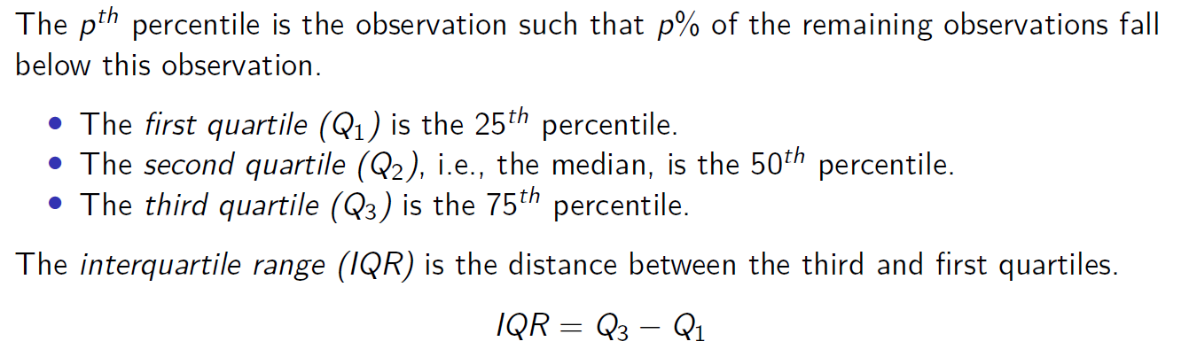
Measure of spread: Percentiles

Slide 26
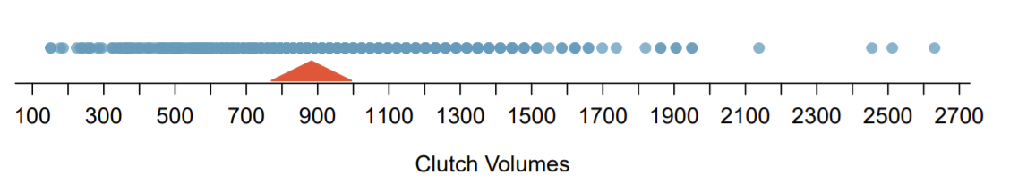
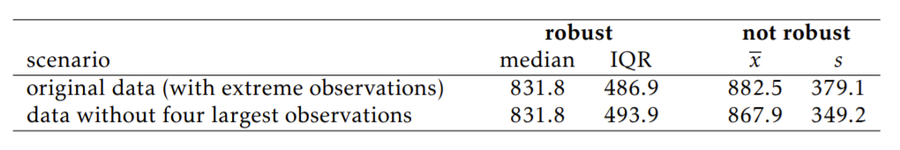
Robust estimates
The median and IQR are called robust estimates because they are less likely to be affected by extreme values than the mean and standard deviation.
For distributions containing extreme observations, the median and IQR provide a more accurate sense of center and spread.

Slide 27
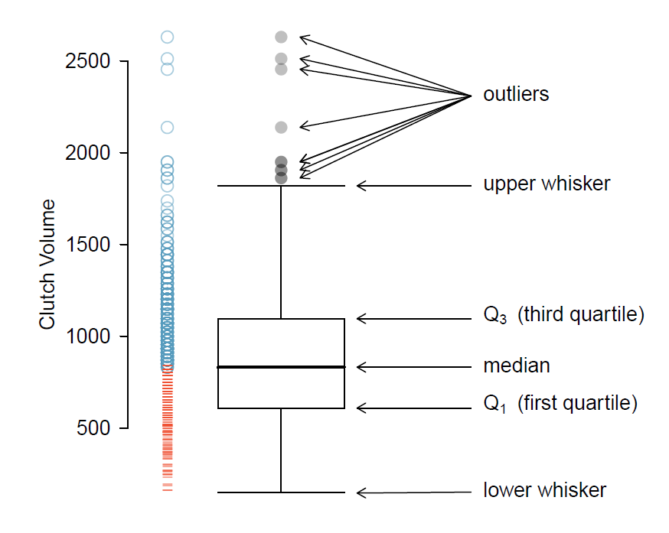
Boxplots

Slide 28
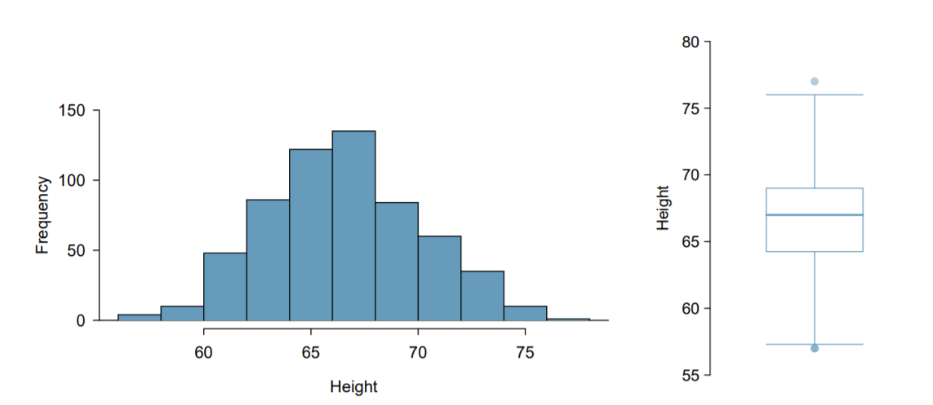
Histograms and boxplots
Unimodal distribution
Most common value about 67 inches
The middle 50% of individuals are between 5.5 feet and just under 6 feet tall
There are 2 outliers of one unusually tall and short person each

Slide 29
Associations between variables

Slide 30
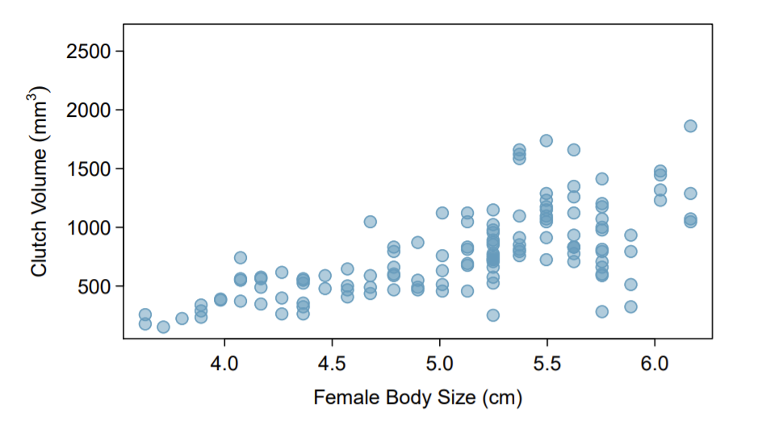
Scatterplots
Can be used to check whether two variables are independent or positively / negatively associated with each other.

Slide 31
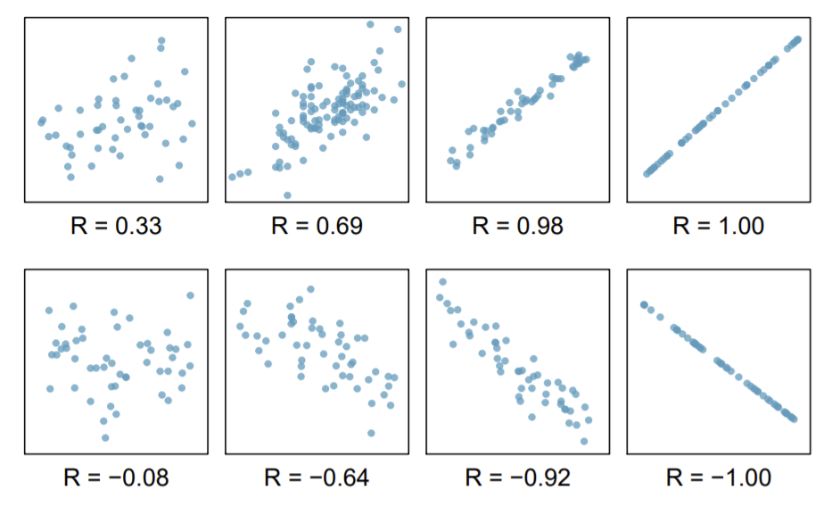
Correlations
Correlations assess the strength of a relationship between two variables.
Correlation coefficients range from -1 to 1.
Correlations are only meaningful for linear relationships!

Slide 32
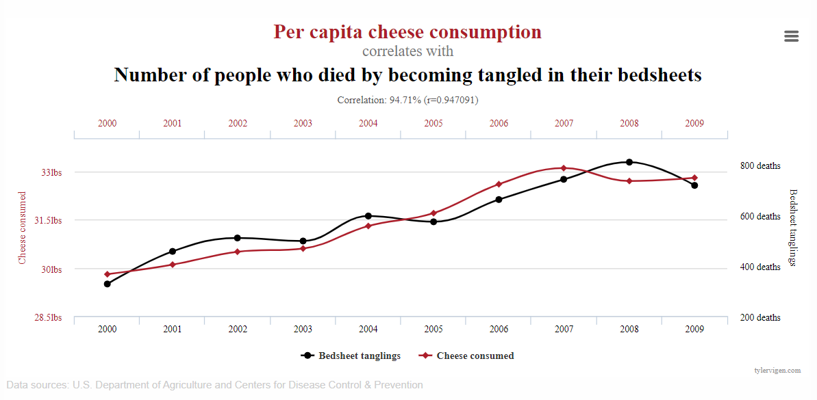
Correlation is NOT causation

Slide 33
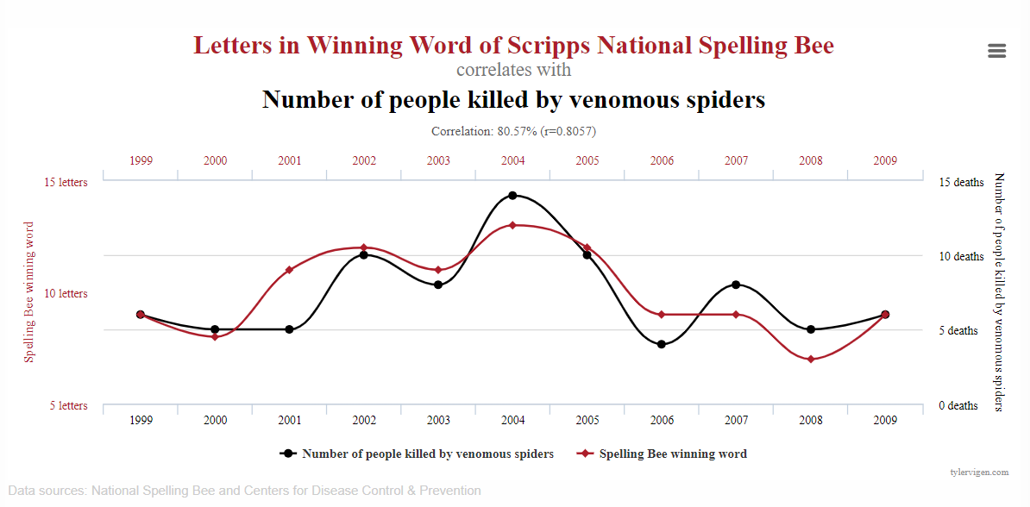
Correlation is NOT causation

Slide 34
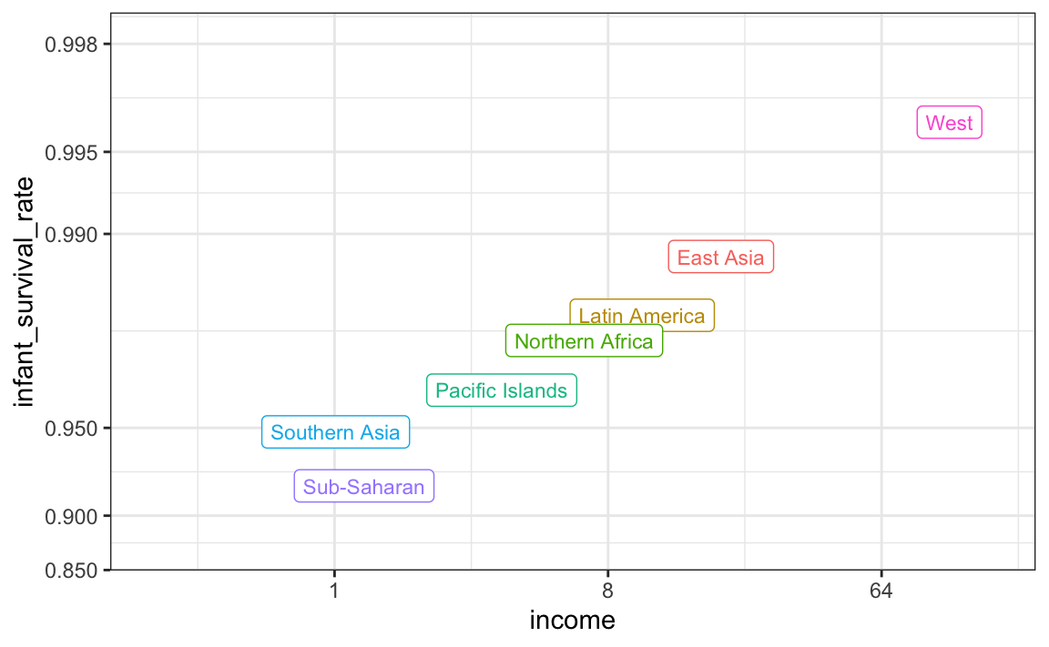

Ecological fallacy
Infant survival is calculated as log-odds.
There seems to be an almost perfect correlation between income and infant survival odds.

Slide 35
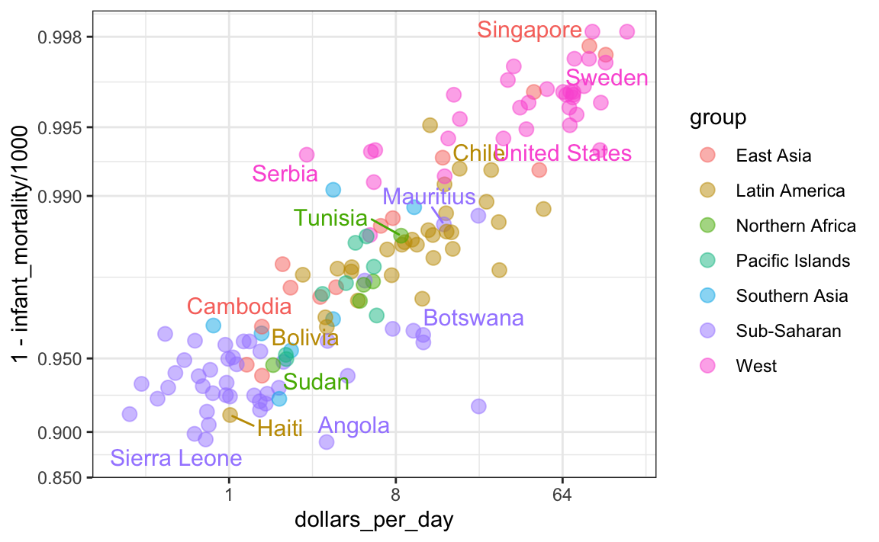
Ecological fallacy
BUT: This relationship does not hold within regions. There are likely other factors than income that determine infant survival!

Slide 36
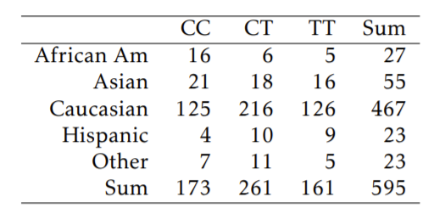
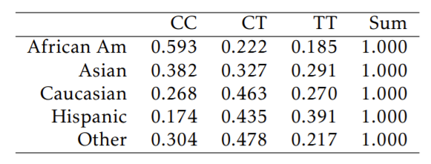
Contingency tables
Summarize categorical variables, counting the number of times each combination of values occurs in the data
Can be converted into proportions (row or column %)

Slide 37
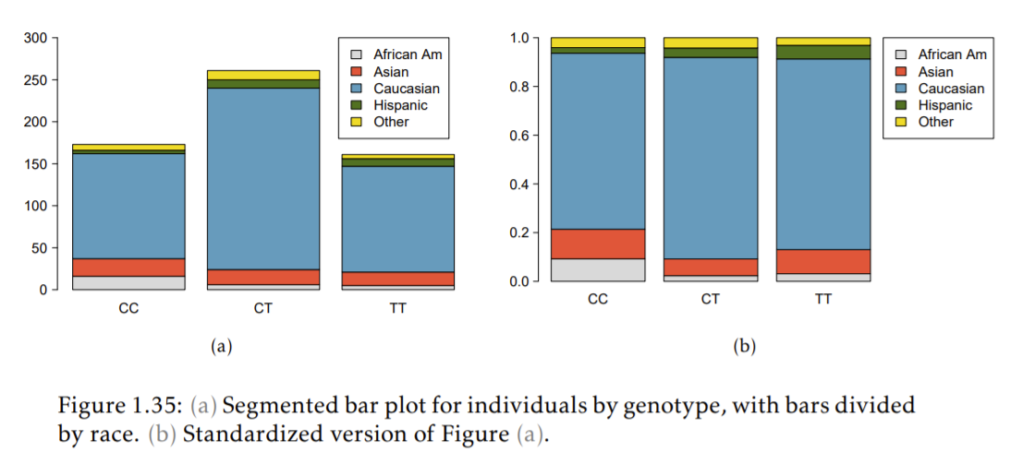
Segmented bar plots

Slide 38
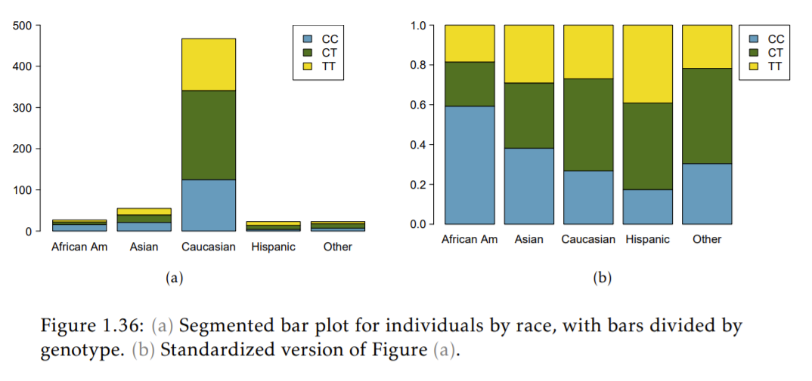
Segmented bar plots

Slide 39
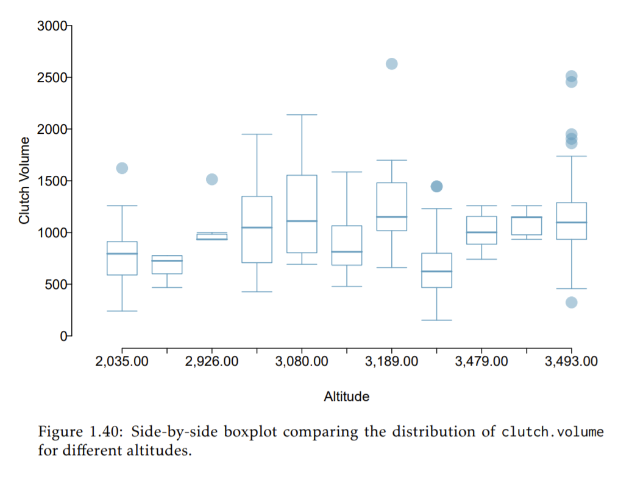
Categorical and numerical variables

Slide 40
Some data visualization principles

Slide 41
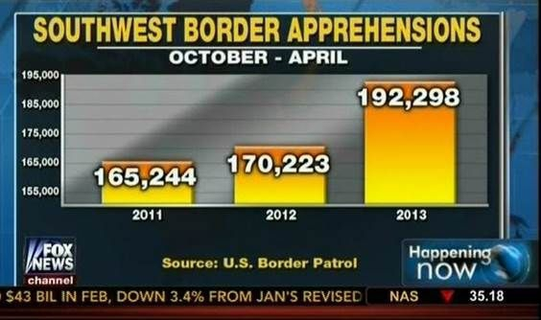
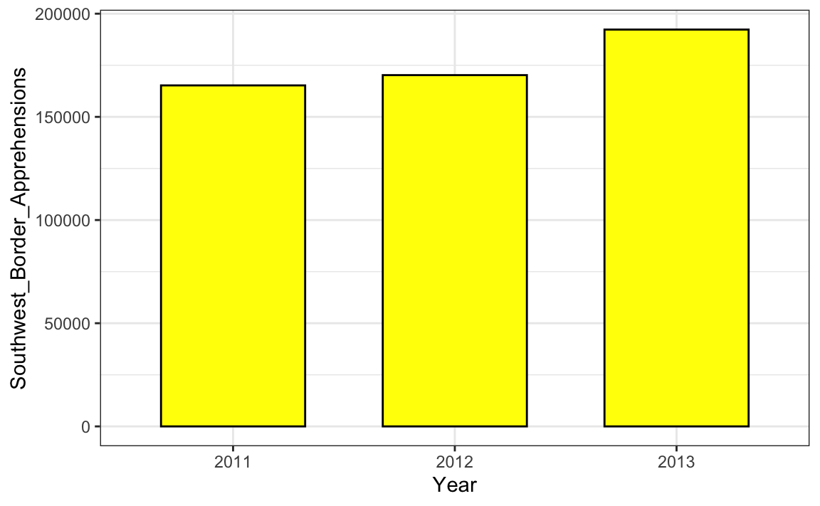
Be sure to include 0 when appropriate
Correct graph

Slide 42
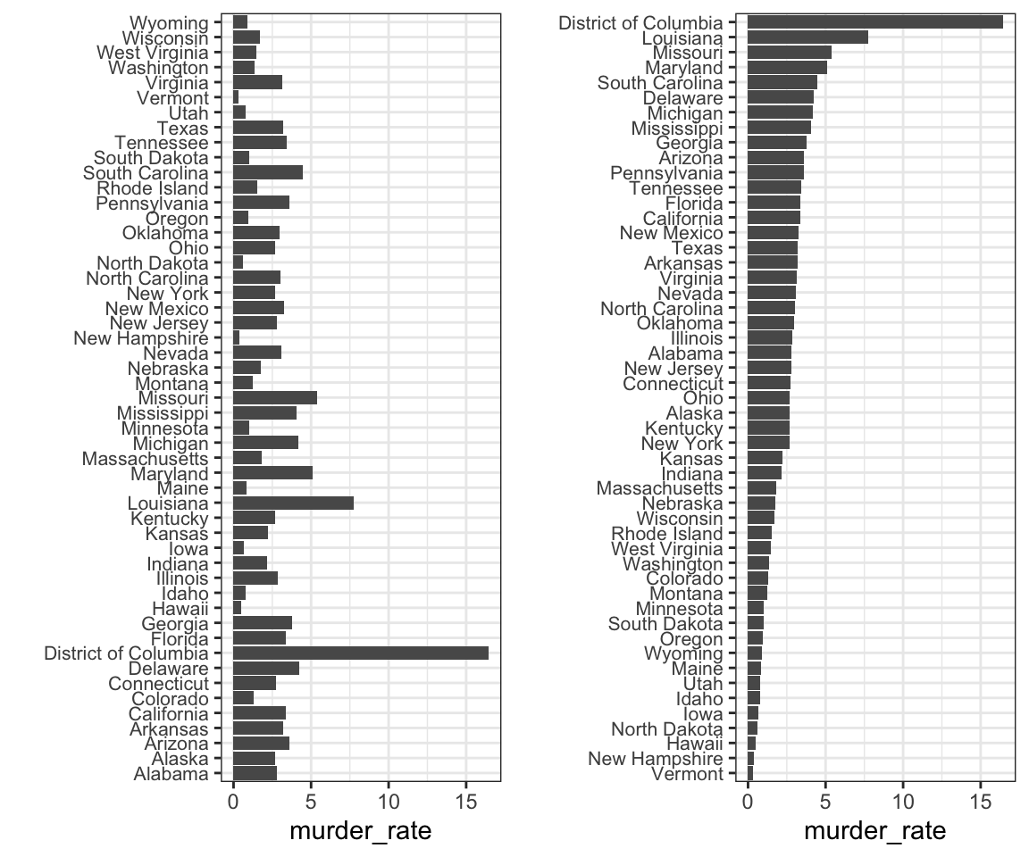
Order categories when meaningful

Slide 43
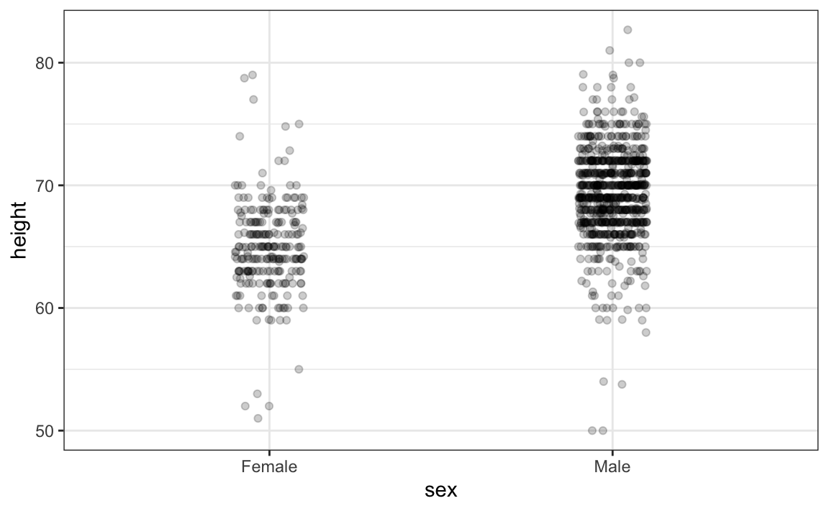
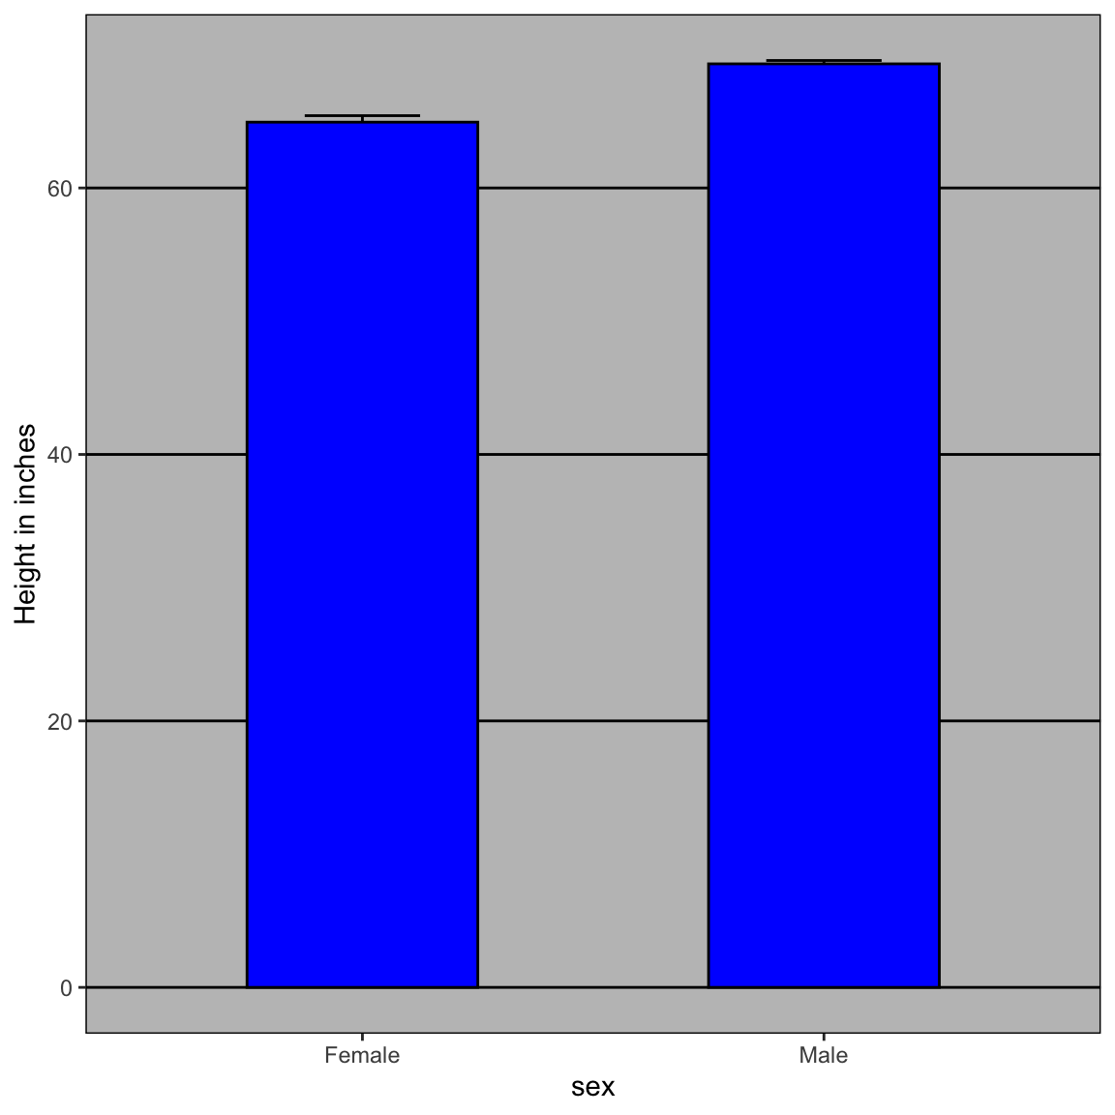
Show the data!

Slide 44
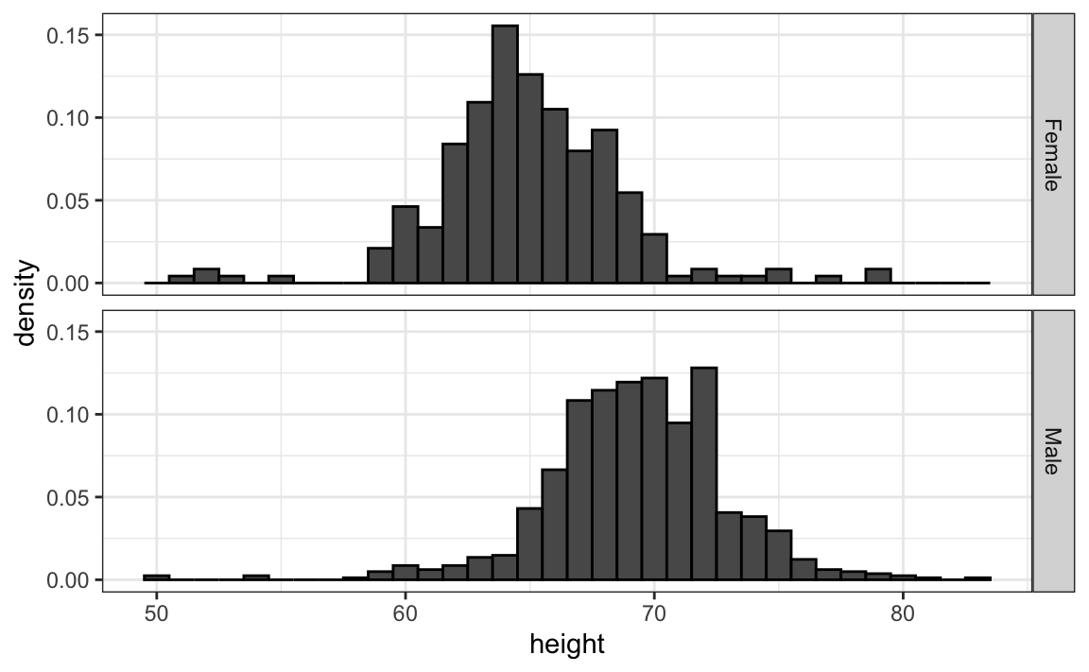
Align plots to make comparisons easier
Vertical alignment for horizontal comparisons and horizontal alignment for vertical comparisons

Slide 45
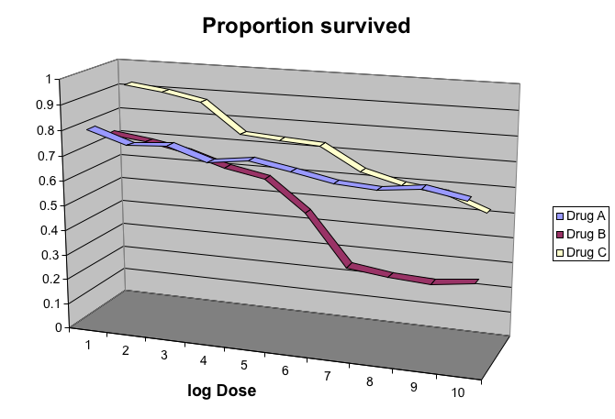
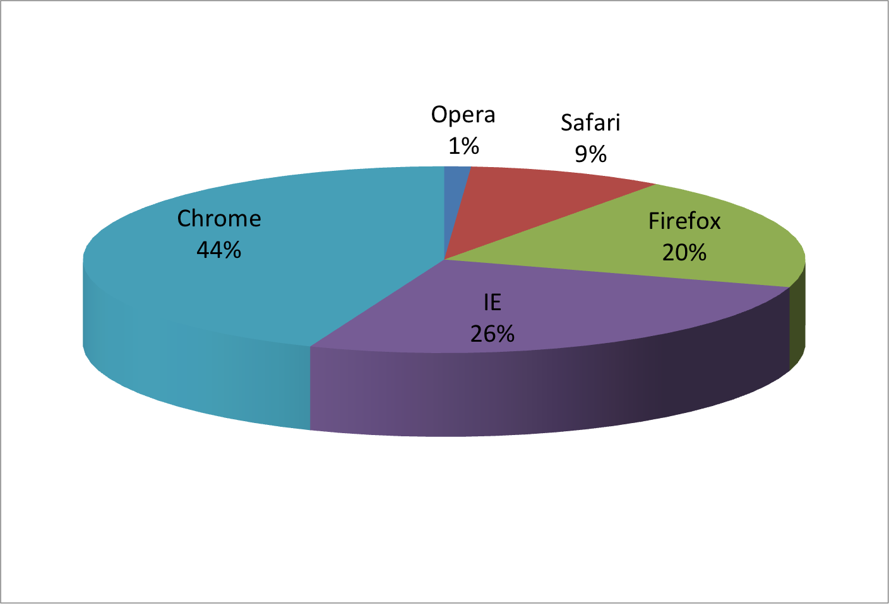
Do NOT use 3D and pie charts!

Slide 46
Next week

Slide 47
Topics & Readings
Introduction to probability and probability distributions
Vu textbook: Pages 89 – 116 (ending with Bayes theorem)
Introduction to null hypothesis testing
Cohen, 1994: The earth is round, b < 0.05. (added to readings folder on Canvas)

