Slide 1
Protokoll
Masterarbeit

Slide 2
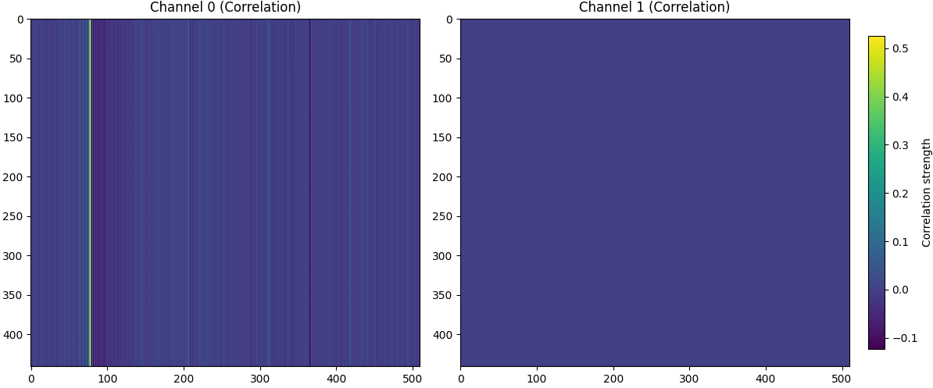
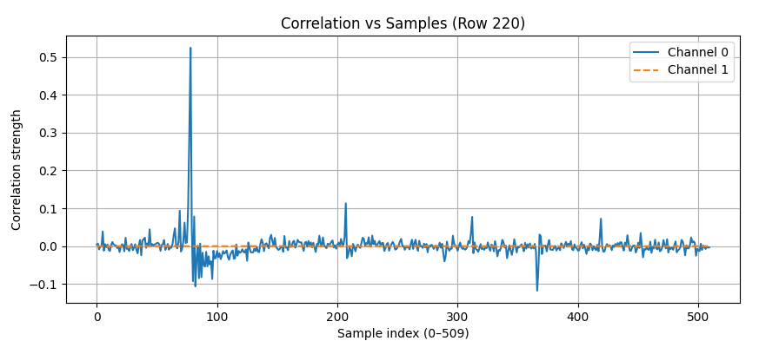
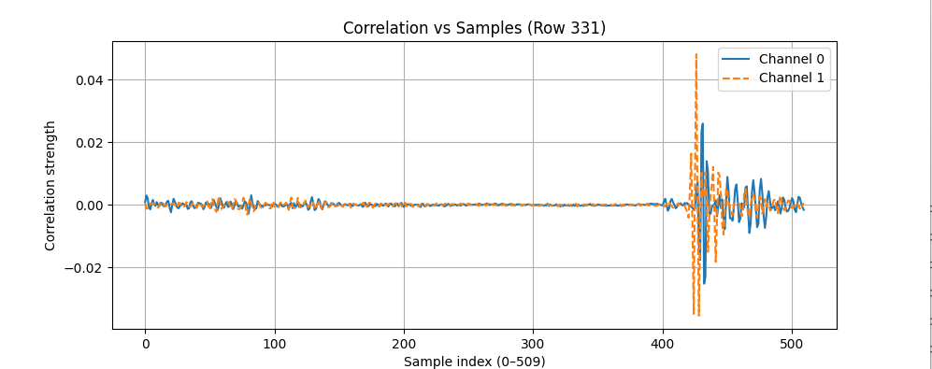
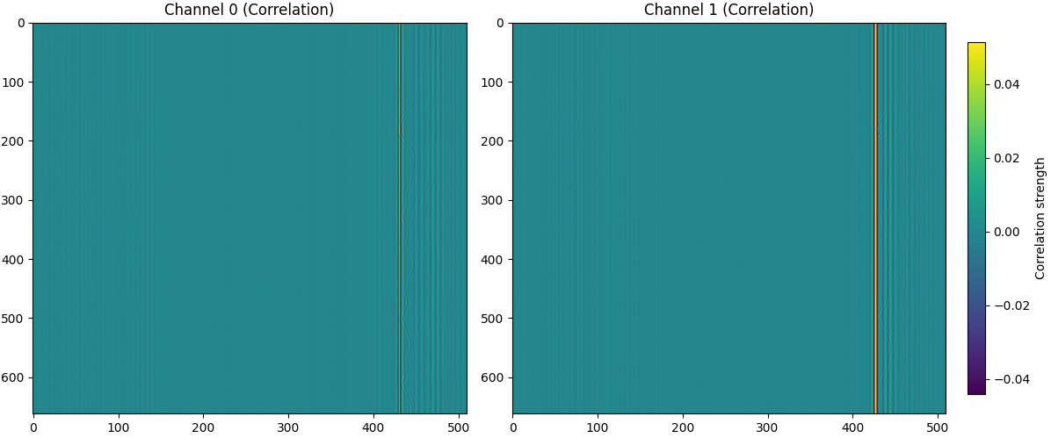
UWB first tests
UWB radar has random first trigger

Slide 3
Stepper Motor Mechanical Data
Laufrad AT5/20
- Durchmesser: d = 31,88mm
- Radius: r = 15,94mm
Umfang: U = 100,153974mm
Auflösung : 20.000 Inkrements proUmdrehung
Schrittdistanz step = 0,005mm (0,0050076987mm)
Speed_min Vmin = 333,3333 Inc/s = 1,6666mm/s

Slide 4
Signal Processing Pipeline:
RX1
RX2
DC
Removal
bin
selection
Stacking
of Rx1&2
Data
Variance
Filter?
Motion
PCA
Why such low correlation? / Value

Slide 5
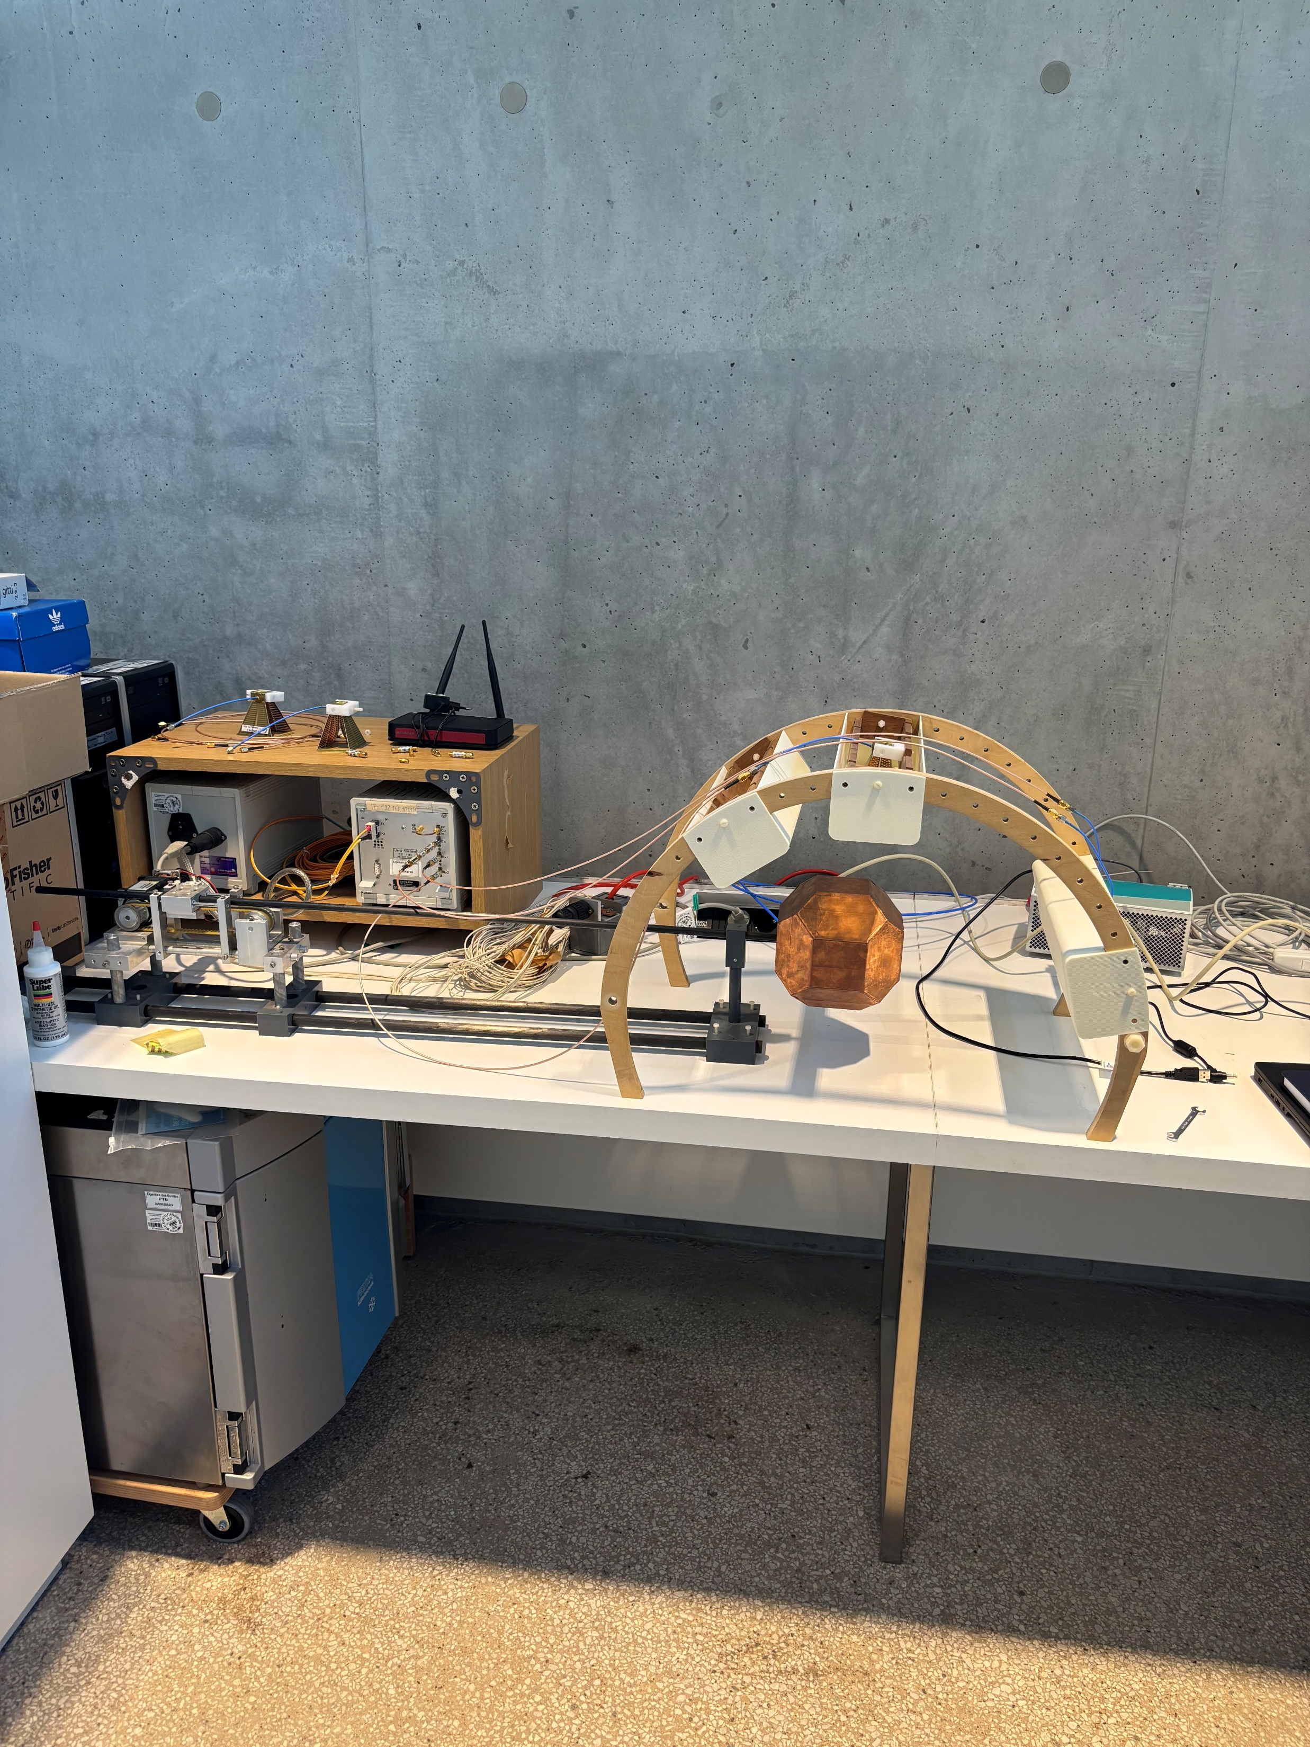

Slide 6
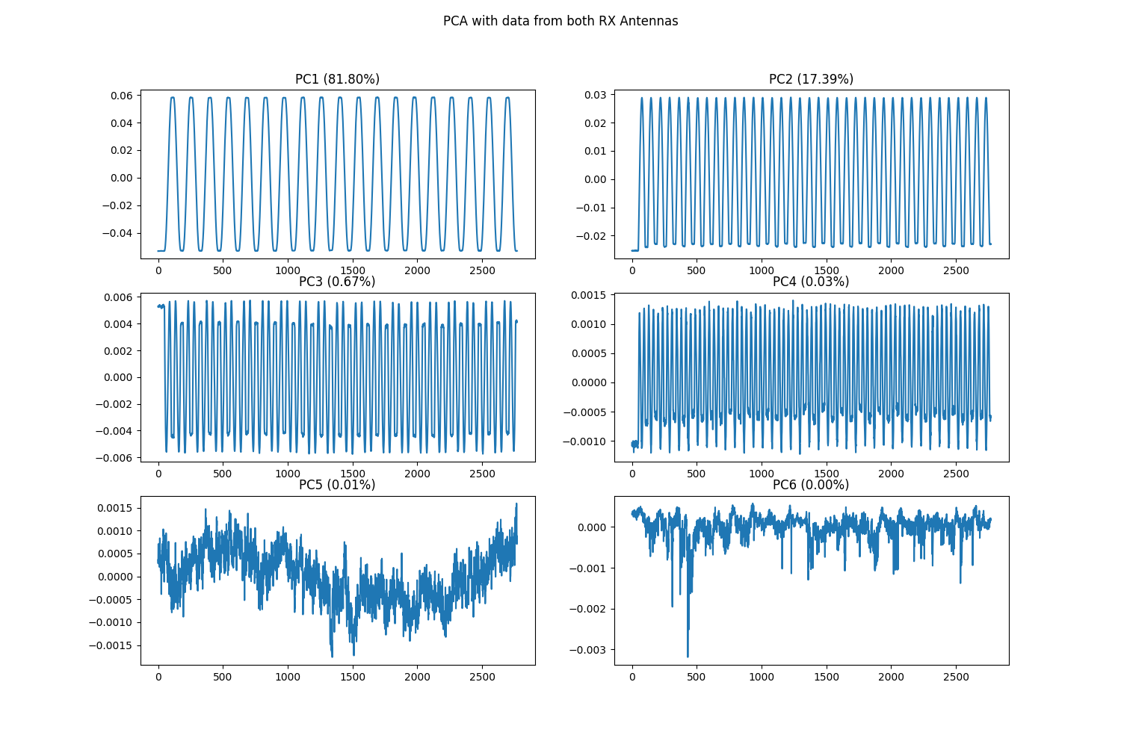
3cm
from sklearn.decomposition import PCA - mit

Slide 7
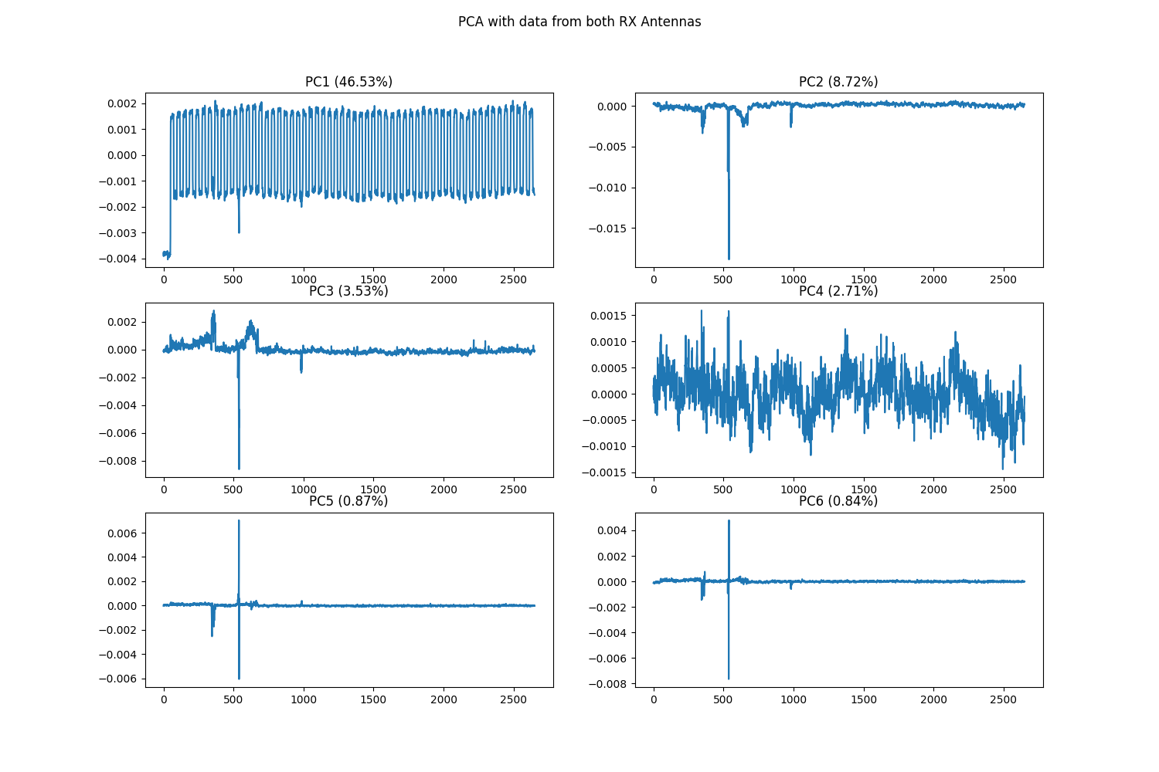
1mm

Slide 8
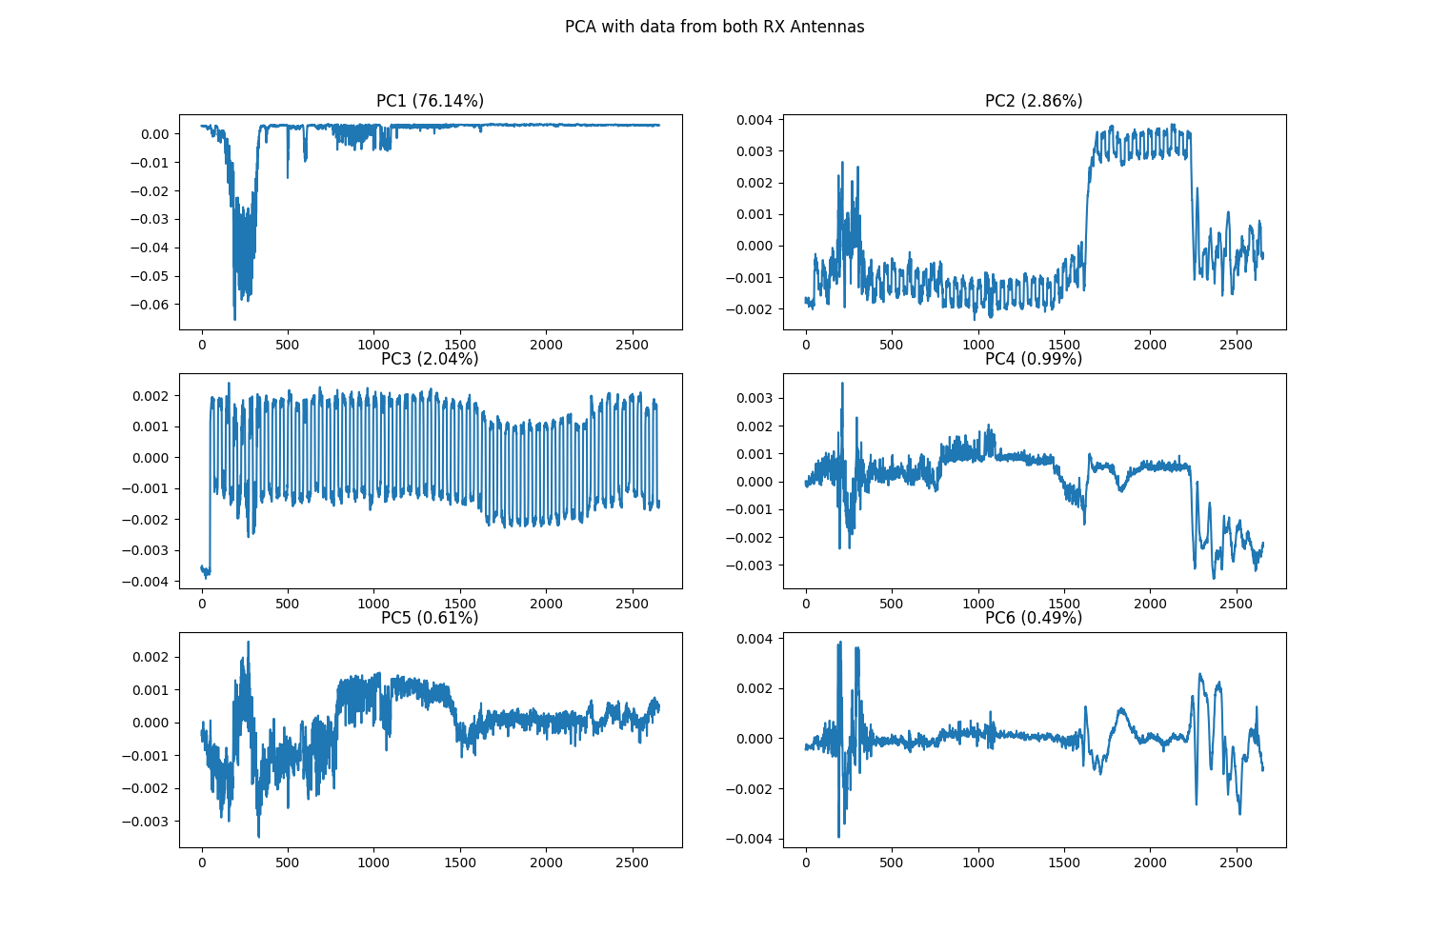
1mm with some movement

Slide 9
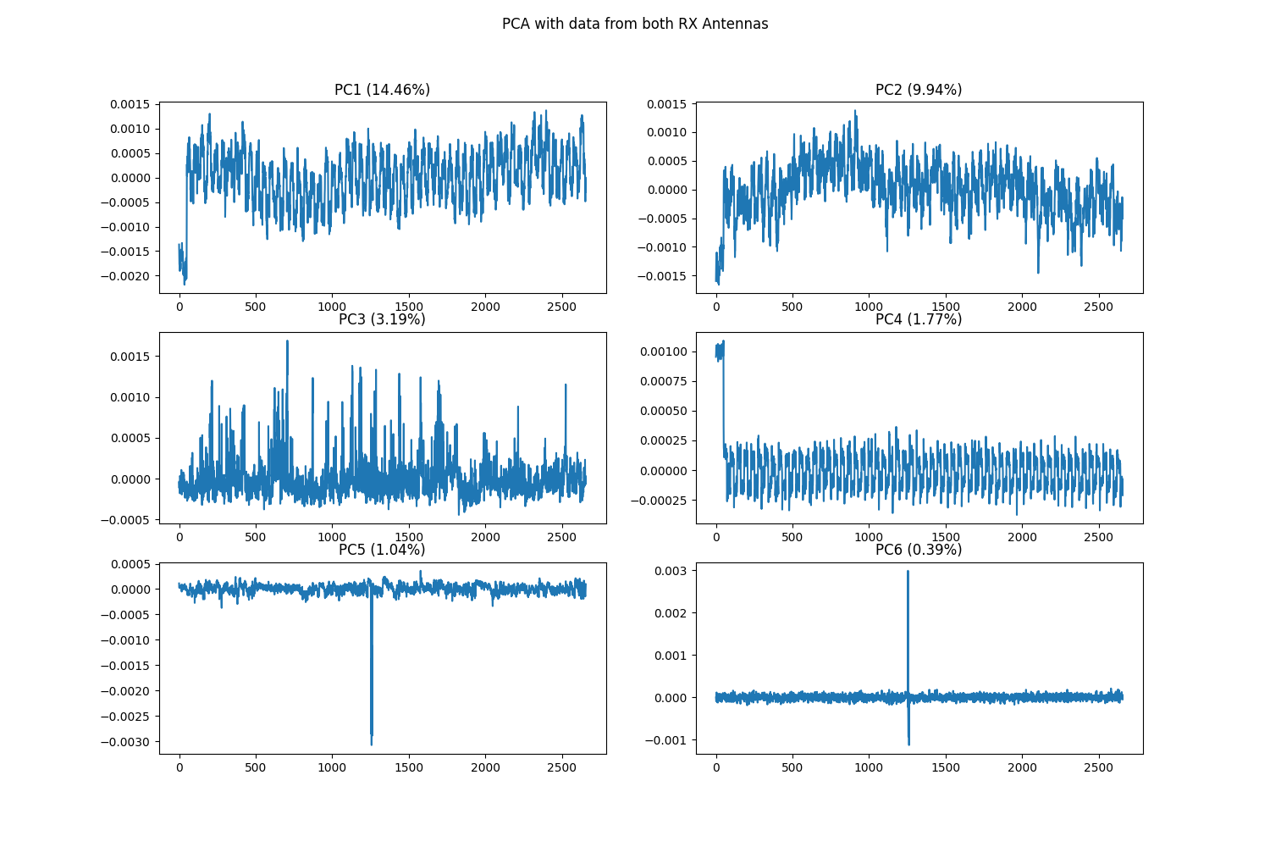
0,5mm

Slide 10
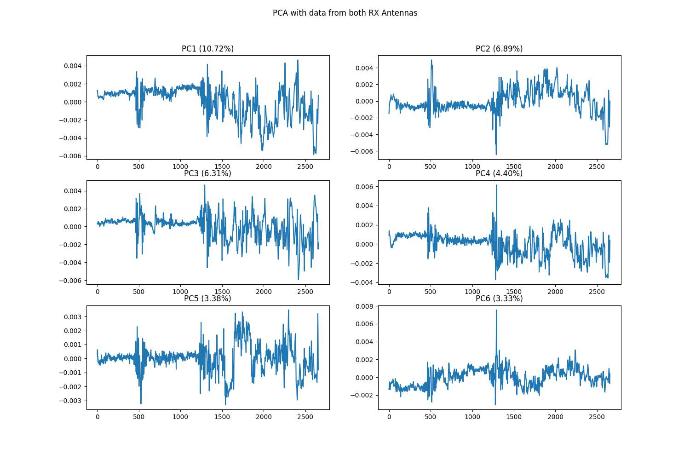
0,5mm with Movement

Slide 11
0,5mm with Movement

Slide 12
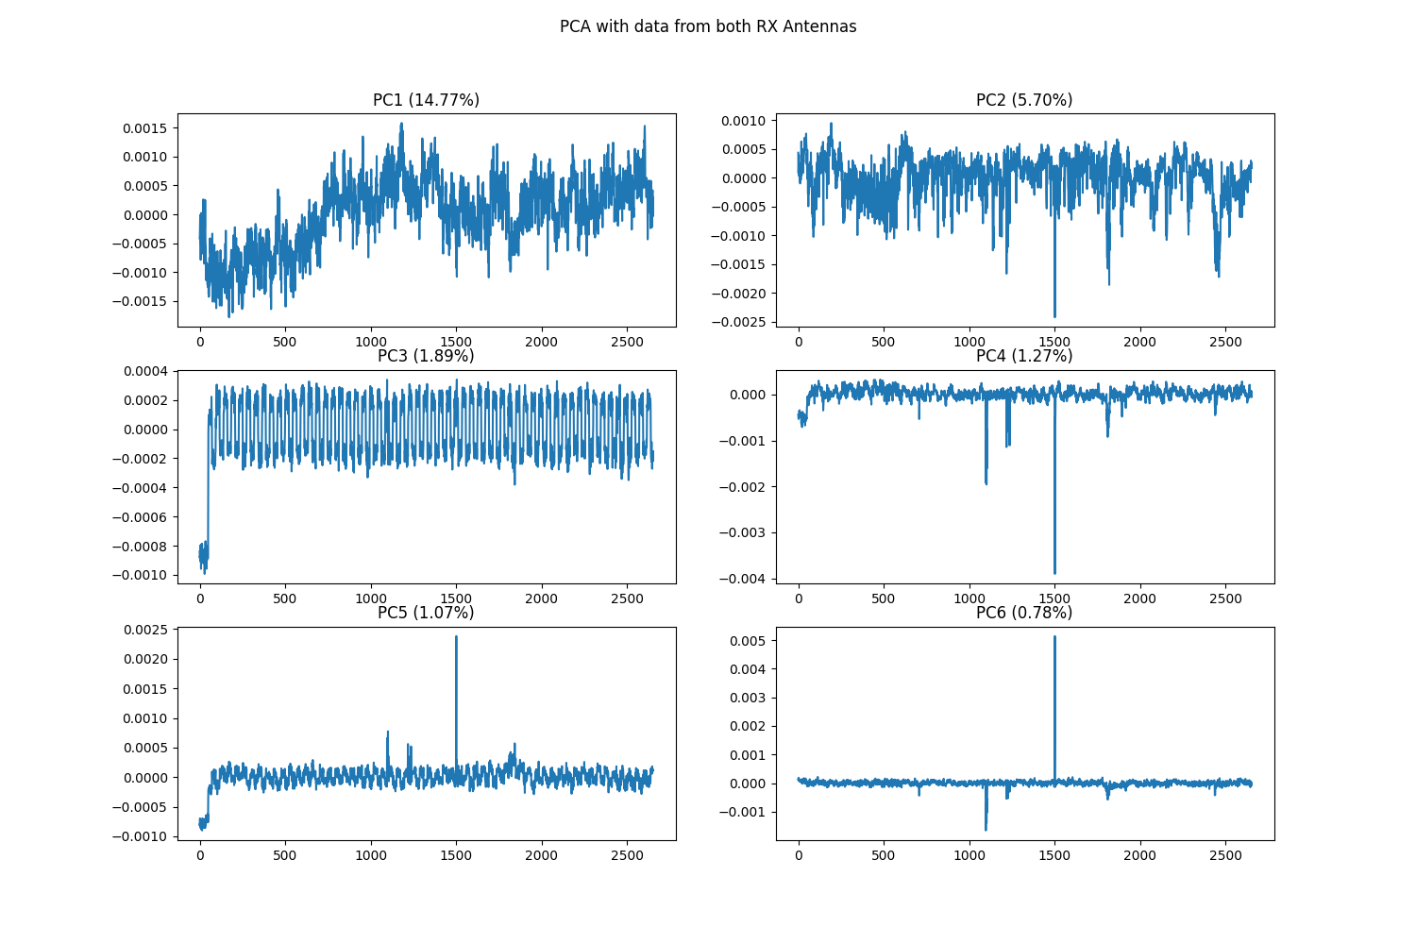
0,25mm

Slide 13
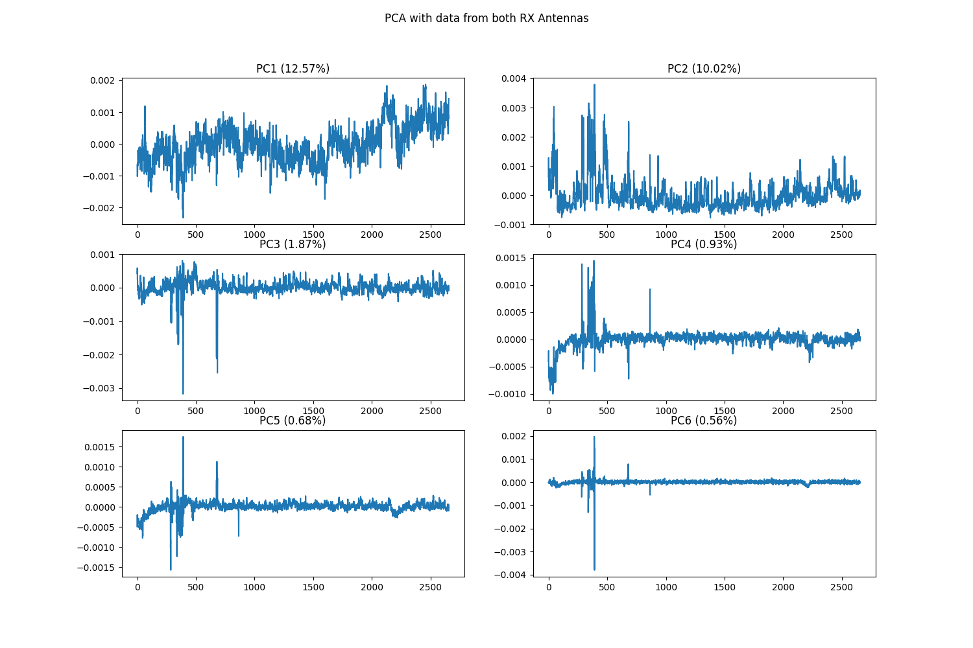
125um

Slide 14
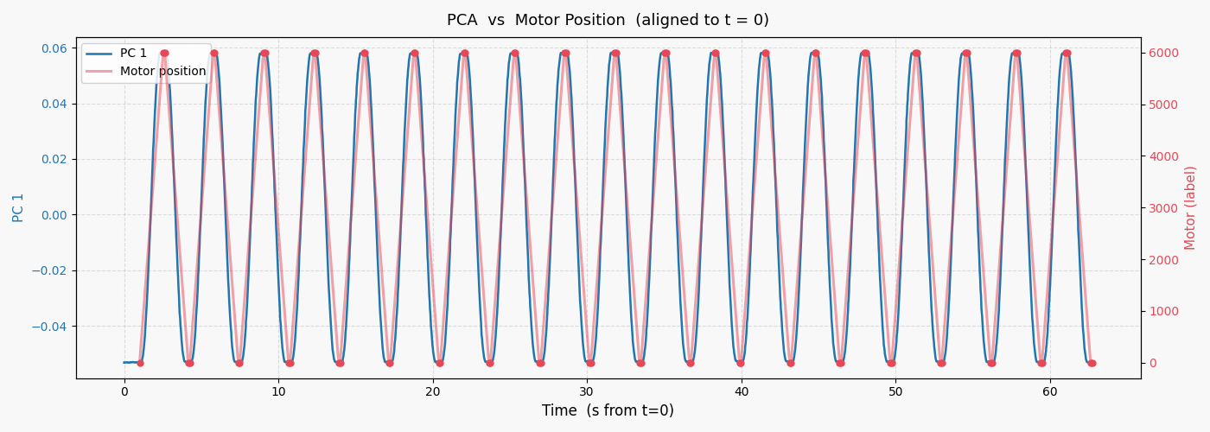
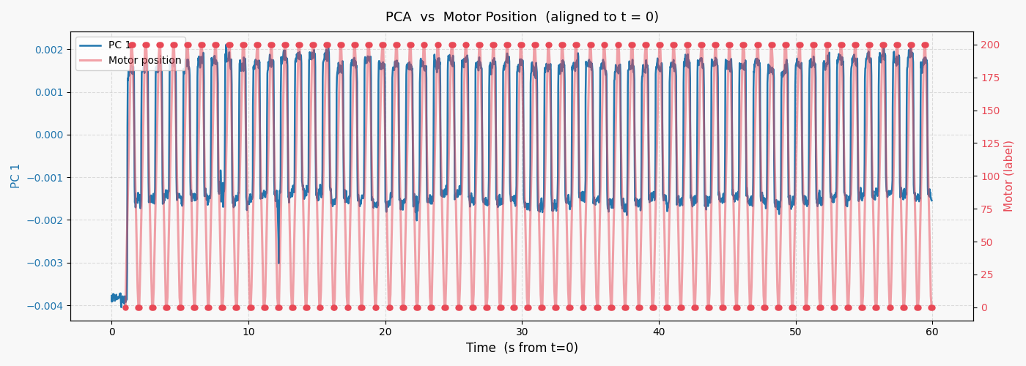
PCA vs Motor
3cm periodic
1mm periodic

Slide 15
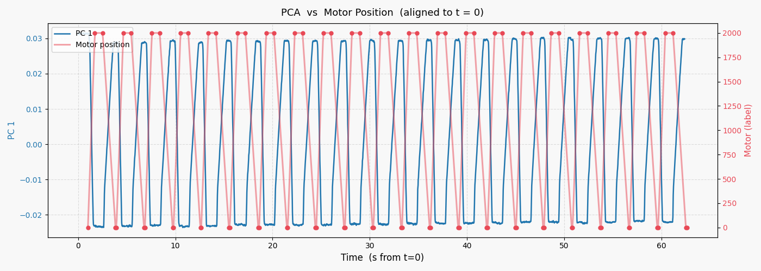
PCA vs Motor
1cm - longer pause at Position 2000 and faster movement

Slide 16
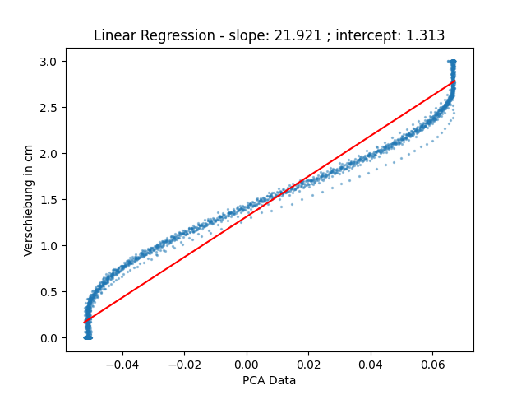
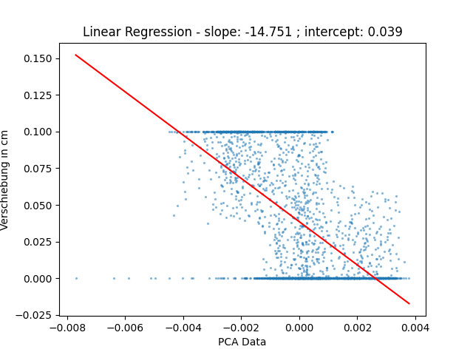
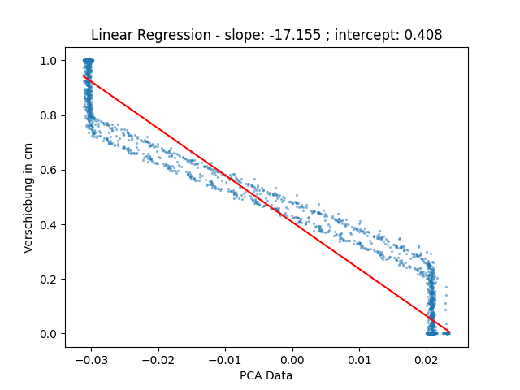
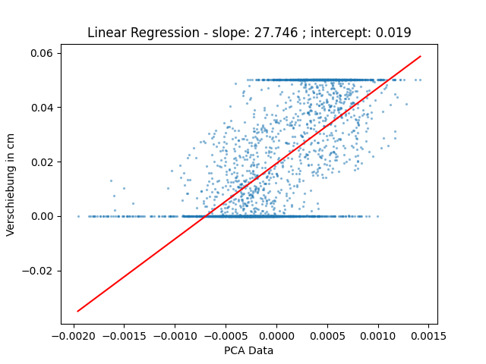
Linear Regression Comparison - Calibration
3cm
1mm
1cm
0.5mm

Slide 17
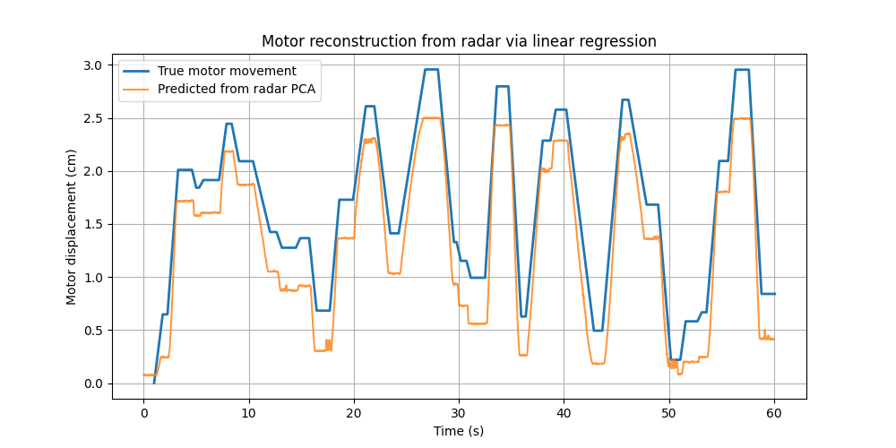
Movement Prediction:
Calibration
Amplitude: 3cm

Slide 18
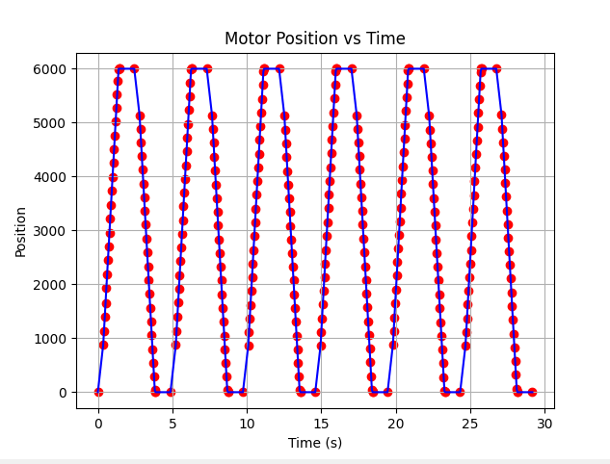
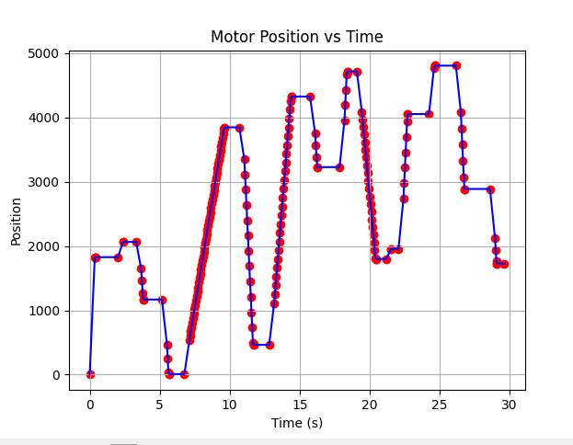
Better motor tracking

Slide 19
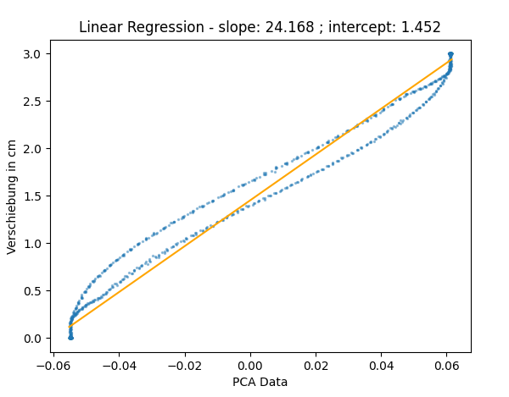
With 3cm calibration
Less precise tracking

Slide 20
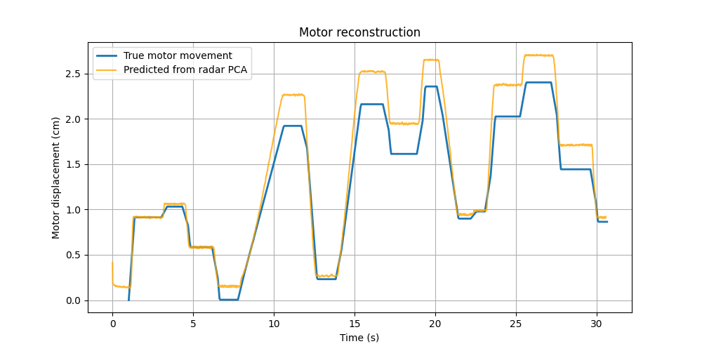
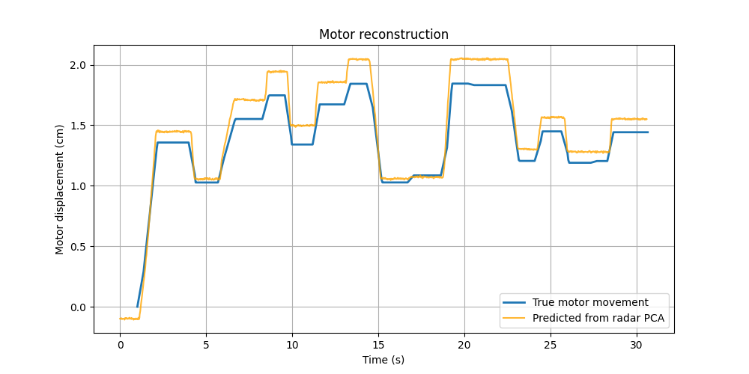
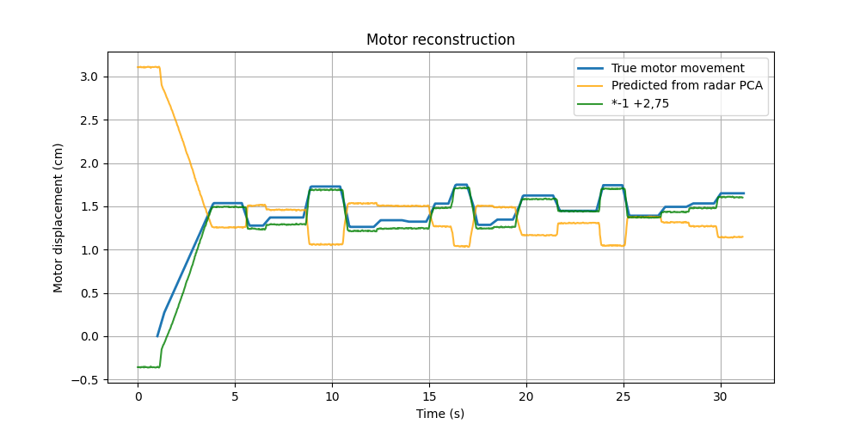
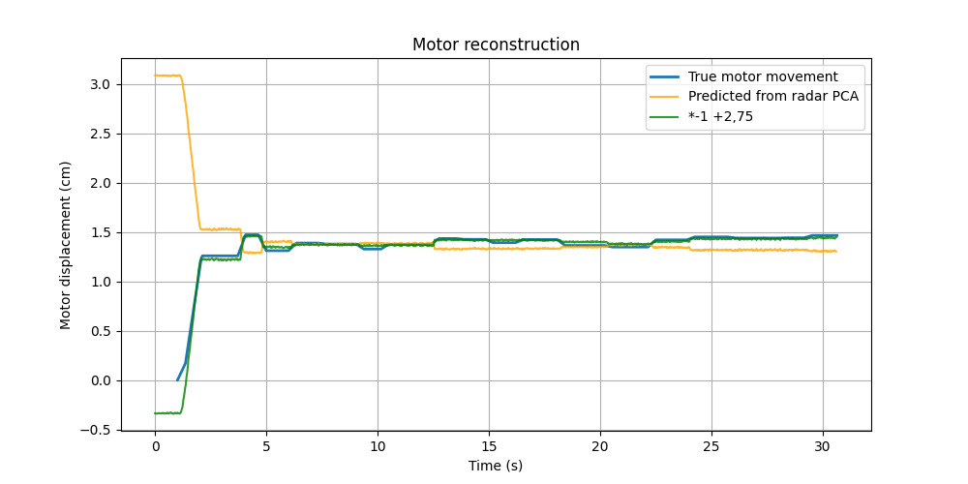
With 3 cm calibration

Slide 21
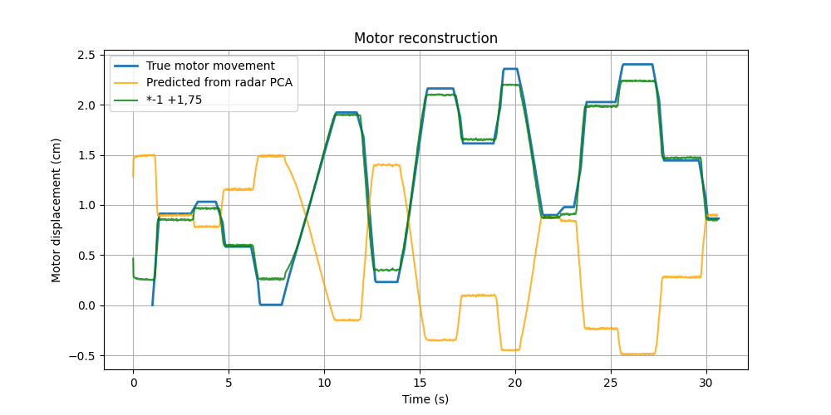
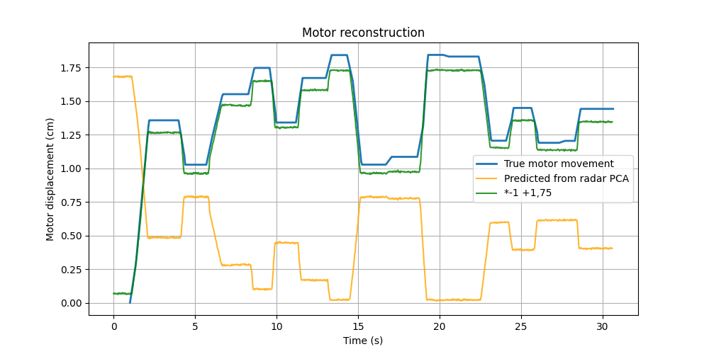
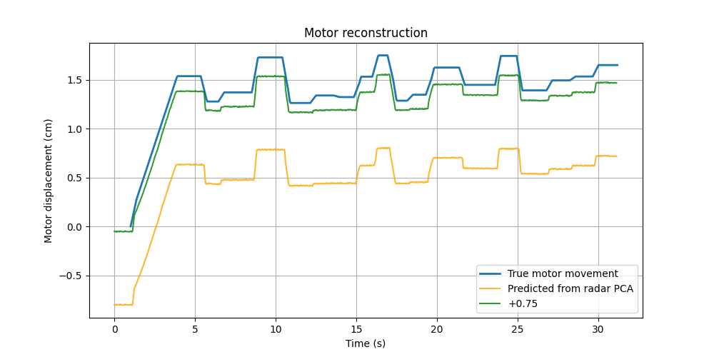
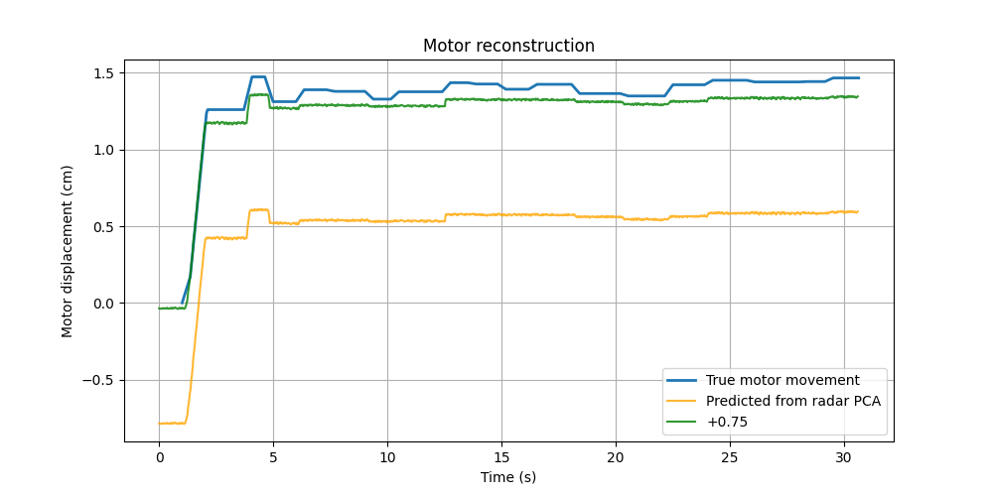
With 1 cm calibration

Slide 22
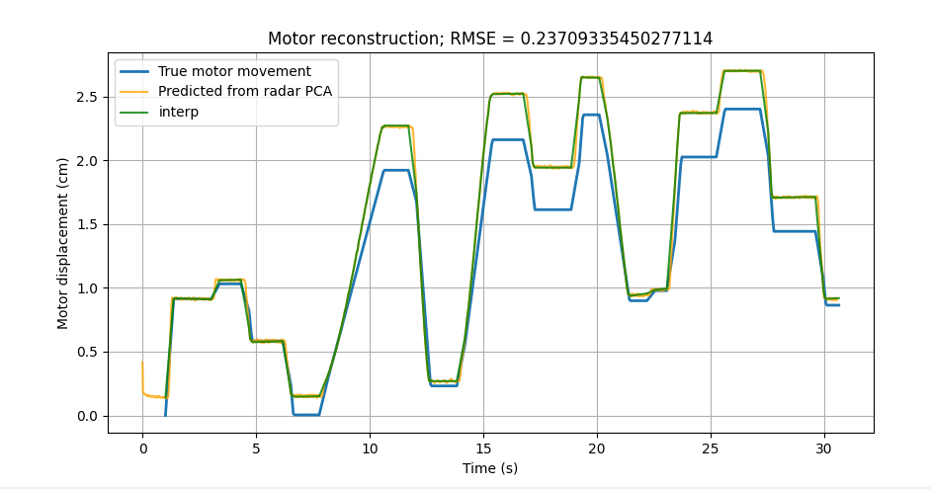
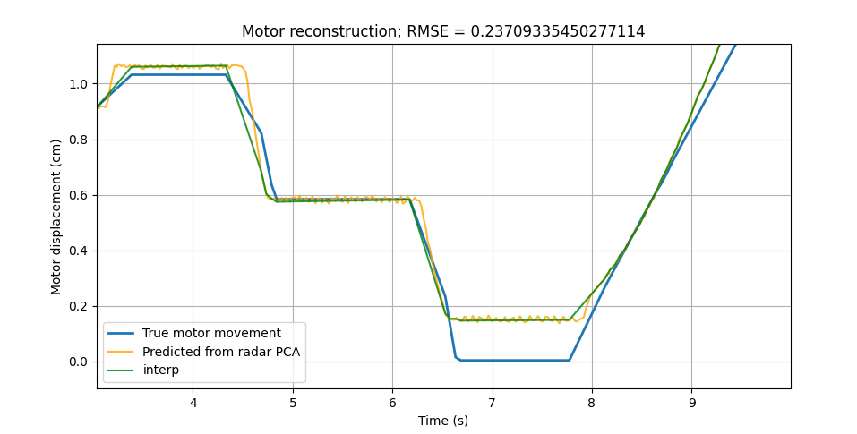
RMSE

Slide 23
PCA
Stack radargram of both antennas from calibration
Substract mean from matrix
pca = PCA(n_components=510)
pca_data = pca.fit_transform(X_centered)
Linearregression with (pca first component, motor positions)
Stack radargram of both antennas of rndm movement
Substract new mean from matrix
pca = PCA(n_components=510)
pca_data_new = pca.fit_transform(X_centered_new)
Predit with new PCA component
→ Sometimes sign flip

Slide 24
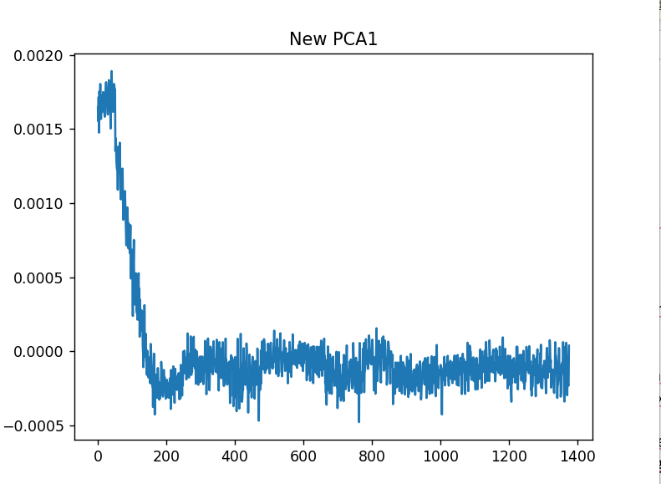
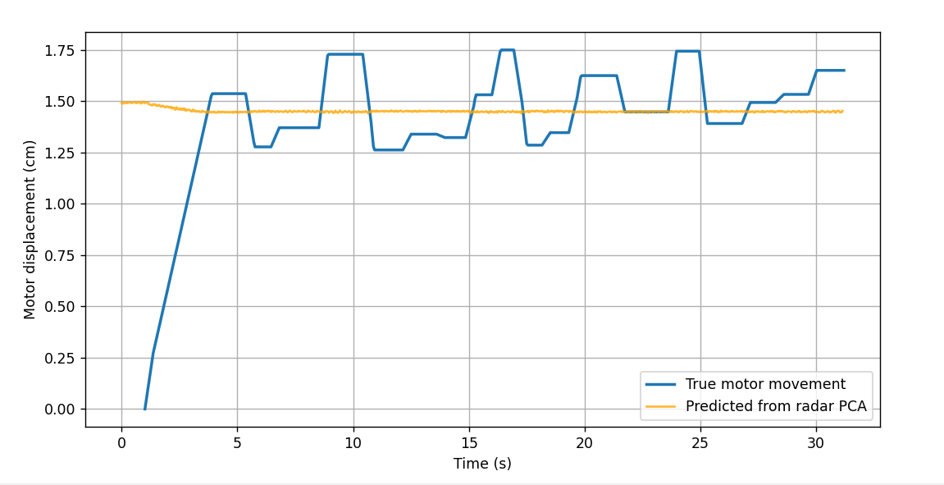
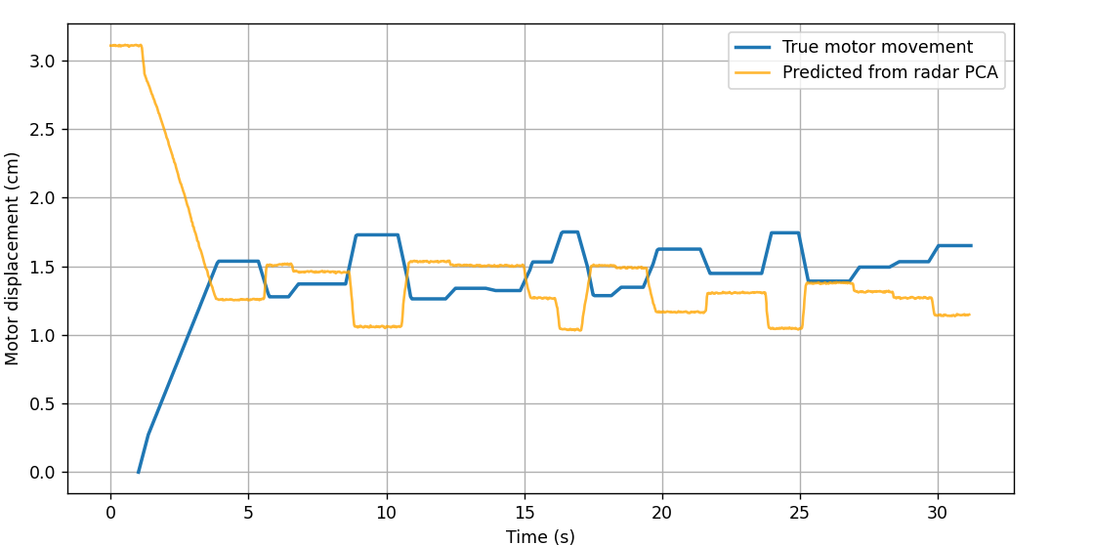
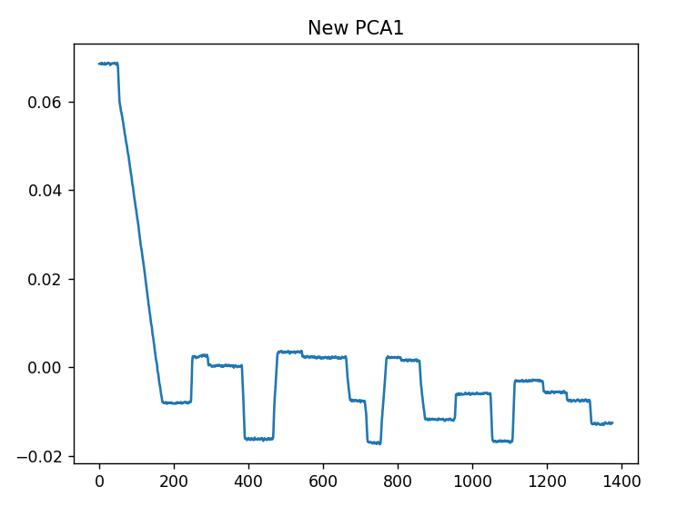
Pca
Stack radargram of both antennas from calibration
Substract mean from matrix
pca = PCA(n_components=510)
pca_data = pca.fit_transform(M_calibration)
LinearRegression with (pca first component, motor positions)
Stack radargram of both antennas of rndm movement
Substract mean of calibration from matrix
pca_data_new = pca.fit_transform(M_movement)
Predit with new PCA component and using model
→ still sign flip
Stack radargram of both antennas from calibration
Substract mean from matrix
pca = PCA(n_components=510)
pca_data = pca.fit_transform(M_calibration)
LinearRegression with (pca first component, motor positions)
Stack radargram of both antennas of rndm movement
Substract mean of calibration from matrix
pca_data_new = pca.transform(M_movement)
Predit with new PCA component and using model
Not useable + sign flip?

Slide 25
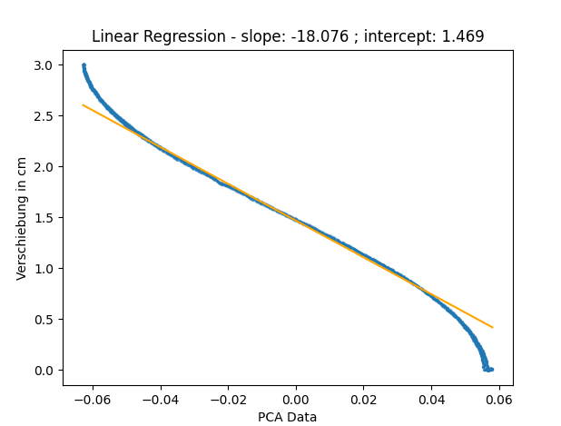
Slow calibration and no extremes

Slide 26
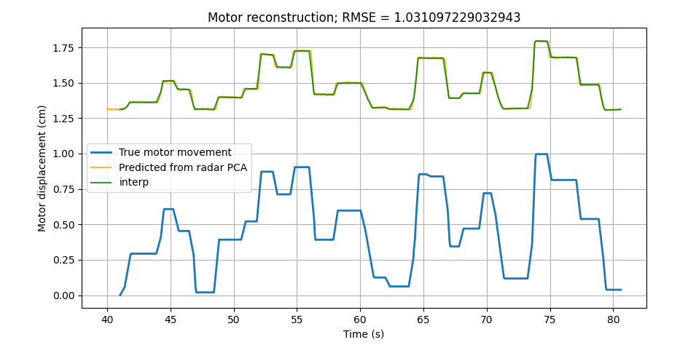
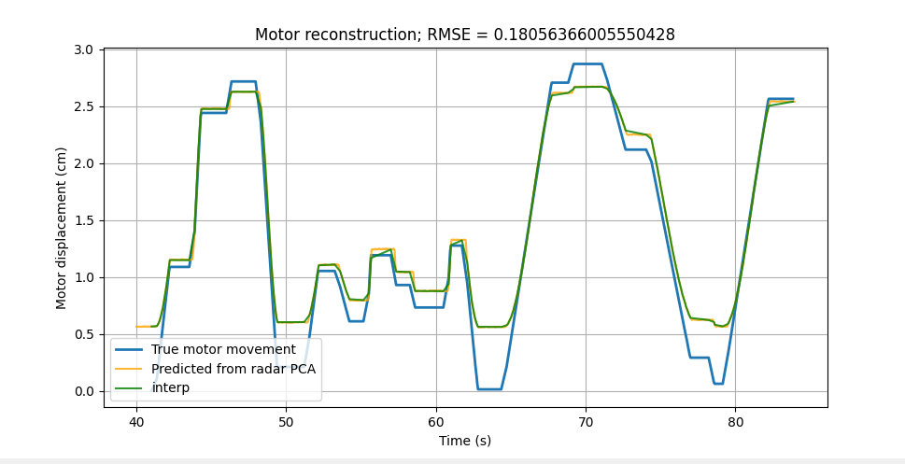
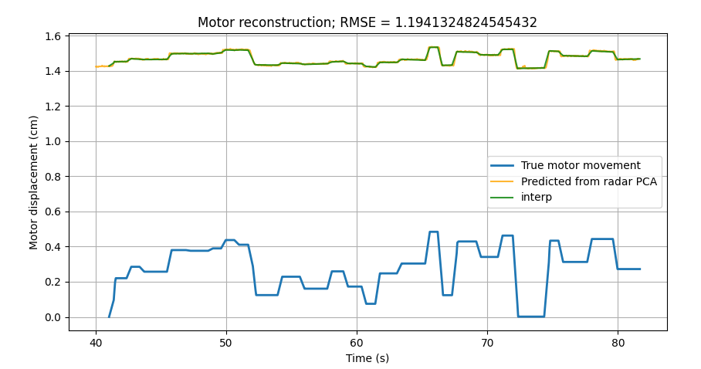
Split measurement - No sign flip
0-1cm
0-3cm
0-5mm
Calibration 0-3cm

Slide 27
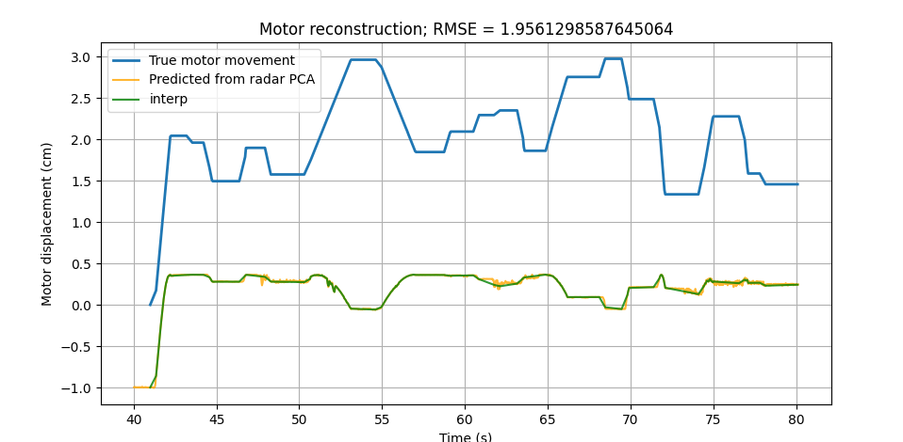
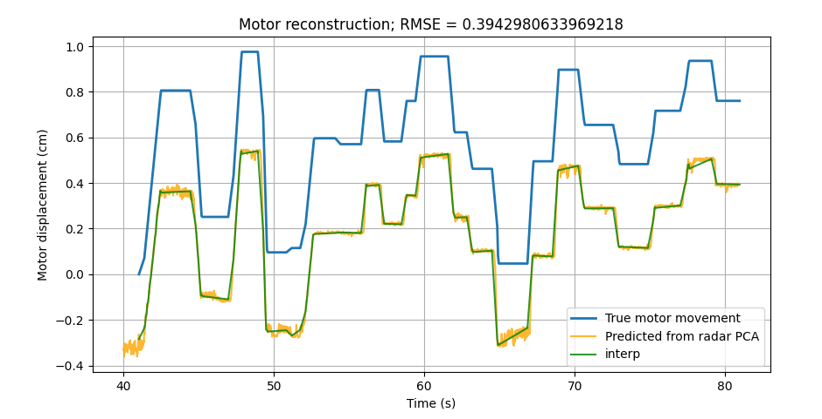
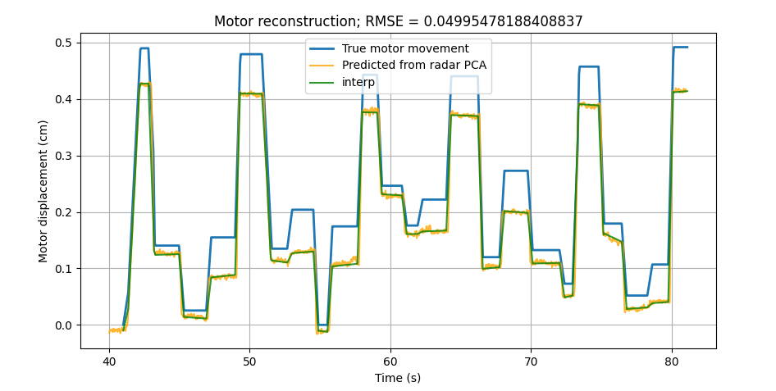
one split measurement - No sign flip
0-3cm
0-1cm
0-5mm
Calibration 0-1cm

Slide 28
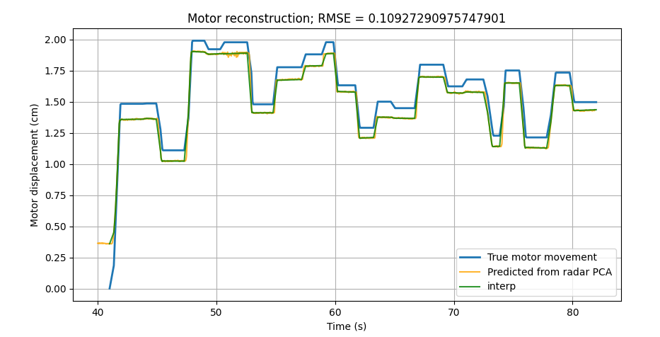
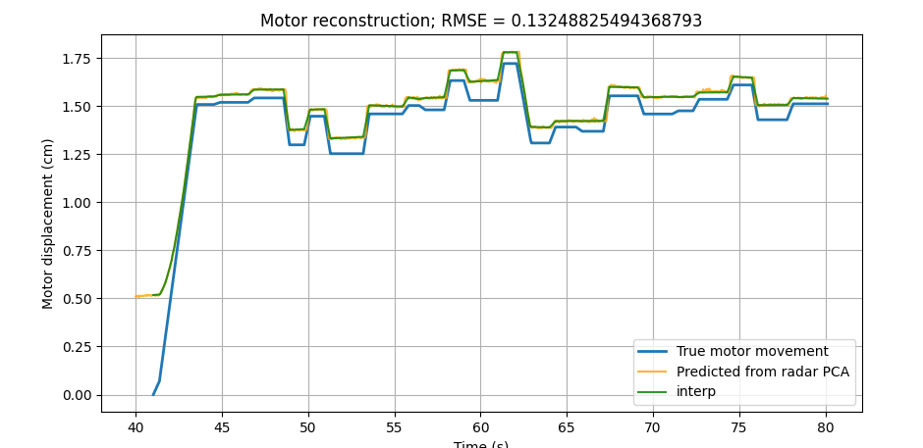
One split measurement - No sign flip
1-2cm
0-1cm
1,25-1,75cm
0-5mm
Calibration 0-3cm

Slide 29
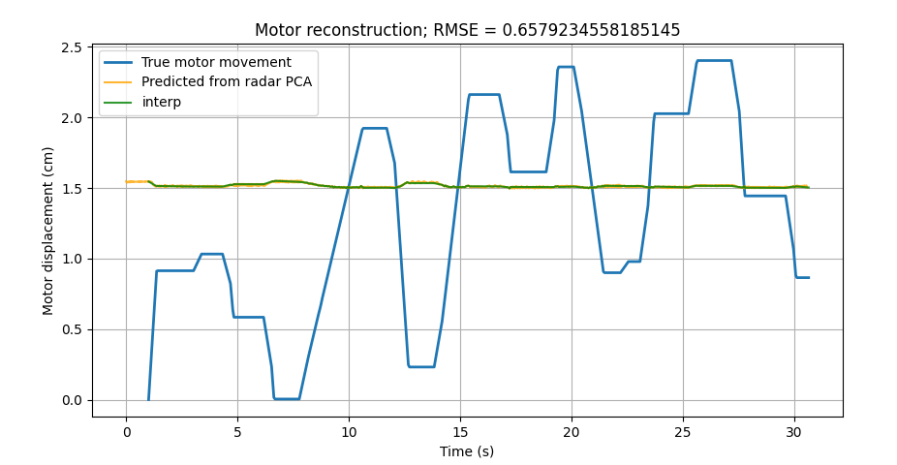
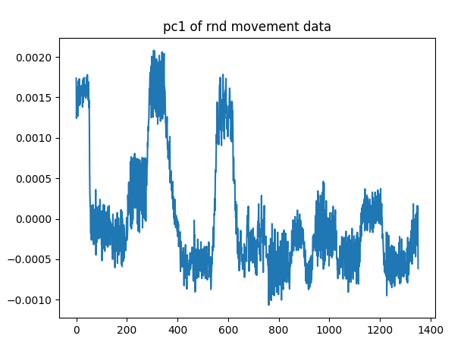
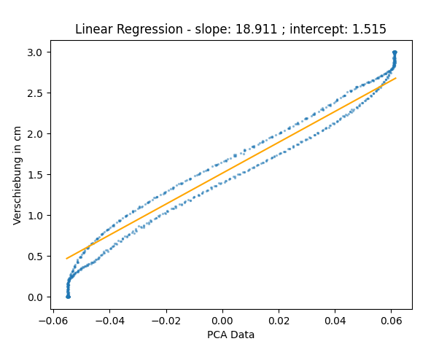
Two seperate measurements – sign flip

Slide 30
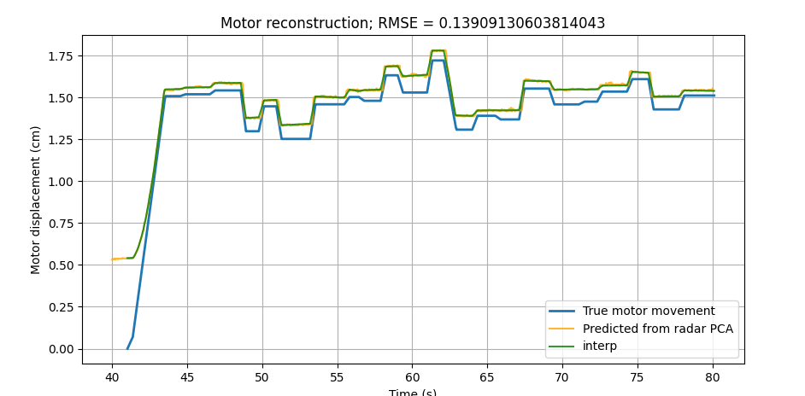



Two seperate measurements – different counter position of radar

Slide 31




Calibrations seperate measurments
0-3cm
0-1cm
0-5mm
0-2cm

Slide 32






Calibrations one measurement
0-3cm
0-1,5cm
0-5mm
0-2cm
0-1cm
0-2,5mm

Slide 33


Calibrations one measurement

Slide 34


Calibrations one measurement
Segment | Calibration
0 | 0-3 cm
1 | 0-2 cm
2 | 0-1,5 cm
3 | 0-1 cm
4 | 0-5 mm
5 | 0-2,5 mm
6 | RND 0-3cm
7 | RND 0,5-2,5cm
8 | RND 1-2
9 | RND1,25-1,75
10 | 17
Segmentation → PCA
PCA → Segmentation
BUT

Slide 35


Calibrations one measurement
Segmentation → PCA
PCA → Segmentation

Slide 36
Next Steps
Translation?
Weights and Biases
Error Calculation
2nd movement

Slide 37
Next Steps
Best way to find optimal translation?
  Optimization with RMSE?
  Calibration measurment right before other measurment
Error Calculation
U-Net integration
2nd movement

Slide 38

Next Steps?
Korrelation von Motor zu PCA?
2. Bewegungsdimension? Wie bekomme ich meine Bewegungsdimension?
Schädeldruck?

