Slide 1
AOL GROUP PROJECT · COMP6799001 DATABASE TECHNOLOGY
SejutaStay
Hotel Booking Database
Database Design & Normalization (UNF → 3NF) for the Tourism & Hospitality Sector
Presented by
Daniel Steffen Kurniawan
2602071171 Edvardo Khong 2602177171
Semester 4 · Academic Year 2025/2026
1
Notes:
Selamat siang Bapak/Ibu dan teman-teman. Kami dari kelompok ini akan mempresentasikan proyek AOL Database Technology kami yang berjudul SejutaStay Hotel Booking Database. Proyek ini membahas perancangan dan normalisasi database untuk sebuah jaringan hotel, mulai dari bentuk tidak normal sampai bentuk normal ketiga atau 3NF. Sektor yang kami pilih adalah Tourism & Hospitality.

Slide 2
AGENDA
Presentation Flow
2
2
2
2
2
2
Problem
→
UNF Data
→
Anomalies
→
Normalization
→
ERD
→
MySQL Result
The story starts with one messy table and ends with a tested 3NF database implementation.
SejutaStay Hotel Booking Database
2

Slide 3
CHAPTER 1 · THE PROBLEM
One Big Table, Many Problems
CURRENT SITUATION
FIVE PERFORMANCE PROBLEMS
SejutaStay is a growing hotel network with branches in Jakarta, Bali, Yogyakarta, Bandung and Lombok.
3
Data redundancy
Guest & hotel details are repeated in every booking row.
Every reservation — guest, hotel, rooms and services — is recorded in a single shared spreadsheet:
3
Update anomaly
One change must be edited in many rows — easy to miss.
3
Insertion anomaly
“BookingRecord”
A new hotel or service cannot be added without a booking.
3
Deletion anomaly
Deleting a booking can erase the only copy of other data.
3
Slow & unreliable
18 columns × many rows — all data mixed together
Hard to search, report, and no integrity checks.
SejutaStay Hotel Booking Database
3
Notes:
SejutaStay saat ini menyimpan SEMUA data reservasi di dalam satu tabel besar, seperti satu file Excel. Setiap booking dicatat dalam satu baris berisi data tamu, hotel, kamar, dan layanan sekaligus. Cara ini menimbulkan lima masalah. Satu, redundansi data: data tamu dan hotel ditulis berulang-ulang. Dua, update anomaly: kalau satu data berubah, kita harus mengubah banyak baris. Tiga, insertion anomaly: kita tidak bisa menambah hotel atau layanan baru tanpa ada booking. Empat, deletion anomaly: menghapus satu booking bisa ikut menghapus data penting lain. Lima, pencarian data jadi lambat dan tidak ada pengecekan otomatis. Lima masalah inilah yang akan kami selesaikan.

Slide 4
CHAPTER 2 · SAMPLE DATA (UNF)
Our Case & The Sample Data
THE SAMPLE DATA
SAMPLE — UN-NORMALIZED TABLE (extract)
7 sample reservations, 18 attributes
Booking | Guest | Hotel | RoomNo ▸ | Service ▸
B001 | Andi Wijaya | Grand Jakarta | 101 | Breakfast; Spa
B002 | Bella Sari | Bali Beach | 201; 202 | Breakfast; Transfer
B003 | Andi Wijaya | Yogya Heritage | 301 | Breakfast
B004 | Citra Dewi | Bali Beach | 203 | Spa; Laundry; Late C/O
B005 | Doni Pratama | Bandung High. | 401; 402 | Breakfast
Modelled on real hotel reservation data (Hotel Booking Demand dataset, Antonio et al., 2019). A small subset is used so each normalization step can be traced by hand.
WHY IS IT “UN-NORMALIZED”?
It contains repeating groups — one booking can have several rooms or services, so many values are stuffed into one cell.
Booking B002
RoomNo = 201 ; 202
▸ marks columns with repeating groups (multiple values). The full table has 7 bookings and 18 attributes.
✕ two values in a single cell
SejutaStay Hotel Booking Database
4
Notes:
Kasus kami adalah jaringan hotel SejutaStay. Data contoh kami terdiri dari 7 reservasi dengan 18 atribut, dimodelkan dari data hotel nyata. Lihat tabel di kanan: data ini disebut TIDAK NORMAL karena ada repeating group. Contohnya booking B002 memesan dua kamar, sehingga sel RoomNo berisi dua nilai sekaligus '201; 202'. Kolom yang punya repeating group kami tandai dengan simbol segitiga. Satu sel yang berisi banyak nilai melanggar aturan dasar tabel relasional, jadi data ini harus dinormalisasi.

Slide 5
CHAPTER 3 · ANALYSIS
Anomalies & Functional Dependencies
INSERTION ANOMALY
UPDATE ANOMALY
DELETION ANOMALY
Cannot add a new room type or service until a guest books it.
Guest data is duplicated; editing one row leaves the rest inconsistent.
Deleting a booking can erase the only record of other data.
Example: RT “infinity pool” cannot be stored yet.
Example: Andi Wijaya appears in B001 & B003.
Example: Delete B004 → lose the “Laundry” service.
KEY FUNCTIONAL DEPENDENCIES ( A → B means A determines B )
BookingID → BookingDate, GuestID, HotelID, CheckIn, CheckOut
GuestID → GuestName, GuestPhone, GuestEmail
HotelID → HotelName, HotelCity
RoomNo → HotelID, RoomTypeID
RoomTypeID → RoomTypeName, PricePerNight
ServiceID → ServiceName, ServicePrice
SejutaStay Hotel Booking Database
5
Notes:
Dari data tidak normal tadi muncul tiga anomali. Insertion anomaly: kita tidak bisa menambah tipe kamar atau layanan baru sebelum ada tamu yang memesannya. Update anomaly: data tamu terduplikasi, contohnya Andi Wijaya muncul di B001 dan B003, jadi kalau emailnya berubah dan kita hanya update satu baris, data jadi tidak konsisten. Deletion anomaly: menghapus booking B004 akan menghilangkan satu-satunya catatan layanan Laundry. Di bagian bawah ada functional dependency. Pada versi revisi, RoomNo juga menentukan HotelID dan RoomTypeID, supaya setiap kamar jelas berada di hotel tertentu.

Slide 6
CHAPTER 4 · METHOD
The Solution: Normalization
Normalization splits the one big table into smaller, well-structured tables — step by step — until every table is in Third Normal Form (3NF).
UNF
1NF
2NF
3NF
Un-Normalized
First Normal Form
Second Normal Form
Third Normal Form
Starting point: one table with repeating groups.
Remove repeating groups — every cell holds one value.
Remove partial dependencies on a composite key.
Remove transitive dependencies between non-key fields.
→
→
→
1 table
3 tables
5 tables
8 tables
Each step keeps the same data — it only re-organises it into a cleaner, safer structure.
SejutaStay Hotel Booking Database
6
Notes:
Solusi kami adalah normalisasi. Normalisasi memecah satu tabel besar menjadi beberapa tabel yang lebih rapi, dilakukan bertahap. Kita mulai dari UNF, bentuk tidak normal. Lalu 1NF menghilangkan repeating group sehingga setiap sel hanya berisi satu nilai, hasilnya 3 tabel. Kemudian 2NF menghilangkan partial dependency, hasilnya 5 tabel. Terakhir 3NF menghilangkan transitive dependency, hasilnya 8 tabel. Yang penting: datanya tidak berubah, hanya strukturnya yang dirapikan. Tiga slide berikutnya akan menjelaskan tiap langkah.

Slide 7
NORMALIZATION
1NF
Step 1 — First Normal Form (1NF)
RULE: every cell must hold only ONE value — remove all repeating groups.
BEFORE — repeating group
AFTER — atomic values
B002
201 ; 202
B002
7
One booking row stores two rooms in a single cell — not allowed.
B002
7
Each value gets its own row — now every cell is atomic.
RESULT — the table is split into 3 relations:
Booking_1NF
BookingRoom_1NF
BookingService_1NF
BookingID, BookingDate, GuestID… CheckIn, CheckOut
BookingID, RoomNo, RoomTypeID, RoomTypeName, Price
BookingID, ServiceID, ServiceName, ServicePrice
SejutaStay Hotel Booking Database
7
Notes:
Langkah pertama adalah 1NF. Aturannya: setiap sel hanya boleh berisi satu nilai, jadi semua repeating group harus dihilangkan. Lihat contoh: sebelumnya booking B002 menyimpan dua kamar dalam satu sel '201; 202'. Setelah 1NF, setiap kamar dipisah menjadi barisnya sendiri: B002-201 dan B002-202. Karena ada dua repeating group, yaitu kamar dan layanan, tabel asli dipecah menjadi 3 relasi: Booking_1NF, BookingRoom_1NF, dan BookingService_1NF. Sekarang semua sel sudah berisi satu nilai.

Slide 8
NORMALIZATION
2NF
Step 2 — Second Normal Form (2NF)
RULE: already in 1NF, and every non-key attribute depends on the WHOLE primary key — not just part of it.
THE PROBLEM — PARTIAL DEPENDENCY
In BookingRoom_1NF the key is {BookingID, RoomNo}. But RoomTypeID, RoomTypeName and Price depend only on RoomNo — only part of the key. The same happens with services depending only on ServiceID.
THE FIX — move partially-dependent fields into their own tables → 5 relations
Booking_2NF
BookingRoom_2NF
Room_2NF
unchanged — single-field key
BookingID, RoomNo (link only)
RoomNo, HotelID, RoomTypeID, RoomTypeName, Price
BookingService_2NF
Service_2NF
BookingID, ServiceID (link only)
ServiceID, ServiceName, ServicePrice
SejutaStay Hotel Booking Database
8
Notes:
Langkah kedua adalah 2NF. Aturannya: tabel harus sudah 1NF, dan setiap atribut bukan kunci harus bergantung pada seluruh primary key, bukan sebagian. Masalahnya ada di BookingRoom_1NF: kuncinya gabungan BookingID dan RoomNo, tetapi detail kamar seperti HotelID, RoomTypeID, nama tipe kamar, dan harga bergantung pada RoomNo saja. Jadi atribut itu dipindahkan ke tabel Room_2NF. Hal yang sama dilakukan untuk layanan. Hasilnya menjadi 5 relasi: Booking, BookingRoom, Room, BookingService, dan Service.

Slide 9
NORMALIZATION
3NF
Step 3 — Third Normal Form (3NF)
RULE: already in 2NF, and no non-key attribute depends on ANOTHER non-key attribute (transitive dependency).
THE PROBLEM — TRANSITIVE DEPENDENCY
BookingID → GuestID → GuestName, GuestPhone, GuestEmail RoomNo → HotelID & RoomTypeID → Price
THE FIX — move each entity into its own table → final 8 tables in 3NF
Guest
Hotel
RoomType
Room
9
9
9
9
Service
Booking
BookingRoom
BookingService
9
9
9
9
Blue = main entity tables · Gold = junction tables that resolve many-to-many links
SejutaStay Hotel Booking Database
9
Notes:
Langkah terakhir adalah 3NF. Aturannya: tabel sudah 2NF, dan tidak boleh ada atribut bukan kunci yang bergantung pada atribut bukan kunci lainnya. Contohnya: BookingID menentukan GuestID, lalu GuestID menentukan nama dan kontak tamu. Untuk kamar, RoomNo menentukan HotelID dan RoomTypeID, lalu RoomTypeID menentukan nama tipe kamar dan harga. Solusinya, setiap entitas dipindahkan ke tabel sendiri. Hasil akhirnya tetap 8 tabel dalam bentuk 3NF.

Slide 10
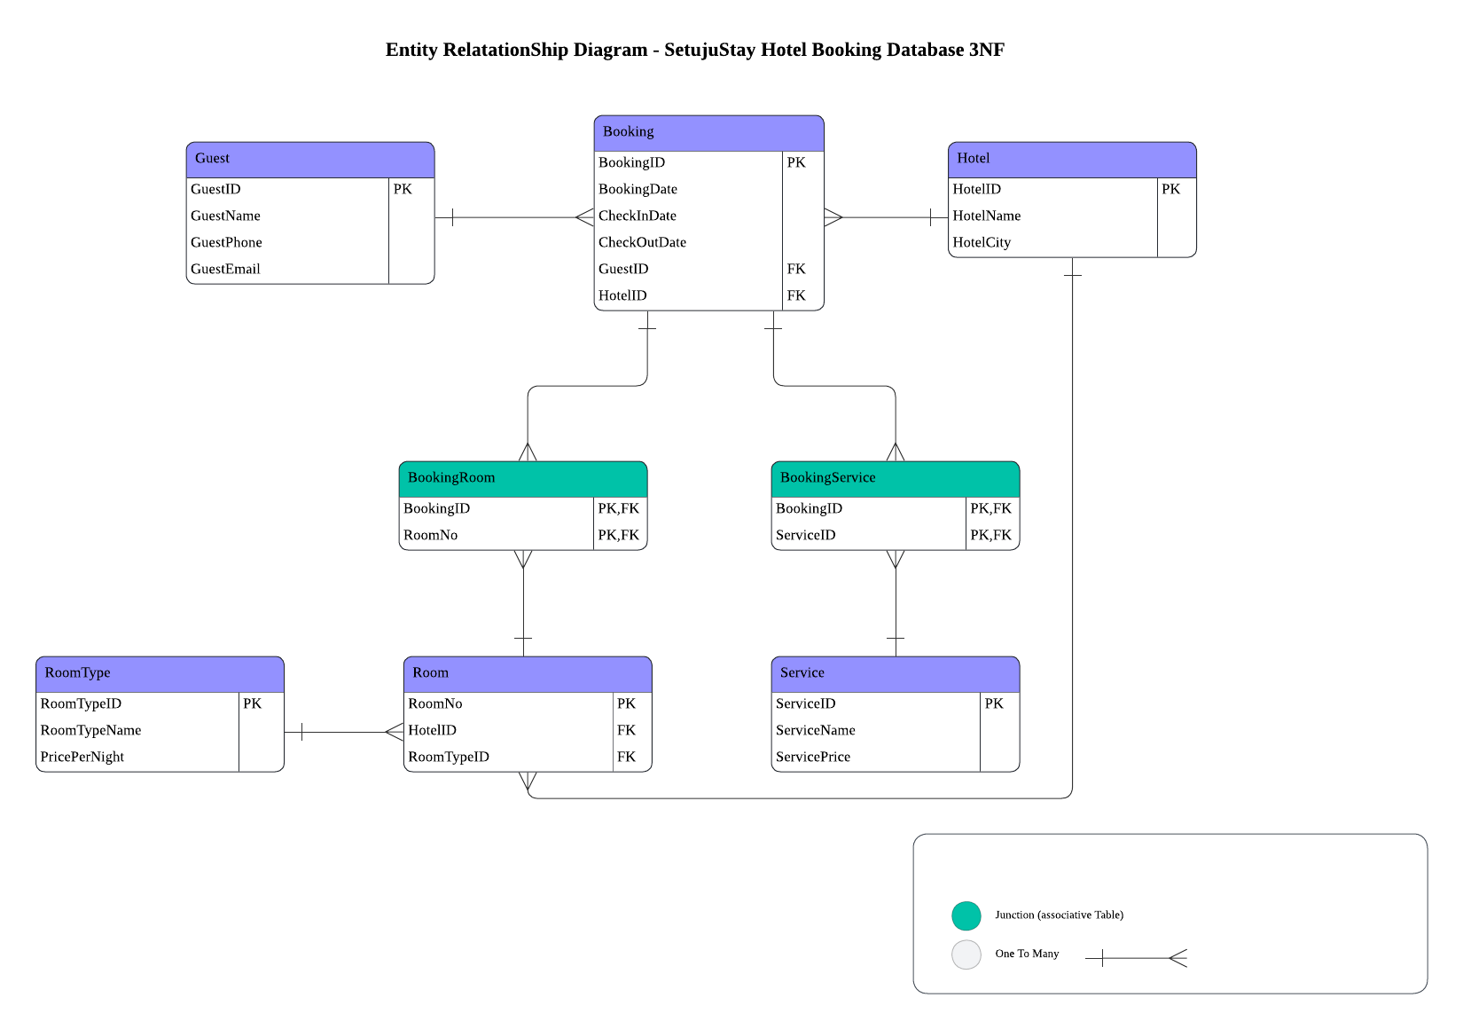
8 Tables in 3NF
SejutaStay Hotel Booking Database
10
Notes:
Inilah hasil akhirnya: Entity Relationship Diagram dengan notasi Crow's Foot. Diagram ini menunjukkan 8 tabel beserta atribut, primary key, dan foreign key. Hubungannya: satu tamu bisa punya banyak booking, satu hotel bisa punya banyak booking, dan satu hotel juga bisa memiliki banyak room. Satu tipe kamar dipakai banyak kamar. Hubungan many-to-many antara Booking dengan Room dan Booking dengan Service diselesaikan oleh dua junction table, yaitu BookingRoom dan BookingService.

Slide 11
BUSINESS IMPACT
Who Benefits From the Database?
Front-desk Staff
Hotel Management
Guests
• Faster booking search
• Less repeated typing
• Fewer wrong room/service records
• Cleaner occupancy reports
• More reliable revenue data
• Easier branch-level analysis
• Faster service
• Correct booking details
• Better check-in experience
A normalized database is not only cleaner technically — it improves daily operations for the hotel network.
SejutaStay Hotel Booking Database
11

Slide 12
BEFORE vs AFTER
From One Big Table to 8 Clean 3NF Tables
BEFORE
AFTER
One BookingRecord table • Guest, hotel, room, and service data mixed together • Repeated values • Insertion, update, and deletion anomalies • Harder to query reliably
8 tables in 3NF • Separate Guest, Hotel, Room, RoomType, Service, Booking tables • PK/FK relationships • Less redundancy • Easier JOIN queries and validation
Normalization keeps the same data, but reorganizes it into a safer and more scalable structure.
SejutaStay Hotel Booking Database
12

Slide 13
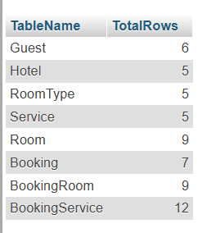
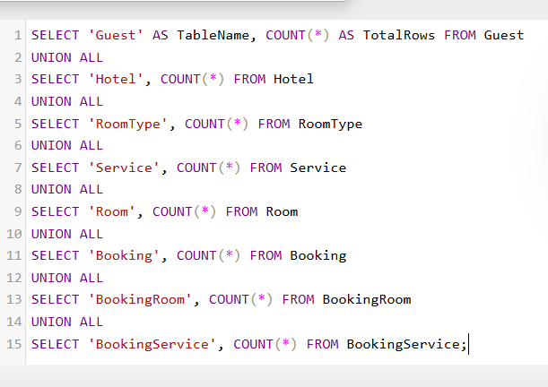
MYSQL RESULT
Implementation Proof & Final Outcome
CREATE TABLE + FK
JOIN Verification
Row Count Check
CREATE TABLE Room (
RoomNo INT PRIMARY KEY,
HotelID VARCHAR(5),
RoomTypeID VARCHAR(5),
FOREIGN KEY (HotelID)
REFERENCES Hotel(HotelID)
);
SELECT b.BookingID,
g.GuestName,
h.HotelName,
r.RoomNo
FROM Booking b
JOIN Guest g ...
JOIN Room r ...;
Guest = 6
Hotel = 5
RoomType = 5
Service = 5
Room = 9
Booking = 7
BookingRoom = 9
BookingService = 12
phpMyAdmin screenshot run code(row count check)
Result
SejutaStay Hotel Booking Database
13
Notes:
Desain 3NF ini kemudian kami implementasikan secara fisik di MySQL, dalam file SejutaStay_Database.sql. File tersebut membuat 8 tabel lengkap dengan primary key dan foreign key, termasuk hubungan Hotel dengan Room. File SQL juga mengisi minimal 5 baris data di setiap tabel dan menyertakan query verifikasi dengan JOIN serta pengecekan jumlah baris. Kesimpulannya, dengan normalisasi sampai 3NF kami berhasil menghilangkan redundansi, menghilangkan anomali, menjaga integritas data, dan menyiapkan fondasi database yang siap dikembangkan.

Slide 14
MYSQL RESULT
Implementation Proof & Final Outcome
CREATE TABLE + FK
JOIN Verification
Row Count Check
CREATE TABLE Room (
RoomNo INT PRIMARY KEY,
HotelID VARCHAR(5),
RoomTypeID VARCHAR(5),
FOREIGN KEY (HotelID)
REFERENCES Hotel(HotelID)
);
SELECT b.BookingID,
g.GuestName,
h.HotelName,
r.RoomNo
FROM Booking b
JOIN Guest g ...
JOIN Room r ...;
Guest = 6
Hotel = 5
RoomType = 5
Service = 5
Room = 9
Booking = 7
BookingRoom = 9
BookingService = 12
Final Outcome
✓ 8 tables created in MySQL ✓ PK/FK constraints applied ✓ Minimum 5 rows per table ✓ JOIN queries verify the design
Conclusion: redundancy and anomalies are removed, and SejutaStay now has a clean database foundation for hotel booking management.
SejutaStay Hotel Booking Database
13
Notes:
Desain 3NF ini kemudian kami implementasikan secara fisik di MySQL, dalam file SejutaStay_Database.sql. File tersebut membuat 8 tabel lengkap dengan primary key dan foreign key, termasuk hubungan Hotel dengan Room. File SQL juga mengisi minimal 5 baris data di setiap tabel dan menyertakan query verifikasi dengan JOIN serta pengecekan jumlah baris. Kesimpulannya, dengan normalisasi sampai 3NF kami berhasil menghilangkan redundansi, menghilangkan anomali, menjaga integritas data, dan menyiapkan fondasi database yang siap dikembangkan.

Slide 15
Thank You
We welcome your questions and feedback.
SejutaStay Hotel Booking Database · AOL Database Technology (COMP6799001)
Daniel Steffen Kurniawan — 2602071171 · Edvardo Khong — 2602177171
14
Notes:
Demikian presentasi kami mengenai SejutaStay Hotel Booking Database. Terima kasih atas perhatian Bapak/Ibu dan teman-teman. Kami persilakan jika ada pertanyaan atau masukan.

