Slide 1
ClinVar Bioinformatics Analysis Pipeline
A Reproducible, Publication-Grade Human Genomic Variant Workflow
Implemented with POSIX Bash, Nextflow DSL2 & Python CLI Tools
Bioinformatics & Data Science Architecture | NCBI ClinVar Dataset (9.05M Records)

Slide 2
CLINVAR BIOINFORMATICS PIPELINE
Executive Summary & Core Objectives
Core Pipeline Objectives
• Automated Data Ingestion: Stream and cache the official NCBI ClinVar dataset (variant_summary.txt.gz).
• Evidence-Based Filtering: Filter variants mapped to GRCh38 and exclude unasserted 0-star submissions.
• Gene Landscape Profiling: Categorize human genes into Pathogenic-only, Benign-only, and Multiclass genetic profiles.
• Publication Visualizations: Generate high-resolution 300 DPI vector/raster figures compliant with journal standards.
Dataset Scale & Core Metrics
9,050,979 – Total Raw ClinVar Submissions Evaluated
3,950,959 – High-Confidence (>=1 Star) GRCh38 Variants
320,260 – Pathogenic / Likely Pathogenic Variants (8.11%)
7,031 – Unique Human Genes Harboring Pathogenic Variants
51,895 – Unique Clinical Phenotypes / Diseases Mapped

Slide 3
CLINVAR BIOINFORMATICS PIPELINE
End-to-End Pipeline Architecture
1. Data Streaming [download_data.py]
HTTP streaming fetch from NCBI ClinVar FTP repository with checksum integrity check and local disk caching.
2. Shell Inspection [run_pipeline.sh]
POSIX Bash verification using head, wc -l, and AWK schema checking to validate headers and GRCh38 counts.
3. Statistical ETL [clinvar_pipeline.py]
Low-RAM chunked stream processing (chunk size = 250k) for GRCh38 filtering, star rating, and gene profile classification.
4. Plot Generator [plot_generator.py]
Automated publication-quality 300 DPI figure generation using matplotlib and seaborn.
5. Nextflow DSL2 [main.nf & config]
Modular Nextflow workflow orchestration with process isolation, parameter channels, and HTML trace reports.

Slide 4
CLINVAR BIOINFORMATICS PIPELINE
ClinVar Data Schema & Core Fields
Column Name | Data Type | Description & Scientific Function
AlleleID / VariationID | Integer | NCBI unique allele and variant identifier markers.
Type | String | Variant structural classification (SNV, Deletion, Duplication, CNV).
GeneSymbol & GeneID | String / Int | Official HGNC gene symbol and NCBI Entrez gene ID.
ClinicalSignificance | String | Clinical assertion (Pathogenic, Likely pathogenic, Benign, VUS).
ReviewStatus | String | Evidence assertion tier mapping to 0 to 4 ClinVar star ratings.
Assembly & PositionVCF | String / Int | Genomic reference build (GRCh38) and chromosome VCF start coordinate.
PhenotypeList | String | Semicolon-delimited list of associated clinical diseases and traits.

Slide 5
CLINVAR BIOINFORMATICS PIPELINE
Evidence Filtering & Star Rating Logic
1. Reference Genome Assembly
• Filtered strictly for Assembly == 'GRCh38'.
• Excludes legacy GRCh37 coordinates to eliminate duplicate variant counting across reference builds.
2. Pathogenicity Categorization
• Pathogenic: Pathogenic & Likely pathogenic
• Benign: Benign & Likely benign
• VUS: Uncertain significance
• Conflicting: Conflicting interpretations
ClinVar Star Rating Evidence System
4 Stars (★★★★): practice guideline (Highest confidence)
3 Stars (★★★☆): reviewed by expert panel (Expert consensus)
2 Stars (★★☆☆): criteria provided, multiple submitters (High confidence)
1 Star (★☆☆☆): criteria provided, single submitter (Medium confidence)
0 Stars (☆☆☆☆): no assertion criteria provided (Excluded (Unverified))

Slide 6
CLINVAR BIOINFORMATICS PIPELINE
Memory Optimization: Stream Processing
Challenge & Solution: Handling 3.77 GB Text Data in Low-RAM Environments
• The Memory Bottleneck: Loading the raw 3.77 GB ClinVar text dataset into Pandas at once requires >4.0 GB RAM, causing Out-Of-Memory (OOM) 'Terminated' errors in WSL/Docker virtual machines.
• Chunked Stream Architecture: Re-engineered clinvar_pipeline.py to process records in stream chunks of chunk_size = 250,000 rows.
• RAM Reduction: Peak RAM footprint drops from 4,000 MB down to ~150 MB RAM (a 96% reduction in memory usage).
• Cross-Platform Resilience: Enables seamless execution across low-resource Linux VMs, WSL2, Docker containers, and HPC clusters.

Slide 7
CLINVAR BIOINFORMATICS PIPELINE
Empirical Results: Pathogenic Cohort Analysis
Bioinformatics Metric Description | Empirical Dataset Quantities
Total ClinVar Variant Submissions Evaluated | 9,050,979
Genomic Assembly Filter (GRCh38 Retained) | 4,491,757
High-Confidence (>=1-Star) Variants Retained | 3,950,959
Pathogenic / Likely Pathogenic Variants | 320,260 (8.11%)
Benign / Likely Benign Variants | 1,336,584 (33.83%)
Uncertain Significance (VUS) Variants | 2,293,888 (58.06%)
Unique Human Genes & Associated Phenotypes | 7,031 Genes | 51,895 Phenotypes

Slide 8
CLINVAR BIOINFORMATICS PIPELINE
Top 10 Ranked Pathogenic Burden Genes
Rank | Gene Symbol | Pathogenic Count | Benign Count | VUS Count | Gene Profile
1 | BRCA2 | 5,593 | 5,816 | 4,186 | Multiclass
2 | TTN | 5,560 | 17,278 | 12,002 | Multiclass
3 | NF1 | 5,378 | 4,325 | 5,804 | Multiclass
4 | BRCA1 | 4,117 | 3,642 | 2,386 | Multiclass
5 | ATM | 3,783 | 5,610 | 8,323 | Multiclass
6 | FBN1 | 3,307 | 2,235 | 2,673 | Multiclass
7 | APC | 2,549 | 3,734 | 8,787 | Multiclass
8 | DMD | 2,328 | 3,840 | 2,692 | Multiclass
9 | MSH6 | 2,234 | 2,456 | 4,464 | Multiclass
10 | MSH2 | 2,127 | 2,239 | 2,298 | Multiclass

Slide 9
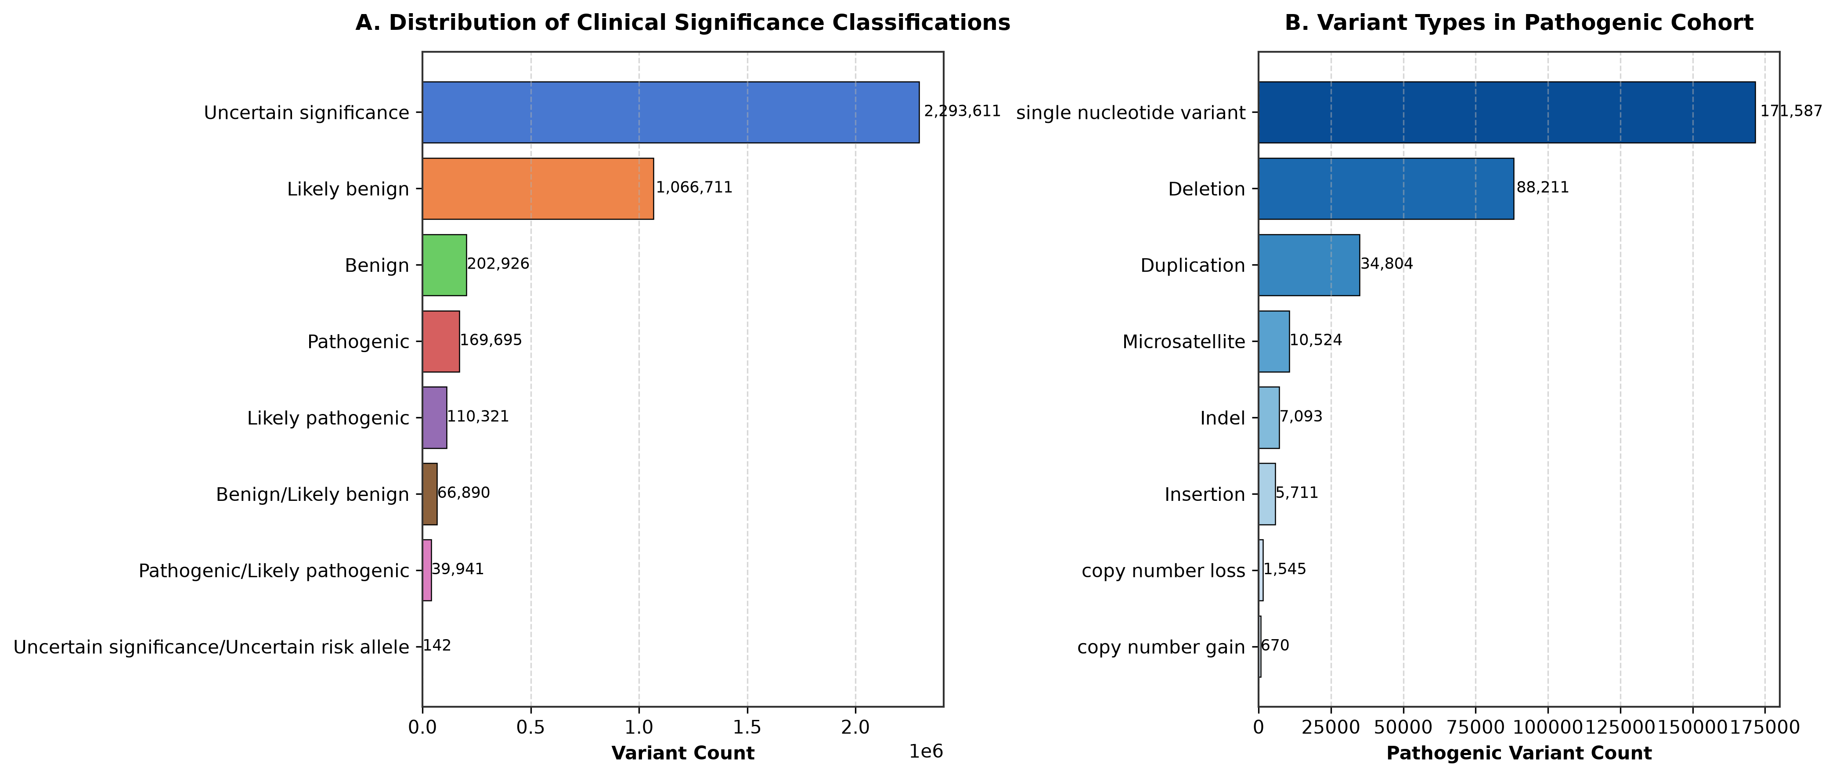
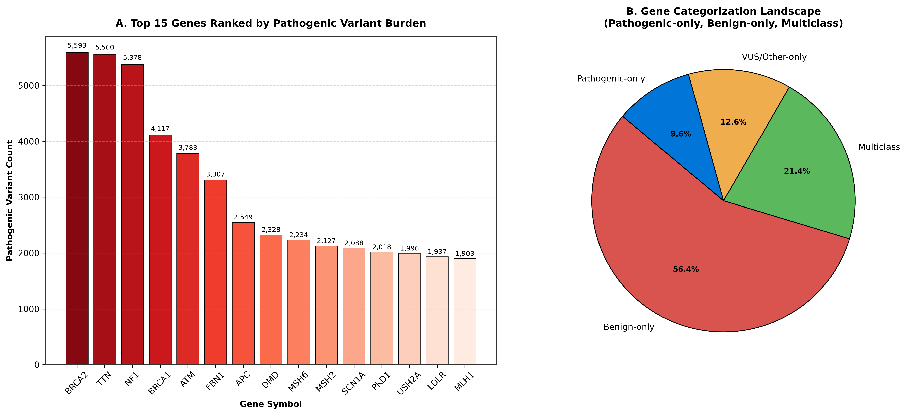
CLINVAR BIOINFORMATICS PIPELINE
Publication-Quality Visualizations (300 DPI)

Slide 10
CLINVAR BIOINFORMATICS PIPELINE
Reproduction & GitHub Setup Guide
Pipeline Execution Commands
1. POSIX Bash Script Execution:
./run_pipeline.sh
2. Nextflow DSL2 Workflow Execution:
nextflow run main.nf -profile standard
3. Standalone Python CLI Modules:
python bin/download_data.py
python bin/clinvar_pipeline.py --chunk-size 250000
python bin/plot_generator.py --dpi 300
GitHub Repository Setup
$ git init
$ git add .
$ git commit -m 'feat: Initial commit of ClinVar bioinformatics pipeline'
$ git branch -M main
$ git remote add origin https://github.com/user/clinvar-pipeline.git
$ git push -u origin main

