Slide 1
AI BUILDER CUP 2026
+9 days
Category: Future of Work & Enterprise Productivity
EVIDENCE TRIGGER
Vendor note: delivery moves Oct 15 → Oct 24
Decision Radar
DIRECT CHALLENGE
Approve launch readiness on the Oct 15 plan
Connect new evidence to the decisions your team needs to revisit.
DOWNSTREAM EFFECT
Final readiness review and launch comms
Team GeminiMaxx · Steffy Lo & Mike Umali
Built with Gemini on Vertex AI · Deployed on Cloud Run
Open the Cloud Run prototype
Notes:
Prototype URL: https://decision-radar-web-ngm5jlvo5q-as.a.run.app . Connected projects require configured OAuth test-user access and project membership. The homepage opens synthetic fixture mode.

Slide 2
THE PROBLEM
Decisions outlive the assumptions behind them
37%
~20%
39%
of survey respondents' time goes to decisions; most say over half is used ineffectively
of interaction workers' workweek goes to finding information or helpful colleagues
named changing priorities among project failure causes; 35% named inaccurate requirements
McKinsey survey (2019)
MGI, The social economy (2012)
PMI, Pulse of the Profession (2018)
A vendor update can challenge a launch assumption while the decision record stays unchanged. The team needs to connect the new evidence to the decisions it affects.
Decision Radar · Team GeminiMaxx · Future of Work & Enterprise Productivity
2 / 14
Notes:
Teams make decisions on assumptions: dates, budgets, vendor commitments. Those assumptions change in documents and meetings every day, but decision records are static. Cite sources as shown.
Historical context, not current prevalence estimates or measured Decision Radar impact. McKinsey (2019), survey of 1,259 participants, 1,228 familiar with organisational decision-making: https://www.mckinsey.com/capabilities/people-and-organization/our-insights/decision-making-in-the-age-of-urgency . MGI (2012), nearly 20% of interaction-worker time: https://www.mckinsey.com/industries/technology-media-and-telecommunications/our-insights/the-social-economy . PMI (2018), Appendix p.25, respondents selected up to three primary causes among projects deemed failures: https://www.pmi.org/-/media/pmi/documents/public/pdf/learning/thought-leadership/pulse/pulse-of-the-profession-2018.pdf . Checked 17 October 2026.

Slide 3
WHY IT HAPPENS
A nine-day delay the launch plan missed
1
Decide
2
Drift
3
Silence
4
Surprise
Launch readiness approved, assuming Acme delivers the integration package by Oct 15.
A vendor note in a Drive subfolder now says Oct 24.
Nobody links the note to the decision. The plan still says Oct 15.
The slip surfaces in a status meeting, after the readiness review and launch comms are booked.
Decision doc
vendor-update.txt
No owner, no alert
Rework and lost trust
The gap is the connection between evidence and decisions. A stored plan can stay unchanged when nobody has reviewed the newer vendor note.
Decision Radar · Team GeminiMaxx · Future of Work & Enterprise Productivity
3 / 14
Notes:
This is our demo scenario and it is deliberately ordinary. The vendor update is a plain text file in a nested folder.

Slide 4
OUR SOLUTION
Organisational memory that checks itself
Remember
Watch
R
W
A decision register where every decision keeps its owner, rationale, revision and quoted source evidence.
Manually refresh one Drive folder and its direct subfolders. Preserve changed content as versioned snapshots.
Detect
Explain
D
E
Gemini extracts new facts; typed rules compare them with monitored assumptions and raise cited alerts.
Trace a challenged decision through recorded dependencies, with direct evidence separated from projected effects.
Humans stay in charge. No decision enters monitoring until an editor confirms it, and no decision changes without a recorded review.
Decision Radar · Team GeminiMaxx · Future of Work & Enterprise Productivity
4 / 14
Notes:
Four jobs: remember, watch, detect, explain. The human review step is a design principle, not an afterthought.

Slide 5
HOW IT WORKS
The source-to-review workflow
1
2
3
4
5
Connect
Confirm
Extract
Assess
Review
Sign in and connect Drive. Refresh the root and direct subfolders, up to 100 files.
Create a quote-backed decision draft. Confirm its owner, rationale and monitored date.
Select the active assumption and trusted wording. Gemini proposes cited facts and decision suggestions.
New facts are compared by date, amount or status. Contradictions become cited alerts.
Keep, Revise, Retire, Dismiss or Request clarification, with a rationale and audit entry.
Gemini extraction runs through the API. Cloud Tasks sends refresh and typed assessment to the private worker. Reviews remain human actions.
Decision Radar · Team GeminiMaxx · Future of Work & Enterprise Productivity
5 / 14
Notes:
Current UI order requires an initial confirmed assumption before text extraction. Source: services/radar/api/routes/sources.py, worker/handlers.py and apps/web/src/components/live-decision-register.tsx. Model suggestions do not automatically become persisted active decisions.

Slide 6
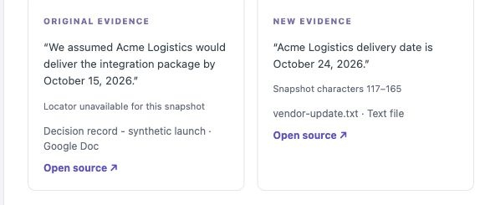
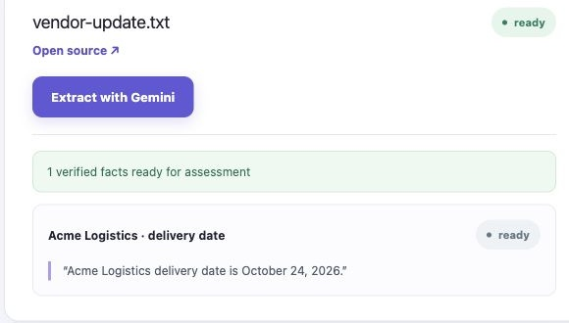
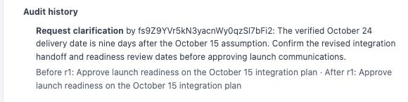
THE PROTOTYPE
Every alert shows its receipts
Verified fact
Gemini reads vendor-update.txt and saves one fact, Acme Logistics · delivery date, with the exact sentence it came from.
Side-by-side evidence
The alert puts the original Oct 15 assumption next to the new Oct 24 fact, each with an Open source link.
Recorded review
The reviewer picks an action and writes a rationale. The audit entry records the decision revision before and after.
Screens from the deployed Cloud Run prototype, synthetic project data, 10 Oct 2026
Decision Radar · Team GeminiMaxx · Future of Work & Enterprise Productivity
6 / 14
Notes:
Left: Sources page with the verified Gemini fact. Middle: the cited alert and review form with audit history.

Slide 7
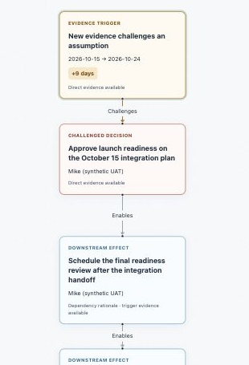
THE FLAGSHIP VIEW
Follow the ripple: the impact graph
Evidence trigger
The new fact and how far it moved the date (+9 days).
Direct challenge
The decision whose monitored assumption is contradicted.
Downstream effect
Decisions that depend on it through recorded links, shown as projected effects.
Ordered dependency path, direct evidence kept separate from projections. Works by mouse or keyboard, and at phone width (390 px).
Decision Radar · Team GeminiMaxx · Future of Work & Enterprise Productivity
7 / 14
Notes:
The graph answers 'so what?'. It separates what the evidence directly shows from what is projected through dependencies.

Slide 8
GEN AI IMPLEMENTATION
Gemini reads. Rules check. People decide.
Gemini · Vertex AI
Verification layer
Human checkpoint
Schema-constrained JSON output (Pydantic schema), temperature 0
Extracts decisions, owners, rationale, typed assumptions and facts
Labels each fact confirmed, tentative or negated
Quotes must resolve to exact snapshot spans; ambiguous or absent quotes reject extraction
Typed rules compare dates, amounts and statuses
Reuse requires unchanged snapshot, assumption, aliases and verified fact
Editors confirm decision drafts
Coverage shows assessed, uncertain or unassessed assumptions
Five review actions retain rationale and audit history
Gemini proposes meaning from source language. Validation checks quotes and typed values before deterministic rules evaluate the assumption.
Decision Radar · Team GeminiMaxx · Future of Work & Enterprise Productivity
8 / 14
Notes:
This is the core technical idea. The model is used where language understanding matters and is fenced in by verification where precision matters.
Source default: VERTEX_MODEL=gemini-2.5-flash, VERTEX_LOCATION=us-central1, configurable. The deployed image/model version was not independently established in this edit; deck labels Gemini on Vertex AI without asserting the runtime model version. Source: services/radar/config.py, pipeline/gemini.py, pipeline/extraction.py, domain/assessment.py.

Slide 9
ARCHITECTURE
Google Cloud deployment
GOOGLE CLOUD · asia-southeast1
Firebase Auth
Vertex AI
Protected project routes
Gemini
Project team
Cloud Run · Web
Cloud Run · API
Cloud Tasks
Worker
Browser, Google sign-in
Next.js, public; same-origin API proxy
Private FastAPI; extraction and CRUD
Queued jobs, retries, idempotent receipts
Cloud Run, private; refresh and assess
Browser never holds database, storage or AI credentials.
Firestore
Secret Manager
Workspace
Decisions, facts, alerts, audit
Per-project OAuth tokens
Drive, Docs, Meet
Decision Radar · Team GeminiMaxx · Future of Work & Enterprise Productivity
9 / 14
Notes:
Three Cloud Run services from one repo. The web service is the only public surface; the API and worker are private and authenticated with service identities.
Simplified architecture. API invokes Vertex for extraction; the private worker handles queued refresh/analysis. API and worker both use Firestore and source storage; content-addressed snapshots are stored in GCS. Meet events use Workspace Events/Pub/Sub and renewal uses Scheduler where configured. Runtime defaults and deployment limits are documented in submission/TECHNICAL_DOCUMENTATION.md.

Slide 10
FEASIBILITY
Recorded validation and remaining checks
30/30
25.2 s
2
11
synthetic comparison cases classified correctly: 5 expected alerts, 0 unexpected
worker execution in one timed assessment; about 30 s to the visible browser result
recorded core rehearsals; retries and mixed environments. Final export rehearsals remain.
sources after unchanged replay; cited versions unchanged, one assessment run and one alert
Recorded reliability checks
Worker retry, manual redispatch and recovery after a corrected file
Unavailable-folder errors shown and recovered in the UI
OAuth refresh tokens stored and rotated in Secret Manager
API access logs disabled; platform request metadata can retain callback queries
Synthetic content and dated UAT. These results do not establish production accuracy, p95 latency or final release readiness.
Decision Radar · Team GeminiMaxx · Future of Work & Enterprise Productivity
10 / 14
Notes:
Evidence: docs/KAN23_QUALITY_EVALUATION.md (30 cases; one 25.2-second worker execution / about 30-second visible result; 16 Oct replay retained 11 sources, cited versions, one run/request/alert); docs/KAN26_DEMO_REHEARSAL.md (8–10 Oct mixed-environment checks and supported retry); docs/CLOUD_RUN_DEPLOYMENT_UAT_20261009.md (invalid UTF-8 failure/retry and corrected-input recovery). No claim of two uninterrupted final runs through the expanded export path, simultaneous refresh safety or production accuracy.

Slide 11
INNOVATION
From storing decisions to monitoring them
Wikis & decision logs
AI meeting notes
Enterprise search
Decision Radar
Captures decision, owner and rationale
●
◐
○
●
Re-checks decisions when new evidence lands
○
○
○
●
Quote-level citations resolved to source spans
○
◐
◐
●
Shows downstream decisions affected
○
○
○
●
Human review with an audit trail
◐
○
○
●
● built in ◐ partial or manual ○ not addressed Team assessment of typical tools in each category
Decision Radar · Team GeminiMaxx · Future of Work & Enterprise Productivity
11 / 14
Notes:
Existing tools store or summarise. Decision Radar is the first layer that treats a decision as something that can go stale and needs monitoring.

Slide 12
IMPACT
Who benefits, and how
Project & program managers
PM
TM
Team contributors
GOV
Leaders, PMO & audit
Review cited contradictions after refresh and assessment
Inspect recorded downstream dependencies
Contribute source updates in Docs, Drive and Meet
Aim to reduce repeated evidence gathering during handovers
Inspect recorded review rationale and decision revisions
Trace the evidence behind a human response
Intended impact: clearer handovers for project teams, including small organisations. Pilot measures will track evidence-finding time and useful alerts; productivity gains are not yet measured.
Decision Radar · Team GeminiMaxx · Future of Work & Enterprise Productivity
12 / 14
Notes:
These are intended beneficiaries and pilot outcomes. The prototype requires explicit refresh/assessment for Drive evidence; no customer productivity or adoption gains have been measured.

Slide 13
SCALABILITY & ROADMAP
Implemented scope and next steps
NOW
NEXT
LATER
Working prototype
Release checks
Trust and scale
Drive Docs/TXT and versioned evidence
Table mappings and generated Meet intake
Typed rules, graph and human review
Reviewed briefs and Google Docs export
Clean deploy and recovery drill
Two final rehearsals through export
Keyboard, contrast and judge access
Public video and final submission
Native per-viewer Drive ACLs
Larger-scale retrieval and load testing
Jira, Chat and Gmail connectors
Shared Drives and portfolio views
Why it scales: stateless Cloud Run services autoscale · Cloud Tasks absorbs bursts with retries · idempotent jobs never duplicate alerts · per-project data and secrets · Gemini Flash keeps cost per check low
Decision Radar · Team GeminiMaxx · Future of Work & Enterprise Productivity
13 / 14
Notes:
Table, Meet and brief/export feature UAT: PRs #24, #28 and #29. Meet delivery passed but a substantive spoken-update-through-assessment rehearsal remains outstanding. Retrieval, native Drive ACL filtering and enterprise connectors are roadmap work. No unmeasured cost savings or exactly-once guarantee is claimed.

Slide 14
DECISION RADAR
Keep decisions connected to their evidence
LIVE PROTOTYPE
3-MINUTE DEMO VIDEO
Open the Cloud Run prototype
Recording and public link pending
CATEGORY
TEAM GEMINIMAXX
Future of Work & Enterprise Productivity
Steffy Lo & Mike Umali
Built with Gemini on Vertex AI · Cloud Run · Firestore · Cloud Tasks · Firebase Auth · Secret Manager · Google Workspace APIs
Notes:
Prototype: https://decision-radar-web-ngm5jlvo5q-as.a.run.app . Recording/public video link remains pending. The three-minute video and final signed-out link checks must be completed before submission.

