Slide 1


CMR TECHNICAL CAMPUS
UGC (Autonomous)
Kandlakoya, Medchal Road, Hyd-501 401
Department of Computer Science and Engineering
Real Time Project Review
IOT BASED E HEALTH DATA ACQUISITION
BATCH NO : 22
Project Guide : ROLL NUMBERS :
Name: Ms. Prashanti 227R1A05C7-Y.STEFFY NORAH JONES
Designation Ass. Professor 227R1A05C3-T.VAMSHI REDDY
Project Coordinator : 237RA0514-MUBARAK SHAREEF
Name G. Pavan Kumar
Ass. Professor

Slide 2
CONTENTS
ABSTRACT
INTRODUCTION
LITERATURE SURVEY
PROPOSED METHODOLOGY
IMPLEMENTATION & ARCHITECTURE
RESULTS & DISCUSSION
REFERENCES

Slide 3
ABSTRACT
The Raspberry Pi 3 is used in an IoT-based eHealth system for local and remote patient monitoring. It records data from various sensors, including blood pressure monitor, pulse oximeter, air flow, galvanic skin response, and body temperature. The system has a graphical interface for analyzing historical data charts and recording new data. The interface can be accessed locally or remotely. The system has a modular architecture and independent software components, ensuring system stability in case of sensor failure.

Slide 4
INTRODUCTION
Embedded systems have unique design constraints compared to desktop computing applications, including cost pressure, long life-cycle, real-time requirements, reliability requirements, and design culture dysfunction. These systems must be optimized for life-cycle and business-driven factors rather than maximum computing throughput. Currently, there is limited tool support for holistic embedded system design. Understanding the strengths and weaknesses of current approaches can set expectations, identify risk areas, and suggest ways to meet industrial needs. Most appliances today are powered by tiny microprocessors, known as embedded systems, working on basic assembly languages. The embedded systems market is conservative, with engineering decisions typically leaning towards established, low-risk solutions.

Slide 5
LITERATURE SURVEY
S.No. | Name of Author | Title of the paper | INVENTION | Issue
1. | Mahmud | fog computing-based system for real-time health monitoring | International Journal of Electronics Engineering Research.(IRJET) | 2018
2. | Pramanik | a blockchain-enabled framework for secure health data | International Journal of Electronics Engineering Research.(IRJET) | 2019
3. | Almotiri | Infrared Sensor | International Journal of Electronics Engineering Research.(IRJET) | 2020

Slide 6
PROPOSED METHODOLOGY
The proposed IoT-based e-health data acquisition methodology uses smart sensors and wearable devices to collect real-time patient health data. The data is securely transmitted to a central gateway for storage and analysis. Machine learning algorithms process the data to identify patterns, predict health issues, and generate alerts for healthcare providers. The methodology ensures patient privacy and security through robust encryption and authentication mechanisms. The system integrates with existing EHR systems for comprehensive patient monitoring and improved clinical decision-making. This IoT-based approach reduces hospital readmissions and facilitates proactive healthcare interventions.

Slide 7
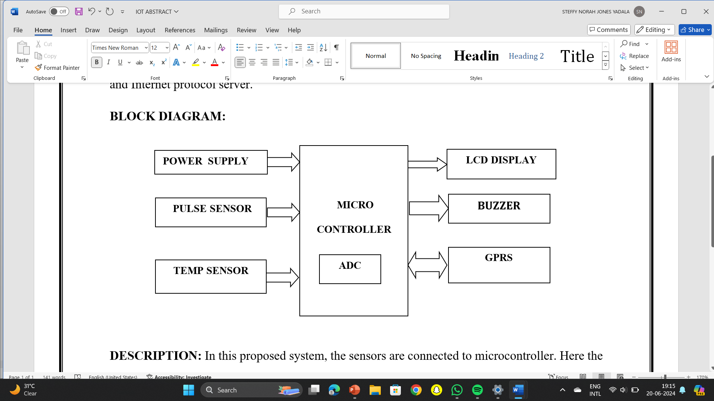
IMPLEMENTATION & ARCHITECTURE
IoT-based e-health data acquisition systems typically involve a multi-layered architecture. At the lowest level, various medical sensors and wearable devices collect patient data such as heart rate,These devices transmit data wirelessly to a local gateway, often a smartphone or dedicated hub. The gateway preprocesses and securely sends the data to the phone. Healthcare providers access this processed data through web or mobile applications, enabling remote patient monitoring and timely interventions. The entire system is secured using encryption, authentication protocols, and compliance with healthcare data regulations to ensure patient privacy and data integrity.

Slide 8
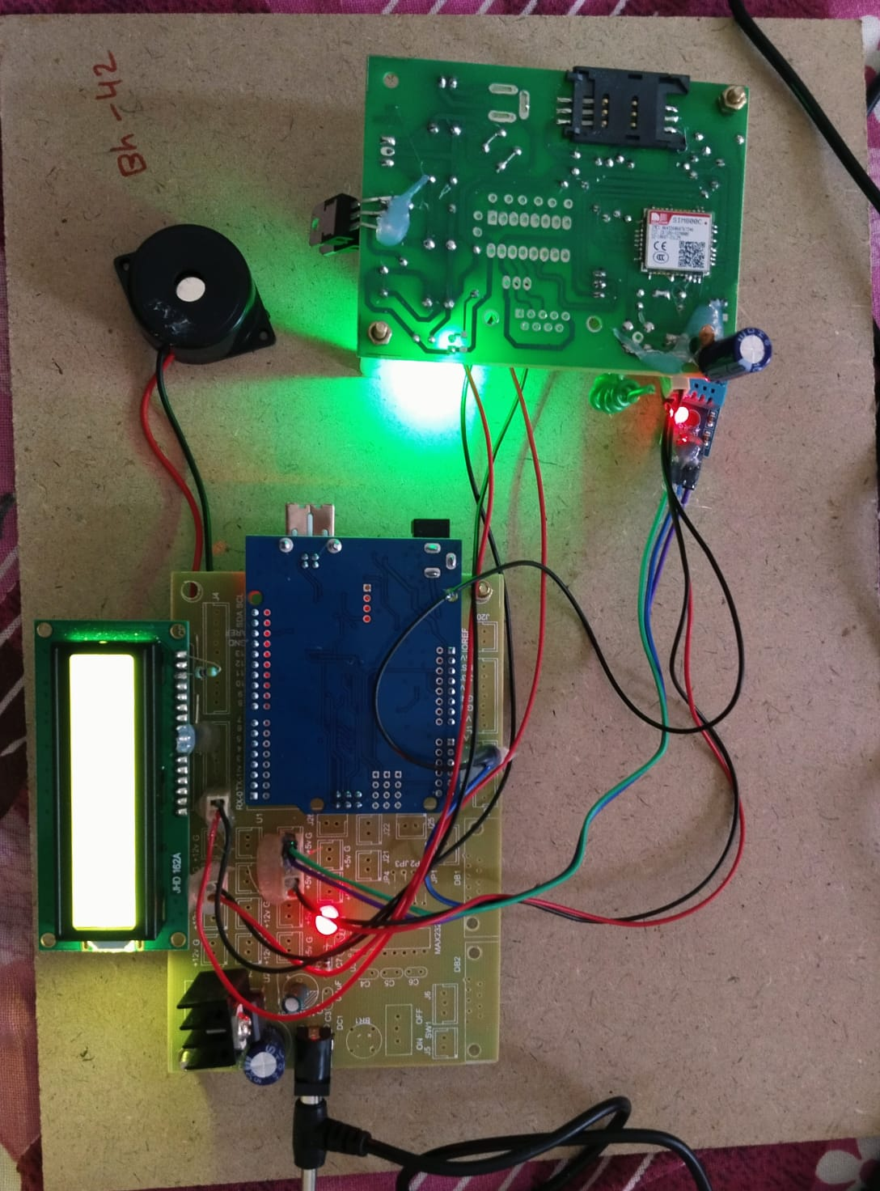
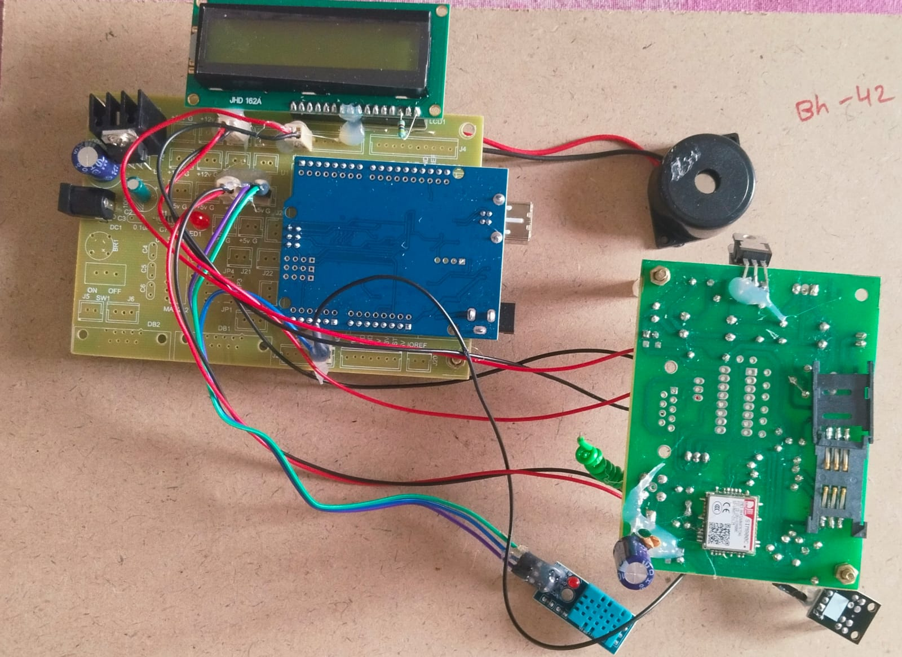
RESULTS & DISCUSSION
Led screen will display the humidity, heart beat ,and body

Slide 9
CONCLUSION AND FUTURE SCOPE
IoT-based e-health data acquisition systems have shown great potential in revolutionizing healthcare delivery and patient monitoring. These systems enable real-time collection and analysis of health data, leading to improved patient outcomes, early disease detection, and more personalized treatment plans. Future developments in this field may focus on enhancing data security and privacy measures, improving the accuracy and reliability of wearable sensors, and developing more sophisticated AI algorithms for data interpretation. Additionally, integrating these systems with emerging technologies like 5G networks and edge computing could further optimize their performance and expand their applications in remote healthcare and telemedicine.

Slide 10
REFERENCES
• Dimitrov, D. V. (2016). Medical Internet of Things and Big Data in Healthcare. Healthcare Informatics Research, 22(3), 156-163.
Yuehong, Y. I. N., Zeng, Y., Chen, X., & Fan, Y. (2016). The internet of things in healthcare: An overview. Journal of Industrial Information Integration, 1, 3-13
Baker, S. B., Xiang, W., & Atkinson, I. (2017). Internet of Things for Smart Healthcare: Technologies, Challenges, and Opportunities. IEEE Access, 5, 26521-26544
Farahani, B., Firouzi, F., Chang, V., Badaroglu, M., Constant, N., & Mankodiya, K. (2018). Towards fog-driven IoT eHealth: Promises and challenges of IoT in medicine and healthcare.

Slide 11
Q&A

Slide 12
THANK YOU

