Slide 1
Aquarius

Slide 2
01
ABOUT US

Slide 3
Aquarius
The name of our tv channel is “Aquarius” and we have been broadcasting since 9th July 2010. We are a world wide popular channel so we try our best to keep up wth the content that’s best liked by our viewers.
We came up with the idea by watching other channels that have interesting but as appealing content. Our marketing team came up with the idea of making a radio station along with the channel so that our audience could follow us even when they can’t watch tv.
Our channel is designed so that it keeps all generations occupied. So we created “Aquarius Junior” that only streams cartoons 24/7.

Slide 4
Aquarius
Our company’s headquarters is located in Novi Sad where we have over 200 employees.
As I mentioned we are a world wide known channel therefore our companies are places in total of 36 countries.
Since we have a lot of views all over the world our guide is quite the same, we stream all the same shows just in different languages.
And I must mention our best tv channel nomination, where we won the 1st place in 2015 in New York.

Slide 5
OUR HISTORY
2010
2013
2015
2019
Aquarius Radio Station
Aquarius Junior Channel
Aquarius TV Channel
New sport, cultural and political news

Slide 6
02
Channel’s Content

Slide 7
Channel’s Content
On our channel, we have various shows such as : children’s shows, news series, movies, funny shows and many more numerous shows that we all use in our lives and that help up so much in life.
We also have a cooking show to help people make something in the easiest way… or find out a new recipe, our channel also has very smart and interesting shows.
I think it should be interesting for everyone because most people use TV more than their phones.

Slide 8

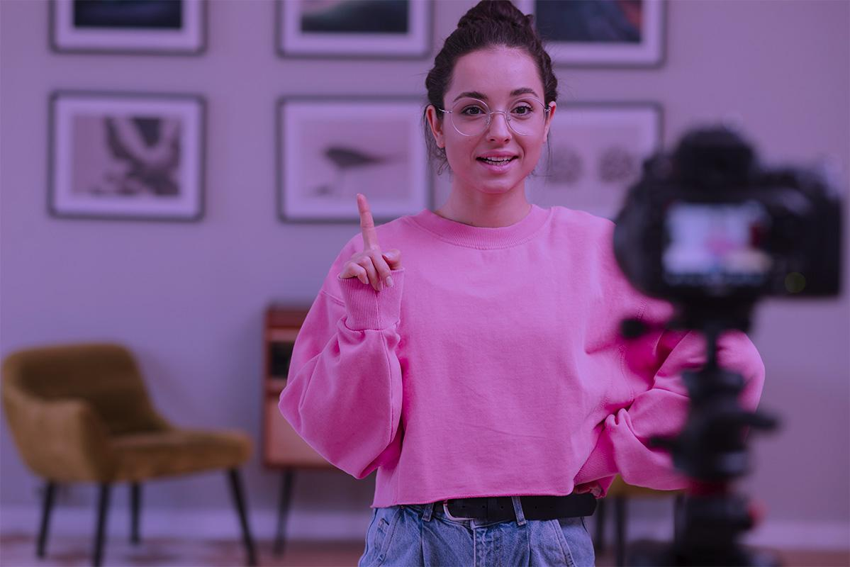
Channel’s Content
Our channel broadcasts a show about cooking at 7 o’clock. The show is hosted by Mihaela Kajganić and she does it very well.
The show featured Svjetlana Ražnatović as the main music guest.
Also, on our radio we play music according to the wishes of our viewers.
Our channel also broadcasts sports, cultural and political news.

Slide 9
AUDIENCE DEMOGRAPHICS
INTERESTS
GENDER
AGE
18 - 25
26 - 35
60%
40%

Slide 10
OUR COVERAGE
36 Countries covered

Slide 11
Thanks for your attention!
More on
Or on website
Aquarius.com

