Slide 1
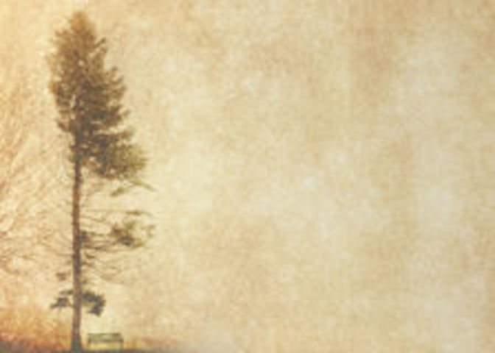
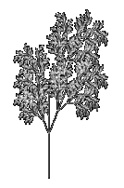
SUBJECT 3
-Draw a tree-
Can you write a program which allows to represent a plant species at your choice?

Slide 2
A tree can be represented in many ways, because it exists a lot of ways to see nature. A first solution –maybe naive- was creating a program which ‘draws’ the tree, more exactly it loads a number of images and shows them at short intervals to create the impression of an animation.

Slide 3
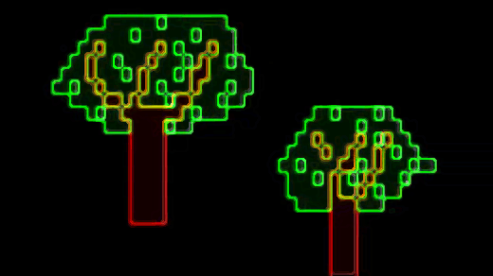
Method 1
First time we wanted to represent this:

Slide 4
The idea is relatively simple:
-> We read the images from text files to showe them in the Windows console, which in the 16-bit preset palette it includes only 8 colors (black, blue, green, red, magenta, yellow, grey, white) at two intensities: background and foregreound. We need green and brown because of drawing o tree. The reading and showing method is very sample:
-> We read from file char by char and, according to the characters, we modify the console window in this way:
For “/” go on the next line;
For “u” color the current box in light green;
For “v” color the current box in dark green;
For “m” color the current boc in brown;
For “0” skip the current box.
->After the file reading, wait 200ms, clear the
screen and read the next file.

Slide 5
The code is very sample:
#include <iostream>
#include <fstream> //for files
#include <windows.h> //for console modifies
#include <stdlib.h> //shows colors
HANDLE h = GetStdHandle(STD_OUTPUT_HANDLE);
//define colors that we need
const WORD green = BACKGROUND_GREEN | FOREGROUND_INTENSITY;
const WORD brown = BACKGROUND_RED | FOREGROUND_INTENSITY;
const WORD black = 0;
const WORD blue = BACKGROUND_BLUE | BACKGROUND_INTENSITY;
const WORD lightgreen= BACKGROUND_GREEN | BACKGROUND_INTENSITY;
//define some functions
void TextBackground(WORD color) //set the background color
{
SetConsoleTextAttribute(h, color);
}
void ClrScr() //clear the screen
{
TextBackground(black);
system("cls");
}
void gotoxy( int col, int ln ) //set cursor position (lin,col)
{
COORD coord;
coord.X = col; coord.Y = ln;
SetConsoleCursorPosition(h,coord);
}

Slide 6
//define the files witch contains the tree char images
ifstream f1("copac1.txt");
ifstream f2("copac2.txt");
ifstream f3("copac3.txt");
ifstream f4("copac4.txt");
ifstream f5("copac5.txt");
void create(ifstream &f) //draw the tree from file
{
char c;
while (!f.eof()) //as long as it's not end of file
{
f>>c;
if(c=='/') { TextBackground(black); cout<<endl; } //go on the next line
else
if(c=='m') { TextBackground(brown); cout<<" "; }//draw a brown box
else
if(c=='v') { TextBackground(green); cout<<" "; }
//draw a green box
else
if(c=='0') { TextBackground(black); cout<<" "; }//a black box
else
if(c=='u') { TextBackground(lightgreen); cout<<" ";}//a lightgreen box
}
f.clear();
f.seekg(0,ios::beg); //reset the file for the next operations
}

Slide 7
int main()
{
while(true) //infinite loop
{
create(f1); gotoxy(1,1);//read the first tree and reset the cursor posotion
create(f2); gotoxy(1,1);
create(f3); gotoxy(1,1);
create(f4); gotoxy(1,1);
create(f5); gotoxy(1,1);
}
return 0;
}
As you can see, the result is a sample animation, and the model tree is general, it can’t be likened with a certain species, and the windows console dowsn’t allow high image quality, because the base unit of an image wasn’t the pixel, but the ‘buffer’ box in the console.

Slide 8
About WinGraph
Wingraph is a data collection implemented for Free Pascal 2.4.0 and was creating by Stefan Berinde, a Romanian teacher from Babes-Bolyai University, Cluj, Romania.
In contrast to the old unit “Graph” pre-included in Free Pascal installation kit , we think that Wingraph can be used easier and contains a lot of new functions. It has 255 predefined colors, allows to modify the size of the graphical window with Mcustom mode, has a structure type for animations, and the UpdateGraph(UpdateOn/UpdateOff) function allows to memorize and processing the graphic content directly in the memory, to shoe them after on the screen using direct pixel accession.

Slide 9
With WinGraph, we can rewrite the first method using graphics. The images are memorized as 24-bit Bitmap files, which offers to the image more graphical quality. We create the program code using Lazarus IDE, based on Free Pascal 3.0.0.
Uses
..................
Wincrt, Wingraph;
Function GetImage(FName:String;Weigh,Heigh:Integer):Pointer;
//Loads the image and saves it in the memory
Var f:File;
Size:Longint;
Begin
Size:=ImageSize(1,1,Weigh,Heigh);
GetMem(GetImage,Size);
Assign(f,FName);{$i-} Reset(f,1); {$i+}
If Ioresult<>0 Then Halt;
BlockRead(f,GetImage^,Size);
Close(f);
End;
Procedure DrawImage(BitMap:Pointer;X,Y:Integer);
//Displays the image at (x,y) coordinates
Begin
PutImage(X,Y,BitMap^,NormalPut);
End;

Slide 10
We memorized the tree variable as an object type, which contains
The coordinates, the image pointer adress and read-write functions:
Type Copac = Object
Public
var Pos:Record
x,y:Integer;
//the coordinates of the image
End;
Img:AnimatType;
(*We used the animation type for making the white color in the image -rgb(255,255,255)- transoprent*)
Procedure Get(input:Byte);
//reading image
Procedure SetXY(Input1,Input2:Integer);
//initialization of %pos% variable
Procedure Draw(Input1,Input2:Integer);
//display image
Private
Procedure Draw_(input1,input2:Integer);
Var Image:Pointer;
End;

Slide 11
The central block is based on the same idea as in the forst method:
DrawImage(BackGround,0,0);
nCopac:=12;
Repeat
For i:=1 to nCopac do
Begin
UpdateGraph(UpdateOff);
DrawImage(BackGround,0,0);
c[i].Draw(100,100);
c[i].Draw(400,150); //we will draw two same trees
UpdateGraph(UpdateOn);
Delay(200);
End;
until CloseGraphRequest; //until the graphical window is
//closed

Slide 12
The result is also an animation, but obtained at pixel resolution. According the artistic talent of each person, it can be represented each type of tree by sample drawing. Here we have a general example:

Slide 13
Method 2
The preview representing models are juice a graphical solution, but not a mathematical one. The faithful mathematical representation of reality are the fractals.
Fractal is "a fragmented geometric shape that can be split or broken into parts so that each of them is (at least approximately) a miniature copy of the whole." The term fractal was created by mathematician Benoit Mandelbrot. Mandelbrot Set and the Koch curve are some famous examples of fractals.
Fractals are found everywhere in nature: in snowflakes, in landforms, the lightning and the formation of galaxies. Of course, and the tree can be considered a fractal.

Slide 14
Before thinking the computer algorithm, we had to resolve some mathematical problems which intervened in this solution.
1: We have to build a segment
(AB) with A at coordinates (x1,y1),
which has the length l and makes an u angle with the horizontal line.
Or, in other words, we need to find the segment point B position. We fit the sgment (AB) in an orthogonal axis system. We tried to adapt in the same time to the graphical window configuration, so we set the O origin point from top-left at coordinates (0px,0px).

Slide 15
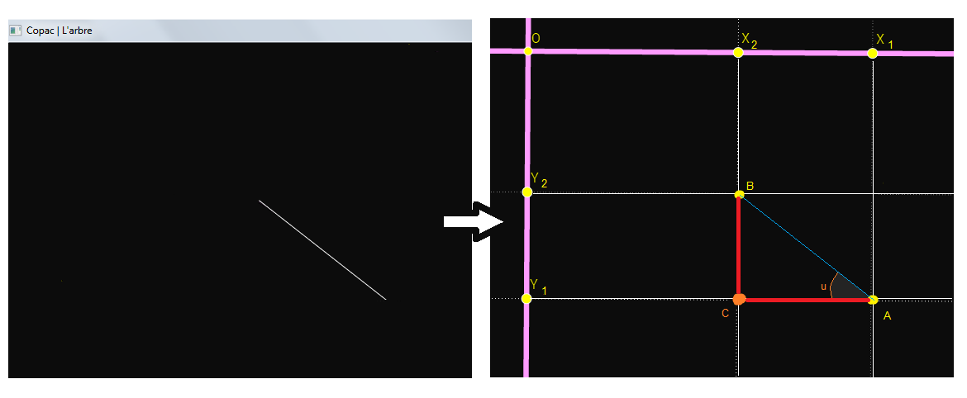
We consider point C (X2, Y1) and Calculate the lengths of sides AC and BC in the right triangle ABC:
AC = AB * cos(u) => AC = l * cos(u)
BC = AB * sin(u ) => BC = l * sin(u )
From the graph we see that X1, X2 and Y1-Y2 = AC = BC, where: X2 = X1 – l * cos(u) Y2= Y1 – l * sin(u)

Slide 16
2. Given a segment (AB), which makes an angle a with
horizontal line, we need to build a segment (BC)
making an angle u segment (AB).
In other words, we need to determine the angle b that makes the segment (BC) to the horizontal in order to apply the formulas obtained in one issue.
The result is obtained simply using the corresponding congruent angles determined by two parallel and secant
(We will choose parallel horizontal axis passing through A and the B, the secant and will be AB):
Depending on the orientation segment (BC) to (AB), detach two cases:

Slide 17
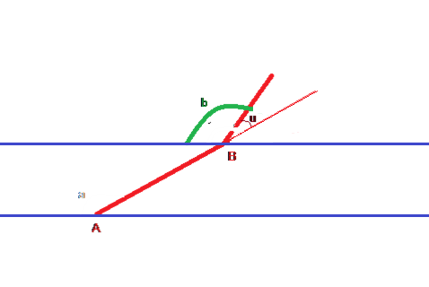
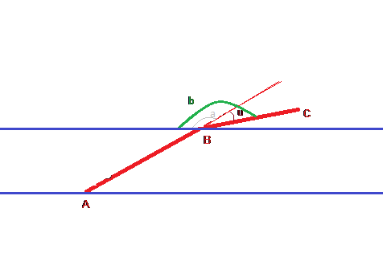
(BC) is in the left side of (AB)
b=a-u
2. (BC) is in the right side of (AB)
b=a+u

Slide 18
The golden ratio (Φ)
It is the first rational number defined and discovered. With an approximate a value of 1.618033 seems to underlie formation of
all things around us. We can find in the Universe, monuments, in cloud formation in humans in nature. It has a connection the Fibonacci sequence, because if we report two numbers row in this series get a value close to that of the golden section and the more numbers are higher, the value Report them only tends towards the irrational.
To reduce computation time performed by computer, we choose
the first numbers in the Fibonacci sequence, 3 and 5, with 5/3 ≈Φ. in solving our disposition we need branches from the bottom up,
from the largest to the smallest, so we need the inverse of the golden ratio, 3/5.

Slide 19
Using these formulas, we can make various types of fractals.
Initially we were guided by graphical representation of a tree and we imagined a list type:
Type pbrench = ^brench;
brench = record
nod:coordinates;
b1,b2:pbrench;
end;
It is useful to understand how the tree unfolds:
…………………………………………………………………………………………
b.b1.b2<-------↓ ↓--------->b.b2.b1
\ / \ / ------>b.b2.b2
b.b1.nod<------Y Y ------->b.b2.nod
b.b1<------\ / ------->b.b2
\ /
Y---------->b.nod
|
|---------->b
b.b1.b1<-----

Slide 20
Our code is based on a recursive algorithm:
type coordinates = record x,y:integer; end;
//data type which memorizes the coordinates of a point
function setcoord(x,y:integer):coordinates;
begin
result.x:=x;
result.y:=y;
end;
function angle(pos:coordinates;l,u:integer):coordinates;
//functions uses the result of problem 1 →
var v1,v2: integer;
semn: coordinates;
Begin
v1:=trunc(l*cos(Pi*u/180));
v2:=trunc(l*sin(Pi*u/180));
...........................//some graphical effects
result:=setcoord(pos.x-v1,
pos.y-v2);
line(pos.x,pos.y,result.x,result.y);
end;

Slide 21
procedure Draw(b:pbrench;u,l,width:integer);
var aux:pbrench;
pos:Coordinates;
l1:integer;
begin
new(b^.b1); new(b^.b2); //we initialize the two sub-branch
l:=3*l div 5;
if width>1 then width:=3*width div 5;
SetLineStyle(SolidLn,0,width);
b^.b1^.nod:=angle(b^.nod,l,random(u));//build segments
b^.b2^.nod:=angle(b^.nod,l,90+random(u));
//We think that the angle needs to be randomized because on
// this type of tree a uniform angle would make it too
// perfect and "unnatural"
aux:=b;
l1:=l;
if l>0 then
begin
b:=b^.b1;
Draw(b,u,l, width); //we repeat the algorithm for the
//new branches
aux:=aux^.b2;
Draw(aux,u,l1, width);
end;
end;

Slide 22
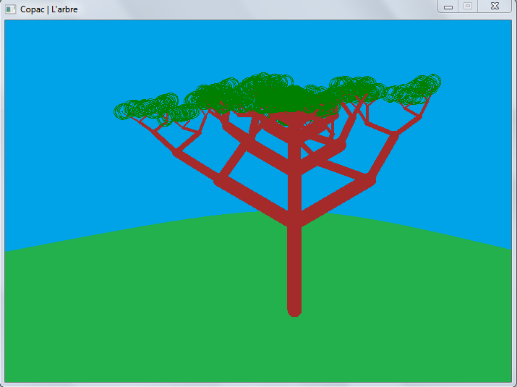
The tree obtained is just an idea of what we want to achieve,
because we need a more complex formula to generate
tree.

Slide 23
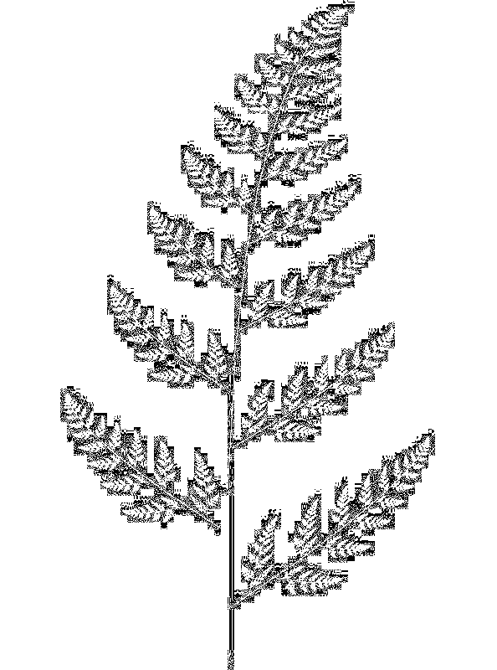
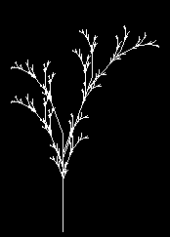
Based on this idea we can make a tree type
fern. We give up the type list (I've used
to create our review construction
tree), but we will add structure "coordinates"
Besides coordinates the end of a segment, and
the angle that it makes with the horizontal
To apply two → result of the problem.
The basic method will be increasingly recursion.

Slide 24
Pascal alternative
C++ alternative
procedure build2(pos:coordinates;l,u,n:integer);
var p1,aux:coordinates;
i:integer=0;
begin
if l>1 then
begin
for i:=1 to n do
begin
aux:=angle(pos,l div (2*(i mod 2+1)),pos.u,true);
if i mod 2=0 then
begin
l:=f(l);
u:=-u;
end;
p1:=angle(aux,f(l),u+aux.u,true);
build2(p1,f(l),u,n);
end;
end;
end;
void build2(coordinates pos,int l, int u, int n)
{
coordinates p1, aux;
int i=0;
if(l>1)
{
for(i=1;i<=n;i++)
{
aux=angle(pos,l/(2*(i%2+1)),pos.u,true);
if (i%2==0)
{
l=f(l);
u=-u;
}
p1=angle(aux,f(l),u+aux.u,true);
build2(p1,f(l),u,n);
}
}
}

Slide 25
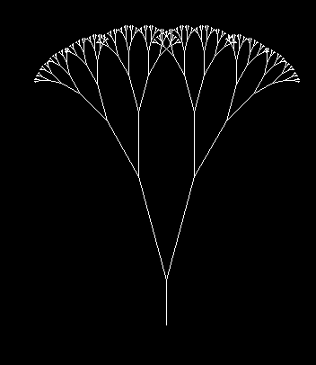
We can also build and Pythagoras tree:
procedurebuild1(pos:coordinates;l,u:integer);
var p1,p2:coordinates;
begin
p1:=angle(pos,f(l),-u+pos.u,true);
p2:=angle(pos,f(l), u+pos.u,true);
l:=f(l);
if l>1 then
begin
build1(p1,l,u);
build1(p2,l,u);
end;
end;

Slide 26
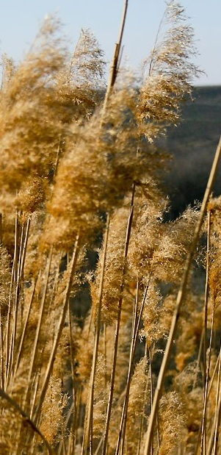
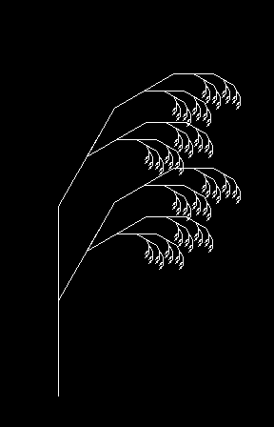
We note that, if we put the golden ratio between the length of a branch nodes, we get a structure resembling reed.
aux=angle(pos,l/(2*(i%2+1)),pos.u,true);
if (3*i%5==0)
{
l=f(l);
u=-u;
}

Slide 27
We tried to represent a tree more particularly, by the code :
void build4(coordinates pos,int l, int u, int n)
{
coordinates p1, p2, aux;
int i=0;
if(l>1)
{
for(i=1;i<=n;i++)
{
aux=angle(pos,l/((i%2+1))-l,pos.u,true);
if ((3*i%5==0))
{
l=f(l);
u=-u;
}
p1=angle(aux,f(l),-u+aux.u,true);
p2=angle(aux,f(l),u+aux.u,true);
build4(p1,f(l),u,n);
build4(p2,f(l),u,n);
}
}
}

Slide 28
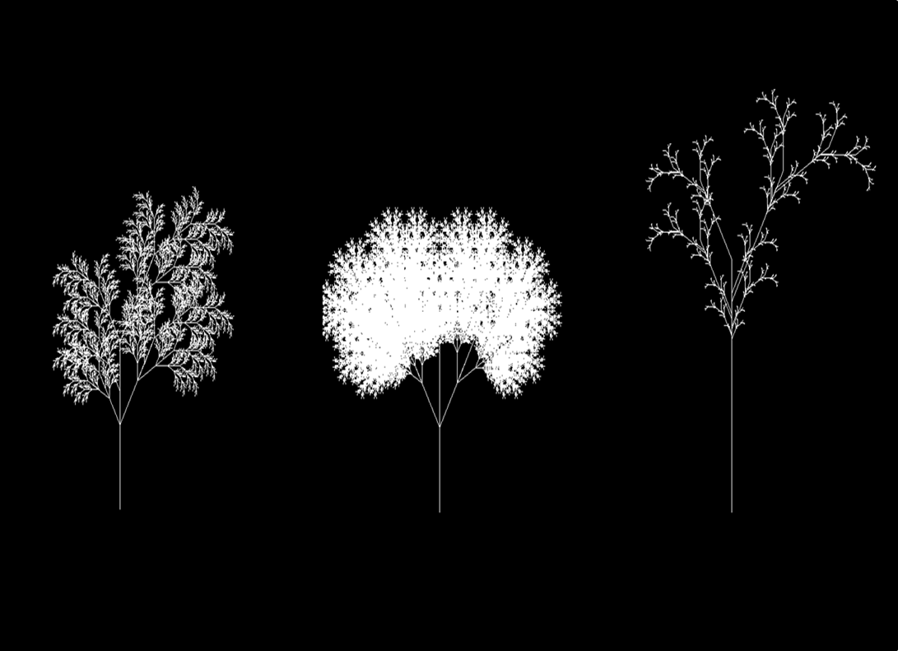
The result is more satisfying:

Slide 29
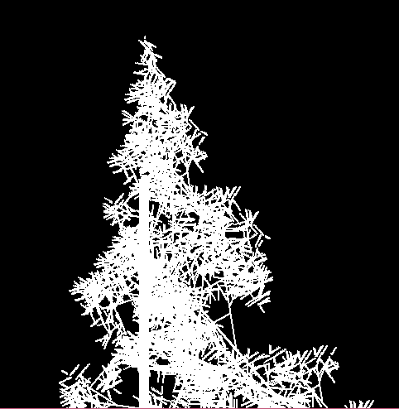
A miscalculation angle for fern led us to the graphical representation of a fir tree, which you can decorate as we want:

Slide 30
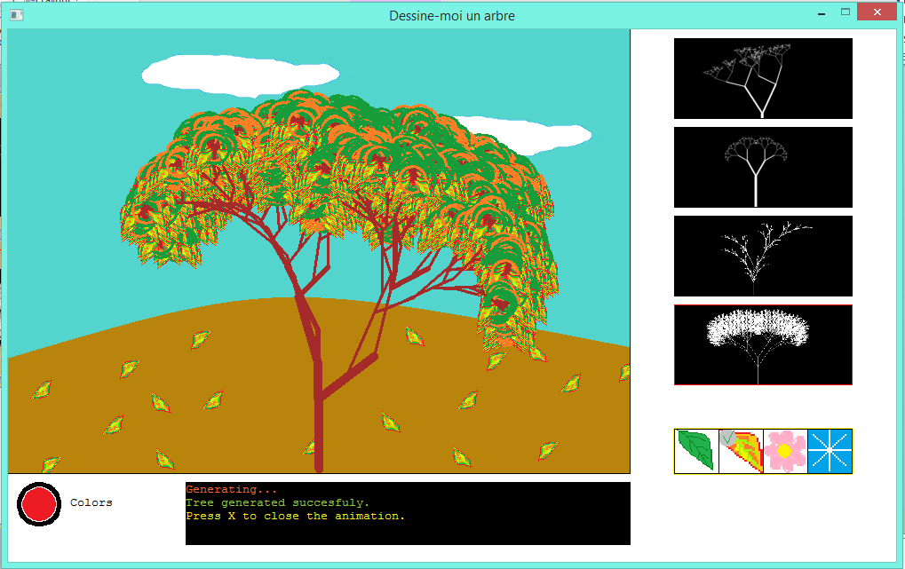
Now we represent all types of trees created in one program,
a natural space in various seasons:

