Slide 1
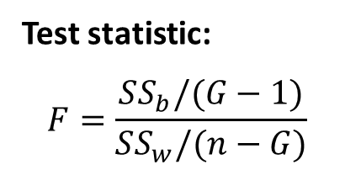

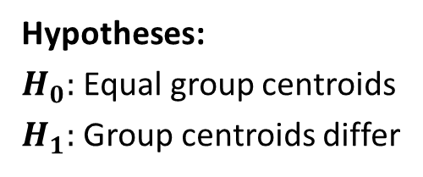
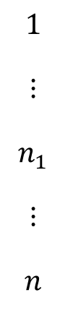
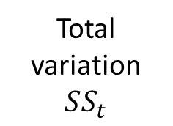

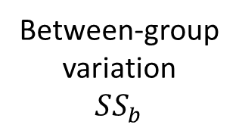
Beta diversity distances
Distance-based variation partitioning
Illustration of
group separation
PERMANOVA
Hypotheses:
$H_{0}:$ Equal group centroids
$H_{1}:$ Group centroids differ
$$1$$
$$⋮$$
$$n_{1}$$
$$⋮$$
$$n$$
…
…
Within-group
variation
$$SS_{w}$$
…
…
…
…
Samples
…
…
Axis 2
Test statistic:
$$F=\frac{SS_{b}/(G−1)}{SS_{w}/(n−G)}$$
Between-group
variation
$$SS_{b}$$
…
…
…
…
…
…
Total
variation
$$SS_{t}$$
$$1$$ | … | $$n_{1}$$ | … | $$n$$
Axis 1
Samples
Group 1
Group 2

