Slide 1

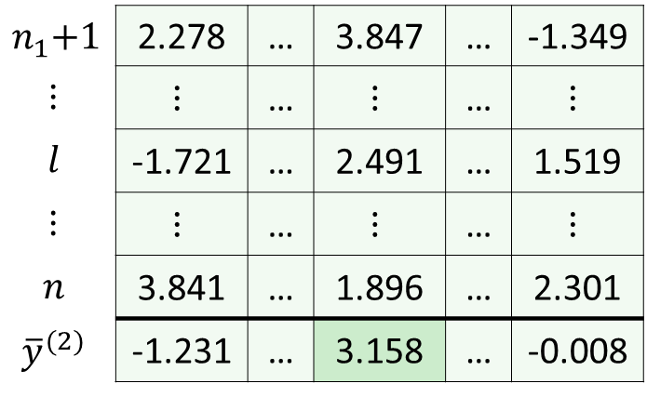

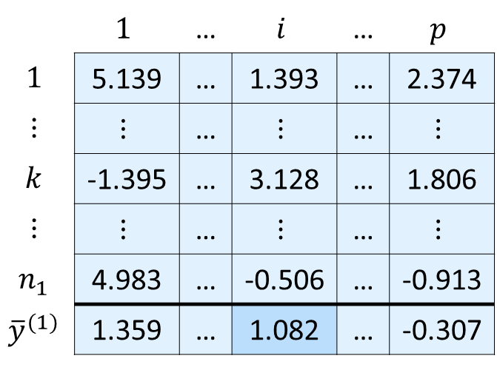


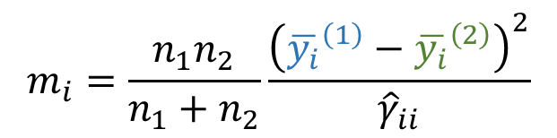
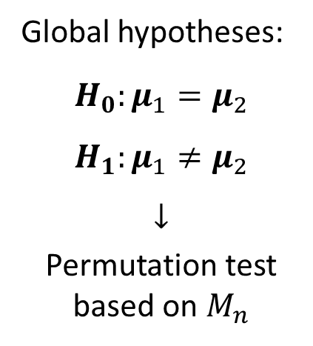
CLR transformed matrix
Taxon-wise contributions
Compositional equivalence test
Genera
 | $$1$$ | … | $$i$$ | … | $$p$$
$$1$$ | 5.139 | … | 1.393 | … | 2.374
$$⋮$$ | $$⋮$$ | … | $$⋮$$ | … | $$⋮$$
$$k$$ | -1.395 | … | 3.128 | … | 1.806
$$⋮$$ | $$⋮$$ | … | $$⋮$$ | … | $$⋮$$
$$n_{1}$$ | 4.983 | … | -0.506 | … | -0.913
$${\overline{y}}^{(1)}$$ | 1.359 | … | 1.082 | … | -0.307
Standardized squared CLR mean difference:
Community-level
test statistic:
$$m_{i}=\frac{n_{1}n_{2}}{n_{1}+n_{2}}\frac{{\left({\overline{y_{i}}}^{\left(1\right)}−{\overline{y_{i}}}^{\left(2\right)}\right)}^{2}}{{\hat{γ}}_{ii}}$$
$$M_{n}=\max_{1≤i≤p}{m_{i}}$$
Group 1
Samples
Global hypotheses:
$$H_{0}:μ_{1}=μ_{2}$$
$$H_{1}:μ_{1}≠μ_{2}$$
$$↓$$
Permutation test based on $M_{n}$
$$1$$
$$2$$
$$⋮$$
$$i$$
$$⋮$$
$$p$$
$$n_{1}\text{+}1$$ | 2.278 | … | 3.847 | … | -1.349
$$⋮$$ | $$⋮$$ | … | $$⋮$$ | … | $$⋮$$
$$l$$ | -1.721 | … | 2.491 | … | 1.519
$$⋮$$ | $$⋮$$ | … | $$⋮$$ | … | $$⋮$$
$$n$$ | 3.841 | … | 1.896 | … | 2.301
$${\overline{y}}^{(2)}$$ | -1.231 | … | 3.158 | … | -0.008
Genera
Samples
Group 2
$$0$$ | 0.05 | 0.1 | 0.15
Taxon-wise contribution $m_{i}$

