Slide 1

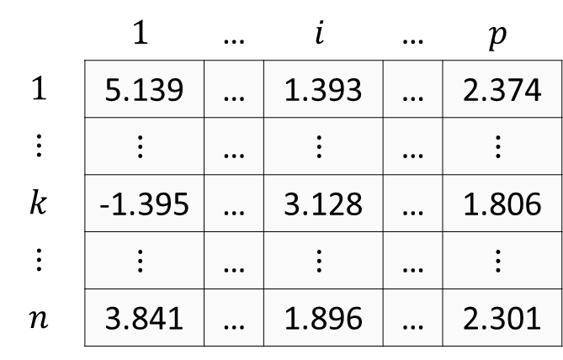
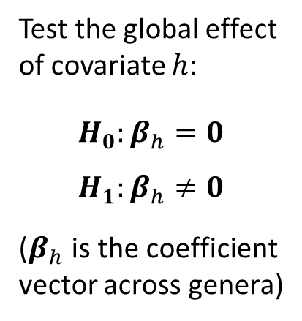

CLR transformed matrix
Coefficient matrix
(feature-level)
Test covariate effects
(community-level)
Genera
 | $$1$$ | … | $$i$$ | … | $$p$$
$$1$$ | 5.139 | … | 1.393 | … | 2.374
$$⋮$$ | $$⋮$$ | … | $$⋮$$ | … | $$⋮$$
$$k$$ | -1.395 | … | 3.128 | … | 1.806
$$⋮$$ | $$⋮$$ | … | $$⋮$$ | … | $$⋮$$
$$n$$ | 3.841 | … | 1.896 | … | 2.301
$$Int$$
$$x_{1}$$
$$x_{2}$$
$$⋮$$
$$x_{q}$$
Test the global effect of covariate $h$:
$$H_{0}:β_{h}=0$$
$$H_{1}:β_{h}≠0$$
($β_{h}$ is the coefficient vector across genera)
+
Multivariate
regression
Samples
0
-
$$1$$ | $$2$$ | … | $$p$$
Genera

