Slide 1
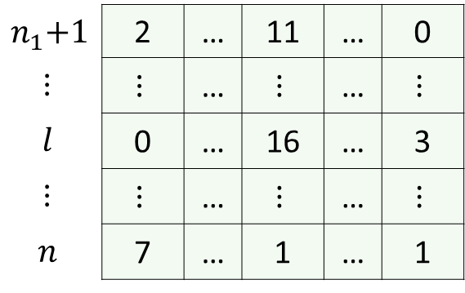
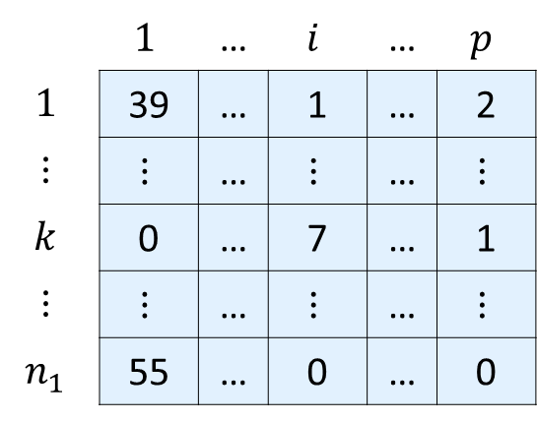
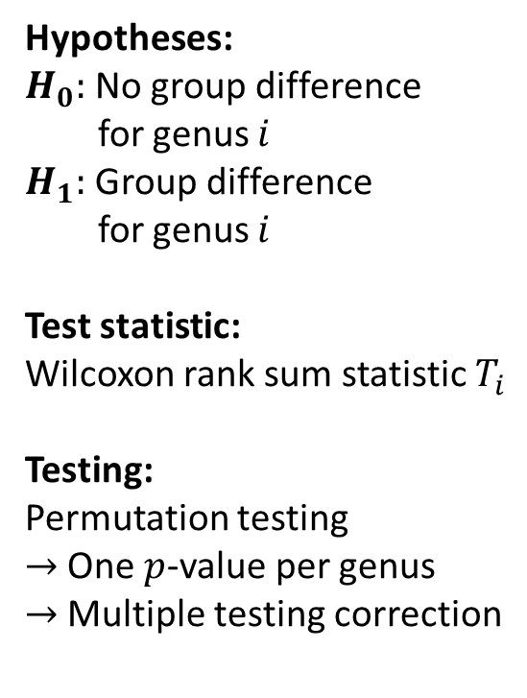

DACOMP-rarefied counts
Visualization of group comparisons
Testing
(one test per genus)
Genera
 | $$1$$ | … | $$i$$ | … | $$p$$
$$1$$ | 39 | … | 1 | … | 2
$$⋮$$ | $$⋮$$ | … | $$⋮$$ | … | $$⋮$$
$$k$$ | 0 | … | 7 | … | 1
$$⋮$$ | $$⋮$$ | … | $$⋮$$ | … | $$⋮$$
$$n_{1}$$ | 55 | … | 0 | … | 0
Hypotheses:
$H_{0}:$ No group difference
for genus $i$
$H_{1}:$ Group difference
for genus $i$
Test statistic:
Wilcoxon rank sum statistic $T_{i}$
Testing:
Permutation testing
$→$ One $p$-value per genus
$→$ Multiple testing correction
Group 1
Samples
DACOMP-rarefied count
$$n_{1}\text{+}1$$ | 2 | … | 11 | … | 0
$$⋮$$ | $$⋮$$ | … | $$⋮$$ | … | $$⋮$$
$$l$$ | 0 | … | 16 | … | 3
$$⋮$$ | $$⋮$$ | … | $$⋮$$ | … | $$⋮$$
$$n$$ | 7 | … | 1 | … | 1
$$1$$ | … | $$i$$ | … | $$p$$
Samples
Group 2

