Slide 1
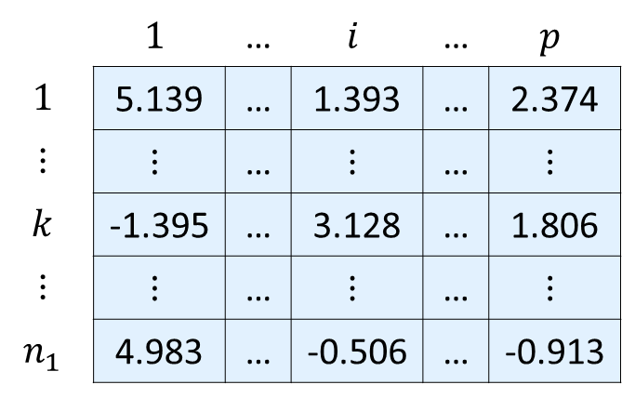

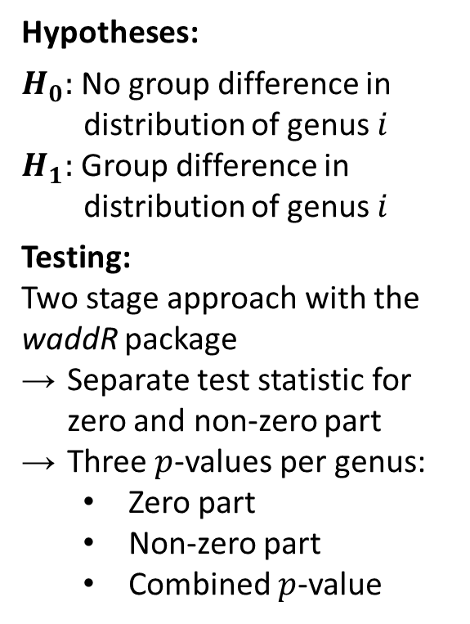


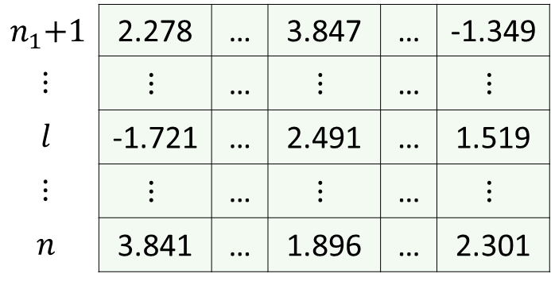
CLR transformed matrix
Visualization of distributions per group
Two-stage testing approach
(one test per genus)
Genera
 | $$1$$ | … | $$i$$ | … | $$p$$
$$1$$ | 5.139 | … | 1.393 | … | 2.374
$$⋮$$ | $$⋮$$ | … | $$⋮$$ | … | $$⋮$$
$$k$$ | -1.395 | … | 3.128 | … | 1.806
$$⋮$$ | $$⋮$$ | … | $$⋮$$ | … | $$⋮$$
$$n_{1}$$ | 4.983 | … | -0.506 | … | -0.913
$$Genus_{1}$$
Hypotheses:
$H_{0}:$ No group difference in
distribution of genus $i$
$H_{1}:$ Group difference in
distribution of genus $i$
Testing:
Two stage approach with the waddR package
Separate test statistic for zero and non-zero part
Three $p$-values per genus:
Zero part
Non-zero part
Combined $p$-value
Group 1
Samples
$$Genus_{i}$$
$$n_{1}\text{+}1$$ | 2.278 | … | 3.847 | … | -1.349
$$⋮$$ | $$⋮$$ | … | $$⋮$$ | … | $$⋮$$
$$l$$ | -1.721 | … | 2.491 | … | 1.519
$$⋮$$ | $$⋮$$ | … | $$⋮$$ | … | $$⋮$$
$$n$$ | 3.841 | … | 1.896 | … | 2.301
$$Genus_{p}$$
Samples
Group 2
CLR coordinate
Group 1
Group 2

