Slide 1
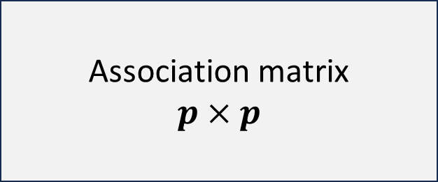
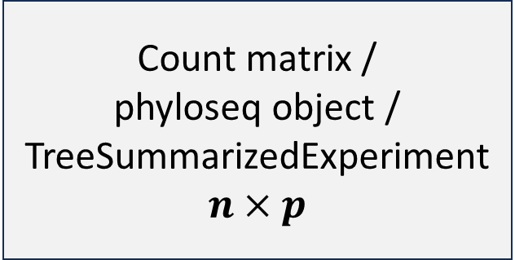
renameTaxa()
plot.diffnet()
Sec. 5.2
Sec. 5.4.1
Count matrix /
phyloseq object /
TreeSummarizedExperiment
$$n×p$$
netConstruct()
diffnet()
createAssoPerm()
plot.microNetProps()
Sec. 5.3
netAnalyze()
summary.microNetProps()
Association matrix
$$p×p$$
plotGCM()
Sec. 5.4.2
netCompare()
summary.microNetComp()

