Slide 1
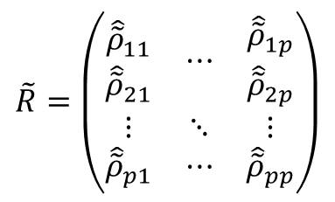


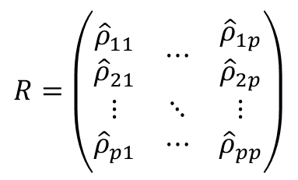
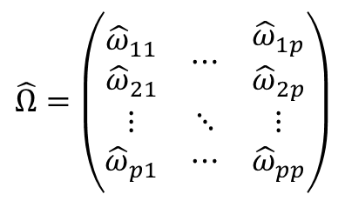
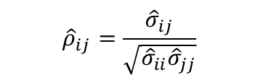
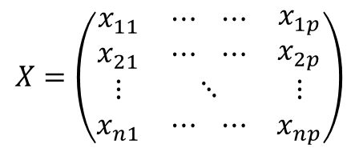

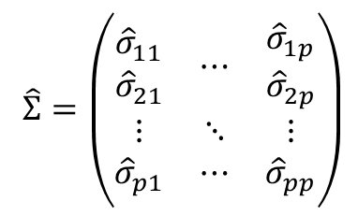

Sparse correlation estimation (e.g., SparCC)
$$\hat{Σ}=\left(\begin{matrix}\begin{aligned}{\hat{σ}}_{11} \\ {\hat{σ}}_{21}\end{aligned} & ⋯ & \begin{aligned}{\hat{σ}}_{1p} \\ {\hat{σ}}_{2p}\end{aligned} \\ ⋮ & ⋱ & ⋮ \\ {\hat{σ}}_{p1} & ⋯ & {\hat{σ}}_{pp}\end{matrix}\right)$$
$${\hat{ρ}}_{ij}=\frac{{\hat{σ}}_{ij}}{\sqrt{{\hat{σ}}_{ii}{\hat{σ}}_{jj}}}$$
$$R=\left(\begin{matrix}\begin{aligned}{\hat{ρ}}_{11} \\ {\hat{ρ}}_{21}\end{aligned} & ⋯ & \begin{aligned}{\hat{ρ}}_{1p} \\ {\hat{ρ}}_{2p}\end{aligned} \\ ⋮ & ⋱ & ⋮ \\ {\hat{ρ}}_{p1} & ⋯ & {\hat{ρ}}_{pp}\end{matrix}\right)$$
$$X=\left(\begin{matrix}\begin{aligned}x_{11} \\ x_{21}\end{aligned} & \begin{aligned}⋯ ⋯ \\ ⋯ ⋯\end{aligned} & \begin{aligned}x_{1p} \\ x_{2p}\end{aligned} \\ ⋮ & ⋱ & ⋮ \\ x_{n1} & ⋯ ⋯ & x_{np}\end{matrix}\right)$$
$$S=\left(\begin{matrix}\begin{aligned}s_{11} \\ s_{21}\end{aligned} & ⋯ & \begin{aligned}s_{1p} \\ s_{2p}\end{aligned} \\ ⋮ & ⋱ & ⋮ \\ s_{p1} & ⋯ & s_{pp}\end{matrix}\right)$$
Shrinkage
Preprocessed
count matrix ($p≫n$)
Sample covariance
matrix (singular)
Sparse covariance
matrix (invertible)
Sparse correlation
matrix
$$\hat{Ω} ={\hat{Σ}}^{−1}$$
$$\hat{Ω}=\left(\begin{matrix}\begin{aligned}{\hat{ω}}_{11} \\ {\hat{ω}}_{21}\end{aligned} & ⋯ & \begin{aligned}{\hat{ω}}_{1p} \\ {\hat{ω}}_{2p}\end{aligned} \\ ⋮ & ⋱ & ⋮ \\ {\hat{ω}}_{p1} & ⋯ & {\hat{ω}}_{pp}\end{matrix}\right)$$
$${\hat{\tilde{ρ}}}_{ij}=\frac{− {\hat{ω}}_{ij}}{\sqrt{{\hat{ω}}_{ii}{\hat{ω}}_{jj}}}$$
$$\tilde{R}=\left(\begin{matrix}\begin{aligned}{\hat{\tilde{ρ}}}_{11} \\ {\hat{\tilde{ρ}}}_{21}\end{aligned} & ⋯ & \begin{aligned}{\hat{\tilde{ρ}}}_{1p} \\ {\hat{\tilde{ρ}}}_{2p}\end{aligned} \\ ⋮ & ⋱ & ⋮ \\ {\hat{\tilde{ρ}}}_{p1} & ⋯ & {\hat{\tilde{ρ}}}_{pp}\end{matrix}\right)$$
Sparse inverse covariance estimation
(e.g., SpiecEasi)
Sparse inverse
covariance matrix
Partial correlation
matrix

