Slide 1
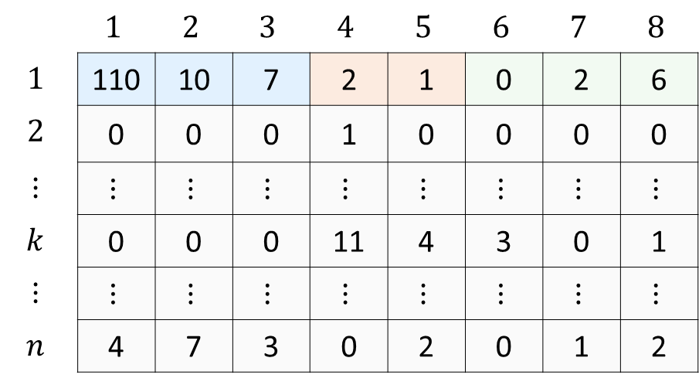
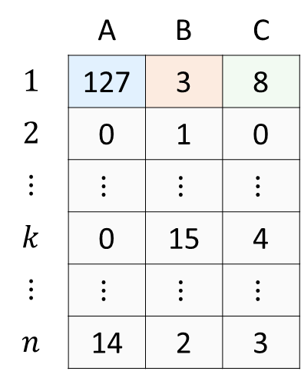
ASV-level count matrix
Taxonomic
annotation
Aggregated count matrix
ASVs
Genera
 | $$1$$ | $$2$$ | $$3$$ | $$4$$ | $$5$$ | $$6$$ | $$7$$ | $$8$$
$$1$$ | 110 | 10 | 7 | 2 | 1 | 0 | 2 | 6
$$2$$ | 0 | 0 | 0 | 1 | 0 | 0 | 0 | 0
$$⋮$$ | $$⋮$$ | $$⋮$$ | $$⋮$$ | $$⋮$$ | $$⋮$$ | $$⋮$$ | $$⋮$$ | $$⋮$$
$$k$$ | 0 | 0 | 0 | 11 | 4 | 3 | 0 | 1
$$⋮$$ | $$⋮$$ | $$⋮$$ | $$⋮$$ | $$⋮$$ | $$⋮$$ | $$⋮$$ | $$⋮$$ | $$⋮$$
$$n$$ | 4 | 7 | 3 | 0 | 2 | 0 | 1 | 2
 | A | B | C
$$1$$ | 127 | 3 | 8
$$2$$ | 0 | 1 | 0
$$⋮$$ | $$⋮$$ | $$⋮$$ | $$⋮$$
$$k$$ | 0 | 15 | 4
$$⋮$$ | $$⋮$$ | $$⋮$$ | $$⋮$$
$$n$$ | 14 | 2 | 3
ASV | Genus
1 | A
2 | A
3 | A
4 | B
5 | B
6 | C
7 | C
8 | C
Aggregate
ASVs
+
Samples

