Slide 1

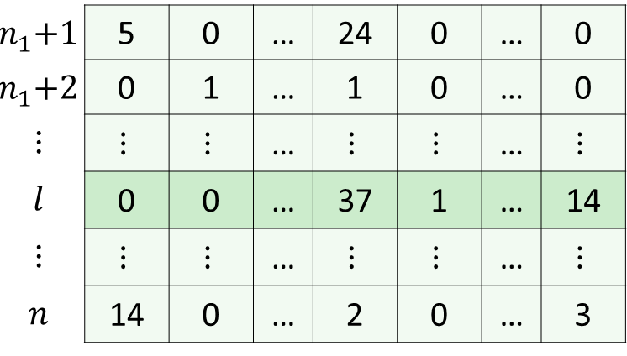
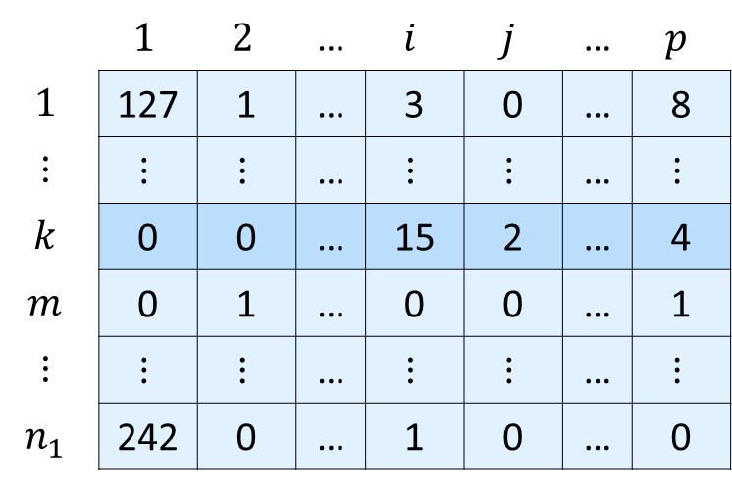
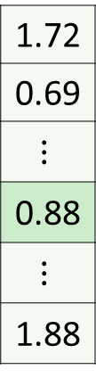
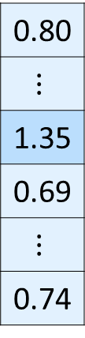
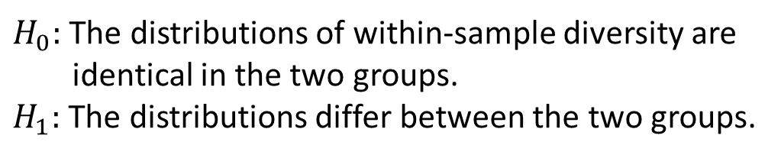


Aggregated count matrix
Within-sample
diversity
Compare within-sample diversity between groups
Genera
 | $$1$$ | $$2$$ | … | $$i$$ | $$j$$ | … | $$p$$
$$1$$ | 127 | 1 | … | 3 | 0 | … | 8
$$⋮$$ | $$⋮$$ | $$⋮$$ | … | $$⋮$$ | $$⋮$$ | … | $$⋮$$
$$k$$ | 0 | 0 | … | 15 | 2 | … | 4
$$m$$ | 0 | 1 | … | 0 | 0 | … | 1
$$⋮$$ | $$⋮$$ | $$⋮$$ | … | $$⋮$$ | $$⋮$$ | … | $$⋮$$
$$n_{1}$$ | 242 | 0 | … | 1 | 0 | … | 0
$$α$$
0.80
$$⋮$$
1.35
0.69
$$⋮$$
0.74
Group 1
Samples
$$1.5$$
Within-sample diversity
$$n_{1}\text{+}1$$ | 5 | 0 | … | 24 | 0 | … | 0
$$n_{1}\text{+}2$$ | 0 | 1 | … | 1 | 0 | … | 0
$$⋮$$ | $$⋮$$ | $$⋮$$ | … | $$⋮$$ | $$⋮$$ | … | $$⋮$$
$$l$$ | 0 | 0 | … | 37 | 1 | … | 14
$$⋮$$ | $$⋮$$ | $$⋮$$ | … | $$⋮$$ | $$⋮$$ | … | $$⋮$$
$$n$$ | 14 | 0 | … | 2 | 0 | … | 3
1.72
0.69
$$⋮$$
0.88
$$⋮$$
1.88
$$1.0$$
Group 2
Samples
Group 1
Group 2
$H_{0}:$The distributions of within-sample diversity are
identical in the two groups.
$H_{1}:$The distributions differ between the two groups.

