Slide 1

Defining a Field, a School and a Curriculum
Brian Wright
brianwright@virginia.edu

Slide 2
Brian Wright Assistant Professor Director for Undergrad Programs University of Virginia PhD: Higher Education Administration Economics, Public Policy Founded the DS Program at GWU Founded the DSI at GWU Founded(ing) UVA’s Undergraduate Programs Chief Data Scientist – Small Consultancy Worked in Defense Consulting for 10 years Board Member for DC Data Community – 30k Members

Slide 3
Research Interest: Intersection of Data Science and Education generally

Slide 4

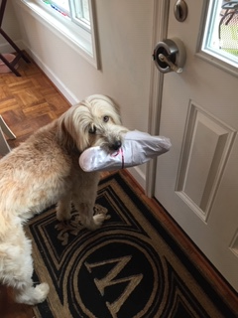
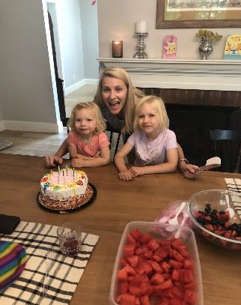

Slide 5
Defining a Field

Slide 6
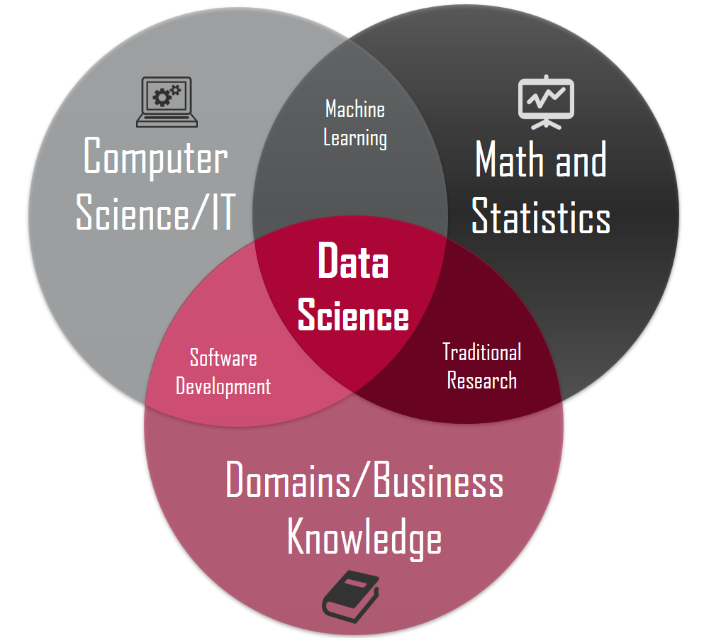
The “Classic” View
X
X
X
Source: https://honingds.com/blog/intro-to-data-science/
A common reference for the field of Data Science. The “Xs” represent a perceived over extension of this model in that ML does require domain knowledge, CS does conduct traditional research and doing software development of course requires math.

Slide 7
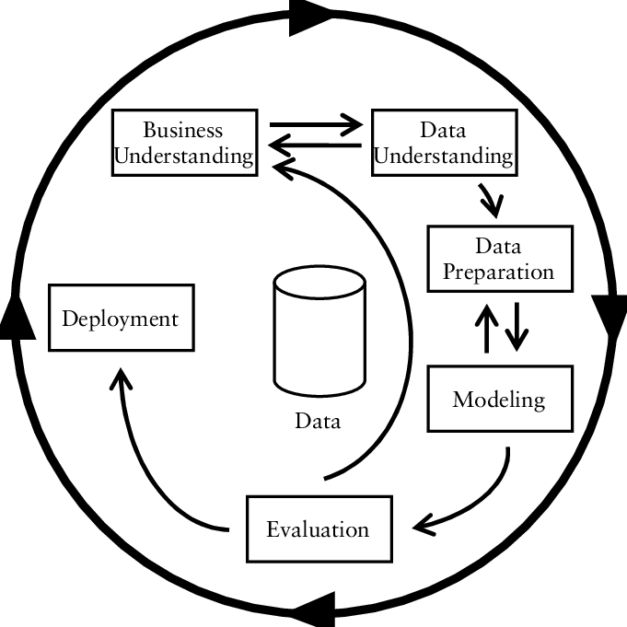
CRISP-DM
Example of a well-known data science process map
https://www.researchgate.net/figure/CRISP-DM-process-model_fig3_261307514

Slide 8
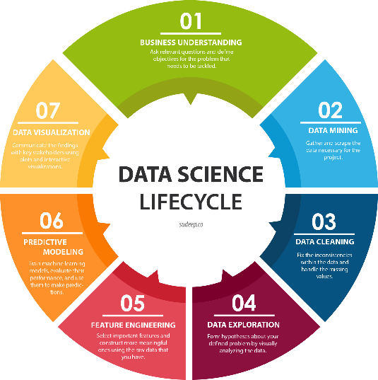
Example of a more contemporary view of a Data Science process
http://sudeep.co/data-science/Understanding-the-Data-Science-Lifecycle/

Slide 9
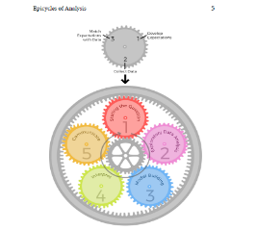
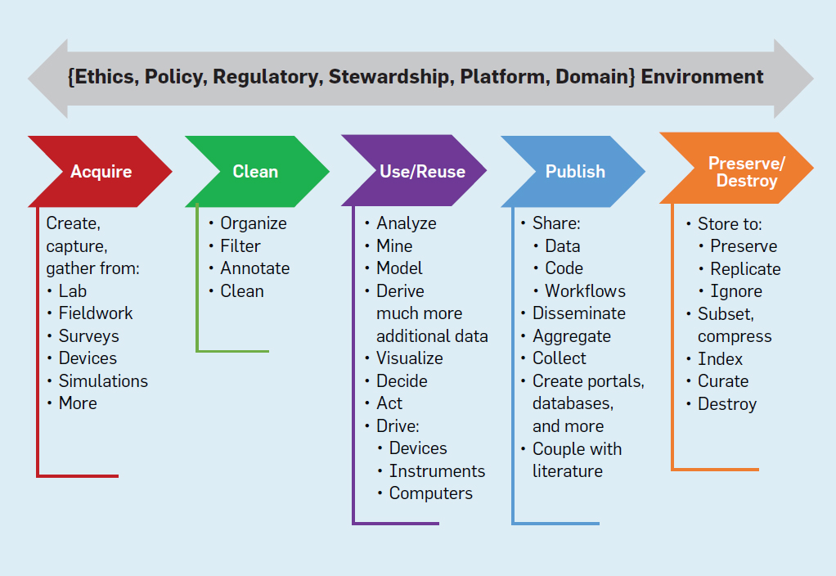


Commonality
Commonality of all of these is that they are more Function than Form

Slide 10
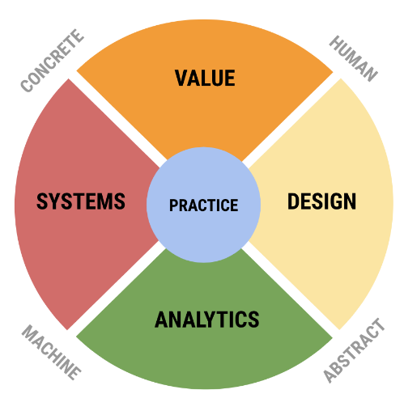
SDS View on Data Science
UVA SDS needed not just pipeline/process but a conceptual model of field. Rafael Alavardo created this framework of the field.

Slide 11
Design
Human machine interaction as it appears at the points of both consuming data and producing data products. Activities here include the representation and communication of human reality as data for the work of analytics, e.g. in database design, the curation of data, and of complex data and analytical results to humans to drive decision-making and influence behavior.
Key tensions: discovery vs product, user-facing vs analyst-facing.
Common theme: Communication.
Keywords: communication, design thinking, representation, use interface, communication, visualization, visual and object languages, informatics, ontology, curation, HCI, informating, data product design, data discovery.
Values: openness, authenticity, beauty, form and function.

Slide 12
Systems
Infrastructure systems and architectures to support working with big data — big in terms of volume, velocity, and variety — and building high performance pipelines in both development and production environments. It includes the broad areas of hardware and software (programming) as such — computer technology as opposed to computer science.
Key tensions: development vs production, volume vs speed.
Common theme: building
Keywords: infrastructure, data systems, data engineering, the cloud, networks, hardware, software, programming languages, big data management, benchmarking, continuous integration, availability, cybersecurity.
Values: speed, stability, robustness, resilience, uptime.

Slide 13
Analytics
Analytics includes what most consider to be the heart of data science, the combination of statistical methods with machine learning, along with optimization, signal processing, network analysis, and other rigorous quantitative methods from a variety of fields.
Key tensions: inference vs prediction, analysis vs simulation.
Common theme: Mathematical models and methods.
Keywords: prediction, inference, machine learning, statistics, operations research, AI, experimental design, causality, optimization, knowledge, models, feature engineering, data mining.
Values: accuracy, precision, validity, truth, convergence, explainability.

Slide 14
Value
Combines the traditional discipline of ethics with the professional activities of business planning, policy making, developing motivations for scientific research, and other activities that have a direct impact on people and the planet.
Key tensions: enterprise vs ethics, private interest vs public good (see Plato’s Republic).
Common theme: human value.
Keywords: ethics, justice, wealth, value, social good, motivation, meaning,
Values: responsibility, diversity, inclusion, flourishing, excellence
Ref: Digital Epidemiology

Slide 15
Practice
This area consists of actual activities that brings people together to combine expertise from each of the four areas. It is characterized by data science teams working together and with external parties to develop solutions and projects that are responsible, authentic, effective, and efficient.
Many activities that are considered an essential part of data science, such as data wrangling, actually exist only in practice, combining expertise in systems, design (representation), and analytics, and they are not usually taught in distinct classes.
Practice is also where the core areas of data science come into contact with domain knowledge and real world problems.

Slide 16
Mapping of Categories
Data description and Curation Design
Mathematical Foundations Analytics
Computational Thinking Design and Analytics
Statistical Thinking Analytics
Data Modeling Design
Communication, reproducibility, and ethics Design, Value

Slide 17

ETHICS BUSINESS VALUE OPEN SCIENCE | DATA CURATION HCI DATA PRODUCTS
PREDICTION INFERENCE STATS, CS, OPTIMIZATION | INFRASTRUCTURE DEVOPS CLOUD
DESIGN
VALUE
DESIGN
Practice
ANALYTICS
ANALYTICS
SYSTEMS
SYSTEMS

Slide 18
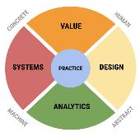
Brian’s Version of Data Science Lifecycle
Phase 2: Idea Testing
G1
G2
Data Acquisition - ETL
Data Understanding - EDA
Initial Model(s) Building
Initial Model
Evaluation
Model Creation & Training
Evaluation Criteria Value Metric
Feature Engineering and Evaluation
Phase 1: Idea Development
Business Understanding
Model Deployment
Optimization – Hyperpara and Evaluation
Data Drift Analysis
Model Performance – Evaluation Value Metric
G3
Question ID
Phase 3: Solution Development
Model Drift Analysis – Model Evaluation
Gate Reviews
Reports – Dashboards - Products
Phase 4: Solution Deployment

Slide 19
This Course: a Bit of Everything but Mostly Analytics

Slide 20

What is DS - Practice of Data Science
Programming R – Systems
Github – Systems
Programming Markdown – Design
ML Foundations – Analytics
kMeans – Analytics
Text Mining – Analytics
kNN – Analytics
Reinforcement Lab – Practice of Data Science
Evaluation – Value
Decision Trees – Analytics
Random Forrest – Analytics
Reinforcement Lab – Practice of Data Science
Ethics/Bias in ML – Value
Final Projects – Practice of Data Science

Slide 21
Dream Job Discussion
Find a data science "dream job". Assume for a moment that you are destined to be a Data Scientist! March bravely onto the world wide web and find your data scientist dream job, then let's talk about it. Requirements: must-have "data scientist" in the title Not a requirement - to be a real job, want to create your own...please do, we would all love to hear about it.
Answer these questions
- What do I love about this job (salary, company, mission, area of focus, location...etc.)?
- Which components of the Data Science framework are represented (if you can tell)?
- What do I need to know to do this job (coding, databases, how to build a self-actualizing and empathetic robot..etc)?
- How much of what is required do I already know? (0%....100%)?

