Slide 1
Introduction Ensemble and Random Forest Brian Wright

Slide 2
Course Schedule
This week Random Forrest – Lab Due 26th
Next Week – No Class
28th and 30th – Fairness Measures – On Class Lab on the 30th - shorter
Final Presentations on 5th

Slide 3
Ensemble Methods
Ensemble methods are more or less aggregated predictions of many different algorithms in order to increase predictive accuracy.
Often in solving a machine learning problem building a ensemble model comes at the end of the process after trying several different approaches you can combine them into one all knowing predictor!
We will focus on Random Forrest, an ensemble of decision tress but also discuss bagging and boosting

Slide 4
Ensemble Methods
Example: suppose we have developed several different classifiers a KNN model, Logistic Regression, an SVM and a Decision Tree.
We could use the majority vote process to build the final classification of our data points, based on below what would be the outcome for this single data point?
This is called hard voting, another approach is soft voting (discuss later)
This process often works better than using single weak learners – or algorithms that predict only slightly better than random guessing
Model | KNN | Logistic Regression | Support Vector Machine | Decision Tree
Prediction | 1 | 0 | 1 | 1

Slide 5
Ensemble Methods
Why do the models work better together?
Essentially scale increases the probability of finding a majority vote.
As an example if we have a bias coin flip the gives us 51% chance of heads and 49% chance of tails the more we toss the coin the higher the probability of getting a majority vote for heads.
1,000 = 75% chance
10,000 = 97% chance
Works the same way for model building, the reliability of the results simple increase with scale.
Works best if the models are perfectly independent, meaning the error terms don’t correlation which is hard when using one approach on a single dataset, that’s why combining approaches can sometimes result in better outcomes

Slide 6
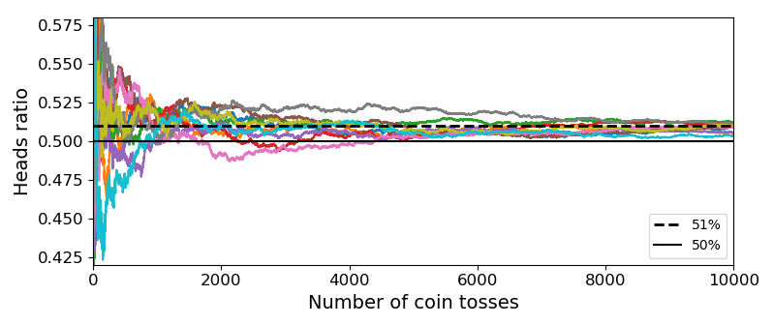
Ensemble Methods: Probabilities Converge (Code Available)

Slide 7
Ensemble Methods: Ensemble
Soft voting is used for algorithms that produce probabilistic outputs or those that have a hyperparameter that can be modified to support probability outputs (such as SVM, probability hyperparameter to TRUE).
The class is generated using the highest-class probability as the metric

Slide 8
Tree-Based Ensembles

Slide 9
Ensemble Methods: Random Forest – power in numbers
Ensemble methods – Essentially instead of building a single tree we are going to build a whole bunch
We can limit the growth of the trees but don’t have to use any of the hyper-parameters
Set the number of trees grown and track the error classification rate of our algorithm
Can be used for again for both Regression or Classification
Random Forest uses a combination of bagging and boosting

Slide 10
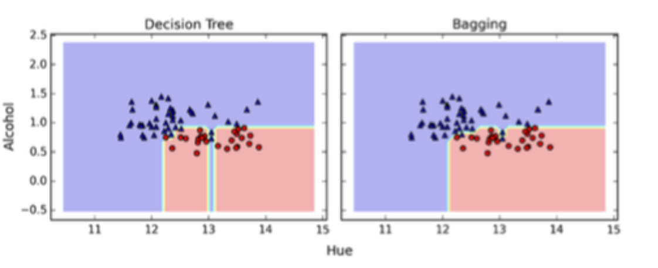
Ensemble Methods:
Tree base Boosting, Bagging and Random Forest
Bagging – Goal is to reduce the complexity of models that have a tendency to overfit through “bootstrap aggregation”. Uses majority voting process to select features, which works to reduce variance (less overfitting) by creating simpler decision boundaries.
Grow a whole bunch of tress and use distribution of results to make predictions.

Slide 11

Ensemble Methods: Bagging
As discussed one approach is to use several methods and combine them to produce a more powerful outcome
You can also you the same technic but re-sample the data numerous times to produce different results, one such method is Bagging
Bagging – is sampling with replacement, meaning that the entire dataset is available for every sub-sample. (without replacement is often called pasting)
3) Predictors
2) Training
1) Random Samples

Slide 12
Ensemble Methods
Sampling with replacement
Sampling without replacement
Obs | X1 | X2 | Y1 | Y2
1 | 2.5 | 3.6 | 4.8 | 3.7
2 | 2.8 | 4.7 | -2.8 | 7.1
3 | 5.8 | 9.7 | 9.1 | 13
Obs | X1 | X2 | Y1 | Y2
1 | 2.5 | 3.6 | 4.8 | 3.7
2 | 2.8 | 4.7 | -2.8 | 7.1
1 | 2.5 | 3.6 | 4.8 | 3.7
Obs | X1 | X2 | Y1 | Y2
2 | 2.8 | 4.7 | -2.8 | 7.1
1 | 2.5 | 3.6 | 4.8 | 3.7
3 | 5.8 | 9.7 | 9.1 | 13
Notes:
Unlike restaurant reviews submitted by different individual, how can we ensure the randomness of decision trees model from an existing training set? Bagging, short for “Bootstrap aggregation”, is a resampling method. It generates a new training set from existing training set by sampling with replacement.

Slide 13

Ensemble Methods
If we keep building decision trees on the same dataset, we would essentially get the same decision trees every time…
Obs | X1 | X2 | Y1 | Y2
1 | 2.5 | 3.6 | 4.8 | 3.7
2 | 2.8 | 4.7 | -2.8 | 7.1
3 | 5.8 | 9.7 | 9.1 | 13
Obs | X1 | X2 | Y1 | Y2
2 | 2.8 | 4.7 | -2.8 | 7.1
1 | 2.5 | 3.6 | 4.8 | 3.7
3 | 5.8 | 9.7 | 9.1 | 13
Obs | X1 | X2 | Y1 | Y2
3 | 5.8 | 9.7 | 9.1 | 13
1 | 2.5 | 3.6 | 4.8 | 3.7
2 | 2.8 | 4.7 | -2.8 | 7.1
Notes:
Bagging is used to generate multiple training sets from existing training set to which decision trees model is fitted. Each resulting decision trees would not necessary be different because even sampling with replacement would generate identical sample, however, it does add randomness to the outcome.

Slide 14


Ensemble Methods
Use a subset of attributes generated by bagging to build original data sets to make decision trees…want the trees to uncorrelated…that’s the goal
Obs | X1 | X2 | Y1 | Y2
1 | 2.5 | 3.6 | 4.8 | 3.7
1 | 2.5 | 3.6 | 4.8 | 3.7
3 | 5.8 | 9.7 | 9.1 | 13
Obs | X1 | X2 | Y1 | Y2
2 | 2.8 | 4.7 | -2.8 | 7.1
1 | 2.5 | 3.6 | 4.8 | 3.7
2 | 2.8 | 4.7 | -2.8 | 7.1
Obs | X1 | X2 | Y1 | Y2
3 | 5.8 | 9.7 | 9.1 | 13
3 | 5.8 | 9.7 | 9.1 | 13
2 | 2.8 | 4.7 | -2.8 | 7.1
Notes:
In addition to “Bagging”, random forest algorithm only uses a subset of attributes as compared to the full set of attributes in decision trees. Given two randomly selected attributes and training set, each decision trees model will produce different results which ensures the randomness of random forest model.

Slide 15
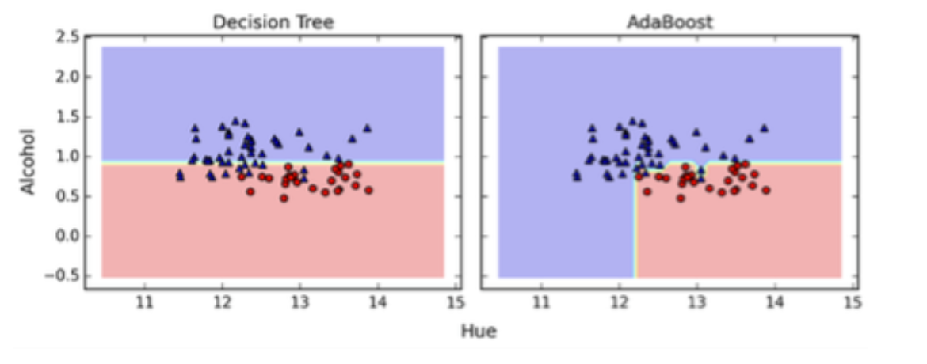
Ensemble Methods
Tree base Boosting, Bagging and Random Forest
Boosting – Combines a series of “weak learners” together to make a more powerful predictor. Think of combining a series of single or two level split trees that learn from each others' weaknesses. This reduces bias and helps the model work against underfitting.
An example is Adaboost which will uses simple trees to fit a model and then dependent on the error or mis-classification increases the weight on the error terms and refits the model. It will do this over and over again, thus “Adoptive Boosting”

Slide 16
Ensemble Methods
Tree base Boosting, Bagging and Random Forest
Random Forest – Is technically a “bagging” model as it uses random bootstrapped samples to model fit that includes reductions in the feature space.
Draws random samples from training data – Mostly Bagging – Reduces Variance
Draws random subsets of features – Kinda Boosting – Reduces Bias
It is this combination of process which makes Random Forest such a powerful and widely used algorithm –
The main tuning parameters are:
The number of variables to use for each tree (kinda boosting)
The number of trees in the forest
The size of the samples used in the bagging process

Slide 17
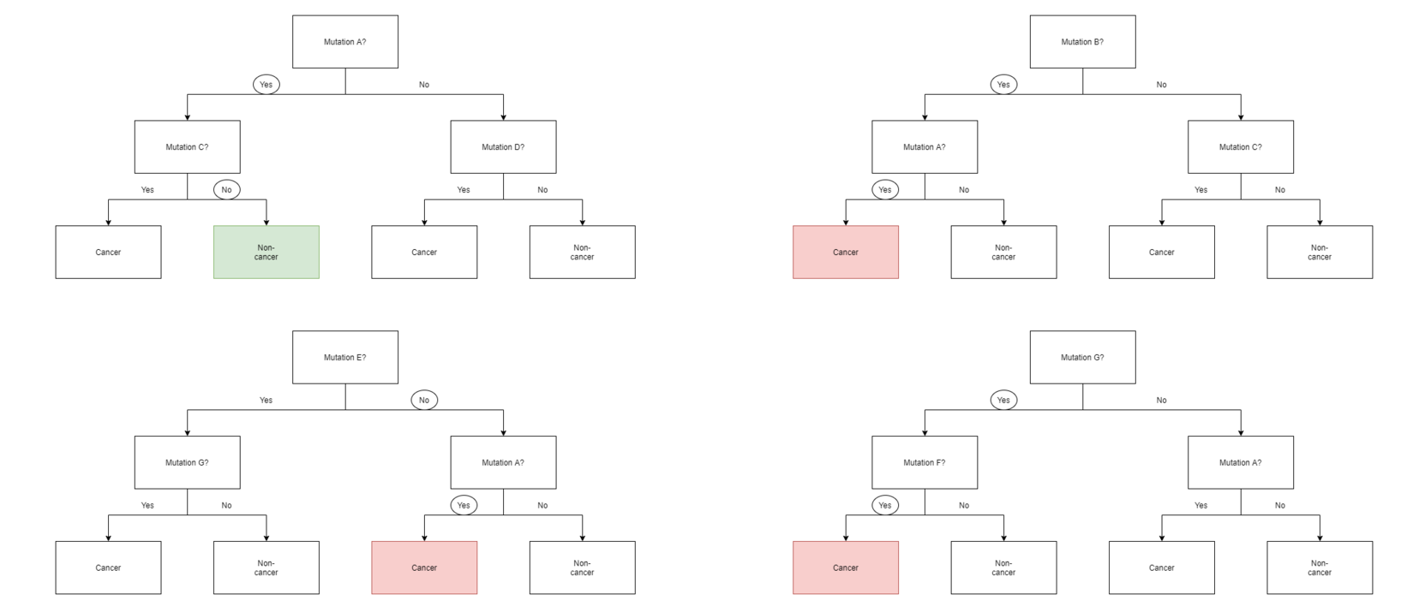
Random Forest Example

Slide 18
Ensemble Methods: Random Forest: Variable Importance
One of the really nice features associated with Random Forrest is it’s ability to select variables that are most “important” to training the model.
This is done using the Out of Bag Error and averaging the decrease in gini impurity across all the nodes where that feature is present.
Random Forrest does this at scale and the output is generated as a part of the training process
Can also use a permutation approach, by shuffling the values of a variable and seeing if there’s a change in model error

Slide 19
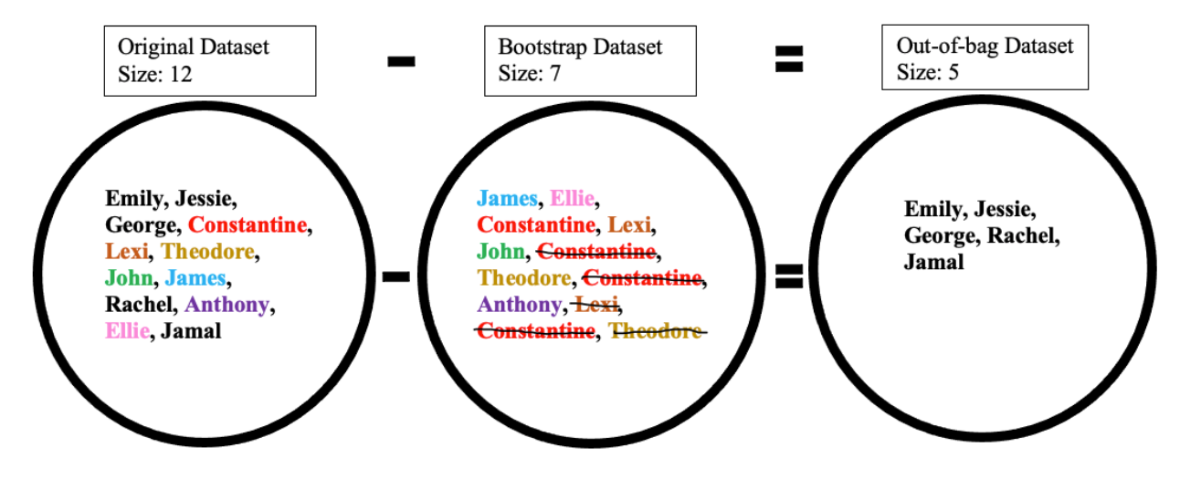
Out of Bag Error

Slide 20
Ensemble Methods: Random Forest: Variable Importance
The Random Forest Package in R is basically a wrapper for the original fortran original program written by Leo Breiman and Adel Cutler from Berkeley
Their original website is still quite useful: https://www.stat.berkeley.edu/~breiman/RandomForests/cc_home.htm

